Slide 1

A System View on SKA Bandwidth Usage
G.W. (Dion) Kant
AAVP Dwingeloo, 14 December 2011

Slide 2
Outline
Introduction
Overview of main envelope requirements
The concept of a base element
Bandwidth requirements

Slide 3
Introduction
Details in Document “AA-MID CONCEPT DESCRIPTION”
Presentation to initiate some discussion
A technology independent approach!

Slide 4
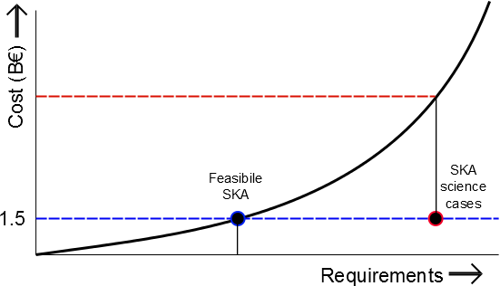
Introduction
Where are we now?

Slide 5
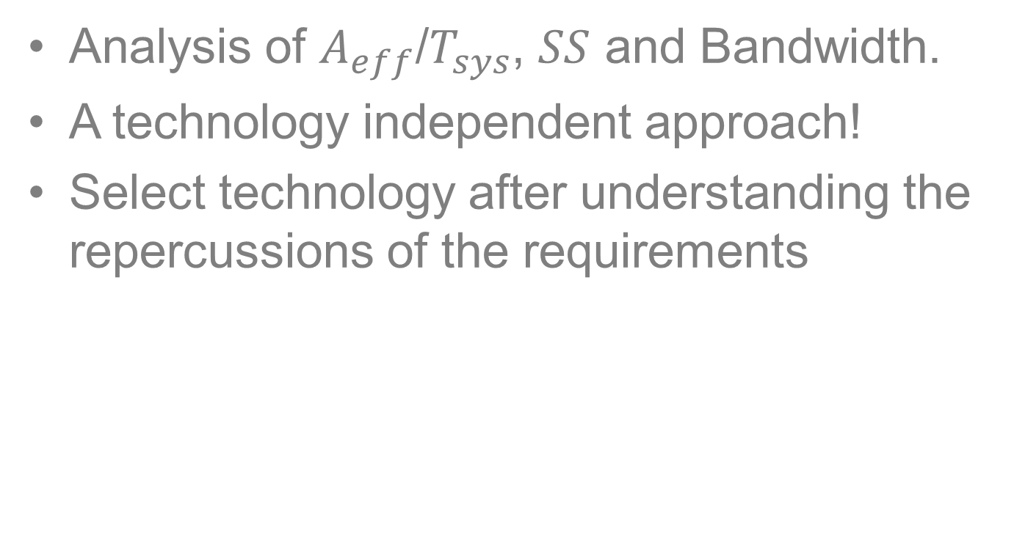
Design Requirements
Analysis of $A_{eff}$/$T_{sys}$, $SS$ and Bandwidth.
A technology independent approach!
Select technology after understanding the repercussions of the requirements

Slide 6
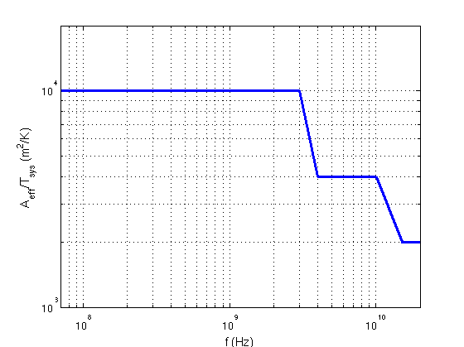

SKA₂ $A_{eff}$/$T_{sys}$ envelope

Slide 7
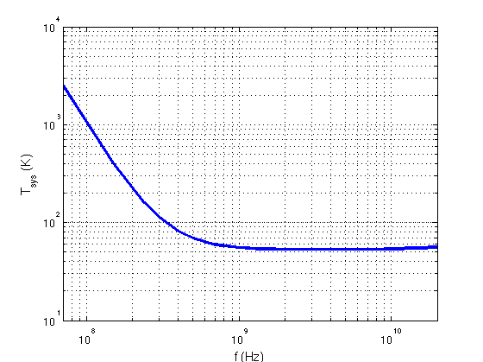

$$T_{sys}=T_{sky}+T_{rec}$$

Slide 8
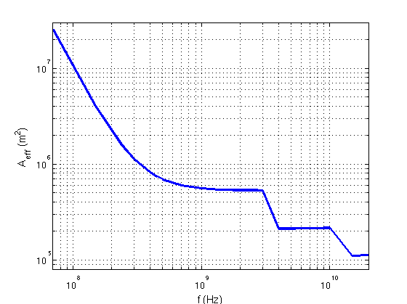

Consequence for $A_{eff}$

Slide 9
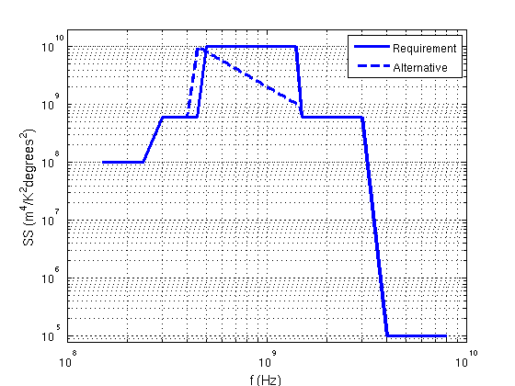
SKA₂ Survey Speed envelope

Slide 10
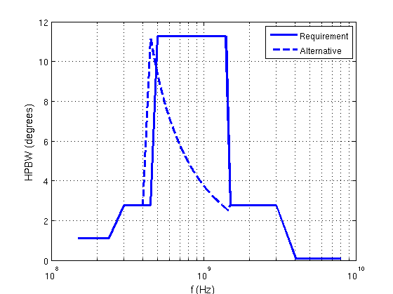
SKA₂ Resulting HPBW

Slide 11
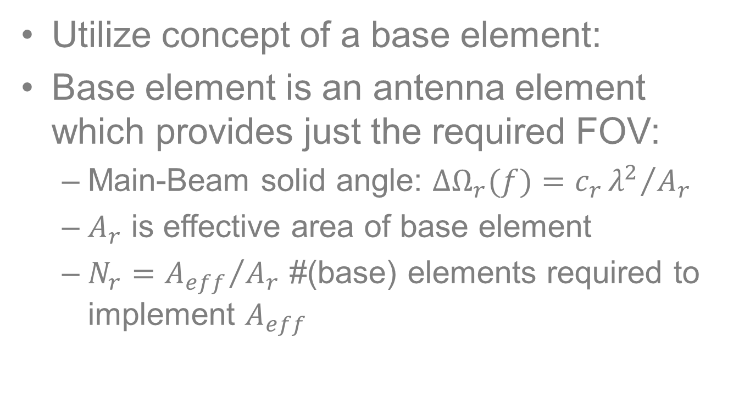
Minimum required bandwidth
Utilize concept of a base element:
Base element is an antenna element which provides just the required FOV:
  Main-Beam solid angle: $ΔΩ_{r}(f)=c_{r}{λ^{2}}/{A_{r}}$
  $A_{r}$ is effective area of base element
  $N_{r}={A_{eff}}/{A_{r}}$ #(base) elements required to implement $A_{eff}$

Slide 12
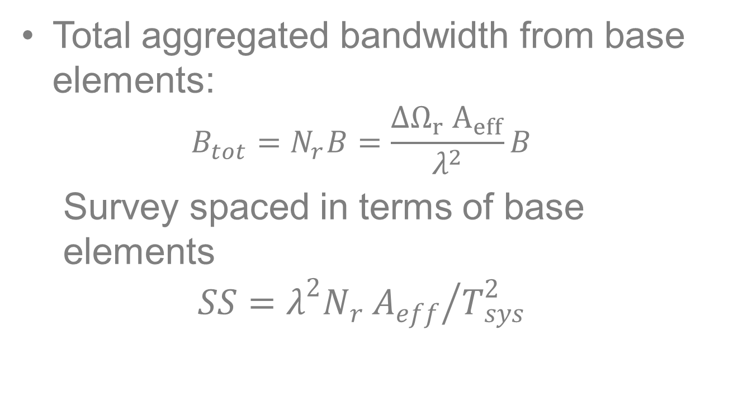
Minimum required bandwidth
Total aggregated bandwidth from base elements:
  $$B_{tot}=N_{r}B=\frac{ΔΩ_{r} A_{eff}}{λ^{2}}B$$
  Survey spaced in terms of base elements
  $$SS={λ^{2}N_{r} A_{eff}}/{T_{sys}^{2}}$$

Slide 13
Bandwidth from base elements

Slide 14
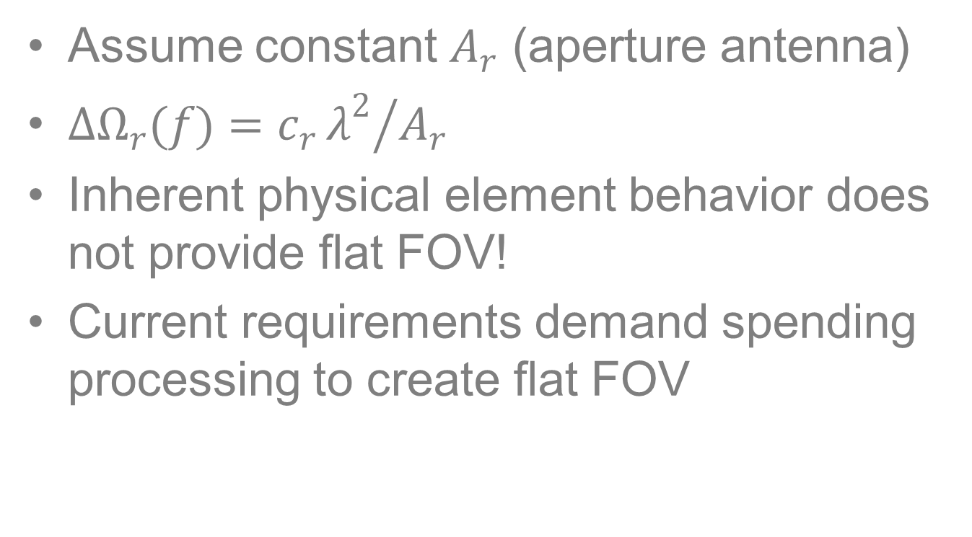
Physical element behavior
Assume constant $A_{r}$ (aperture antenna)
$ΔΩ_{r}(f)=c_{r}{λ^{2}}/{A_{r}}$
Inherent physical element behavior does not provide flat FOV!
Current requirements demand spending processing to create flat FOV

Slide 15
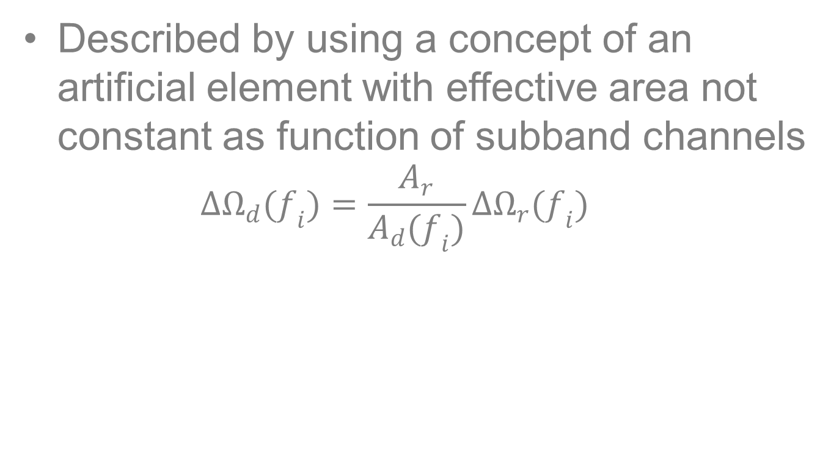
FOV processing
Described by using a concept of an artificial element with effective area not constant as function of subband channels
  $$ΔΩ_{d}(f_{i})=\frac{A_{r}}{A_{d}(f_{i})}ΔΩ_{r}(f_{i})$$

Slide 16
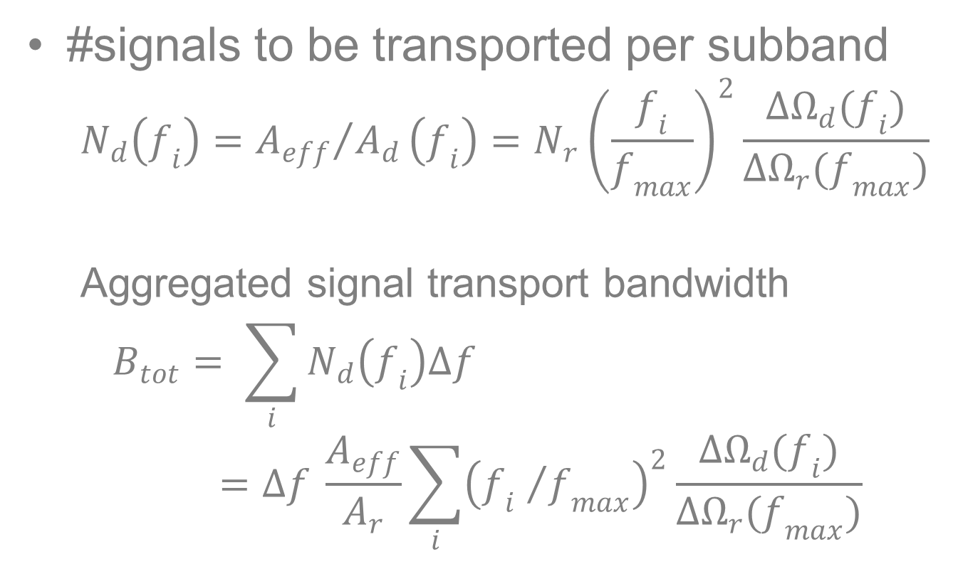
Station Bandwidth
#signals to be transported per subband
  $$N_{d}\left(f_{i}\right)={A_{eff}}/{A_{d}}\left(f_{i}\right)=N_{r}{\left(\frac{f_{i}}{f_{max}}\right)}^{2}\frac{ΔΩ_{d}(f_{i})}{ΔΩ_{r}(f_{max})}$$
  Aggregated signal transport bandwidth
  $$B_{tot}= \sum_{i}{N_{d}\left(f_{i}\right)Δf}=Δf \frac{A_{eff}}{A_{r}}\sum_{i}{{\left({f_{i} }/{f_{max}}\right)}^{2}\frac{ΔΩ_{d}(f_{i})}{ΔΩ_{r}(f_{max})}}$$

Slide 17
Bandwidth
AA-mid aggregated signal transport bandwidth from (base) receptors & from stations

Slide 18
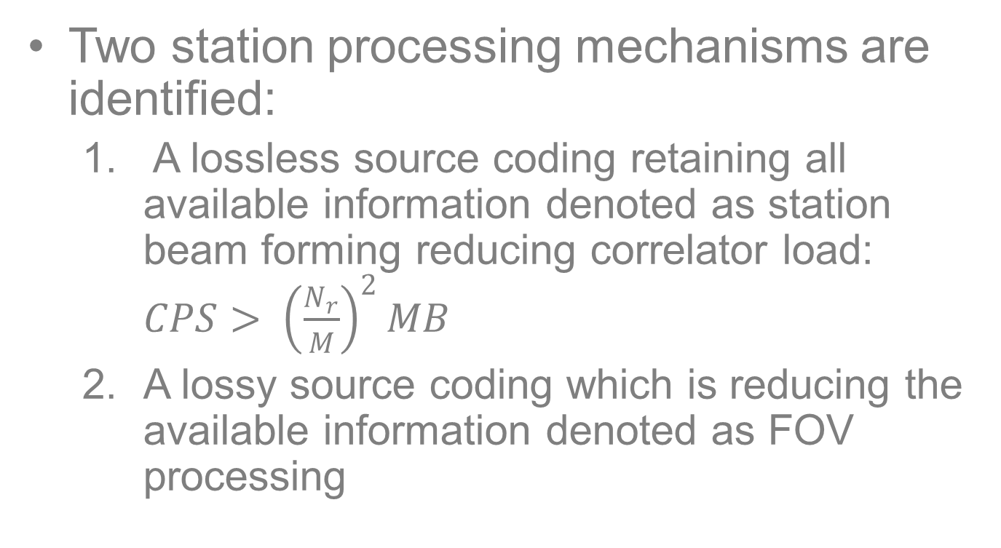
Station processing mechanisms
Two station processing mechanisms are identified:
  A lossless source coding retaining all available information denoted as station beam forming reducing correlator load: $CPS> {\left(\frac{N_{r}}{M}\right)}^{2}MB$
  A lossy source coding which is reducing the available information denoted as FOV processing

Slide 19
An integral survey speed
Current SS requirement is a spot frequency property. Bandwidth is not involved.
A practical way to include bandwidth is defined (Integral Survey Speed)
Provides a means to define spectral efficiency

Slide 20
Spectral efficiency
Average survey speed encoded in one Hertz bandwidth (ISS/B_{tot})

Slide 21
Conclusion
An analysis is presented of three key science requirements
Analysis not based on specific technology
Current science requirements dictate huge differences in resource requirements over the different SKA bands.
Tailor science requirements for better usage of physical antenna properties

Slide 22
Conclusion (continued)
Introduced the concept of a base receptor element to analyse bandwidth requirements
Aggregated bandwidth is a measure for required processing

Slide 23
Conclusion (continued)
Two different station processing mechanisms are identified:
  Signal processing required for limiting information in the spatial domain;
  Signal processing required for reducing the processing load of a correlator subsystem. This one can be considered as a lossless recoding of information in the form of station beam forming providing the station beams.

Slide 24
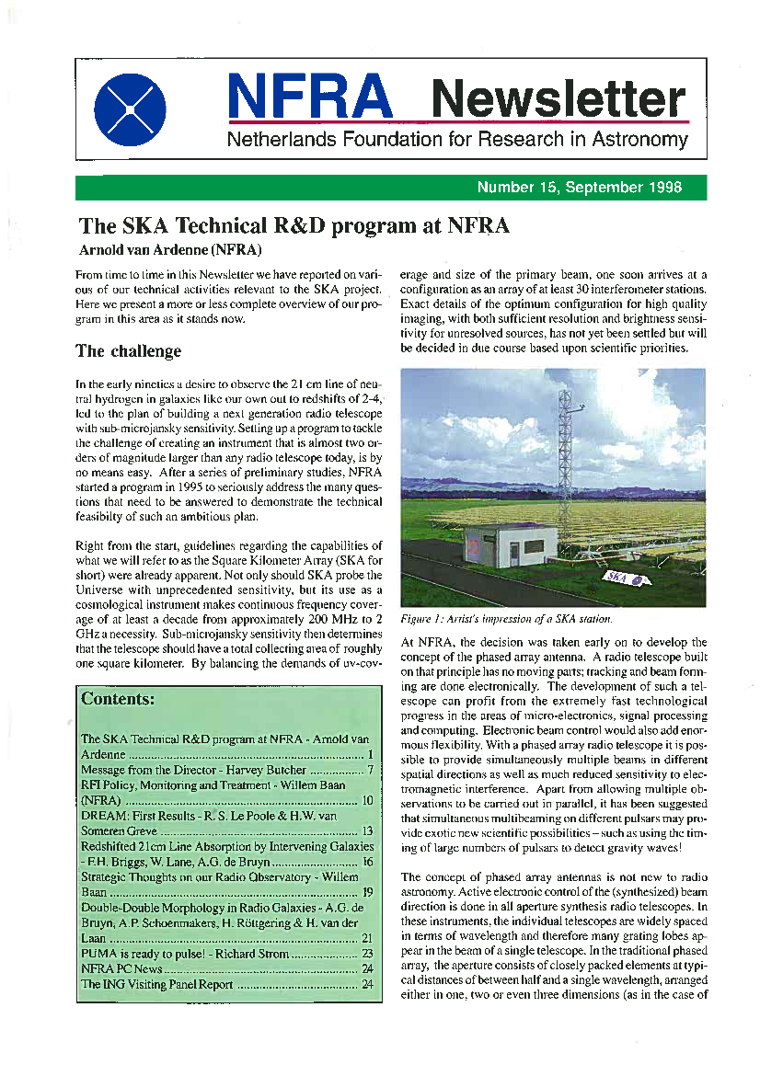
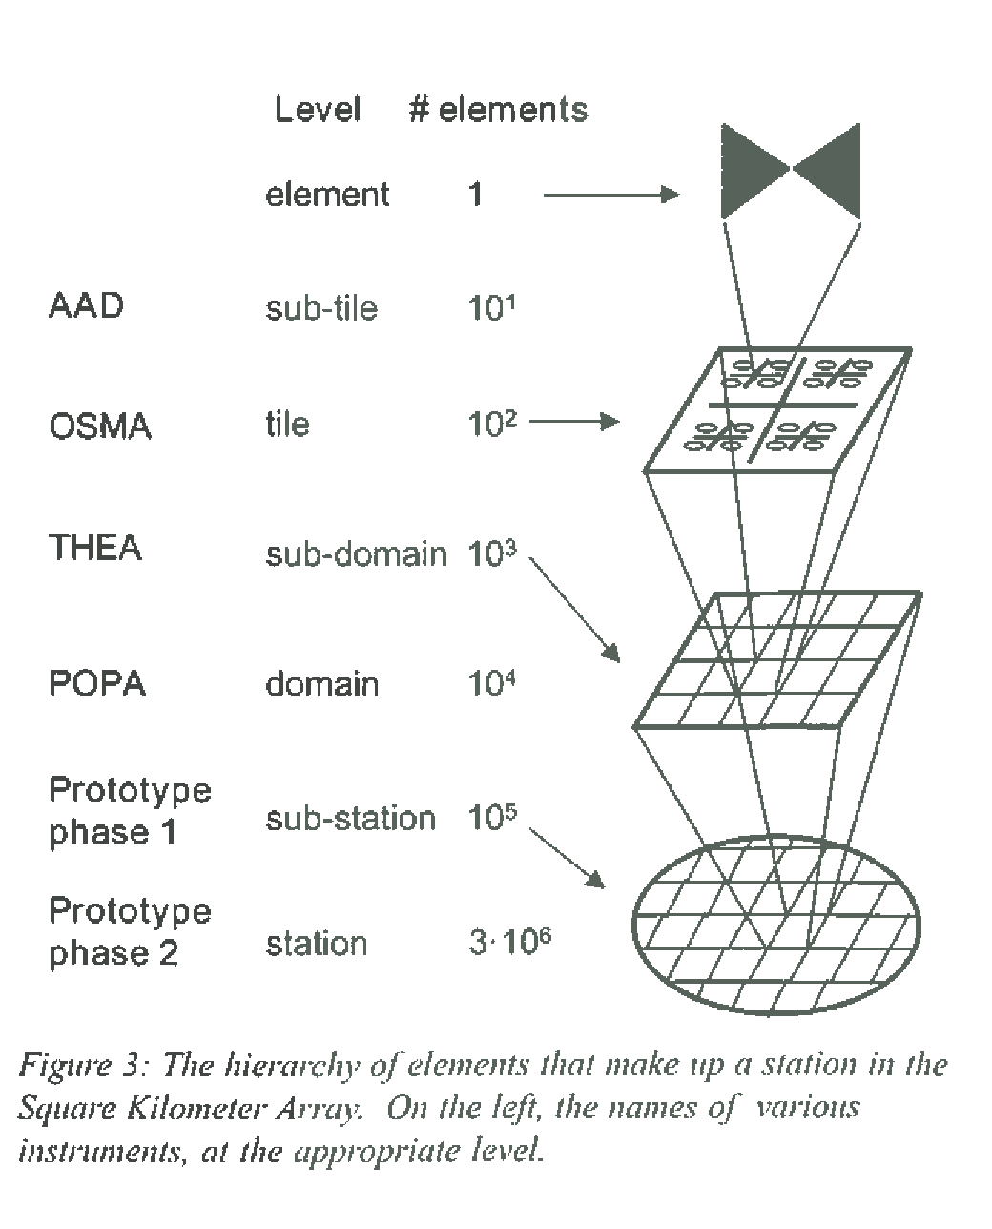
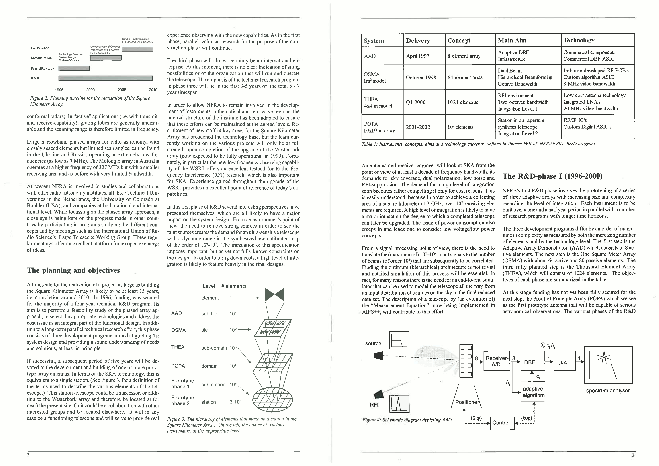
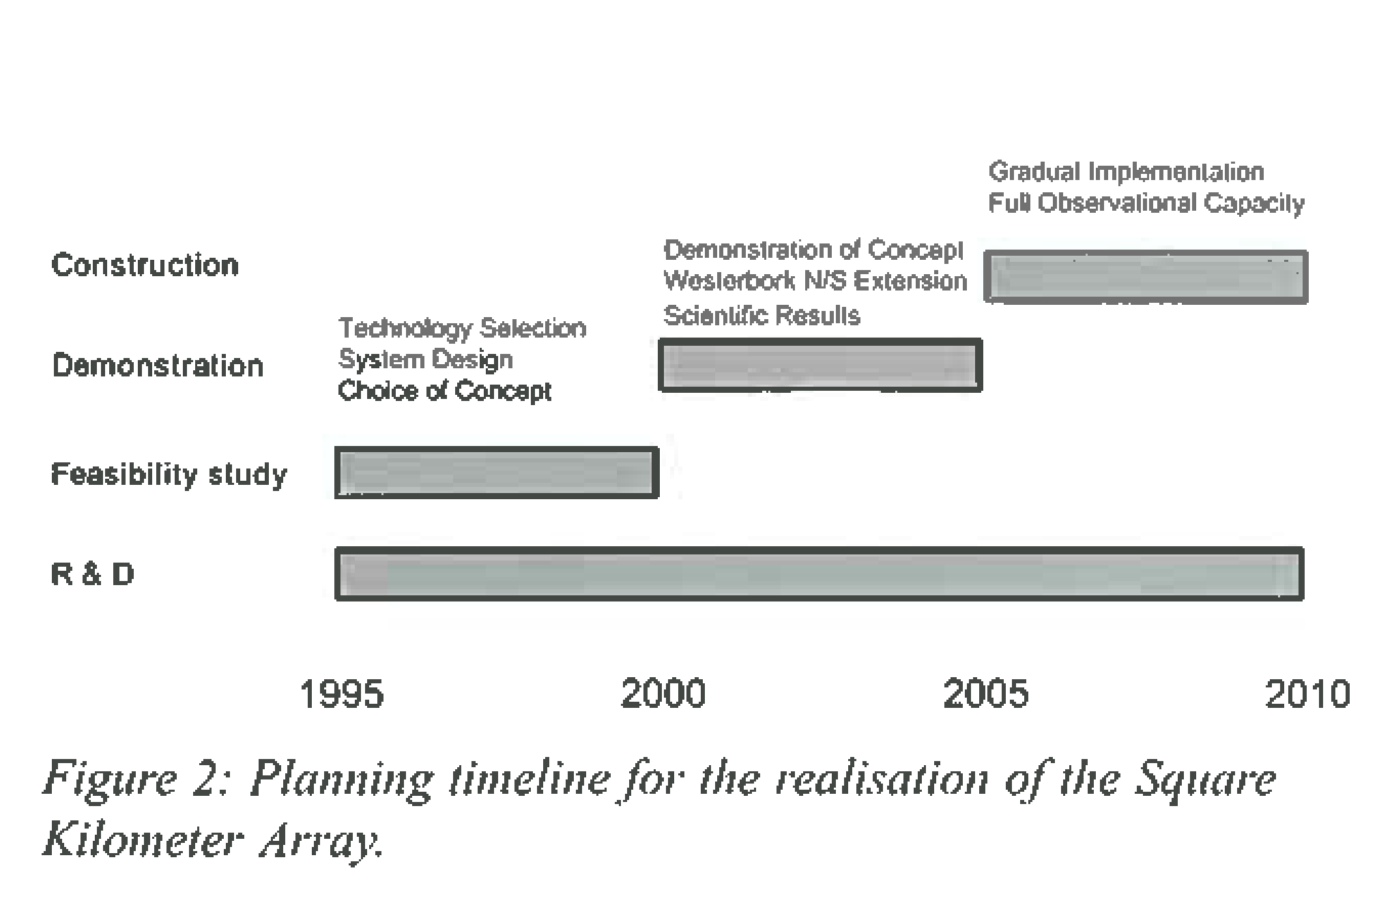
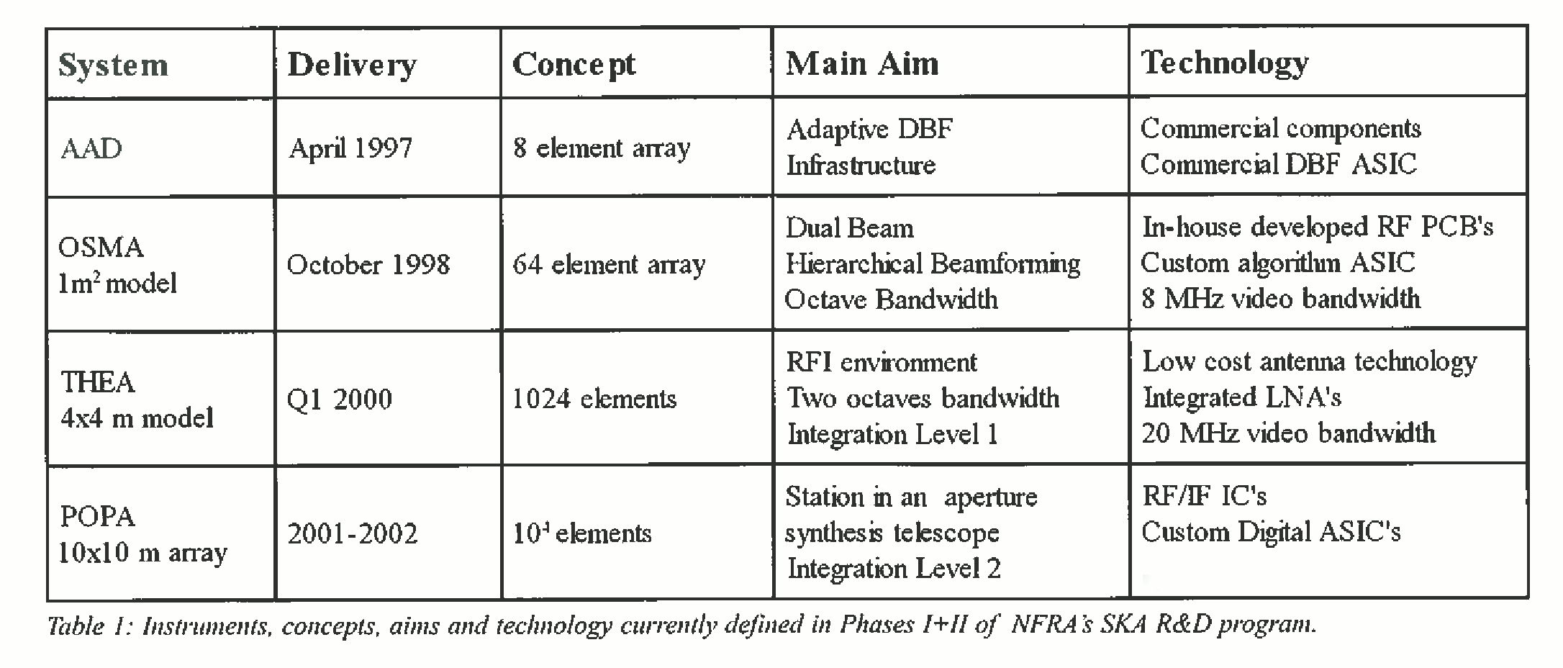
From the archives

Slide 25
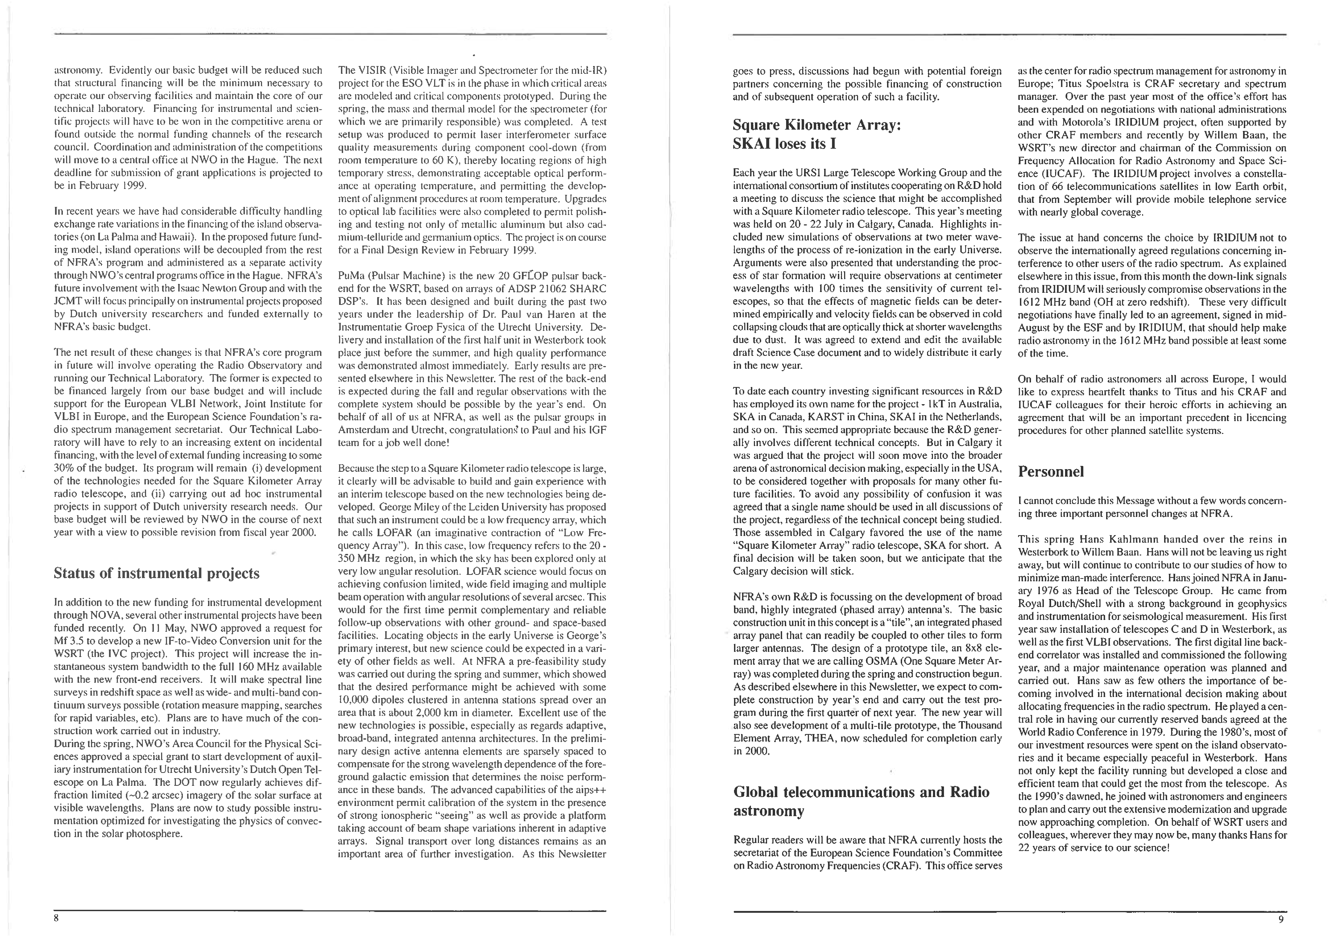
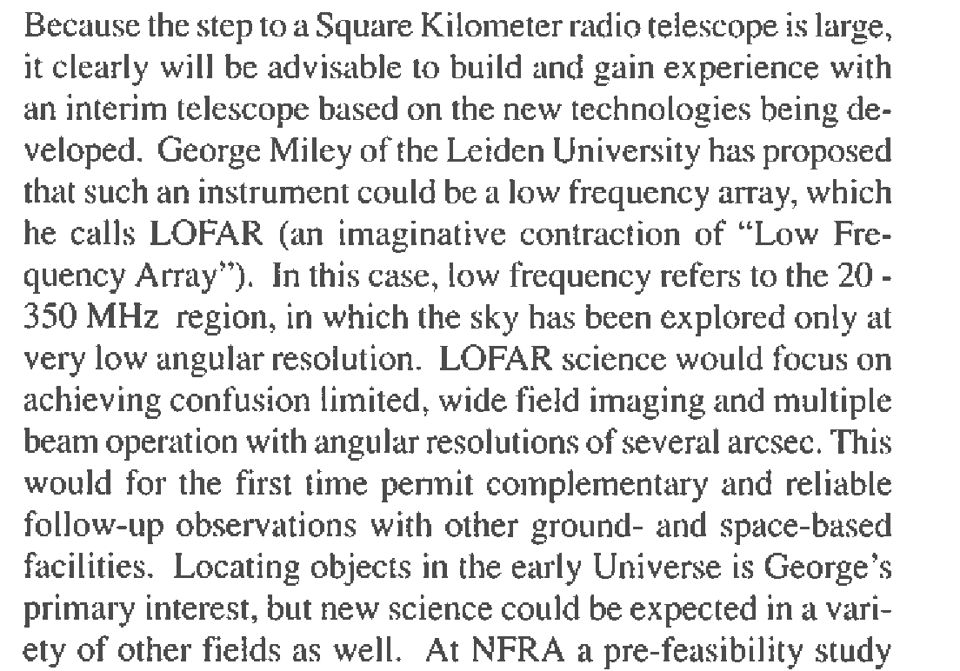
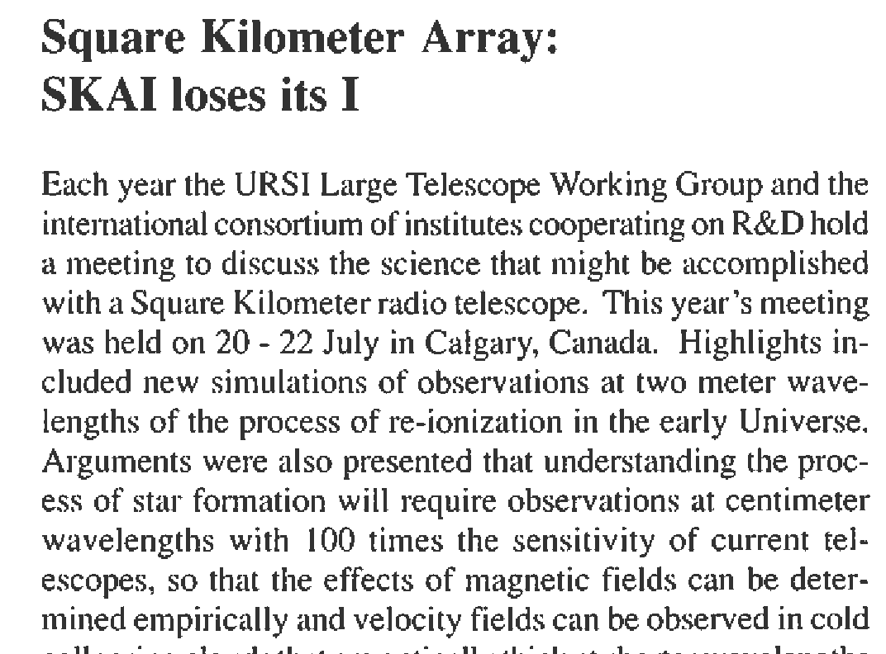
From the archives

Slide 26
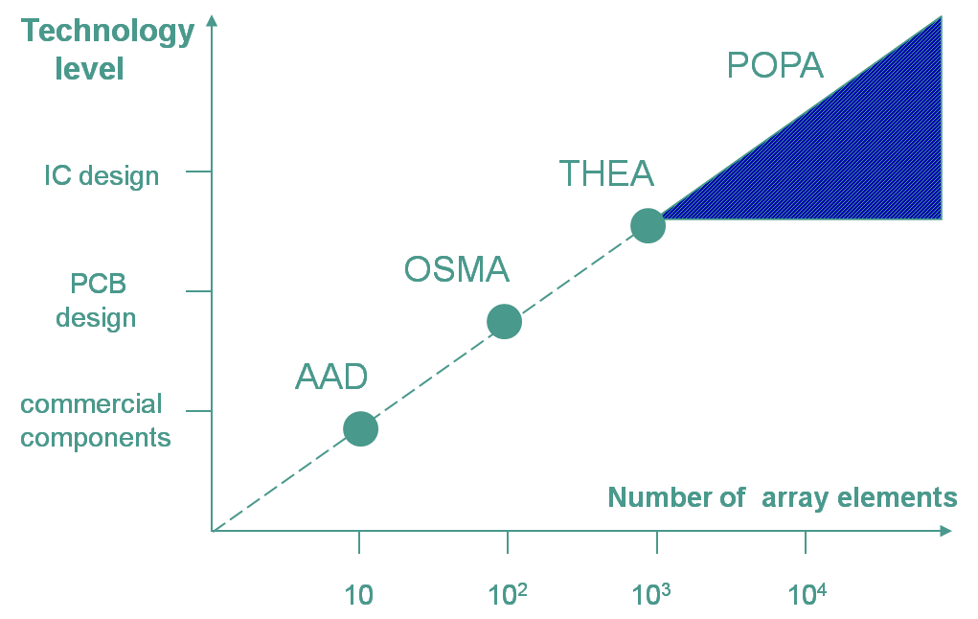
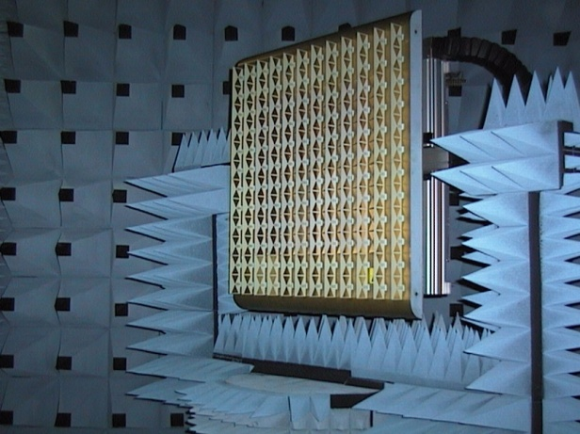
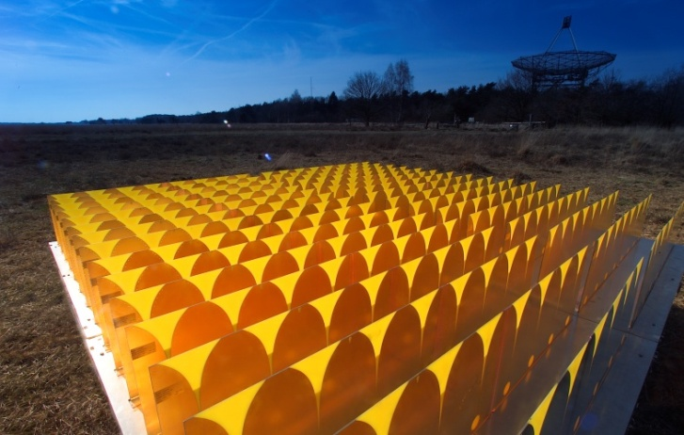
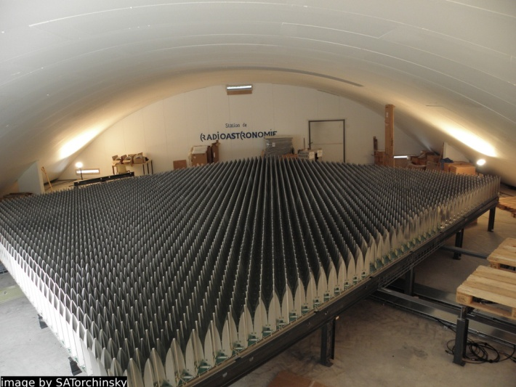
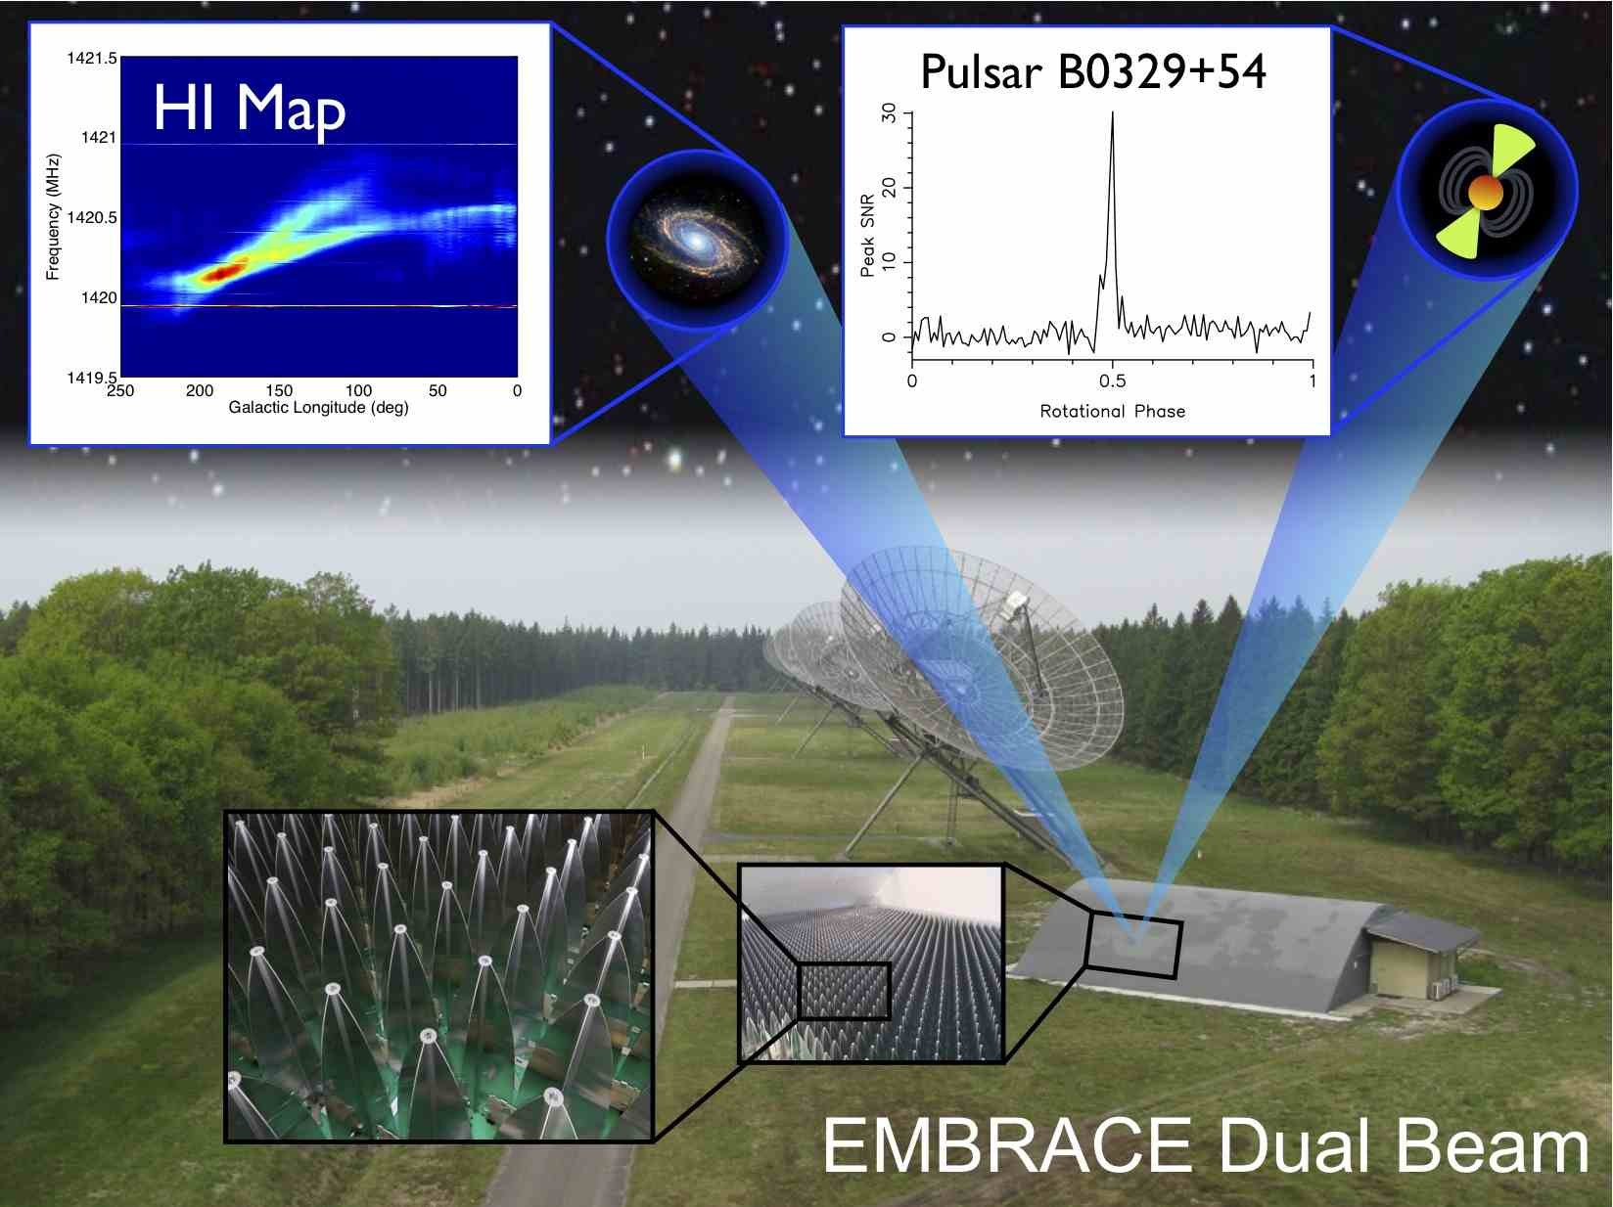
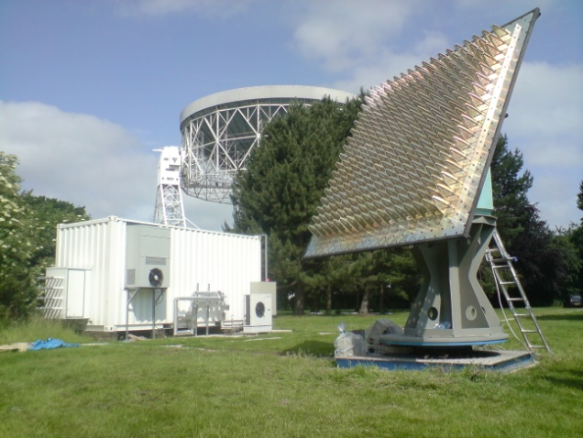
15 Years of SKA AA Concepts

