Slide 1

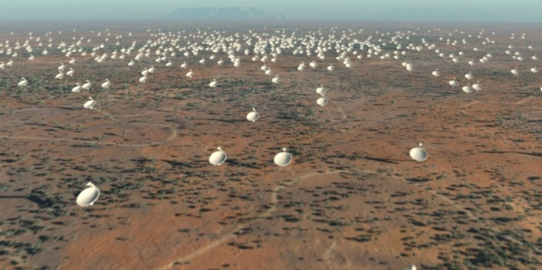

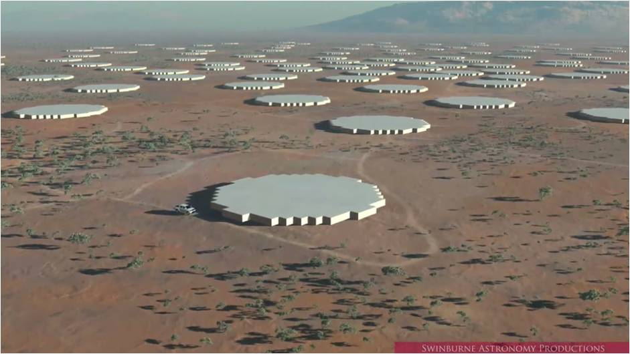
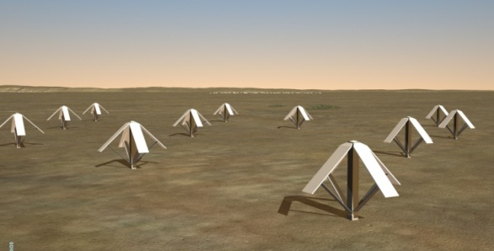
The Square Kilometre Array
Exploring the Universe with the
world’s largest radio telescope
Energy supply for RIs in remote areas:
Case study of the ESFRI’s SKA facility
in radio astronomy
Michael Kramer
Max-Planck Institut für Radioastronomie

Slide 2
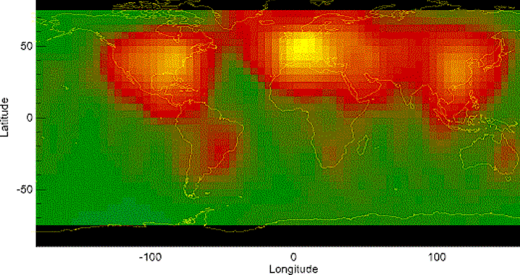
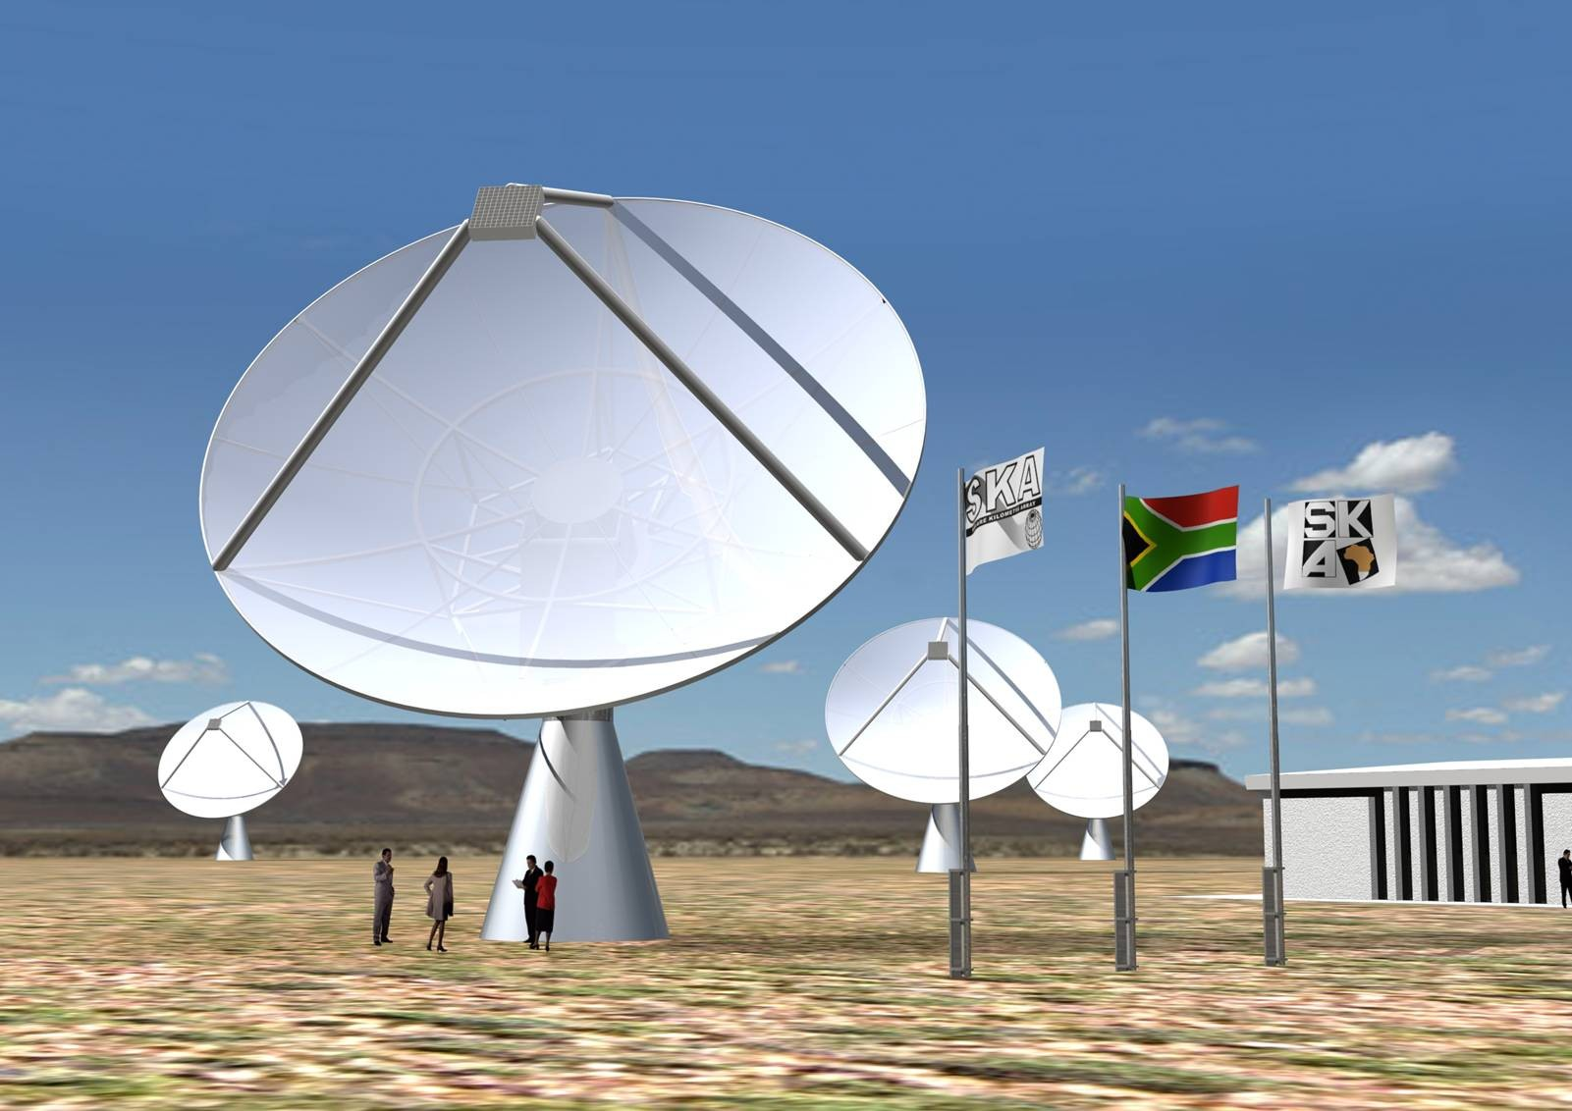
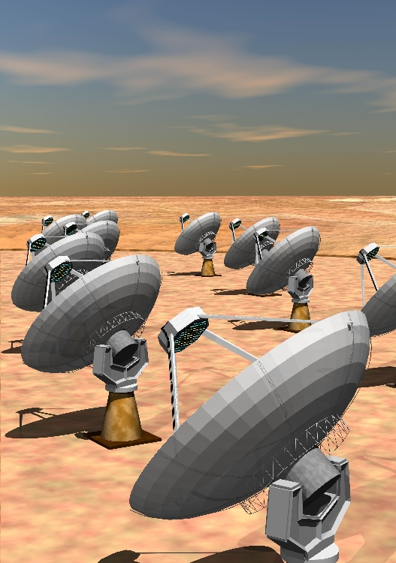
Where to go?
Man-made radio emission (Radio Frequency Inteference, RFI):
MeerKAT
ASKAP

Slide 3
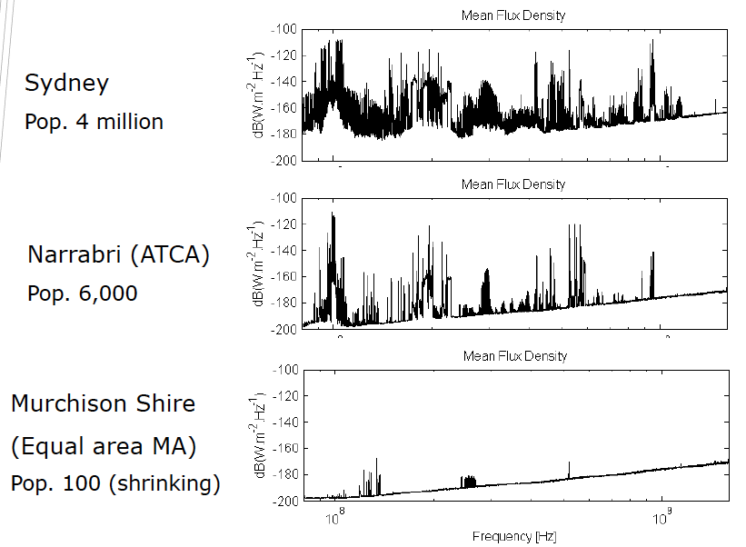
Where to go?
Source: CSIRO
We need to be at site far away from population centres – away from grid?

Slide 4
Site selection
Physical requirements
  Extremely radio quiet environment
  At least 3000 km in extent
  Low ionospheric turbulence
  Low tropospheric turbulence
Two candidates short-listed in 2006: Western Australia and Southern Africa
Site selection process
2010
2011
2012
2010
2011
2012
Site characterisation
decision
selection criteria
info acquisition & analysis
evaluat-ion

Slide 5
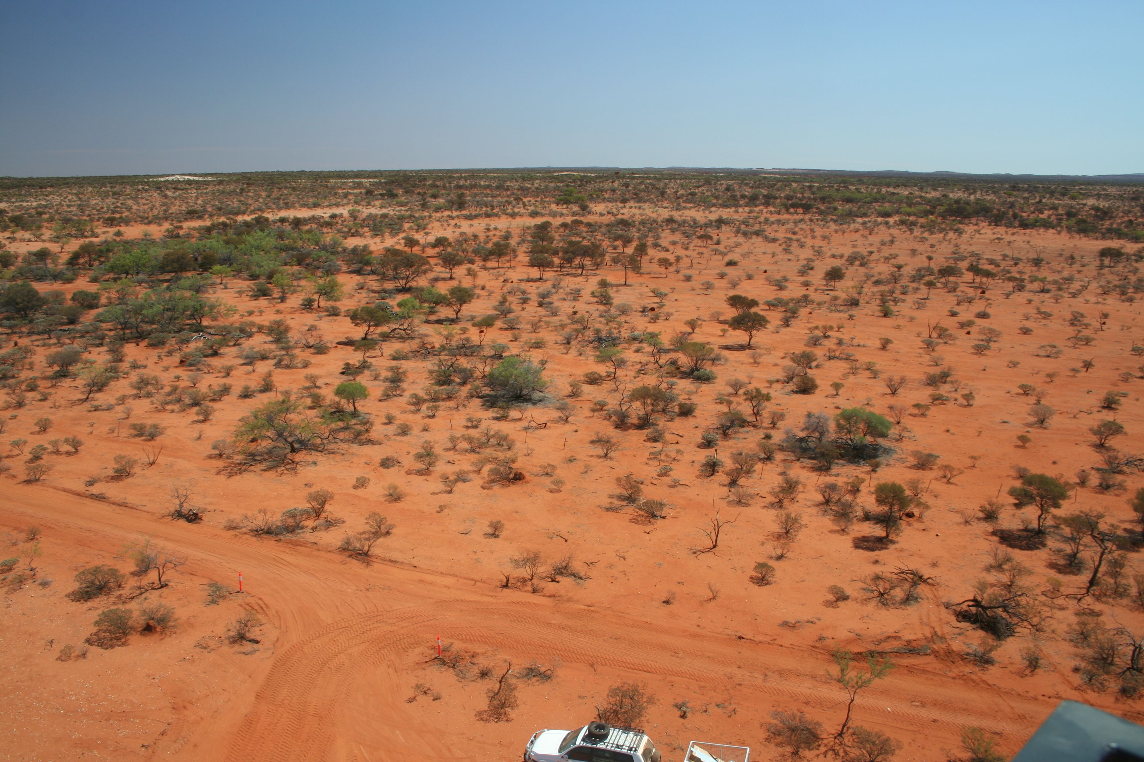
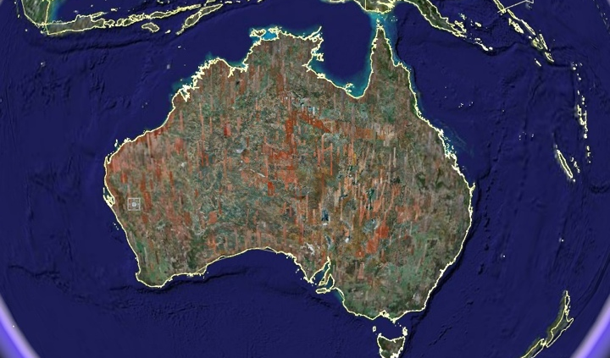

Western Australia & New Zealand
Notes:
A possible SKA configuration in Australia and New Zealand.
Each dot represents one of ~50 antennas stations with ~60 antennas.
50% of the antennas will be within a 5x5km core
A further 25% within 300kmx300km ‘inner region’
A further 25% out to a least 3000km from core
World’s fastest supercomputer in 2020: 10^18 Operations/second (1ExaFlop)
World’s fastest data network 10^12 bits/sec
Target construction cost: Euro1.5B
Estimated Operating cost: Euro 150M per year

Slide 6
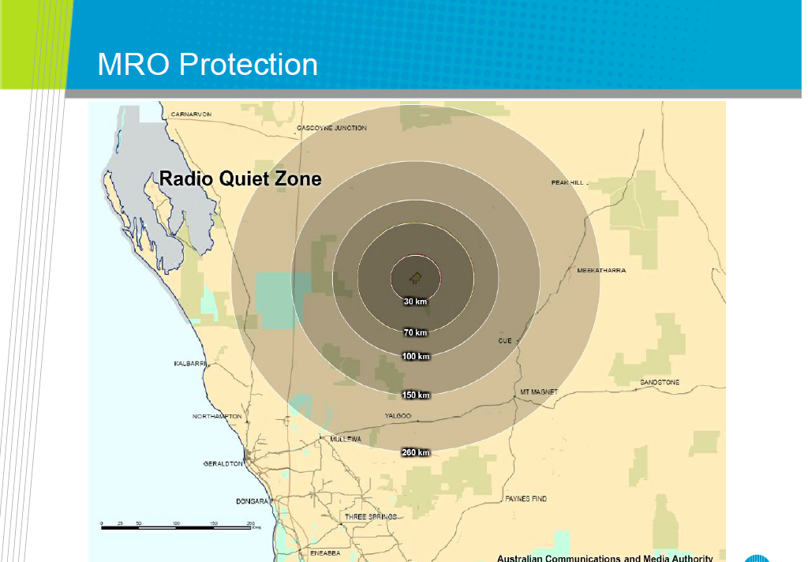
Legal regulations in place to protect site

Slide 7
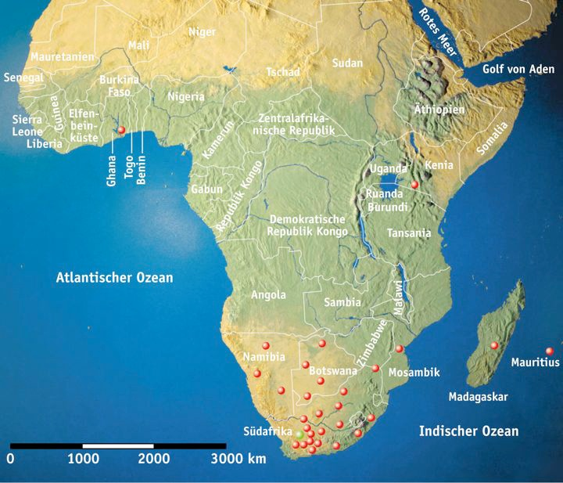
South Africa + 7 countries

Slide 8
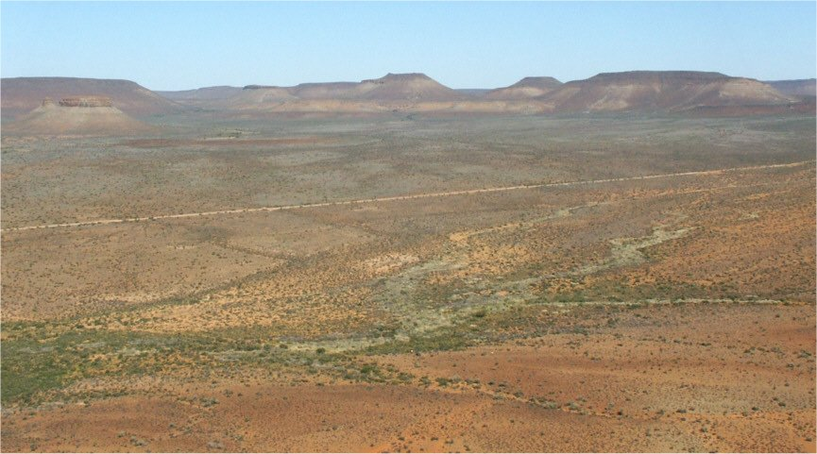
South Africa + 7 countries

Slide 9
The Challenges

Slide 10
Challenges
The radio astronomical techniques are under control
The most important challenges are instead from:
Computing
Power supply
related
Notes:
To be covered: (1) perspective on radio sky coverage w.r.t. the high-energy sky.
(2) kinds of sources expected or hoped for
(3) technical capabilities of the SKA needed
(4) time frame

Slide 11
System Block Diagram

Slide 12
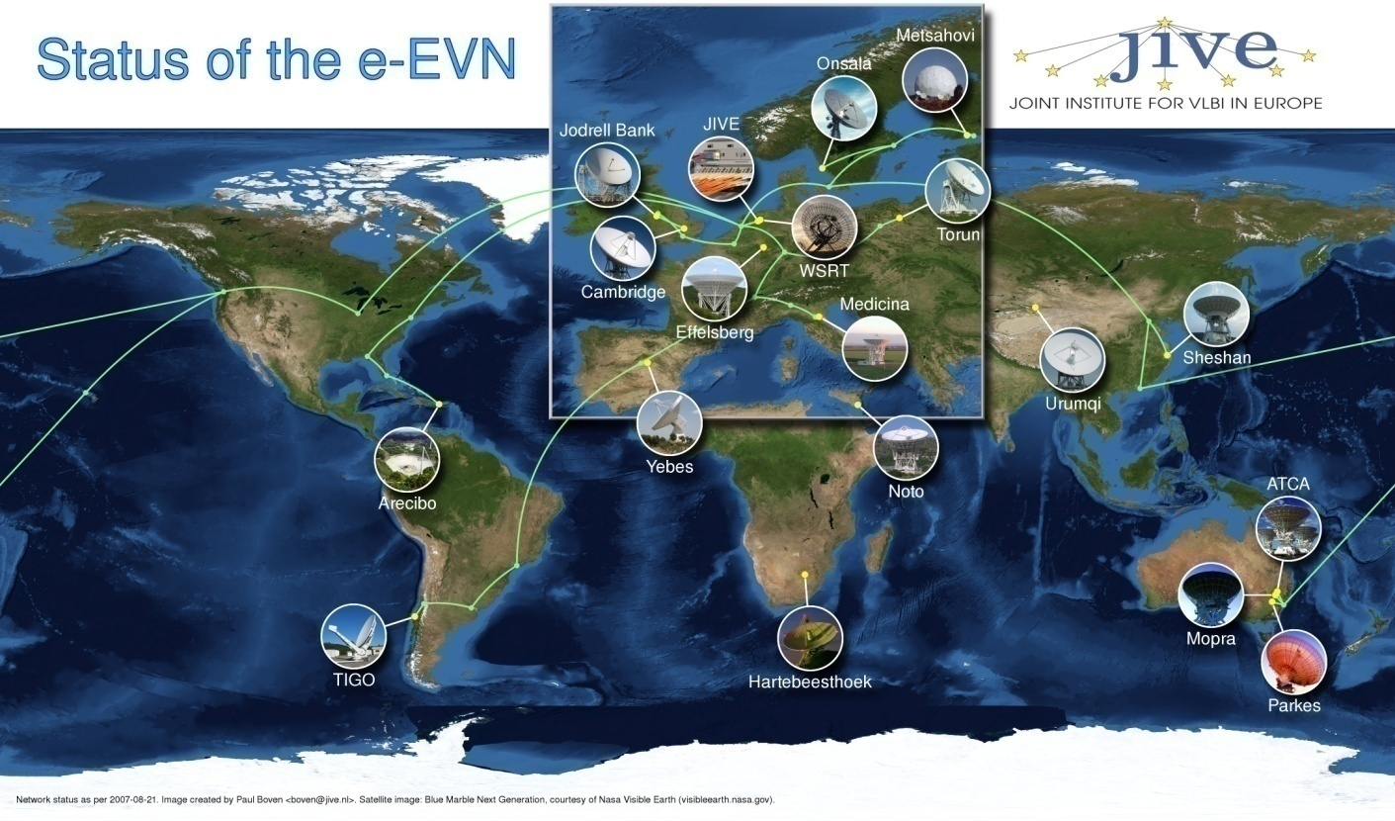
Signal transport networks
European Very Long Baseline Interferometry Network (1 Gbit/s)
EC-FP6 EXPReS
SKA data rates
80 Gbit/s/beam/dish (<200km)
40 Gbit/s/station (20 dishes) (>200km)
~100 Tbits/sec!
About 1 Exabyte per day!! – We need Exa-Scale HPC!

Slide 13
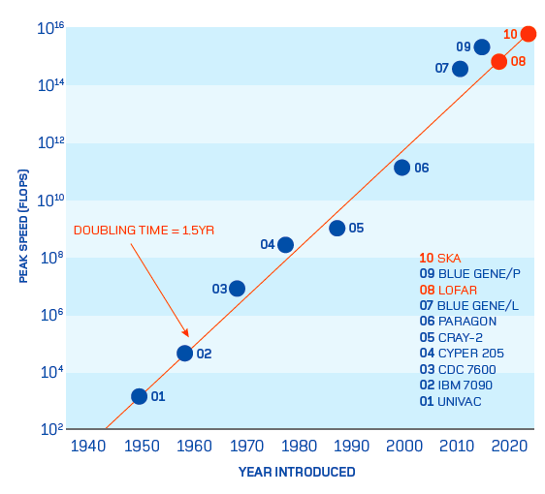

We need an ExaFlop Computer on-site!
In line with ESFRI PRACE goals
But, we need to make HPC more energy efficient to achieve goal!
In Germany, collaboration with FZ Juelich to develop solutions for SKA

Slide 14
Energy supply
Digital electronic needs power and needs cooling
Running costs probably dominated by energy costs
Site is far away from civilisation centres and power grid
- Different power requirements – energy mix!
- Core(s): ~30 to 50 MW
- HPC centre near core: ca. 50 MW
- Distant stations: each ~100 kW for ca. 80 stations
- Differences in peak and average demand (Electronic,
cooling, telescope movements)
- Continuous operation 24/7: Storage required?!
- Avoid variations in power supply: power stability
Environment: Temperature changes, wind, rain

Slide 15
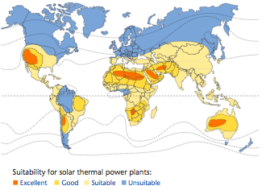
Power supply: Solar Energy?
Supply with solar energy obvious and best (and only?) solution ?
Quelle: Schott
Excellent light house project for renewable energies (already for “SKA Pathfinders”)
Sustainable energy solution for the whole life time (~50 year)
Opportunities to open new markets.

Slide 16
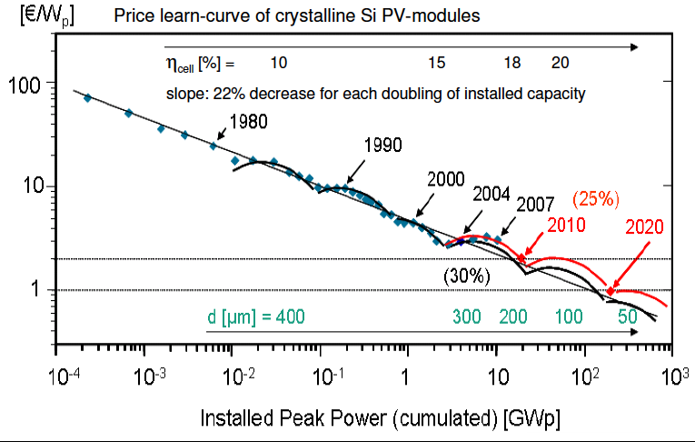
Green astronomy, Green SKA
Slide by Eike Weber (FhG ISE)
SKA will drive innovative solutions in generation, distribution,
efficiency and demand reduction in a harsh environment.
The largest challenge is the storage for 24/7 operation

Slide 17
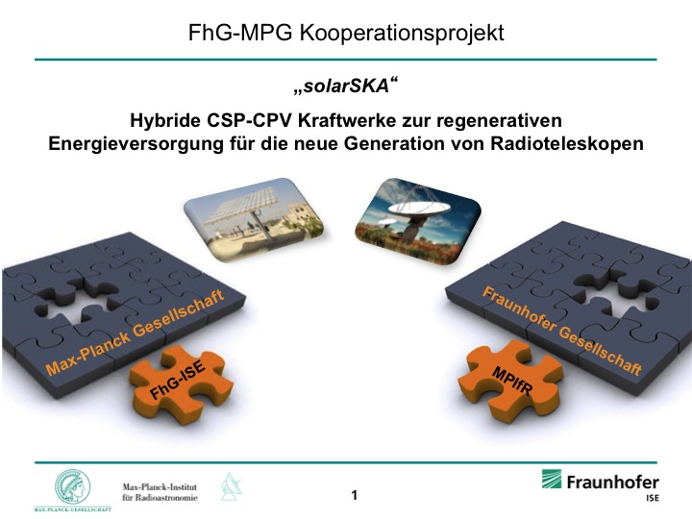
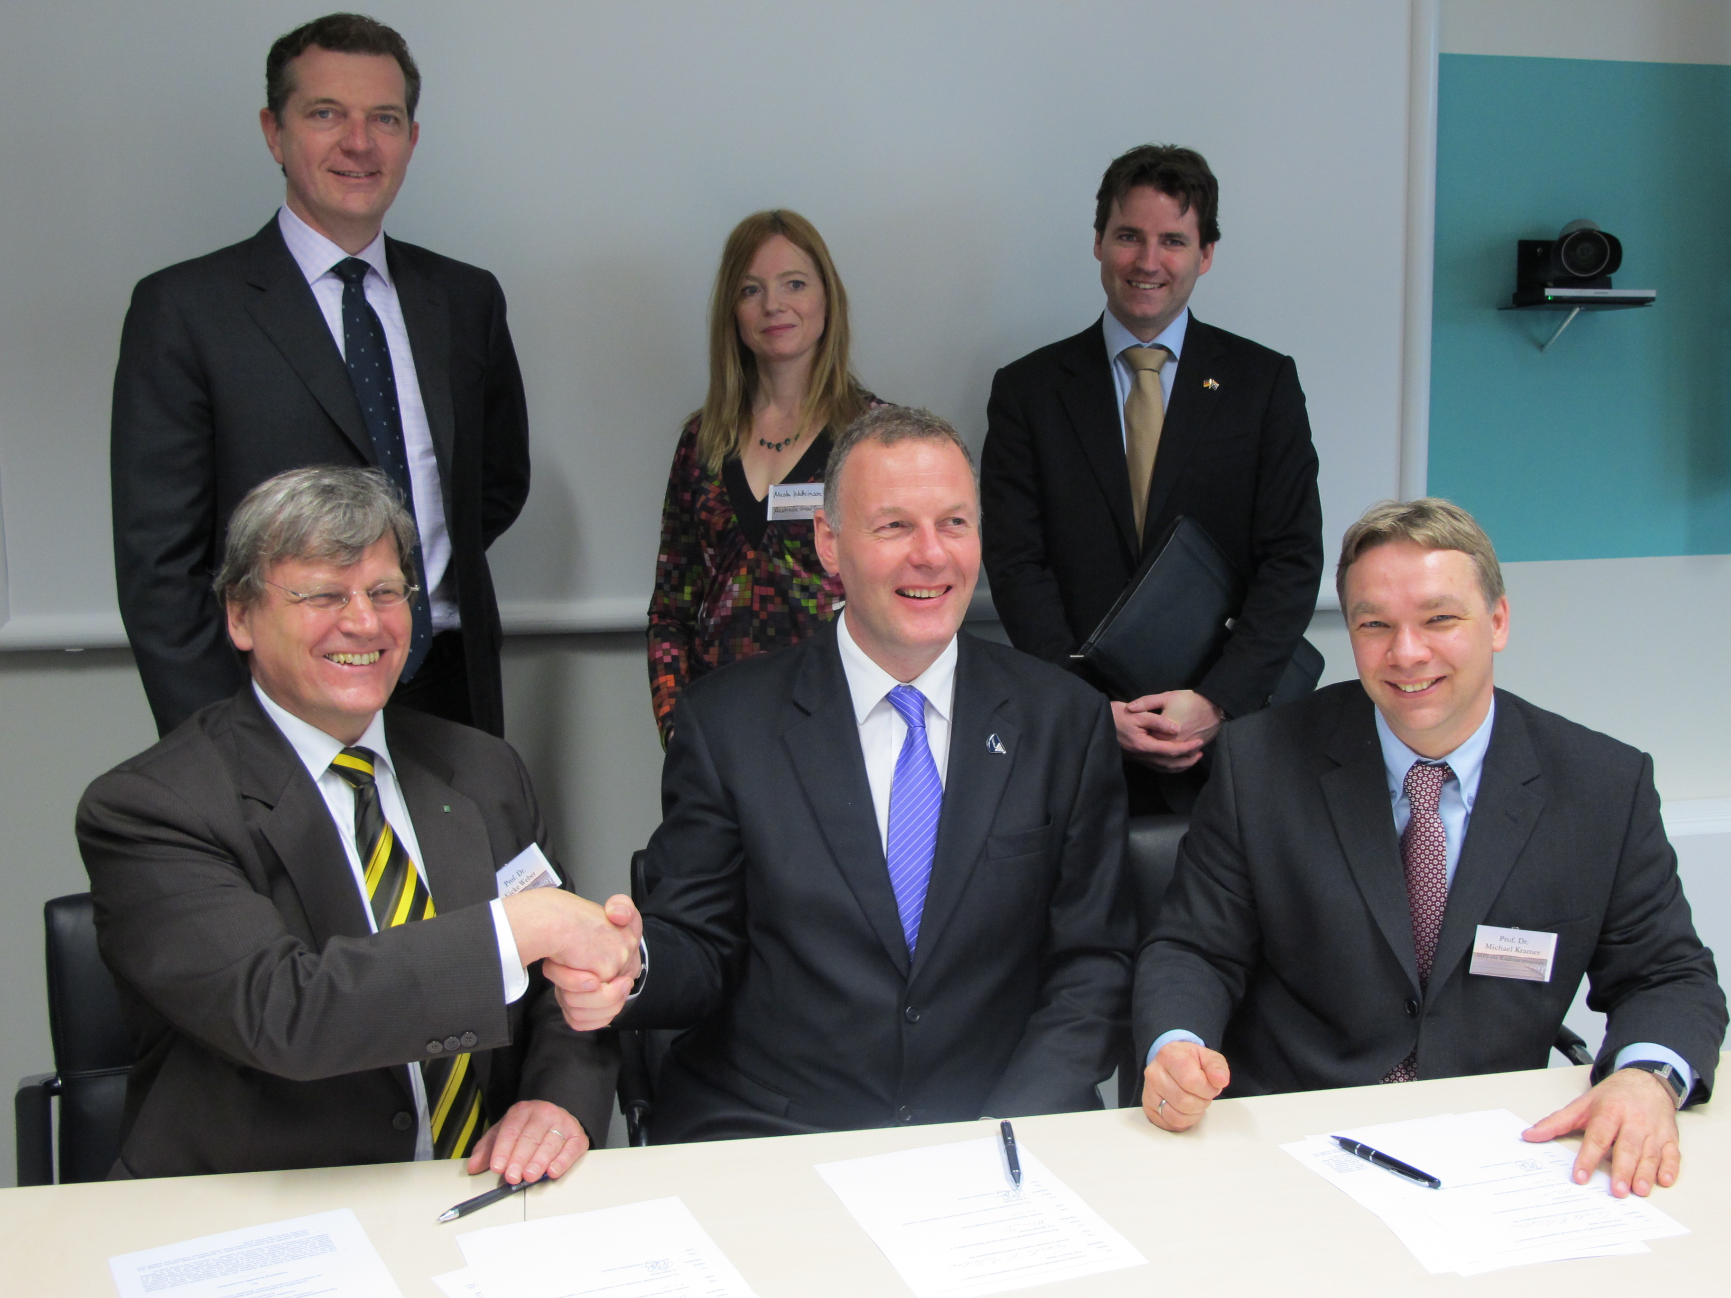
Vision in partnership with Fraunhofer ISE
SKA as lighthouse project for future Mega-Science Projects
World-class science with 100% renewable energy and 0% carbon footprint:
Workshop, 7. April 2011,
Signing MoU: MPIfR/ISE/CSIRO
NB. Australia is pushing renewable, as it is nuclear free and fossil fuels are no option

Slide 18
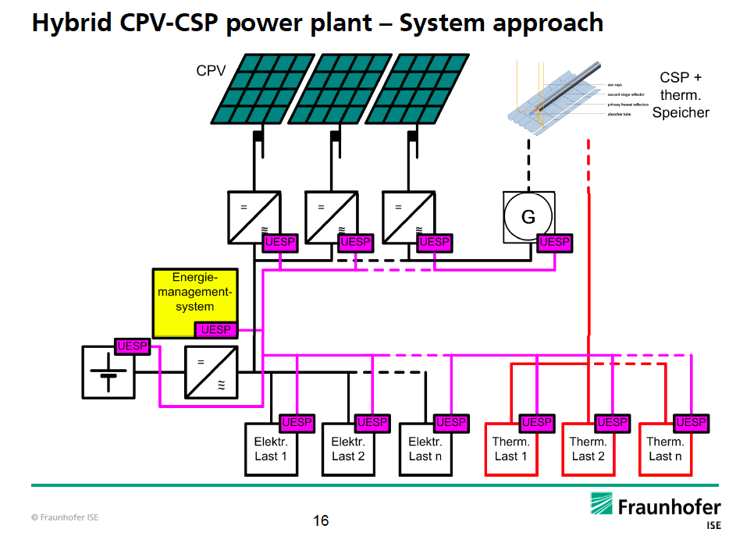
One possible energy concept
Source: Vetter (ISE)
However, with different requirements at SKA core and remote stations
a mix (100kW – 50 MW) is required

Slide 19
Testing systems on the ground
It has not been fully agreed that the SKA is to be powered by renewable energy (Costs!)
Solar power and alternatives are currently studied by „Power Investigation Task Force“
However, adopting a scheme which will make the SKA the largest “green”
scientific megaproject with lessons for every one

Slide 20
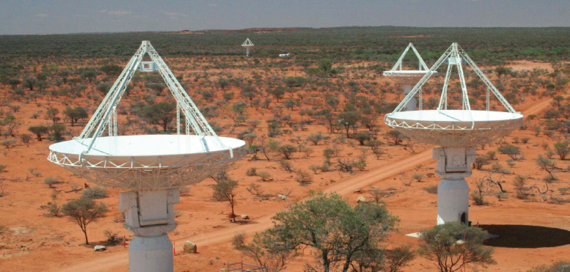
Testing systems on the ground
It has not been fully agreed that the SKA is to be powered by renewable energy (Costs!)
Solar power and alternatives are currently studied by „Power Investigation Task Force“
However, adopting a scheme which will make the SKA the largest “green”
scientific megaproject with lessons for every one
Test stations being developed and planed:
1. CSIRO contracted FHG ISE/MPIfR for initial planning of solar energy solution for ASKAP
Source: Vetter (ISE)

Slide 21
Testing systems on the ground
It has not been fully agreed that the SKA is to be powered by renewable energy (Costs!)
Solar power and alternatives are currently studied by „Power Investigation Task Force“
However, adopting a scheme which will make the SKA the largest “green”
scientific megaproject with lessons for every one
Test stations being developed and planed:
1. CSIRO contracted FHG ISE/MPIfR for initial planning of solar energy solution for ASKAP
2. Aperture Verification Programme (AAVP) tests hardware in a radio quiet area in Portugal
Site will also serve as a test site using solar
energies in combination with the power grid
for the AAVP.
Nearby the Moura Solar Photovoltaic plant.
generating over 60MW with 350.000sqm
solar cells over 1000 solar trackers,

Slide 22
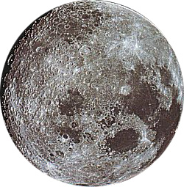

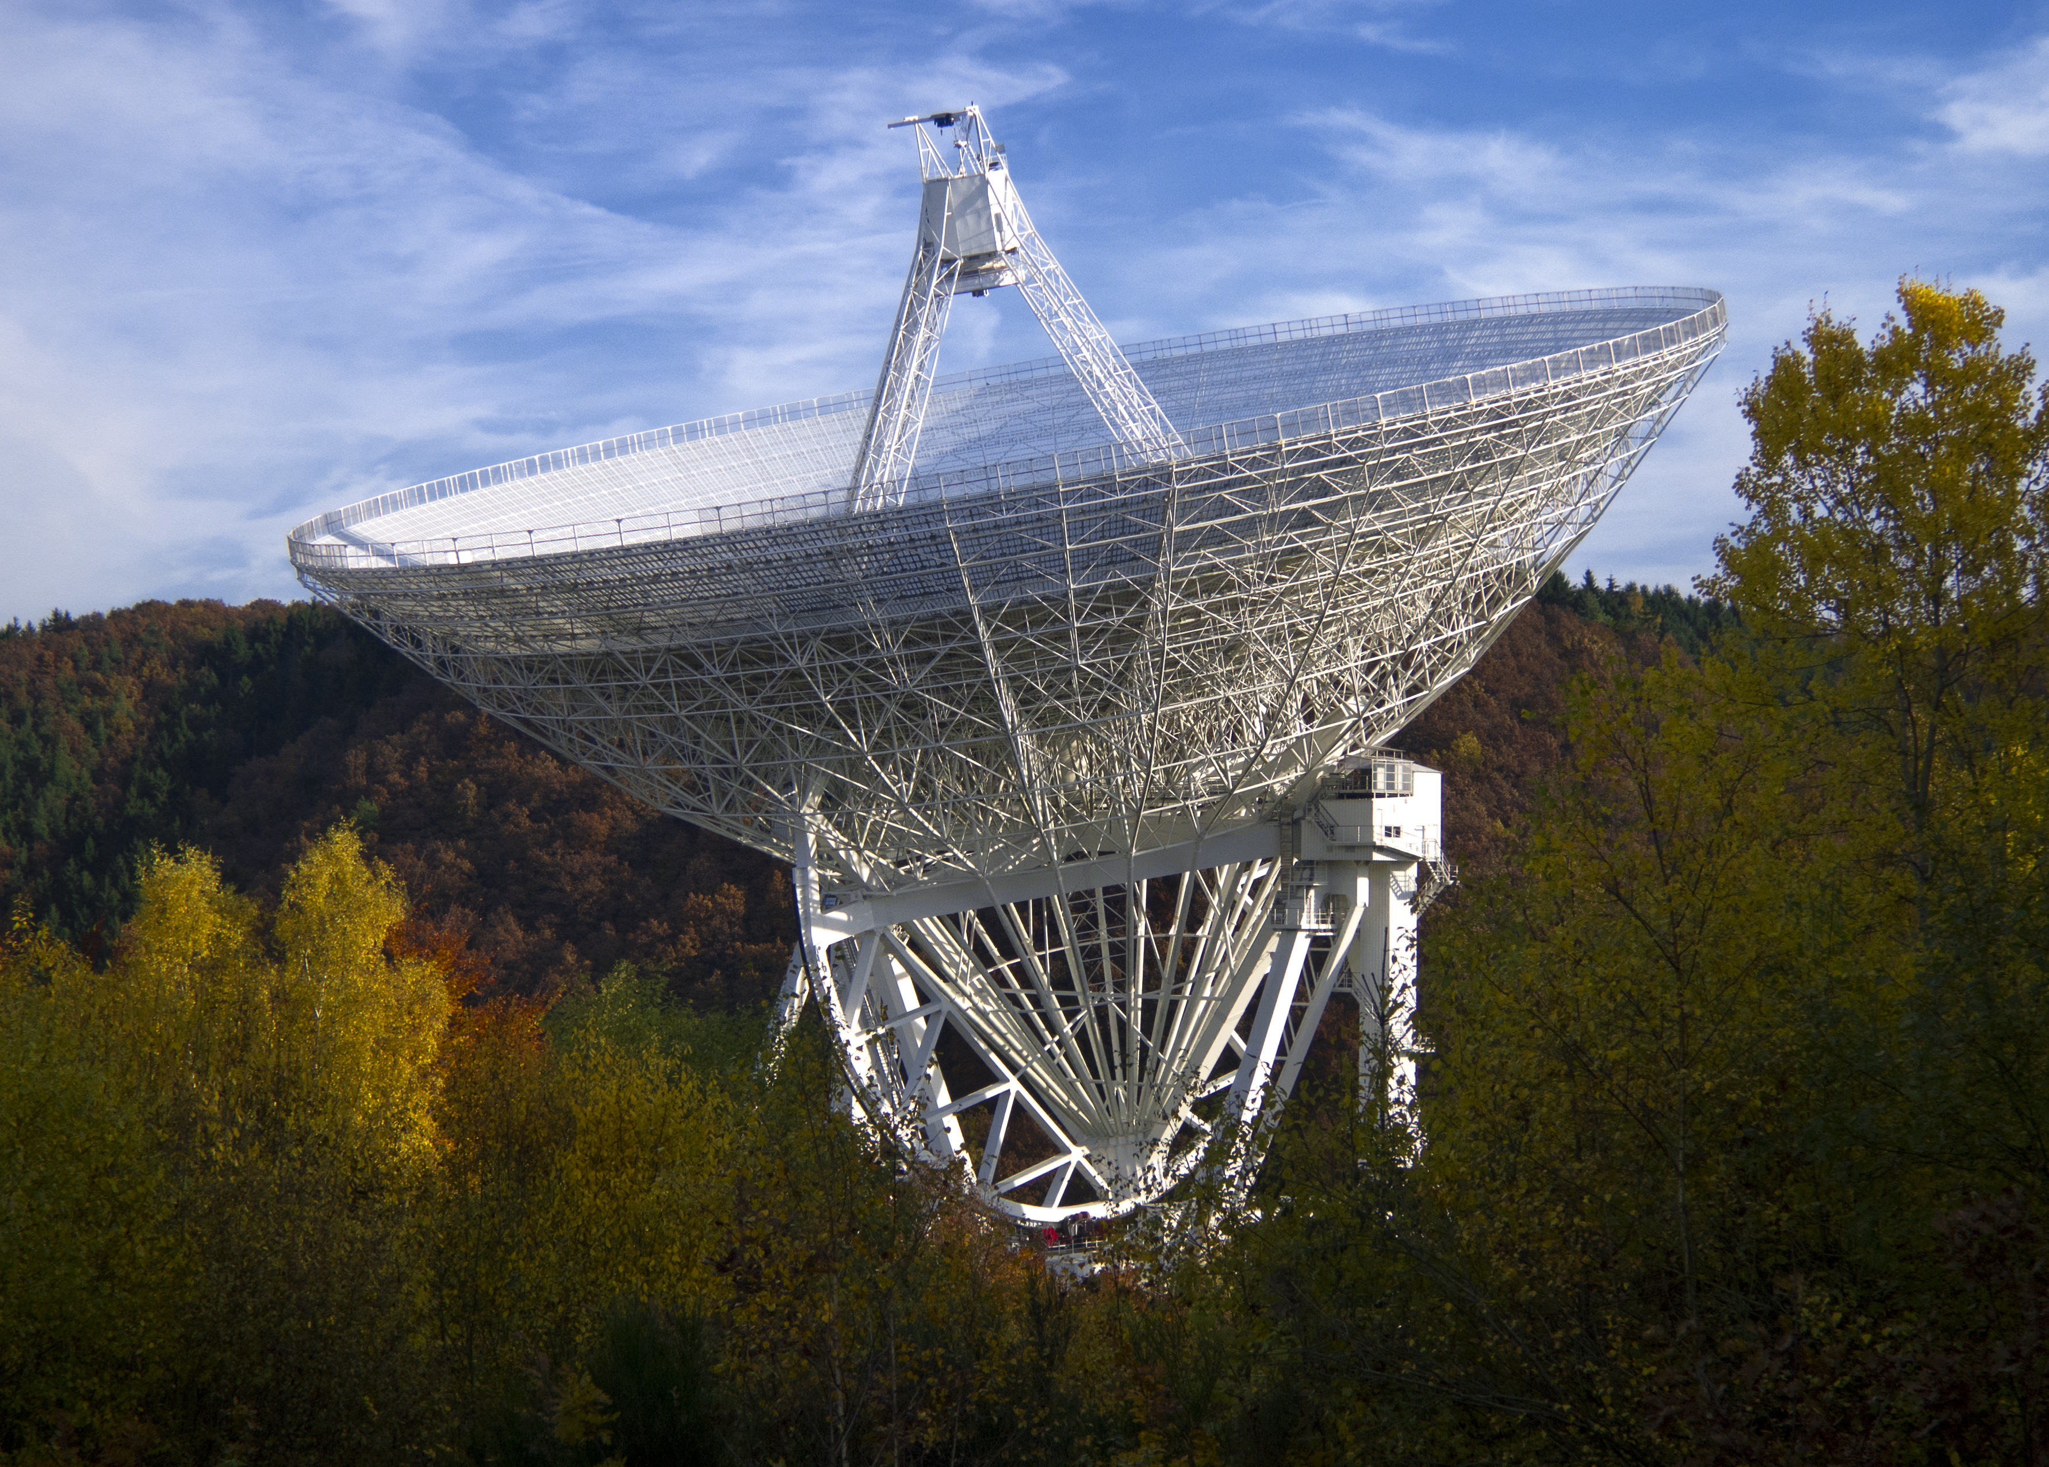
Challenges and ways to make it possible
Don‘t shoot yourself in the foot:
- The SKA will be ultra-sensitive – we must avoid producing
Radio Frequency Intereference on our own, NB:
Mobile on the phone = 3rd brightest radio source
- Balance between power transport, power electronic, losses
Try to reduce power requirements from the start (green HPC, low-power devices, efficient architecture)
Use combination of technologies,
e.g. add geo-thermal cooling
Develop effective, efficient and inexpensive
storage solution
Involve industry! – New Markets: 1.6 Billion
people without access to power grid!!
Use the public attraction of astronomy!

Slide 23

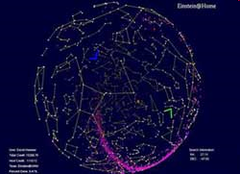
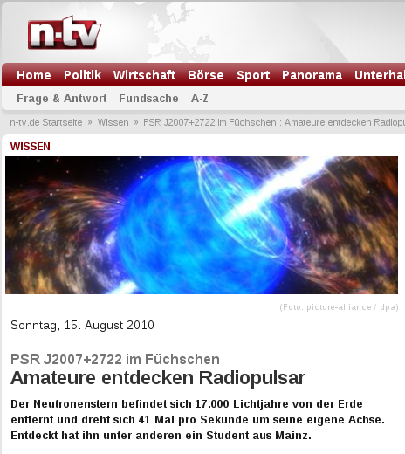
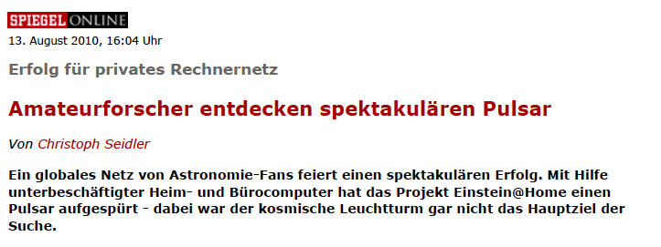
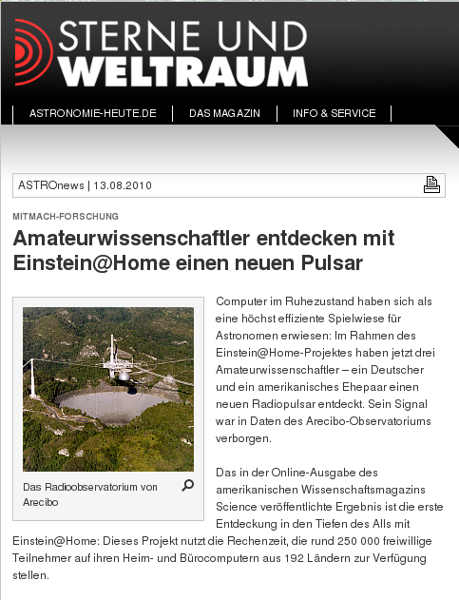
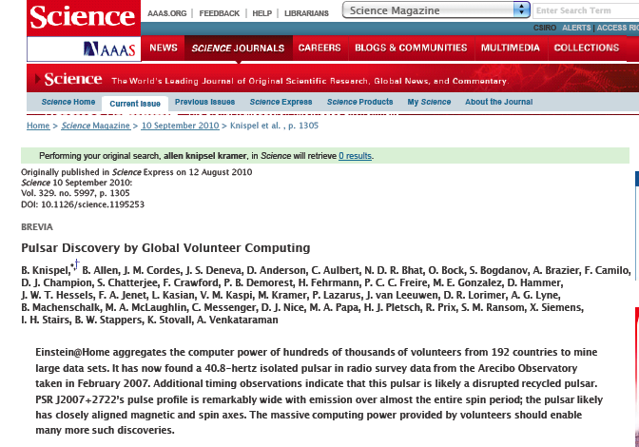
Public is very keen to be involved: An Example...
...finding pulsars with your screen saver!
Over 300,000 volunteers
providing 450 TeraFlops
www.einsteinathome.org
Notes:
Seit März 2009 auch für die Pulsarsuche, 500 000 Rechner weltweit
Student aus Mainz und Ehepaar aus USA

Slide 24
Conclusions
The SKA will be a game-changing observatory producing stunning science
It can serve as a lighthouse project to demonstrate 24/7 operation with
100% renewable energy independent of grid-solutions
It can be a prime example for sustainable Mega-Science with 0%-Carbon Footprint
With astronomy (and SKA’s Key Science, e.g. Einstein, Black Holes ..) appealing
enormously to the public, the SKA can break ground for other projects
Required energy mix (mini-grid solutions with storage) is likely to produce solutions
for many applications
Key to the success of a 100% RE-SKA will be the development of innovative
systems solutions: PV, CPV, CST solar power, wind if available, plus storage
It is not clear whether we can afford it, but “Green Astronomy” is likely to be
spectacularly popular
In any case, we may not be able to afford to pollute the Earth for the exploration of
the Cosmos
It is not easy – but we should certainly try it!

