Slide 1
LOFAR
Ger de Bruyn
ASTRON, Dwingeloo & Kapteyn Institute, Groningen
Thanks to Heino Falcke for the many slides from his
“Dalfsen Conference Summary”
(14-15 September 2011)

Slide 2
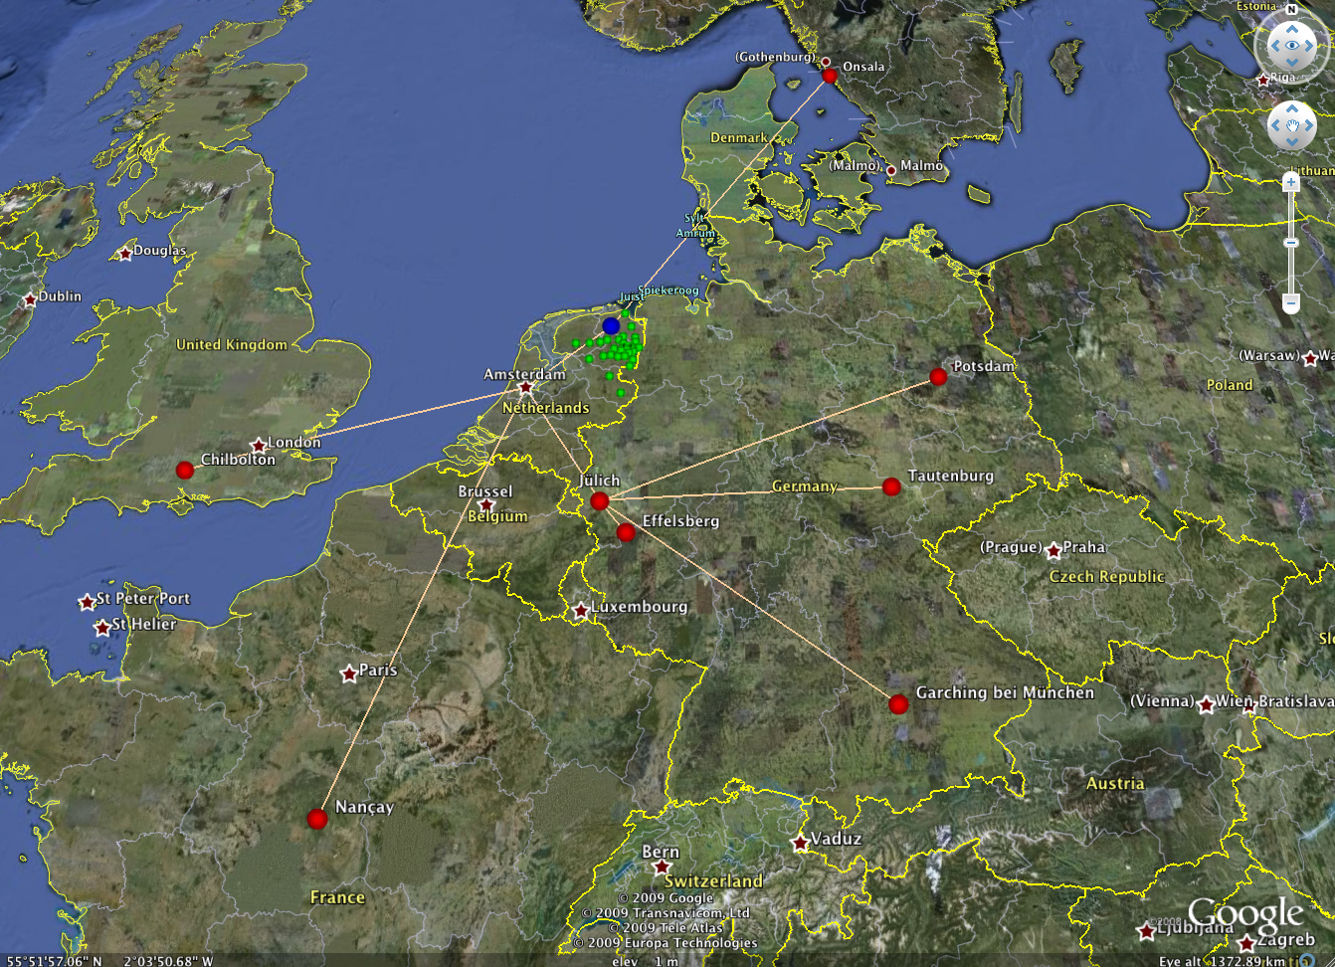
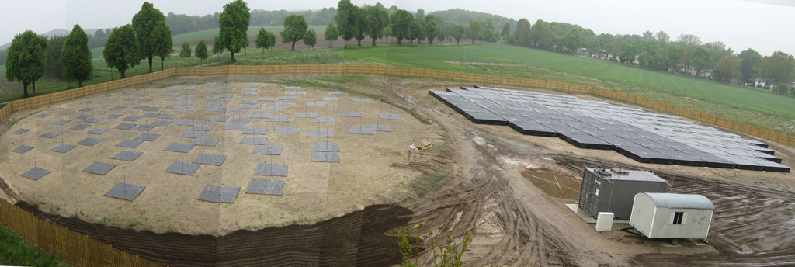
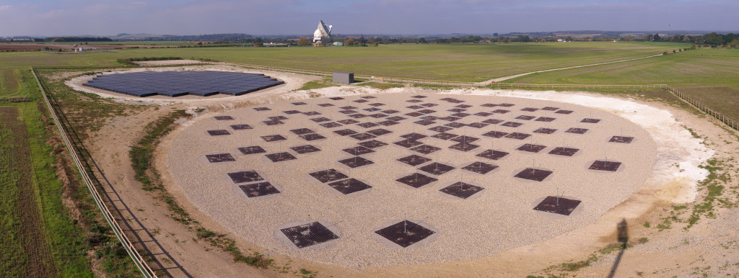
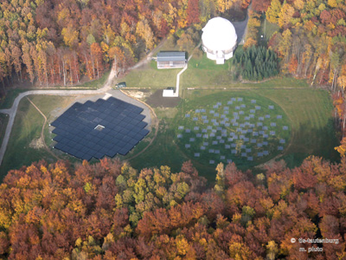
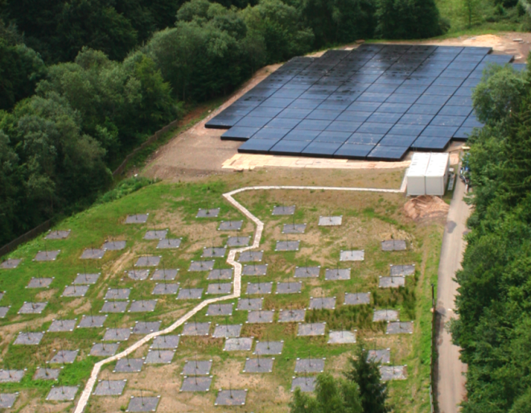
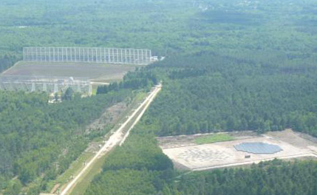
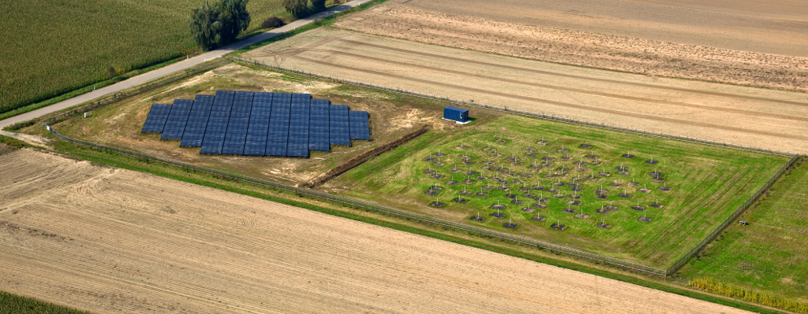
LOFAR Stations Across Europe
Onsala (SE)
Chilbolton (UK)
Potsdam (DE)
Tautenburg (DE)
Effelsberg (DE)
Nançay (FR)
Jülich (DE)
Unterweilenbach (DE)
Notes:
There is an ILT with a legal structure, budget and financial contributions, documented science policy, organisational structure in place which hasn’t changed after a year!
European collaboration of rather diverse partners, it is bottom up, does many things that simply haven’t been done that way.
Lot of slack and extremely low efficiency, but that is almost unavoidable.

Slide 3
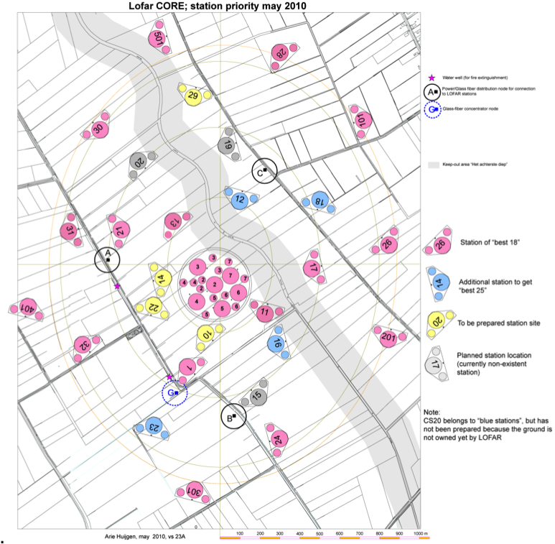
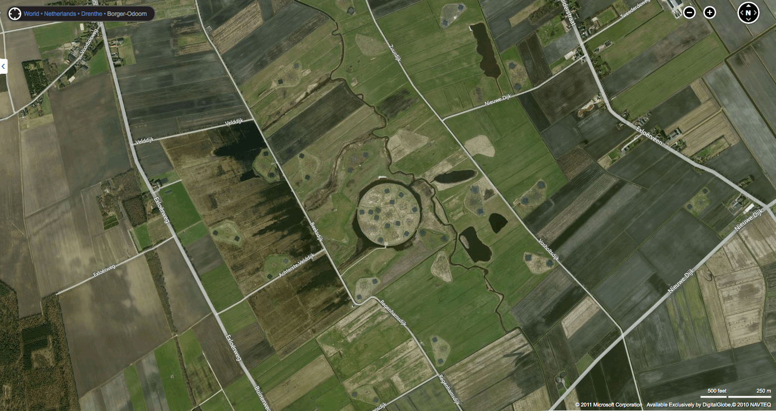
LOFAR core configuration (22 split-stations)
Dimension 2 x 3 km
The ‘superterp’
is ~ 350 m diameter
1000 m

Slide 4
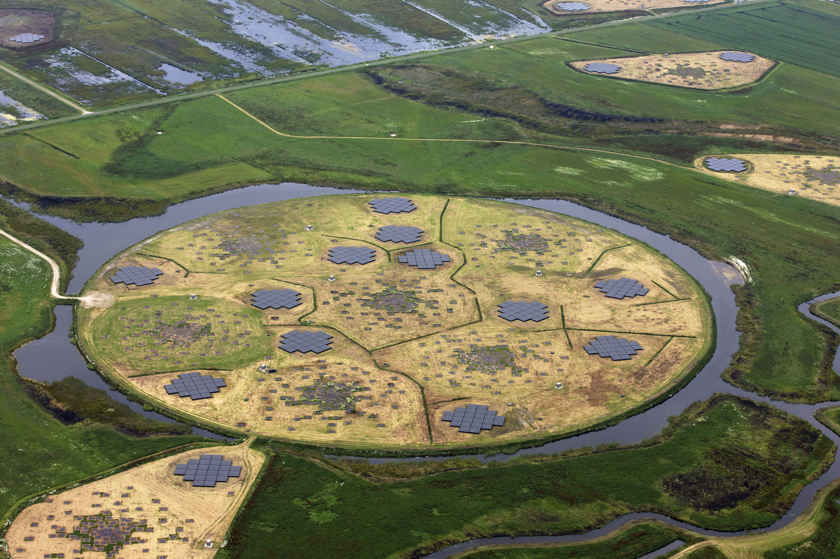
The LOFAR superterp: 350 diameter
6 LBA x 96 dual-dipoles, 6 HBA x 2x24 tiles (4x4 dual-dipoles)

Slide 5
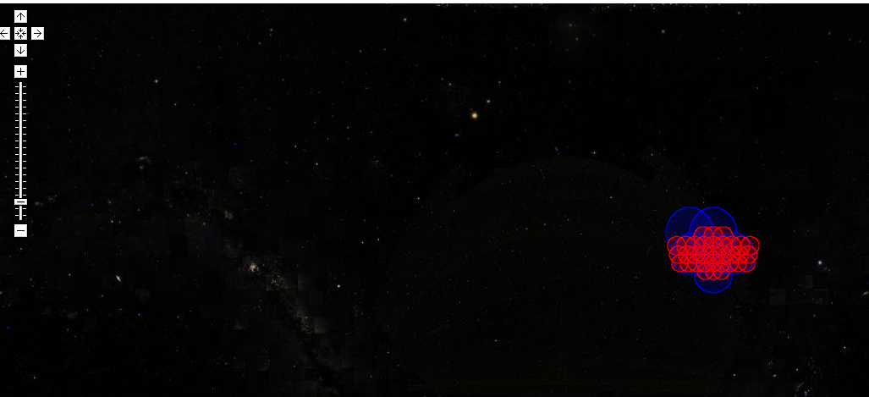
Tracking MSSS observations
8hr of
MSSS-test
observations:
1% of MSSS sky
MSSS fundamentally a commissioning survey
Key roles:
Fill the initial GSM for calibration of arbitrary fields at arbitrary frequency in LOFAR bands
Multifrequency - need fluxes over wide LOFAR bands
Snapshot - spend little time to image the sky
Sky - cover the full LOFAR sky (dec ≳ 0 degrees)
Survey - provides output catalog of sources in the sky
Guide development of, and exercise observatory operations, processing software, imaging pipeline, (and commensal applications?)
George Heald / First Science with LOFAR / 14-09-2011

Slide 6
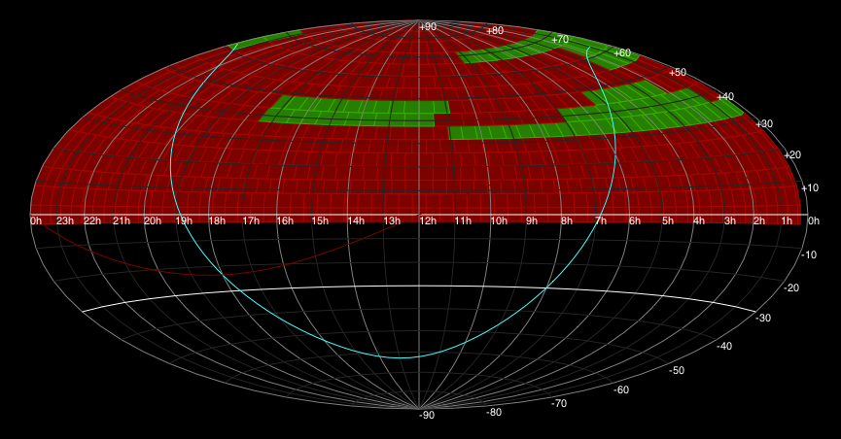
LOFAR calibration survey: MSSS has started
George Heald, AJDI, 9 Dec 2011

Slide 7
Deep Imaging EOR
de Bruyn, Labropoulos, Yatawatta
6h, 115-163 MHz, 25 stations (18(x2) CS + 7 RS)
13° x 13°
2° x 2°
Within factor ~1.2 of thermal noise!
Sagecal: S. Yatawatta
Notes:
Fantastic! Scientifically crap??? (beam effects and deconvolution? Needs central source)

Slide 8
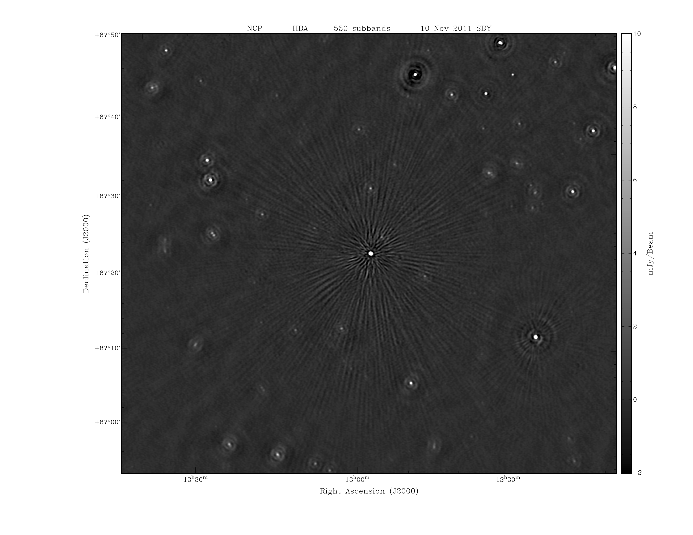
Ionospheric effects in NCP HBA-image
NCP
550 subbands (of 0.18 MHz)
~ 40 MHz x 18h
noise ~ 120 μJy

Slide 9
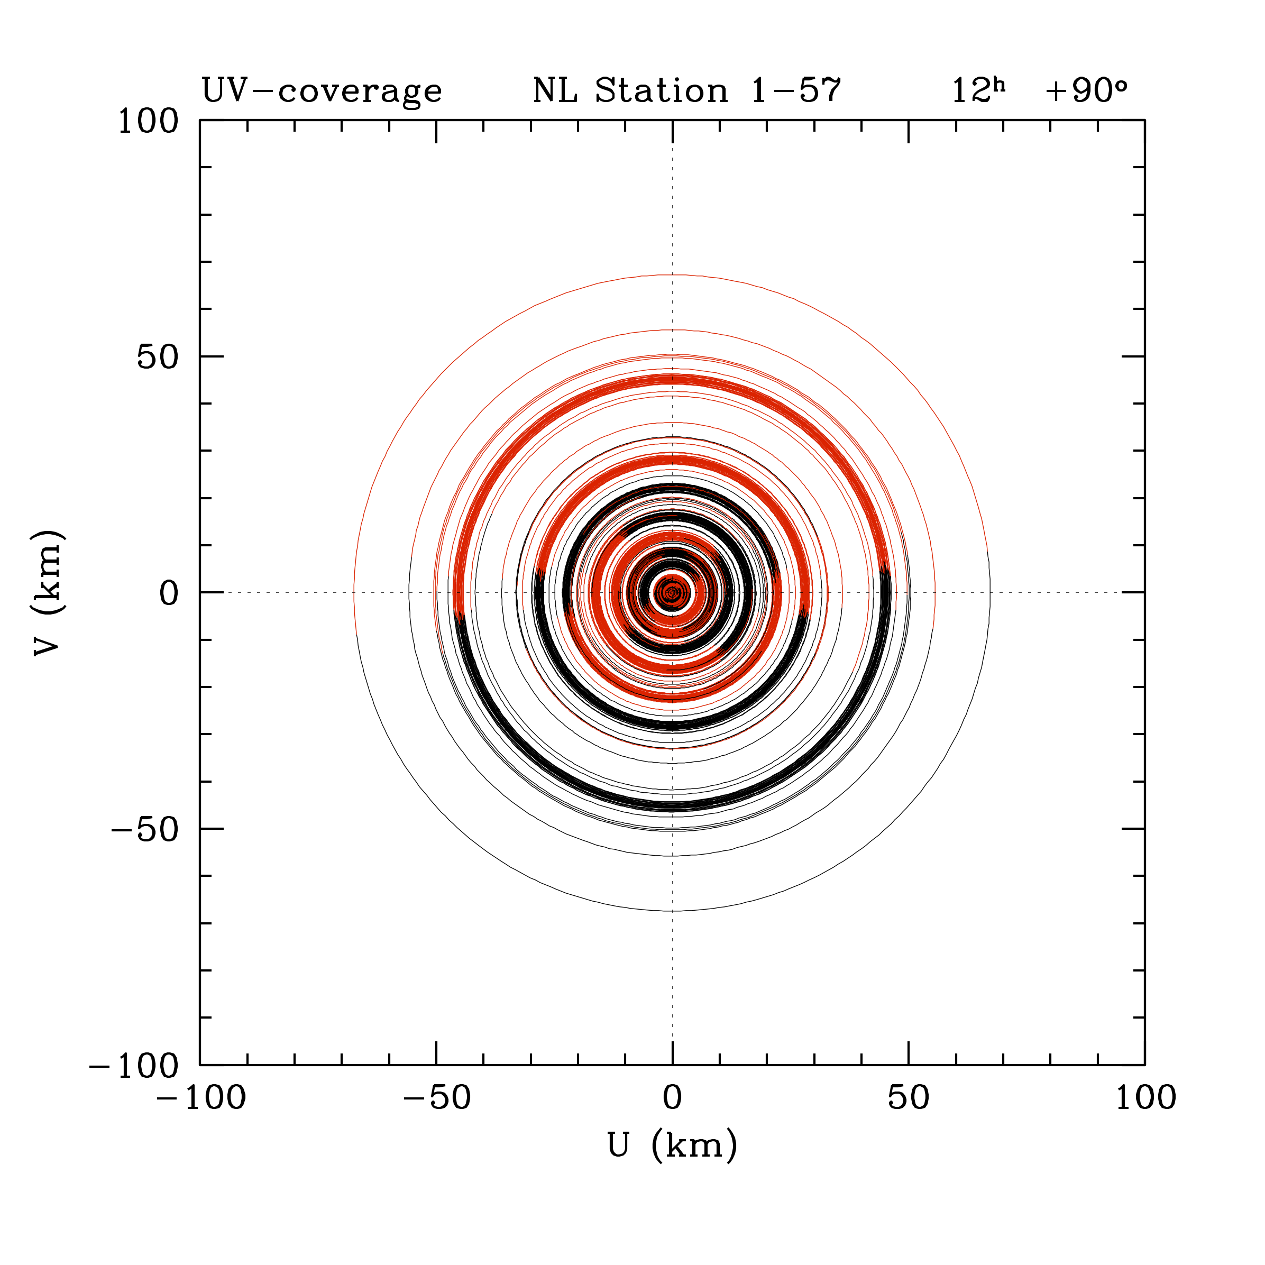
uv-coverage 12h Dec +90º
24x2 CS + 9 RS
(1596 baselines)
Longest baseline
RS208-RS509 ~ 83 km
But at NCP this is projected to 66 km

Slide 10
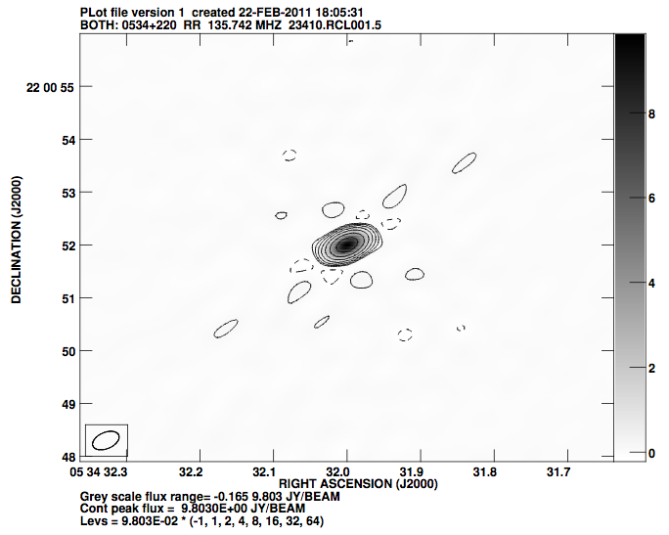
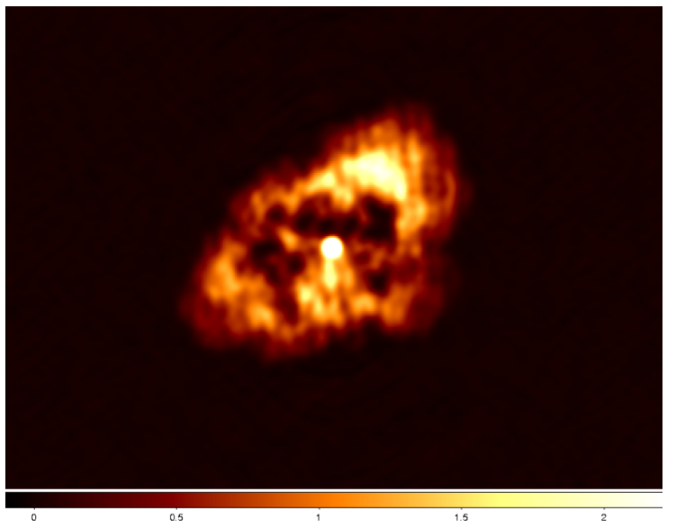
Taurus A with international baselines
1 Core station, 7 remote stations, 2 international stations
O. Wucknitz
Detection of central source (Crab pulsar)
Notes:
ingenious strategy, needs circular pol, need 5 people to jump on this and embrace this technique

Slide 11
Polarized structure in Fan Region with RM synthesis
Talk by Manu Orru

Slide 13
Imaging of galaxies
Talk by David Mulcahy
Notes:
One sideband

Slide 14
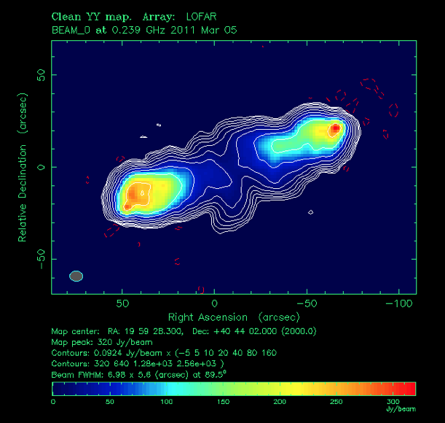
HBA imaging at 239 MHz
Large (counter)-lobe emission
Hot spot
Relic hot spot?
Plume
Counter hot spot
John McKean - LOFAR Imaging of Cygnus A
Notes:
2010 data ….

Slide 15
SS433 (Jess Broderick)
Notes:
2011, but black and white

Slide 16
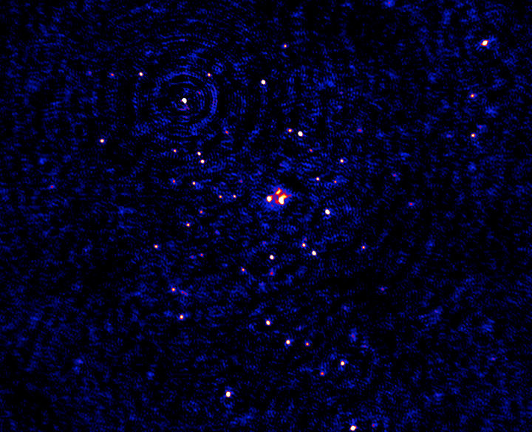
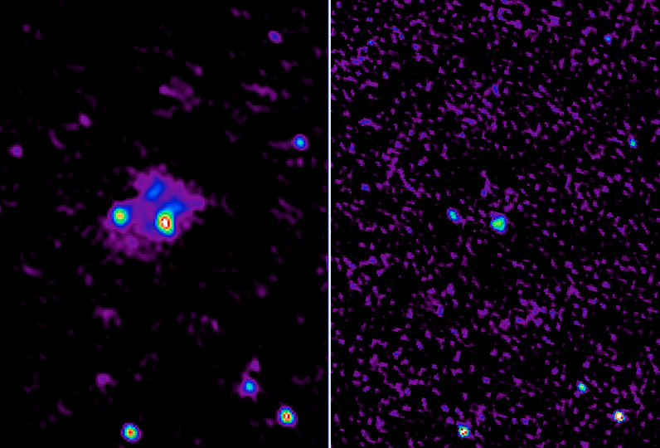
50 MHz
Abell 2256 (Reinout van Weeren)
3°
See also Coma (A. Bonafede)
49 MHz
74 MHz VLSS
August 2011
49 MHz (longest baseline 25 km)
16
Notes:
Better than VLA by > factor 2

Slide 17
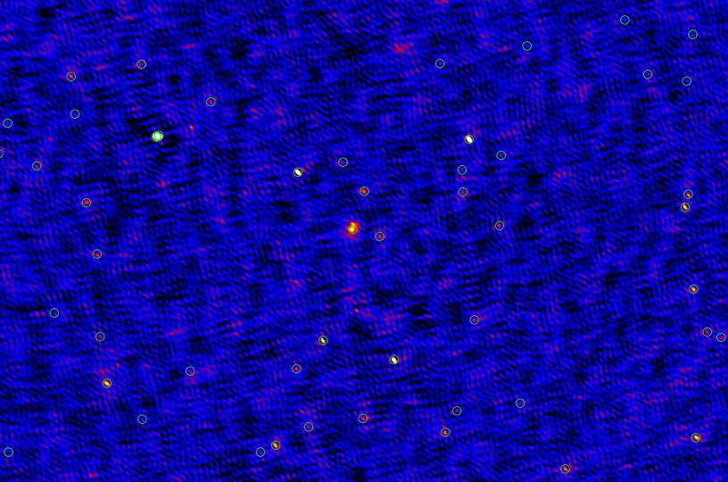
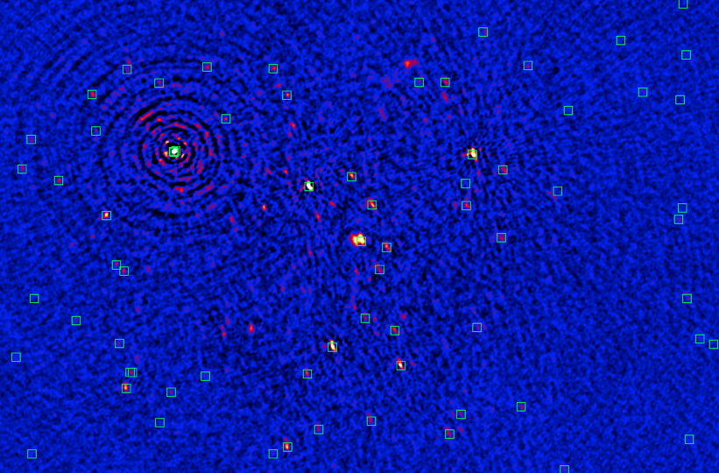
16 - 18 MHz, 6hr data, 2 MHz bandwidth
5°
August 2011
Abell 2256 (Reinout van Weeren)
17

Slide 18
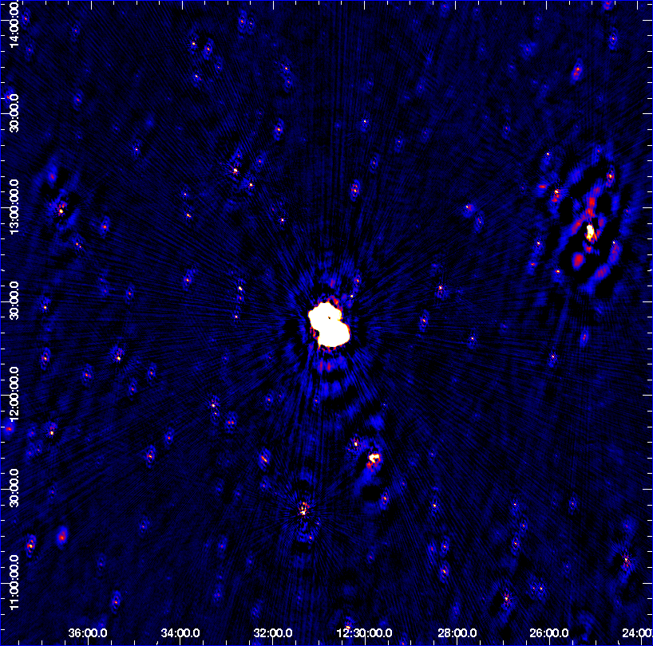
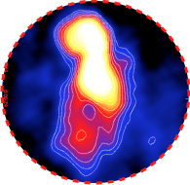
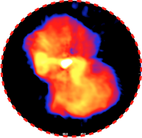
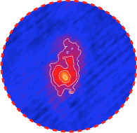
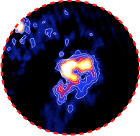
Virgo A (de Gasperin)
M84
M87
NGC4568
A1552

Slide 19
The new imager with A-projection
Talk by Tasse

Slide 20
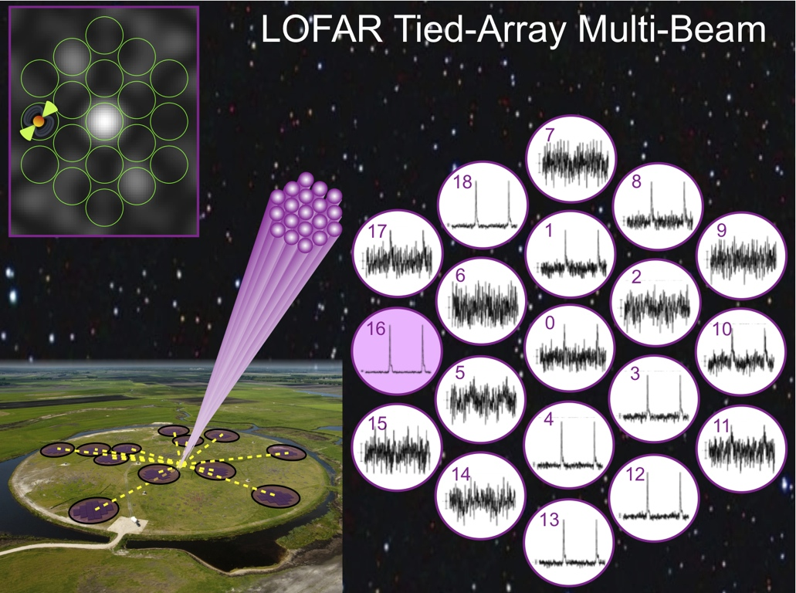
Talks by Hessels
See Mol & Romein 2011 for multi-beam tied-array benchmarking results
Credit: Hessels, Stappers & Scaife
First Science with LOFAR - Dalfsen - Sept. 14th, 2011

Slide 21
Anomalous Intensity Pulses
Vlad Kondratiev
Notes:
Seen only over limited bandwidth: smells like coherence effects, but is there a low-frequency cut-off, why? Rising solar flare … (most people have given up understanding pulsar emission mechanisms). Honor the intrinsic value of pulsars, not just because they are useful.

Slide 22
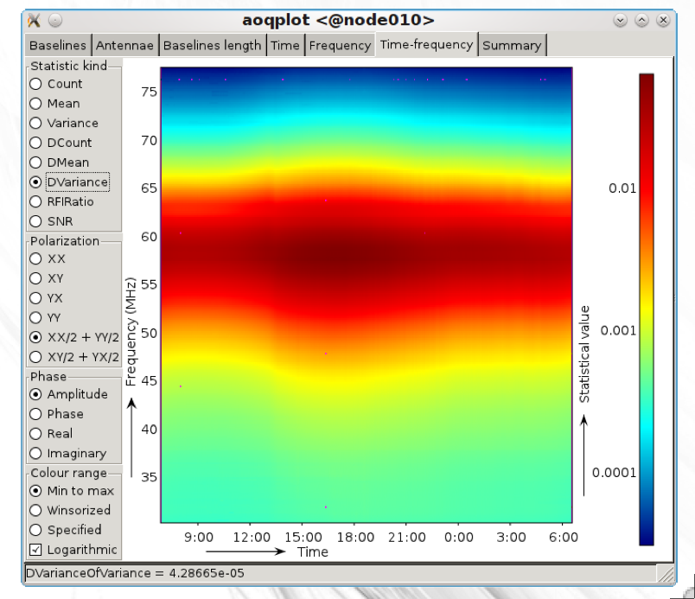
Andre Offringa’s visualization tool: aoqplot:
results from a 24h LBA campaign in Oct 2011, with ~ 3% RFI excised

Slide 23
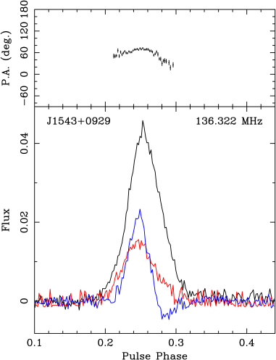
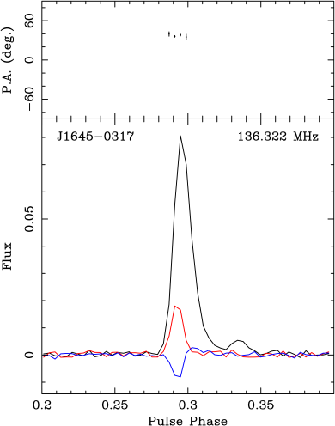
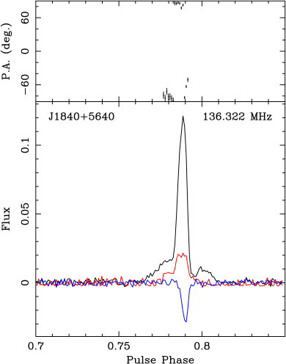
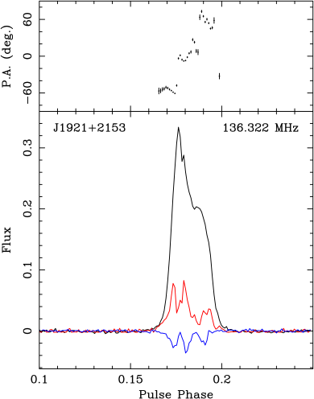
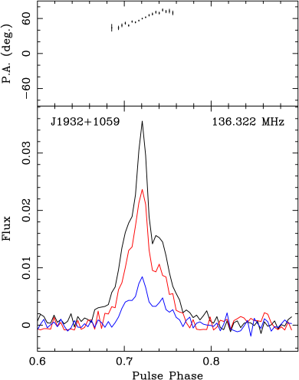
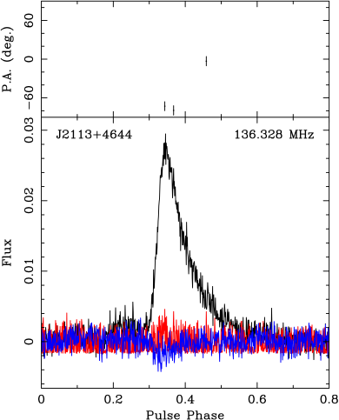
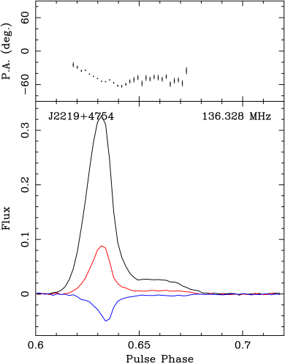
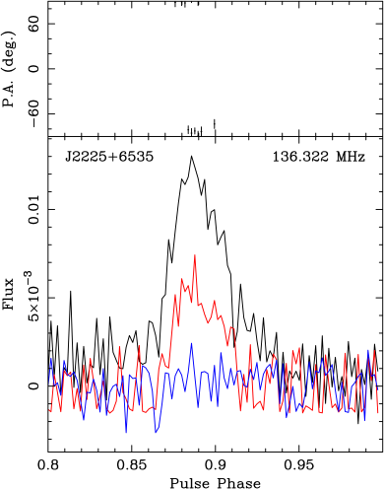
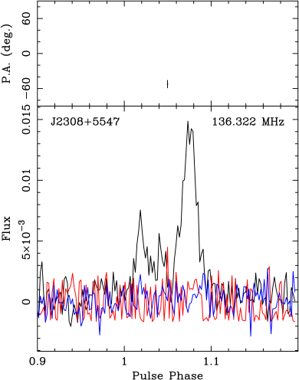
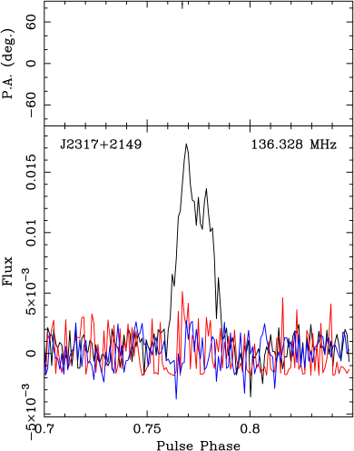
Outline Polarisation Observations RM synthesis & Analysis Conclusion
● ●● ●●●●● ●●●●●●● ●
LOFAR Observations
B1541+09
B1642-03
B1839+56
B1919+21
B1929+10
P.A. (deg)
P_{min}
Flux
B2111+46
B2217+47
B2224+65
B2306+55
B2315+21
Charlotte Sobey Max-Planck-Institut für Radioastronomie
Polarised Pulsars: Observations & applications Wed 14th September 2011
Notes:
“Use timing, if present”

Slide 24
Transients (Rol, Broderick)
Notes:
Will likely get better soon, with imaging/calibration making improvements

Slide 25
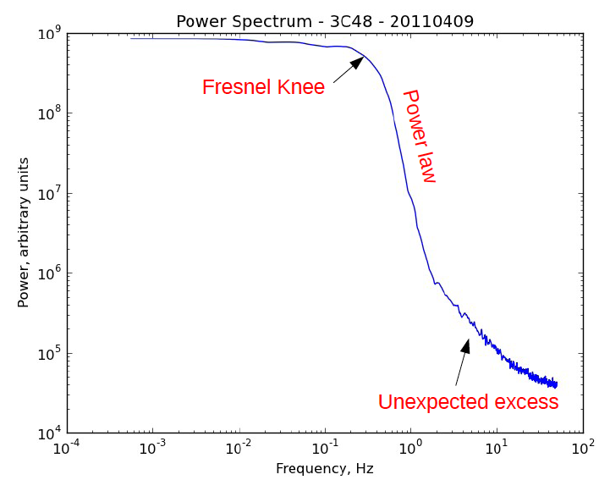
Interplanetary Scintillation
Richard Fallows
Notes:
Finally IPS work ! Breadth of science

Slide 26
Cosmic Rays seen with LOFAR
Talk by S. ter Veen
Most densely instrumented measurements of air shower radio emission!

Slide 27
NuMoon – Cosmic Rays hitting the Moon (Mevius)
P10 distributions
No pulses other than Gaussian noise were found in 5 minutes of data
Next steps:
Repeat analysis on full bandwidth data
More stations (tied array mode)
Point one or more beams to the Moon, to check for differences
Investigate short time structure of others sources?
Implement simple trigger (@TBBS or CEP)
After coincidence requirement

Slide 28
Some recent LOFAR visibility, sensitivity, RFI and imaging data

Slide 29
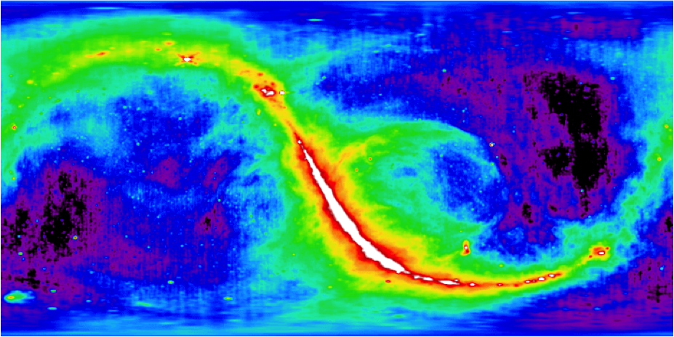
Galactic locations of compact LOFAR calibrators:
3C147 3C380 3C295 3C196
Haslam et al, 1981

Slide 30
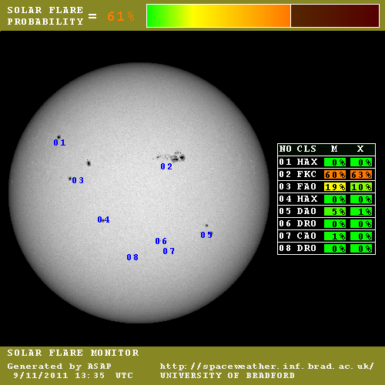
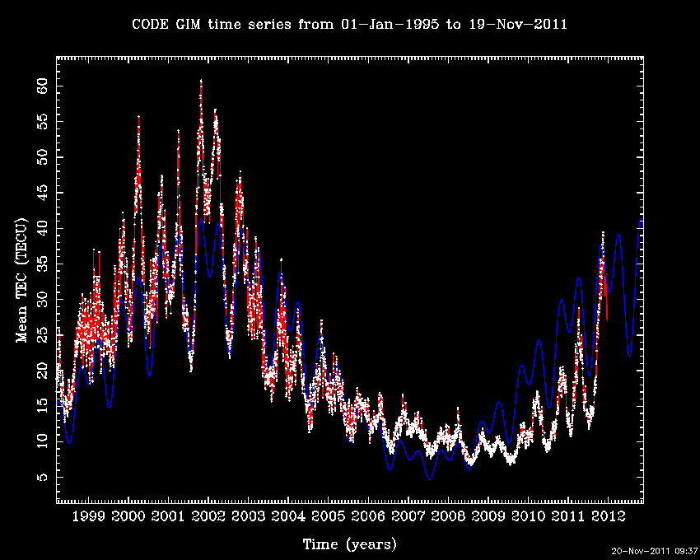
Solar maximum is coming !!
Mean TEC thickness

Slide 31
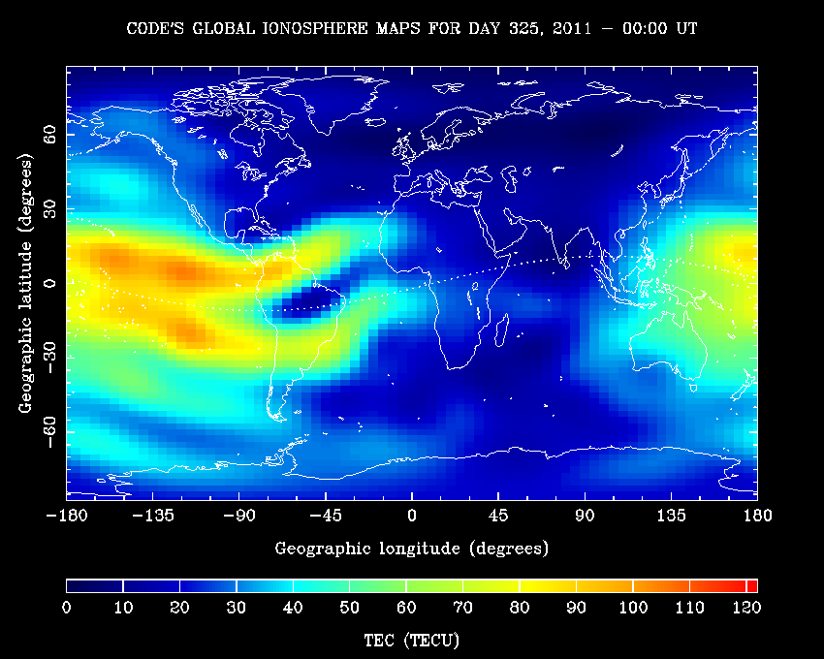
The ionospheric TEC layer thickens !
2011
22-30 Nov
VLA LOFAR SKA-SA GMRT SKA-Aus

Slide 32
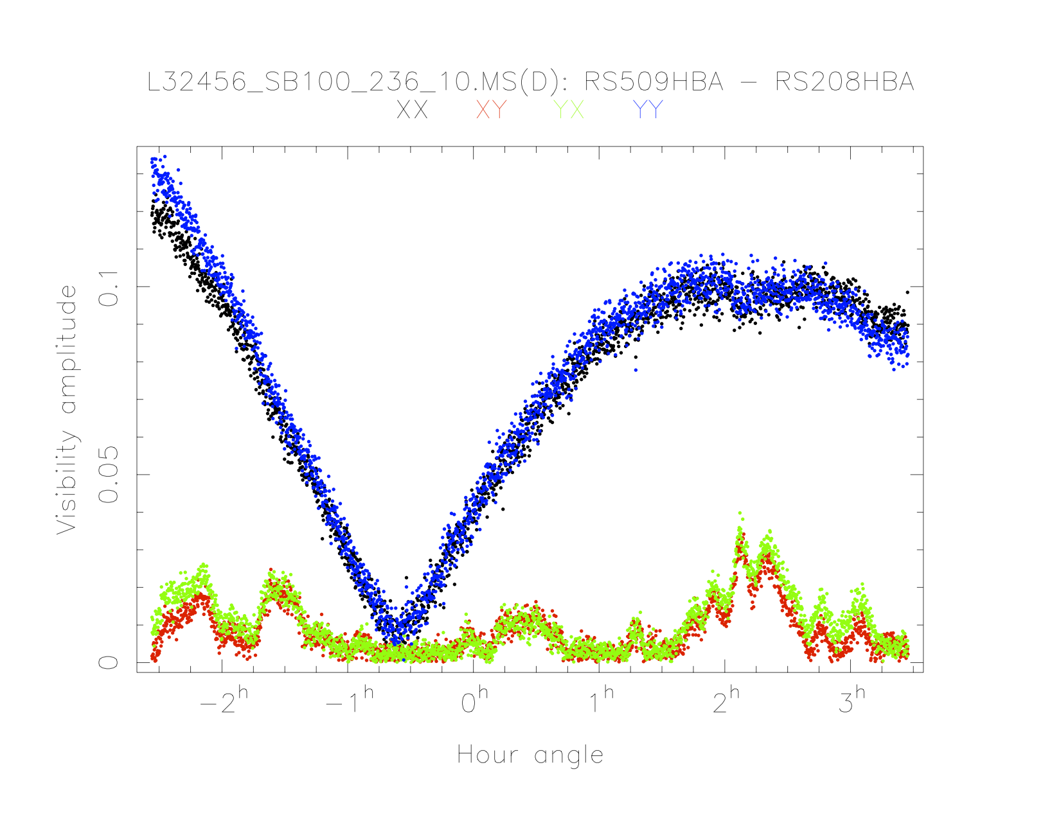
Differential Faraday rotation on a 80 km baseline:
3C295 (5” double) 135 MHz (10s, 0.2 MHz) 14 Oct 2011, 09-15h UT

Slide 33
LOFAR HBA CS SEFD as a function of Frequency
Caution:
depends on adopted flux 3C295
SEFD still higher for several CS
lower by factor 1.3 in typical 6h
synthesis at normal declination
Galactic plane values much
higher (2-3x)

Slide 34
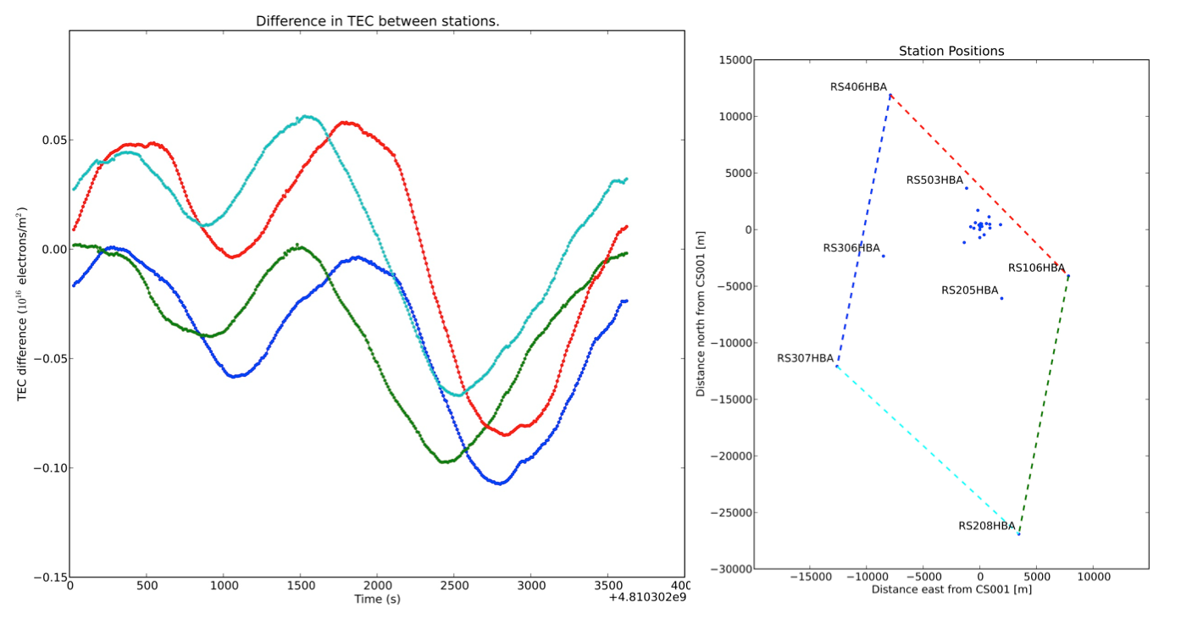
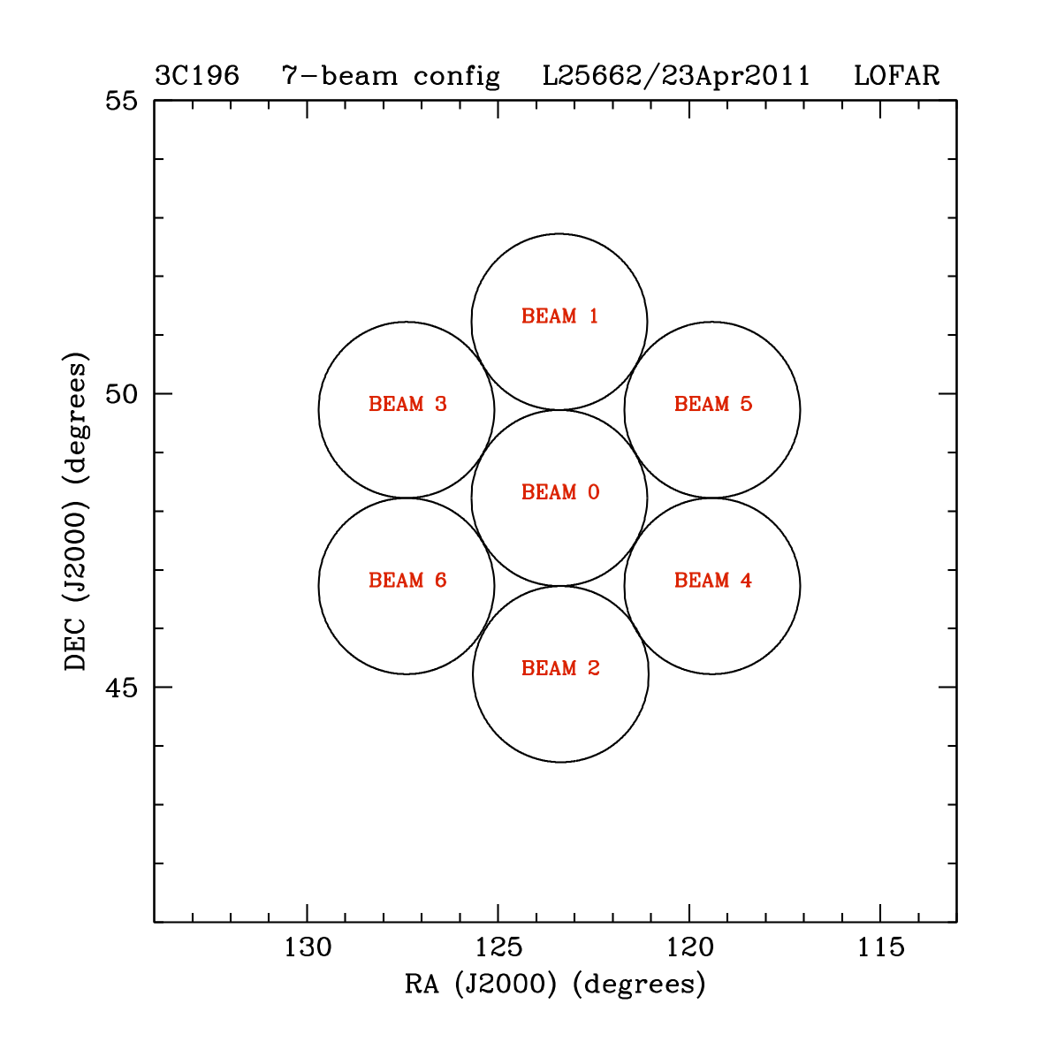
Ionospheric TID’s over LOFAR
Mark Aartsen,
ASTRON 2011 Summer student
AJPD 14 Sep 2011
0.1 TECU
Wave duration ~ 1800s
Delay across ~20 km ~ 300s
TID wavelength ~ 1800/300 x 20 km = 120 km !
Speed 120 km/0.5h = 240 km/h
Direction of wave propagation South → North

Slide 35
Thank you

