Slide 1
The OSKAR Simulator (Version 2!)
AAVP Workshop, ASTRON, 15th December 2011
Fred Dulwich, Ben Mort, Stef Salvini

Slide 2
Overview
OSKAR-2: Interferometer and beamforming simulator package.
Intended for simulations of SKA₁ aperture arrays.
Based on full-sky Measurement Equation formalism.
“Brute force,” 3D, direct evaluation approach.
Takes advantage of large computational power offered by modern GPUs via NVIDIA’s CUDA API.
Scale up to large aperture array interferometer simulation.

Slide 3
Measurement Equation
The ME as implemented by OSKAR-2
Baseline p, q for all visible sources, s.
B – Source brightness.
R – Parallactic angle rotation.
P – Propagation term.
G – Antenna element field pattern.
E – Station beam.
K – Interferometer phase.
V – Complex visibility.
... and any others required!

Slide 4
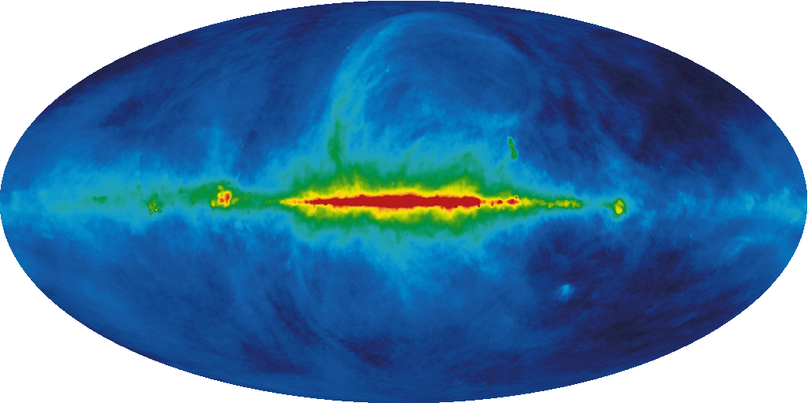
Sky Model
Equatorial point source model.
Extended objects modelled as large collections of point sources.
“Large” could easily be ~ 10⁶ sources across whole sky!

Slide 5
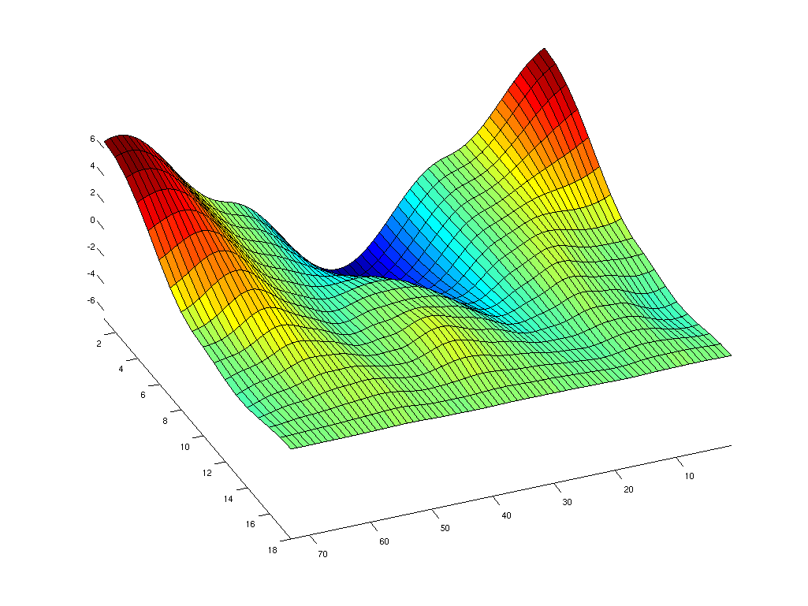
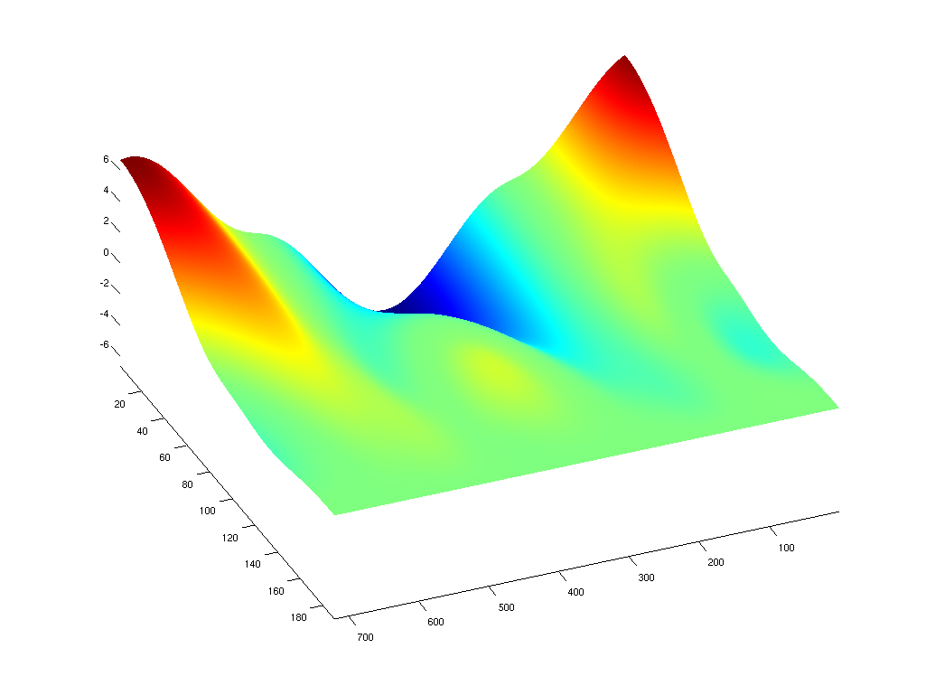
Antenna Field Pattern (G-matrix)
The average embedded element pattern for antennas within a station
Antenna data given in tabular form:
Fit bicubic B-splines to nodal points to construct surface with continuous derivatives.
Evaluate spline coefficients to get antenna response at each source position.

Slide 6
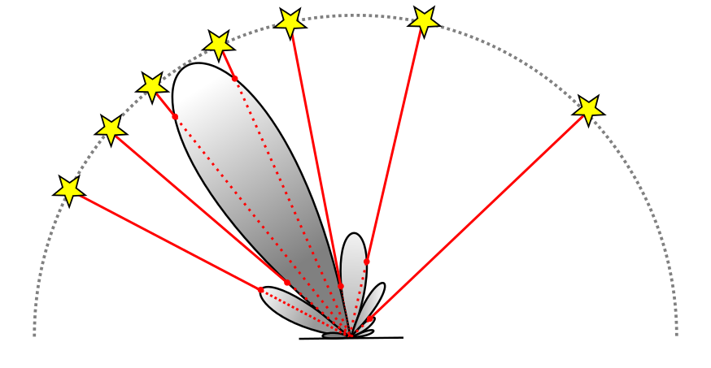
Station Beams (E-matrix)
OSKAR-2 evaluates every station beam (i.e. for every aperture array) at every source position.
This incorporates all effects at the station level, e.g. phase and gain errors, different beamforming schemes, antenna patterns...
GPUs make this feasible!

Slide 7
Station Phases (K-matrix)
K-matrix effectively “phases-up” the array of stations.
Compute phase of each source s at every station a.
Determine station (u,v,w) coordinates by rotating (x,y,z) onto a plane perpendicular to direction of phase centre.

Slide 8
“Correlator”
Multiplies Jones matrices with the source brightness to obtain a complex visibility per source and per baseline.
Time-average smearing: each visibility point can be averaged over time.
K is recomputed to include motion of baseline during integration period.
E is allowed to vary throughout the integration at a slower rate than K.
Bandwidth smearing: multiply each visibility by f_{s,i,j} before collapsing the source dimension.

Slide 9
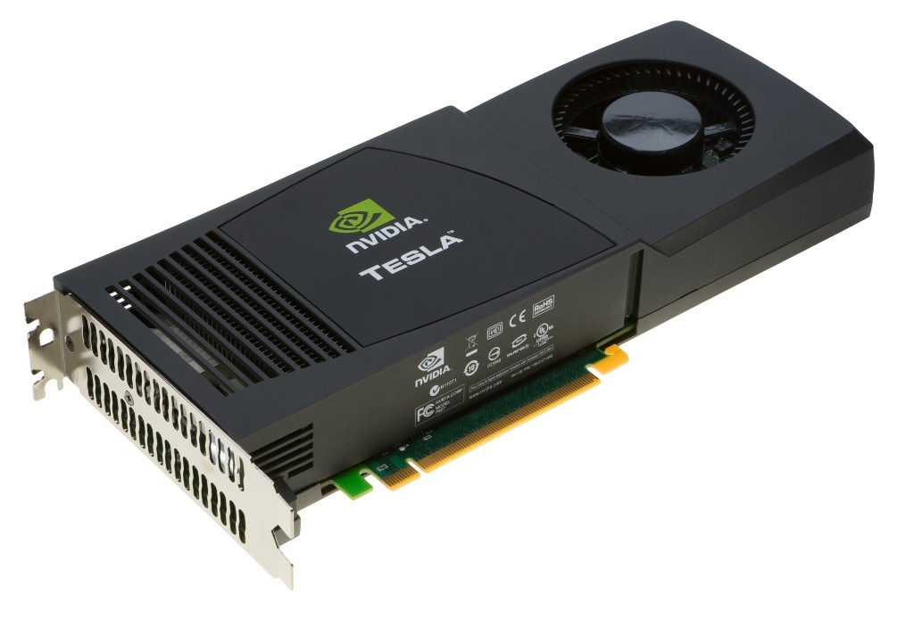
The OSKAR Package
OSKAR-2 consists of a library and some simulation applications.
Simple C interface makes it possible to quickly construct new simulation applications.
Designed to interface easily with other languages
MATLAB
(Python)
All computationally intensive functions carried out using NVIDIA CUDA.
Can be used with multiple GPUs for very large simulations.
Output can be written to measurement set.

Slide 10
Some pseudo-code
oskar_SkyModel sky = oskar_set_up_sky(settings)
oskar_TelescopeModel telescope = oskar_set_up_telescope(settings)
oskar_SimTime times = settings.times
vis_amp = function oskar_interferometer(sky, telescope, times, freq)
oskar_Jones J, R, E, K
oskar_Mem vis_temp, u, v, w
for j = 1:num_visibility_dumps
vis_temp.clear_contents()
for i = 1:num_visibility_averages
time = oskar_evaluate_sidereal_time(times, j)
R = oskar_evaluate_jones_R(sky, telescope, time)
E = oskar_evaluate_jones_E(sky, telescope, time)
R = oskar_jones_join(E, R)
for k = 1:num_fringe_averages
time = oskar_evaluate_sidereal_time(times, j)
[u, v, w] = oskar_evaluate_station_uvw(telescope, time)
K = oskar_evaluate_jones_K(sky, u, v, w)
J = oskar_jones_join(K, R)
vis_temp = oskar_correlate(vis_temp, J, sky, telescope, u, v)
end
end
vis_amp.insert(vis_temp, j)
end
end

Slide 11
Some results from OSKAR-2

Slide 12
Simulation Example: AA station setup
Offset grid geometry.
~80m diameter.
~2600 antennas.

Slide 13
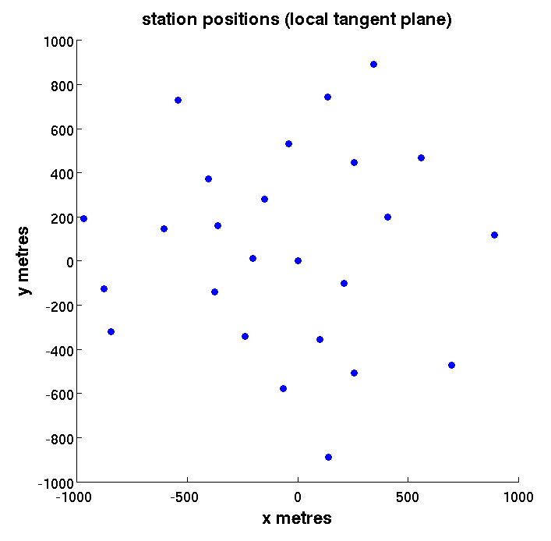
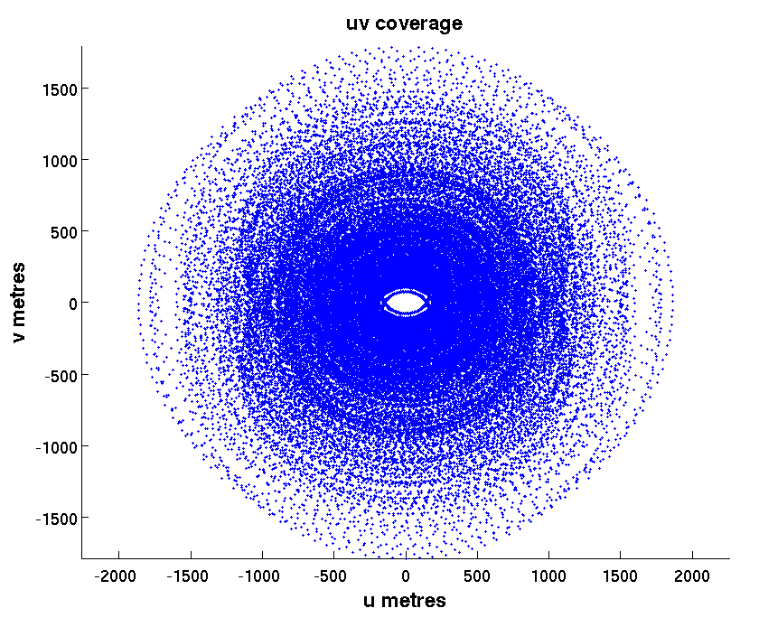
Simulation Example: Telescope setup

Slide 14
Simulation Example: Observation setup
Telescope at ASTRON!
24h observation in direction of Cas-A

Slide 15
Simulation Example: Beam pattern

Slide 16
Simulation Example: Dirty image snapshots

Slide 17
Timing results
2x Xeon X5650 @ 2.67GHz, 24 GB DDR3.
2x NVIDIA C2070 (GF110) 6GB.
Compute 2.0 (Fermi)
448 CUDA cores.
1 channel, 4 polarisations
25 AA stations.
1,080 M.E. evaluations
E Jones updated every 60 evaluations

Slide 18
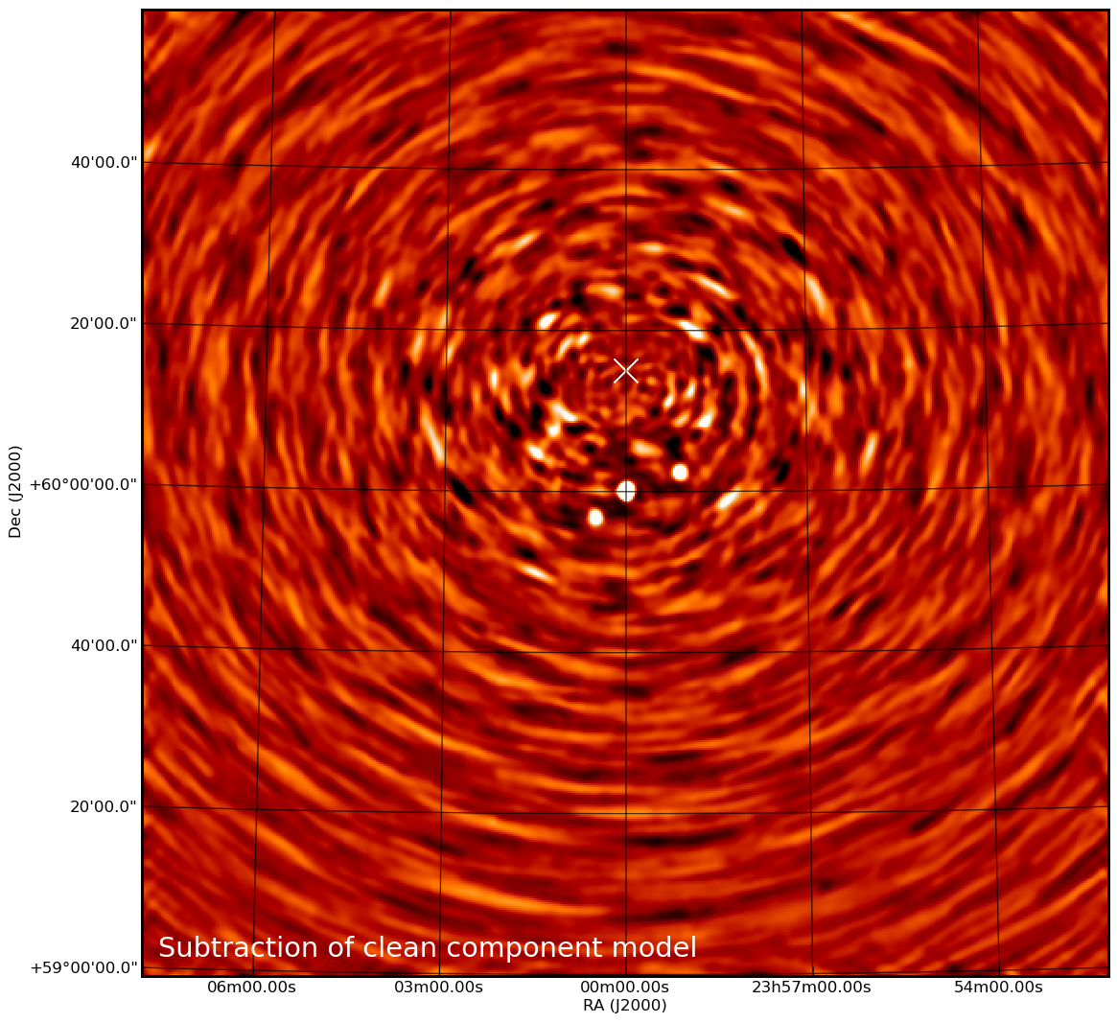
Imperfect source subtraction
Bright interfering source on the flank of the station beam at position X.
A number of other sources scattered over the sky.
Because the source has effectively become highly time-variable, a simple subtraction of its clean-component model leaves large residuals.
Limits dynamic range of image.

Slide 19
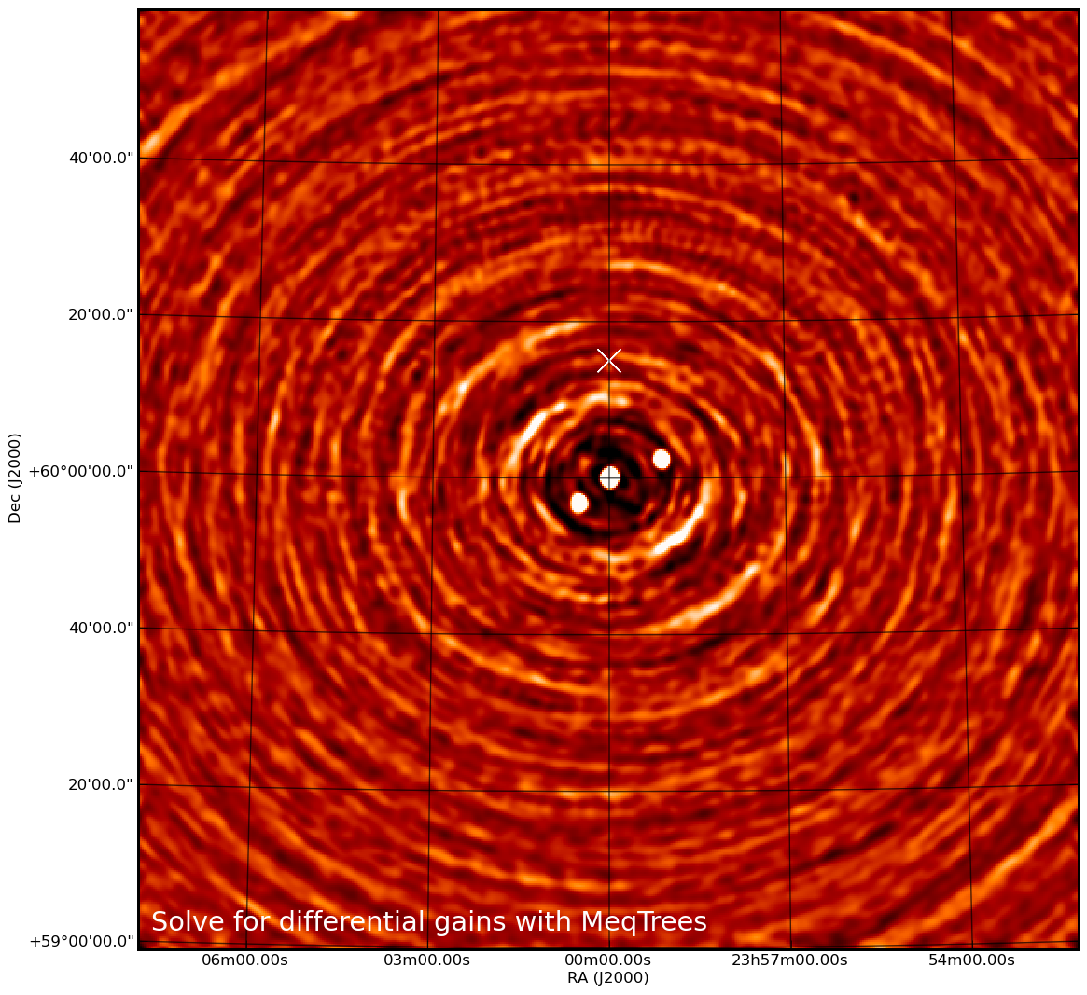
Source removal
Solving for differential gains in MeqTrees (Ian Heywood) is far more effective.

Slide 20
Next Steps
Element pattern evaluation (in progress).
Simple treatment of noise (in progress).
Antenna gain and phase errors (as in OSKAR 1).
Hierarchical beamforming schemes (as in OSKAR 1).
Extended sources.
Digitisation effects.
Testing sky noise from large source databases.
Running some large simulations!

