Slide 1
SKA1-low: Cost Considerations
AAVP Meeting, ASTRON
14 December, 2011
Tim Colegate, Peter Hall (ICRAR/Curtin)
Andre Gunst (SPDO/ASTRON)

Slide 2
Motivation, caveats
Consider single versus dual-band SKA-low implementation from a cost perspective
See also performance issues raised by Alexander and Hall (2010), and others
Recognize that useful cost data is available
Various pathfinders, design studies (SKADS) and industry analyses
Inhomogeneous formats
Incomplete across all system blocks
Variable reliability
Recognize use of different costing methodologies
Parametric
Reference class
Bottom up
Recognize that SKA-low architecture is still to be defined
Single-band or dual-band receptors?
RF or digital front-end beamforming?
...
Recognize that incremental costing between scenarios is sometimes more feasible than absolute costing
e.g. Site submission infrastructure estimates still confidential

Slide 3
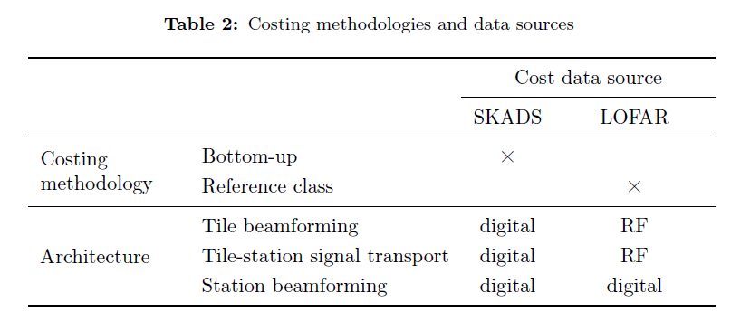
Cost estimation matrix
At least three axes for input data characterization
Data source, basis of estimate, system architecture
We work with a limited subset of the parameter space
LOFAR or SKADS data (Faulkner et al., AA CoDR, 2011)
Reference Class or Bottom Up costing inputs, to form a scalable Parametric model
RF or digital first-stage beamforming and signal transport

Slide 4
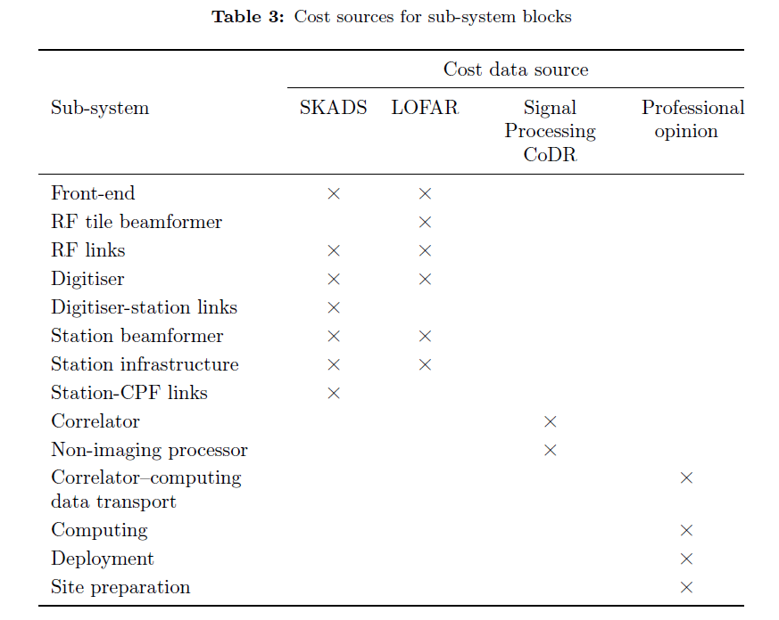
Data sources

Slide 5
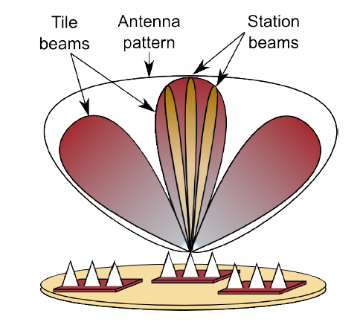
Definitions

Slide 6
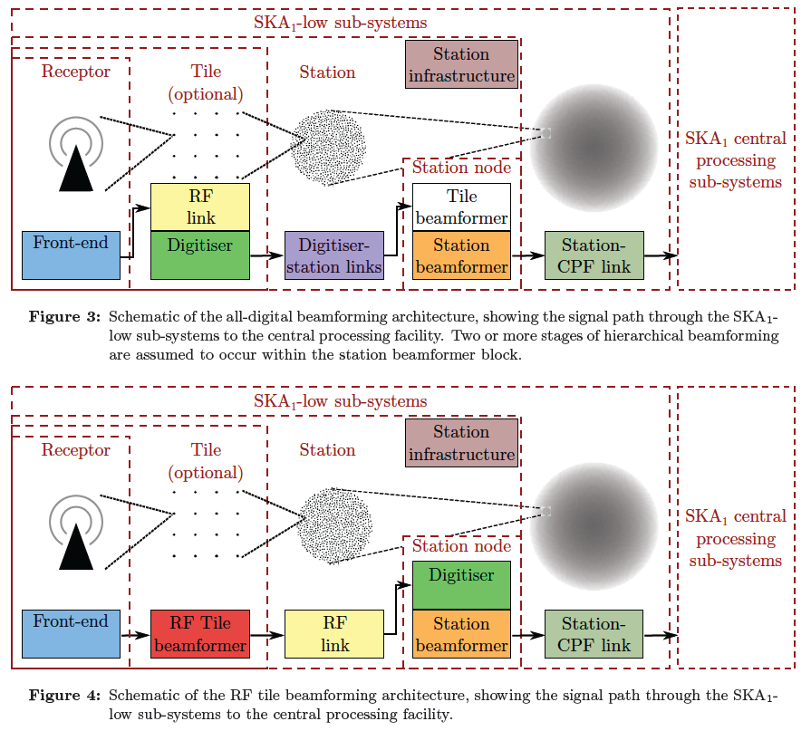
Station front-end architectures

Slide 7
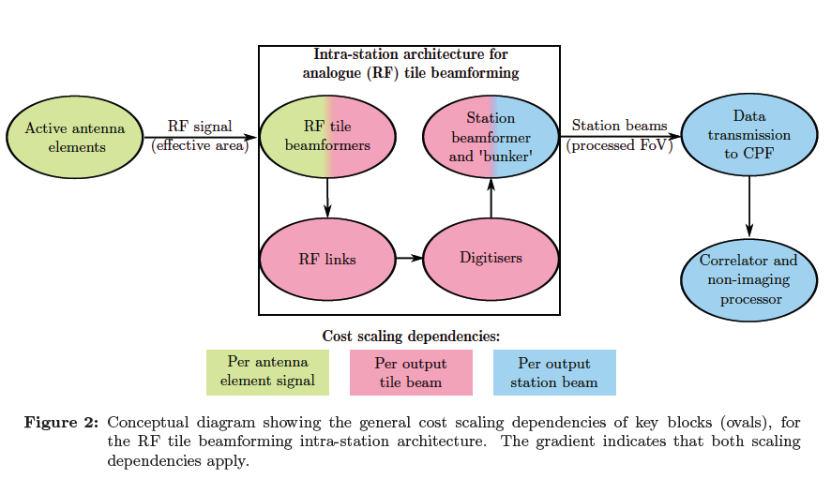
Parametric scaling – RF b/f example

Slide 8
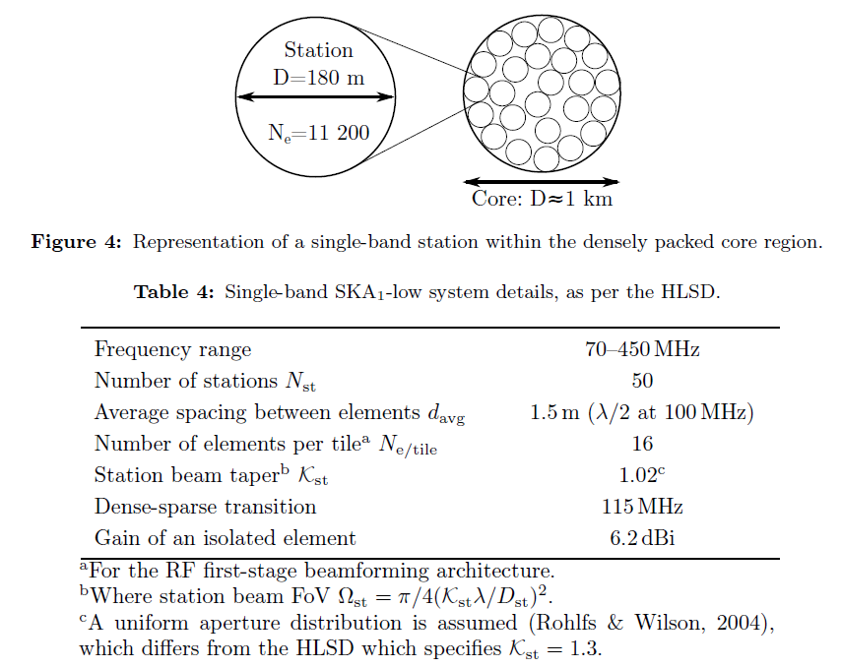
SKA1-low: single-band model

Slide 9
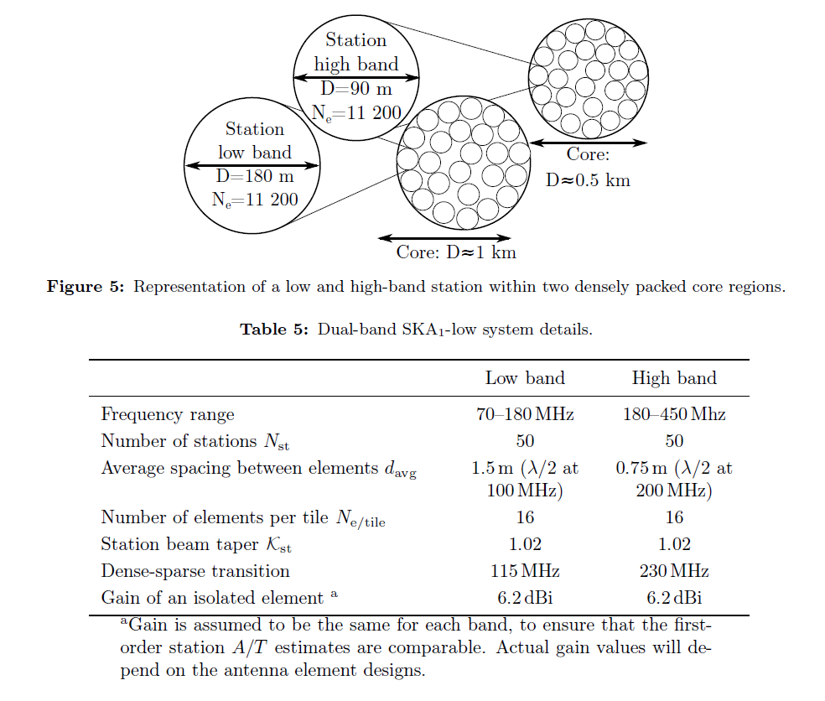
SKA1-low: dual-band model

Slide 10
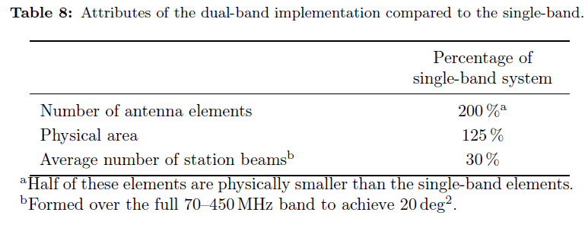
Dual-band vs. single-band derived parameters
Fewer station beams → lower processing cost
Single-band station is large and very sparse at high frequencies; lots of station beams to meet FoV spec.
More signal chains in dual-band before station beamforming → more cost

Slide 11
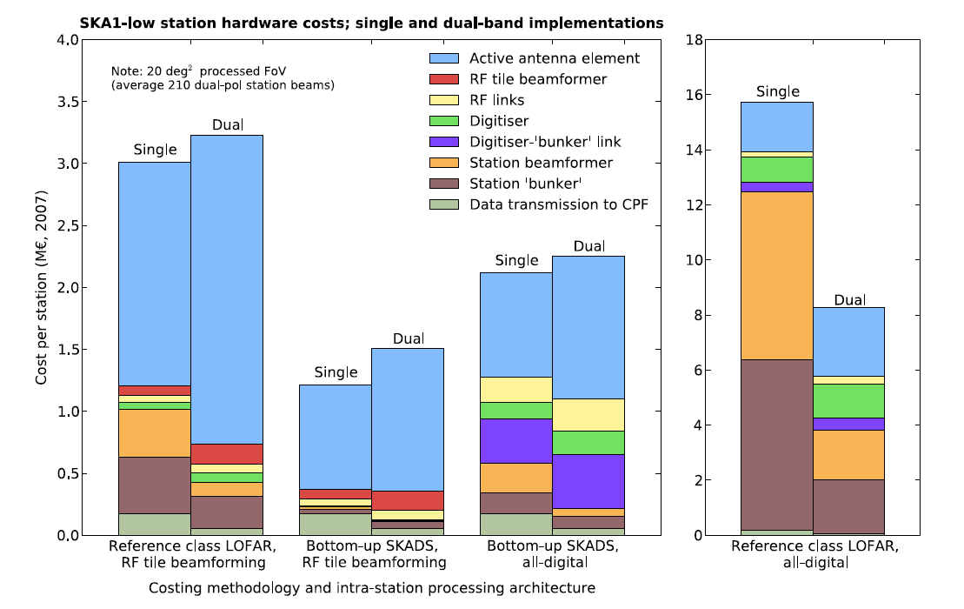
Station hardware costs compared

Slide 12
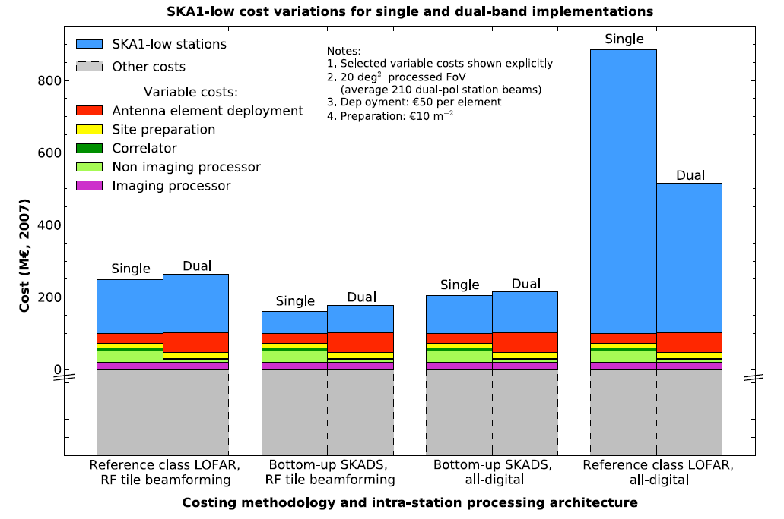
Overall costs compared

Slide 13
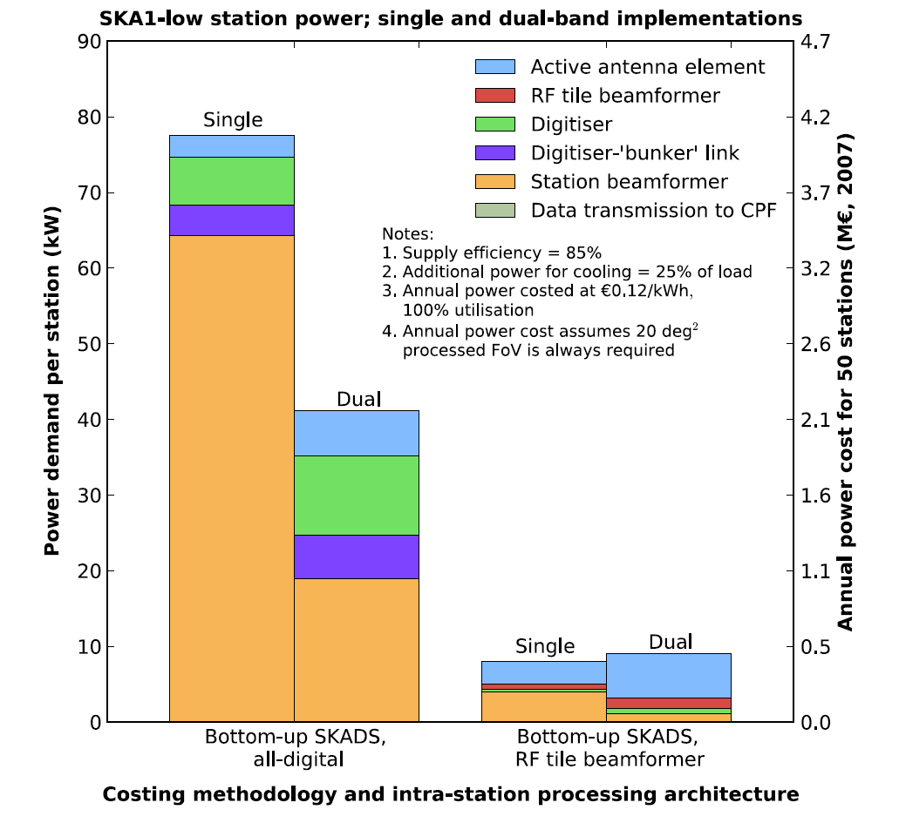
Aggregate station power consumption

Slide 14
Conclusions
Assumption that “single-band is cheaper” is too simplistic
For 3 out of 4 cases considered, single-band is slightly cheaper but the difference is lost in estimation uncertainty
Single-band costs are highly dependent on station beamforming costs
Especially important to get better estimates
No attempt has yet been made to optimize SKA-low architectures
The RF and digital beamforming arrangements discussed are representative only
Important not to confuse ‘single-band’ with ‘high-gain’ element discussions
High-gain may save money in either single or dual-band SKA-low
RF beamforming saves power and may be more tractable in e.g. solar-powered arrays
Operational and lifetime support costs need to be included in more complete analyses
Cost is only one half of the equation
Performance is critical
Cost to achieve a particular performance is the required estimator
e.g. no point building a “cheap” single-band array, then spending a fortune on computing capex and opex in order to calibrate it
Our small study is indicative of where cost estimate refinement is needed

Slide 15
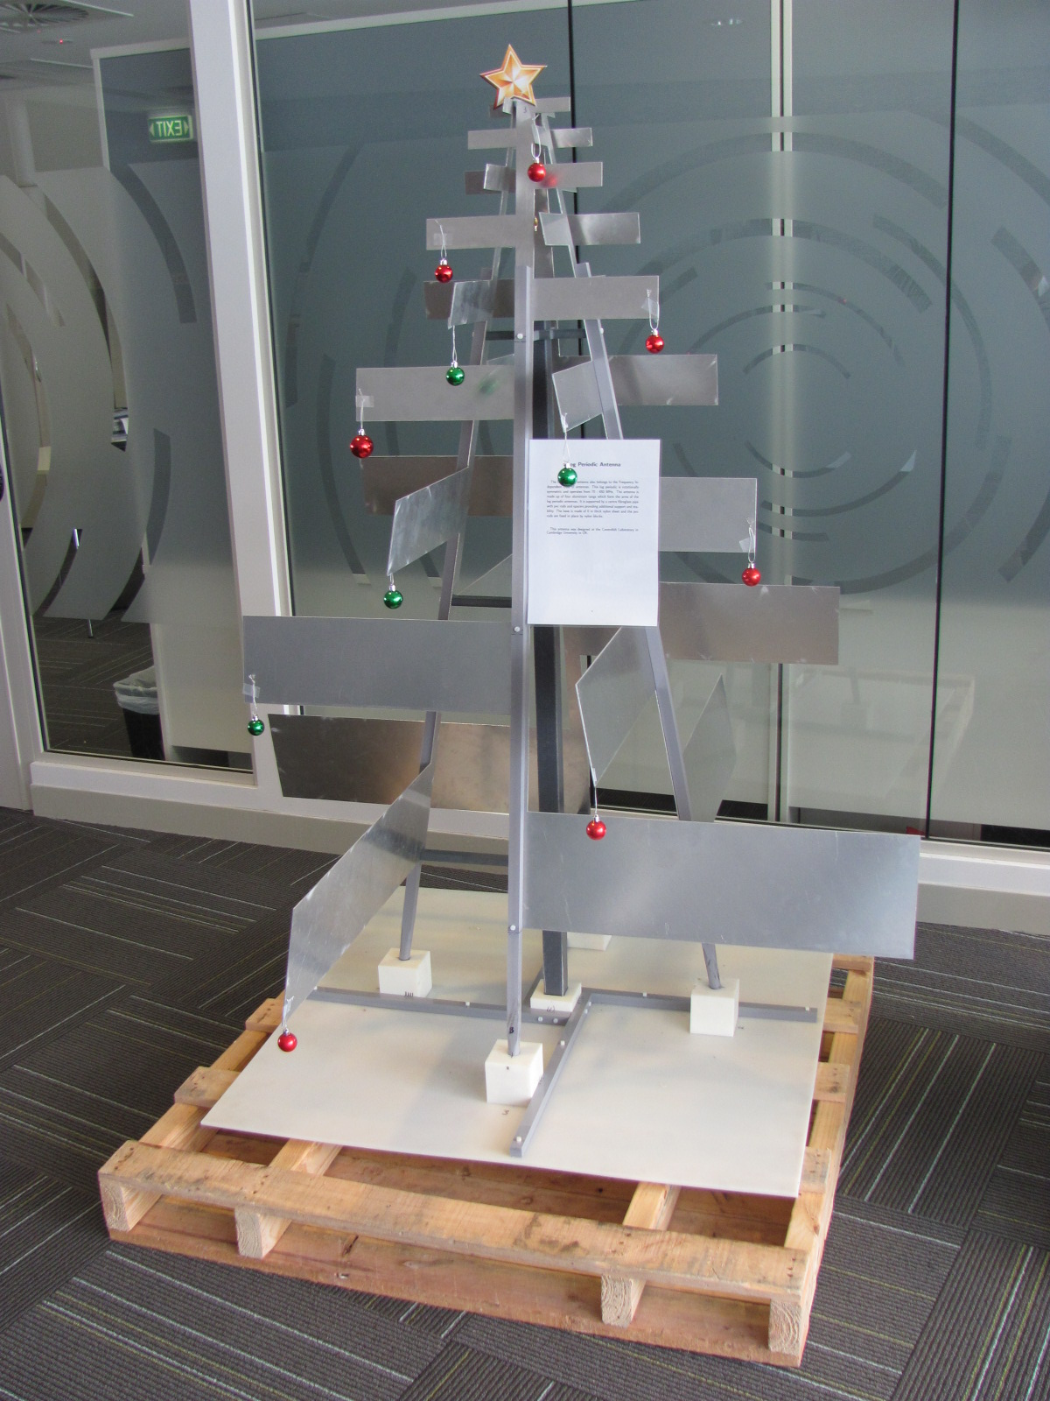
Single-band element spin-offs

