Slide 1
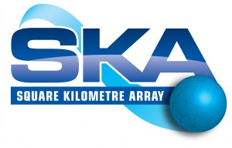

SKA AA-low:
LPD antenna (SKALA) & path towards AAVS0 at Cambridge
Eloy de Lera Acedo
University of Cambridge

Slide 2
Overview
Introduction
Current status of SKALA (LPD antenna)
Low Noise Amplifier for SKALA
SKALA tests and AAVS0 (16-element array)
Important numbers
Summary and conclusions

Slide 3
Introduction
Parameter | Specification |  | Remarks
Low frequency | MHz | 70 | Lowest frequency expected for the EoR
Nyquist frequency | MHz | 100 | Frequency with element spacing is λ/2, defines max A­_{eff}
High frequency | MHz | 450 | Freq where sky noise is low, overlaps with AA-hi and/or dishes
Frequency coverage |  | contiguous | There are no gaps between low and high frequency
Bandwidth, max | MHz | 380 | Individual beams can operate over the full frequency range
Polarisations |  | 2 | Orthogonal
Station diameter | m | 180 | Determined from SKA₂. Uses 250 arrays for expected SKA₂ sensitivity
Geometric area | m² | ~25,000
No. of element types |  | 1 | A single wide-band element type e.g. bow-tie or conical spiral
No. of elements |  | ~10k | Each element is low gain, dual polarisation
Scan angle range | deg | ±45 | Will operate at larger scan angles, but sensitivity not defined
Sensitivity @ 100 MHz | m²/K | 17 | Single array, sensitivity varies over the band. Assumes T_{sky}= 1000K, 70% for appodisation.
Frequency channel | kHz | 250 | Assumes 2048 channels splitting the full sample rate, further channelization will be required at correlator
Output data rate | Tb/s | 16 | Defines the survey performance of the array. Can be used flexibly for frequency, bandwidth and number of beams

Slide 4
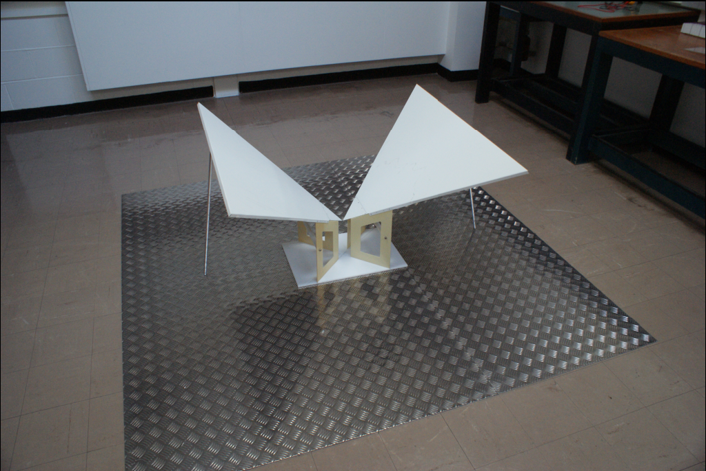
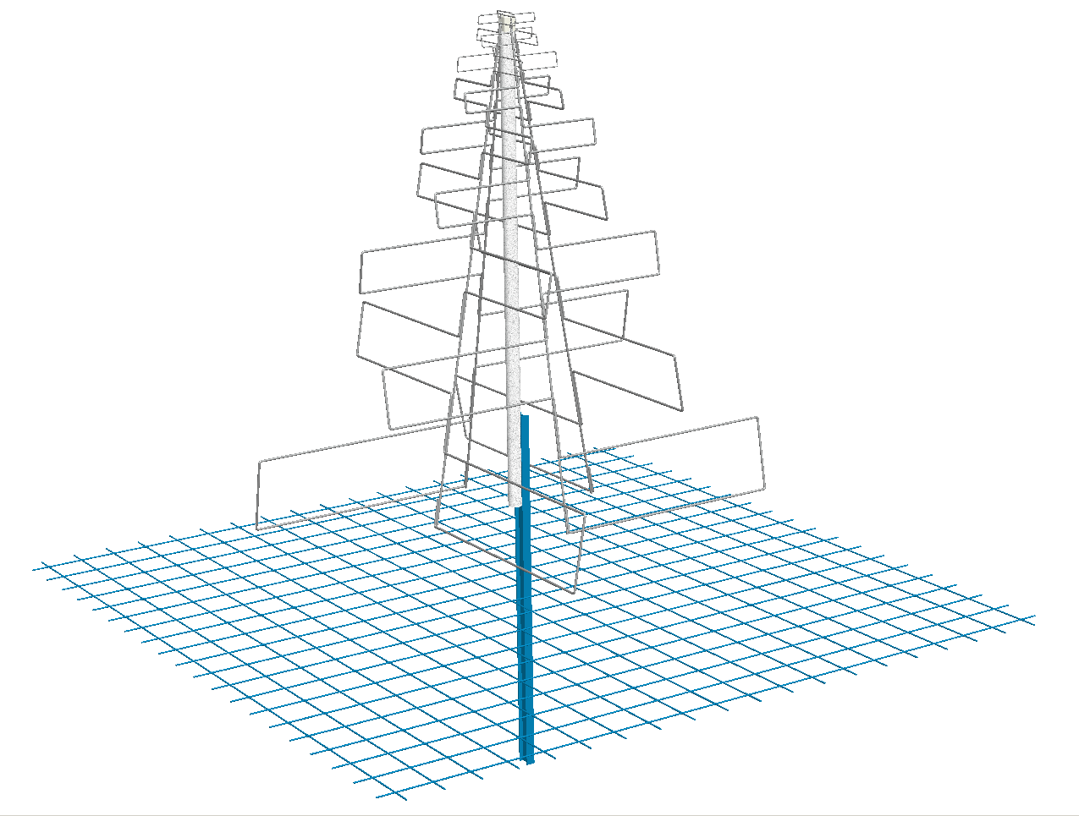
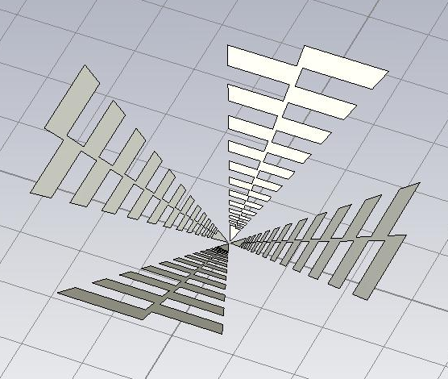
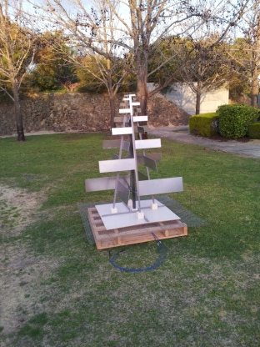
Evolution: from BLU to SKALA
Impedance
Dual polarisation
Sky coverage
Cost
BLU
Impedance
Dual polarisation
Sky coverage
Cost
Impedance
Dual polarisation
Sky coverage
Cost
w-SKALA
Toothed log periodic
Impedance
Dual polarisation
Sky coverage
Cost
SKALA

Slide 5
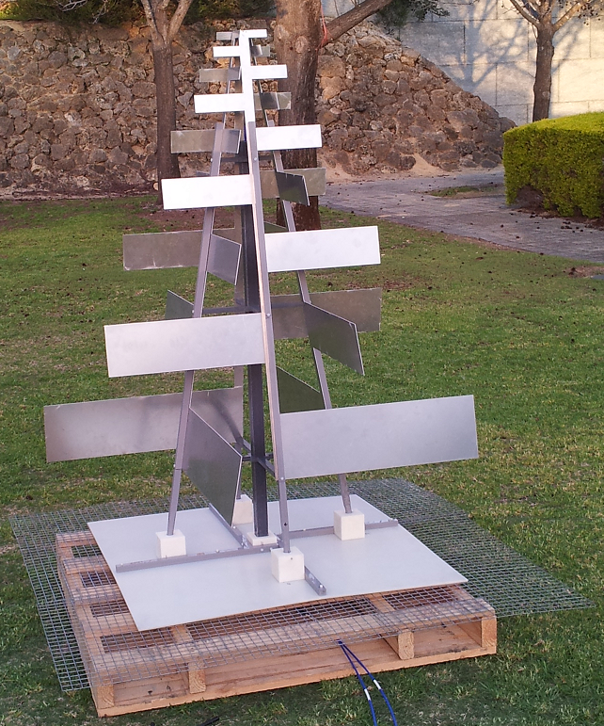
SKALA: SKA Log-periodic Antenna
1.6 m
1.3 m
* GND mesh is 1.5 x 1.5 m.

Slide 6

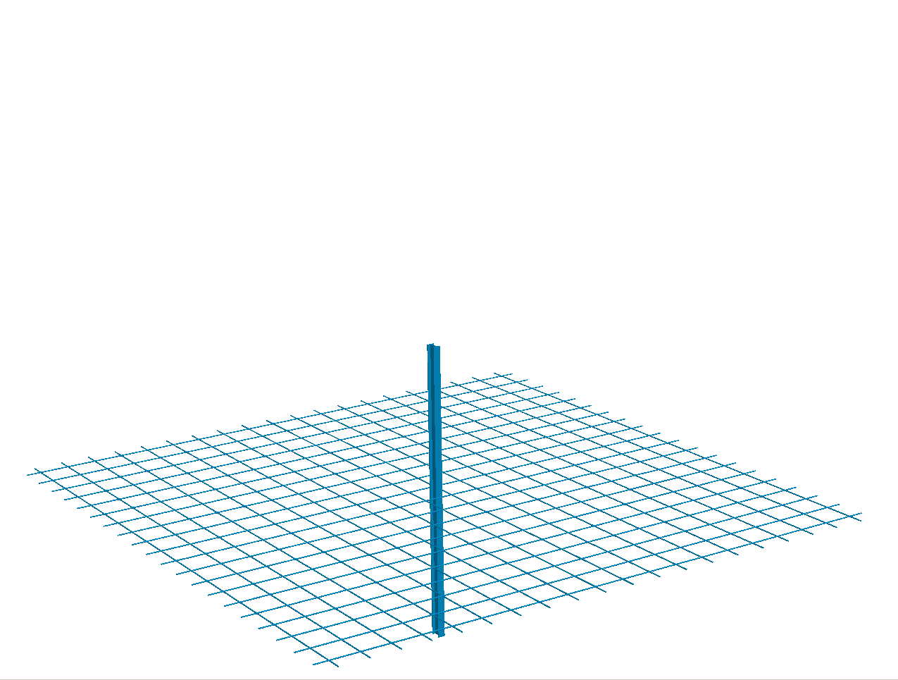
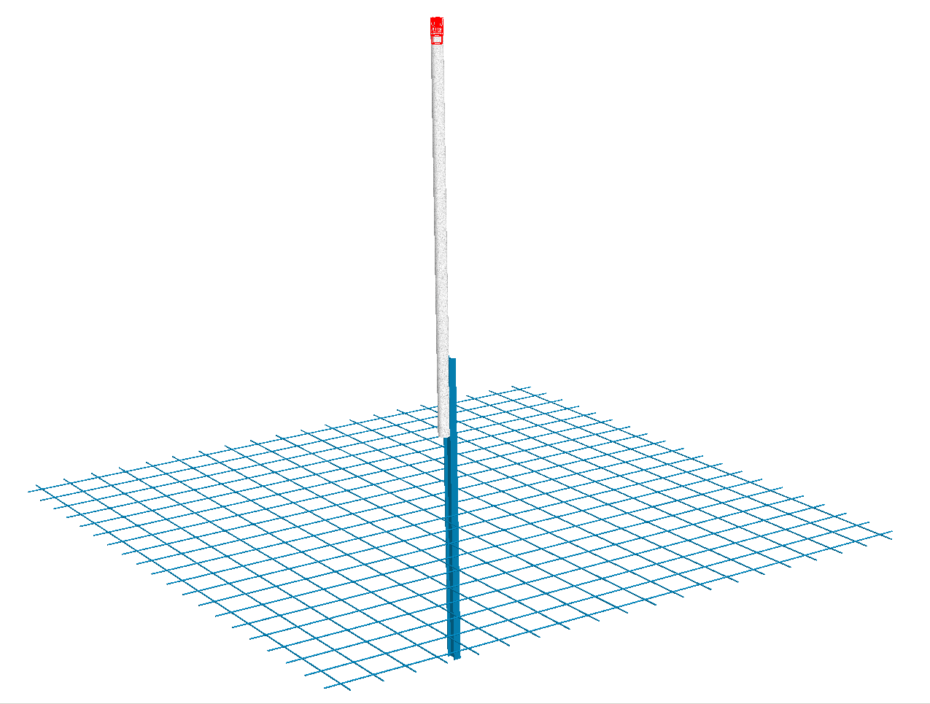
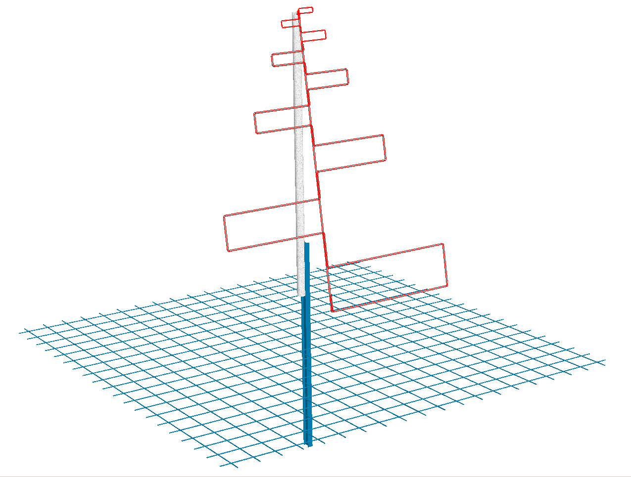
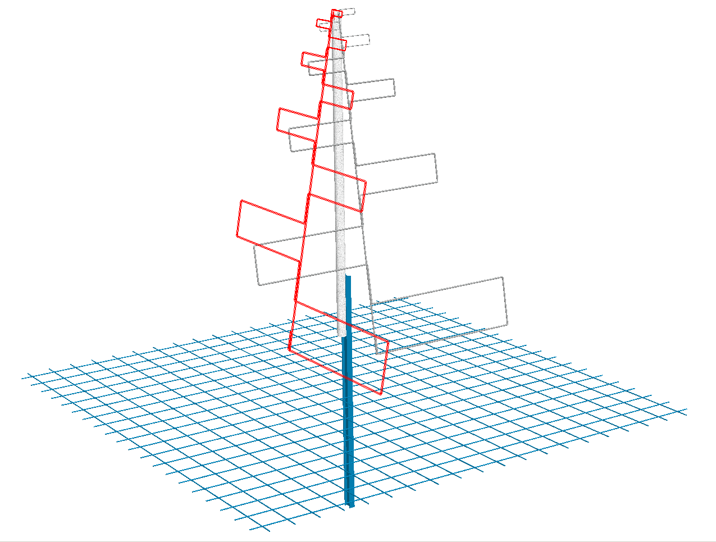
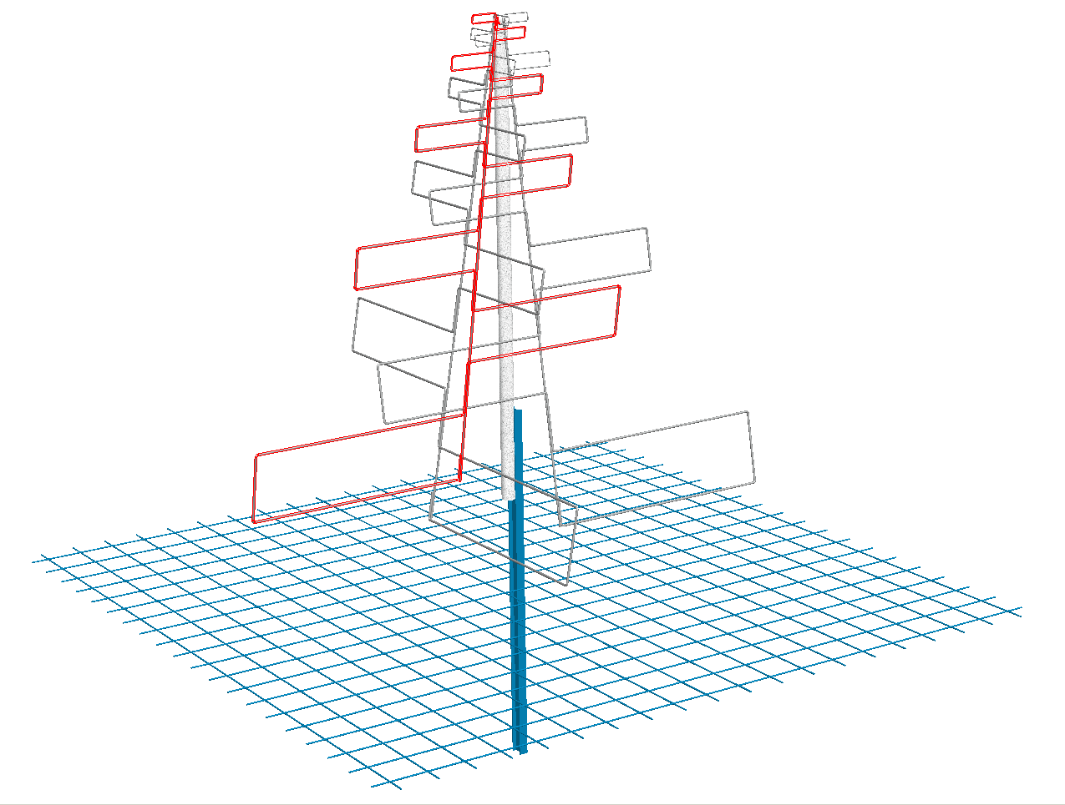
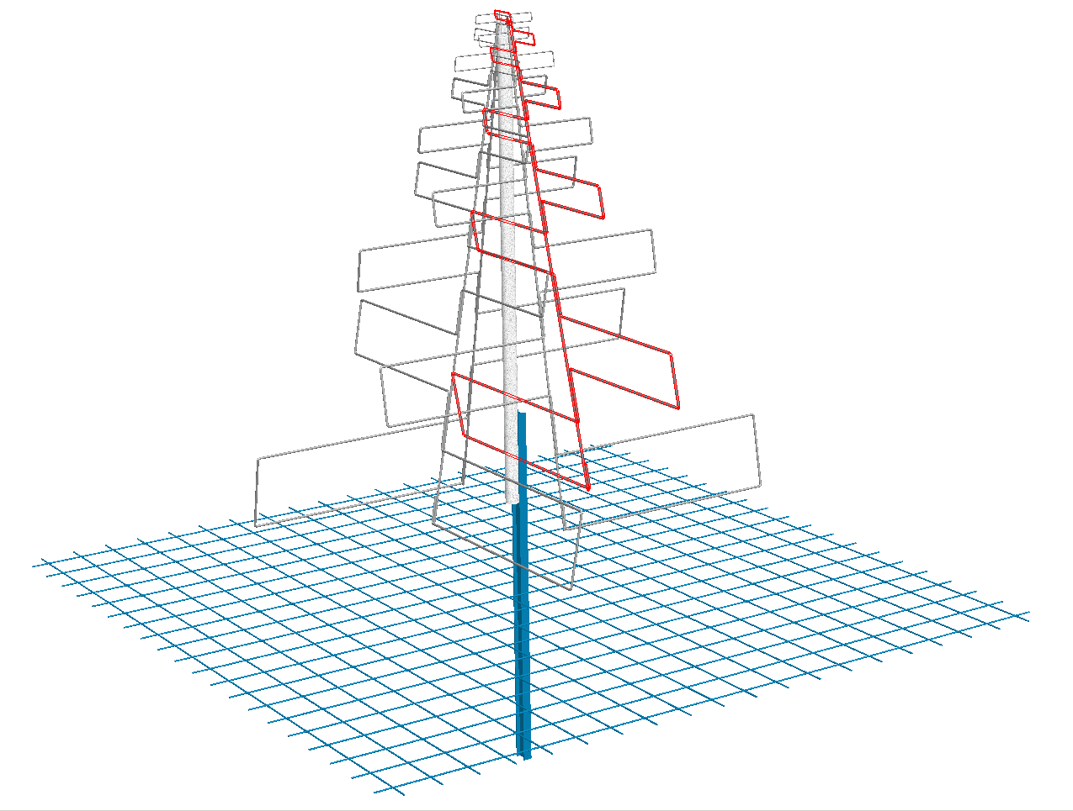
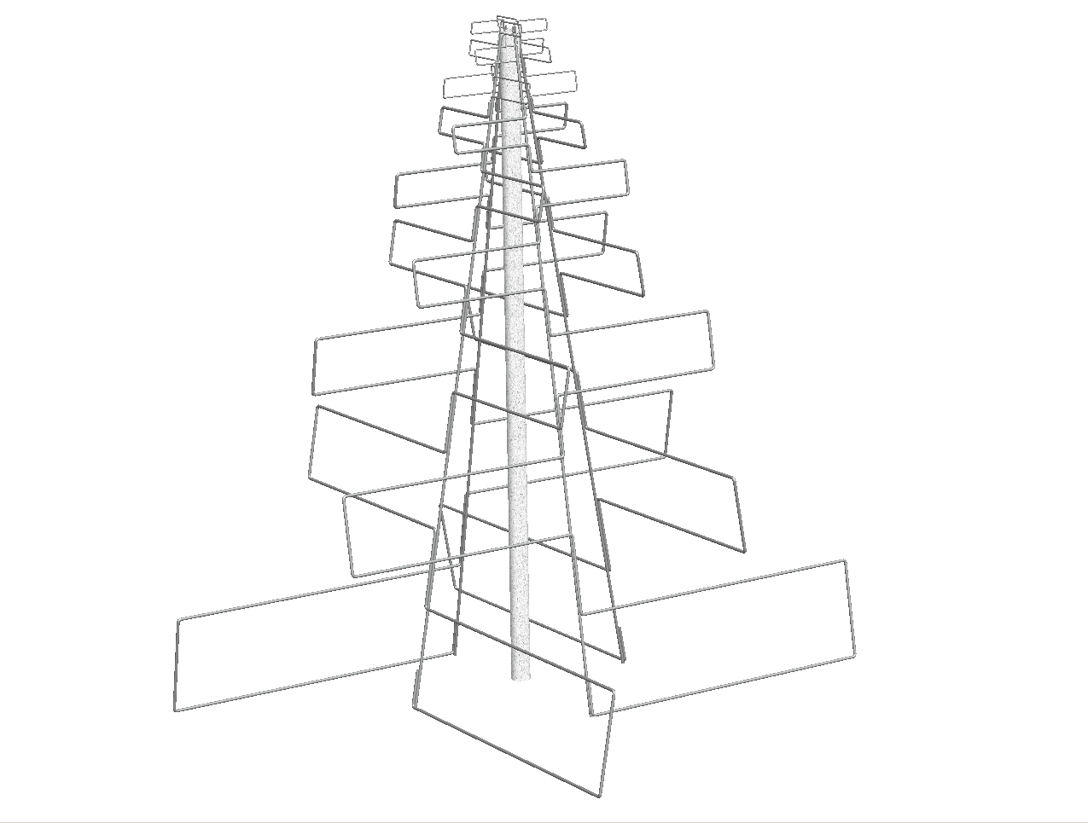
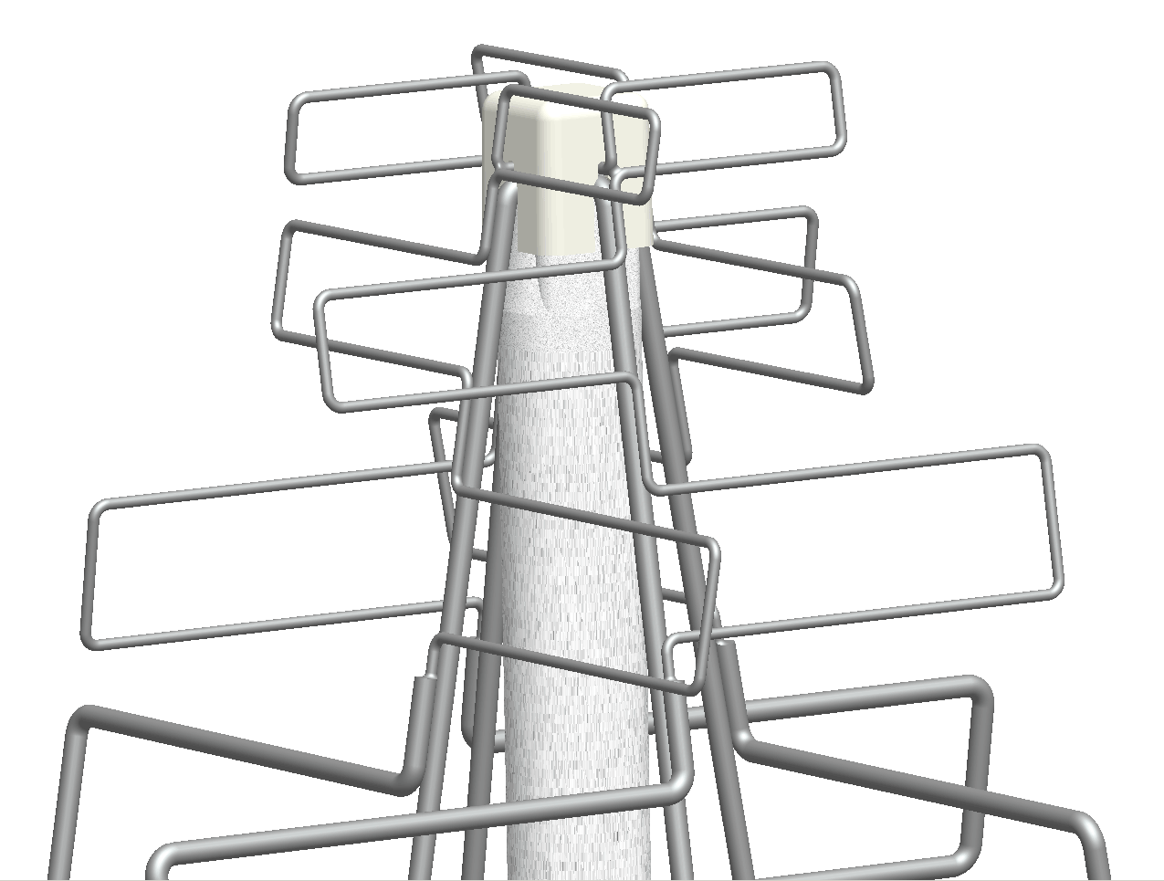
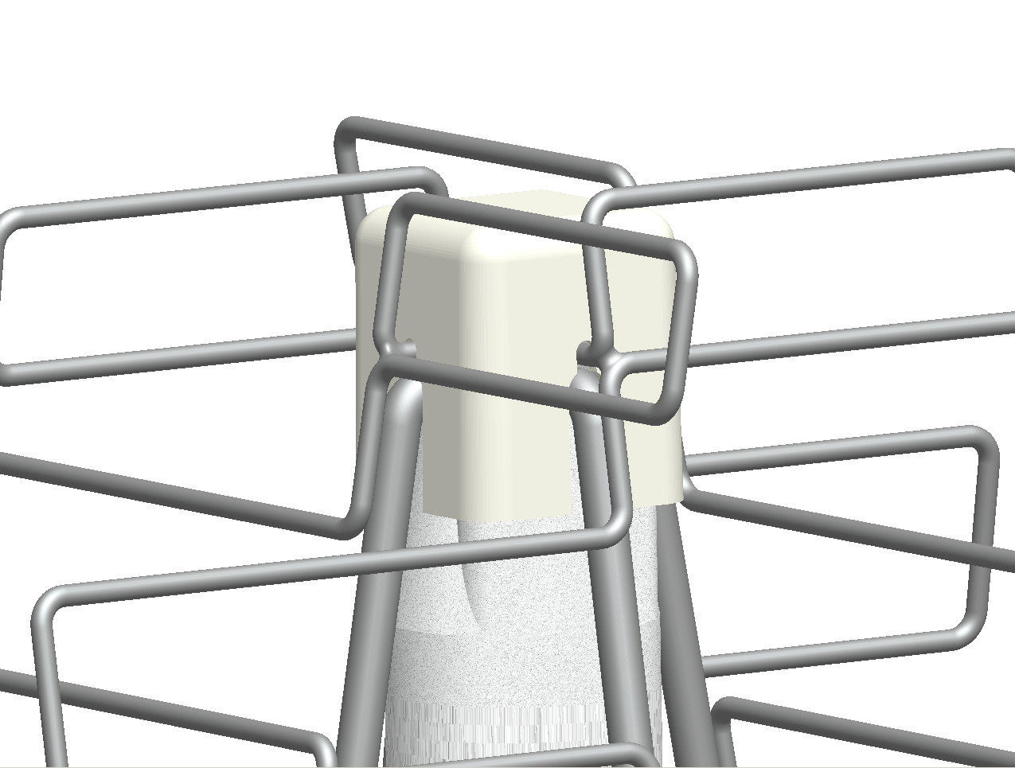
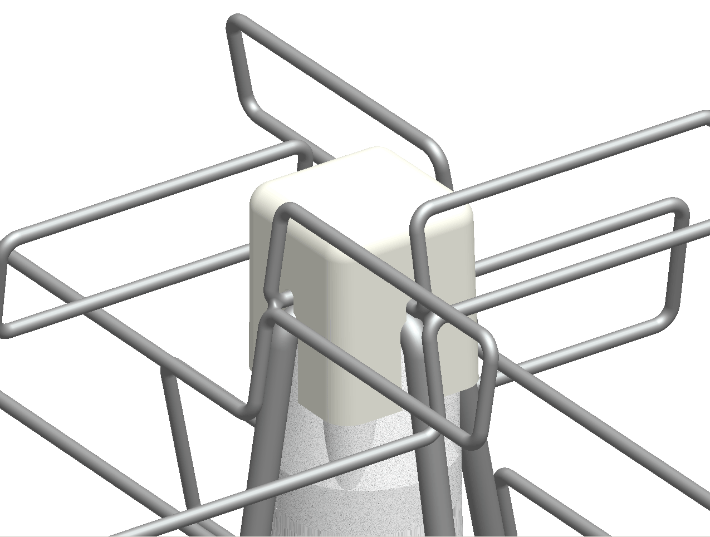
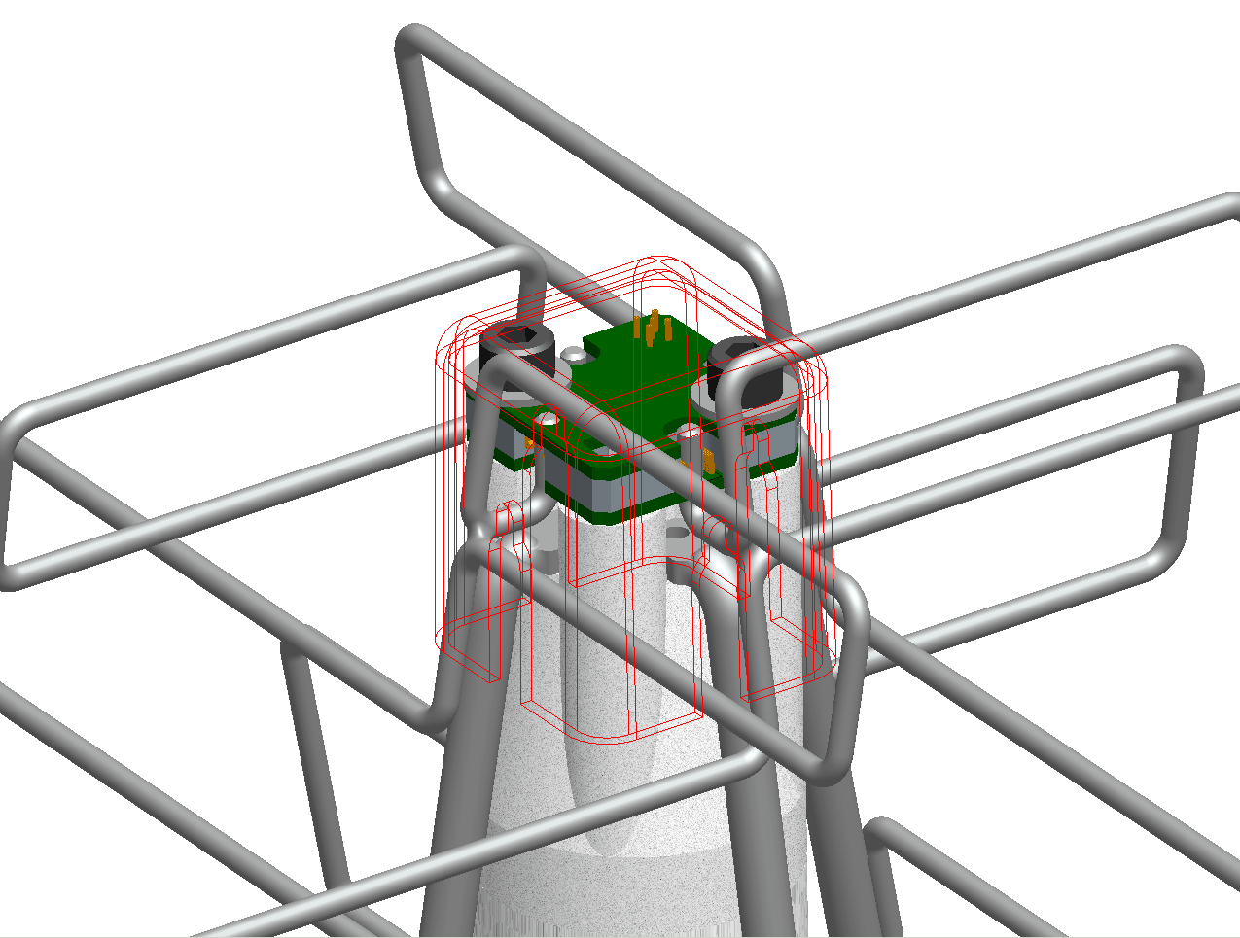
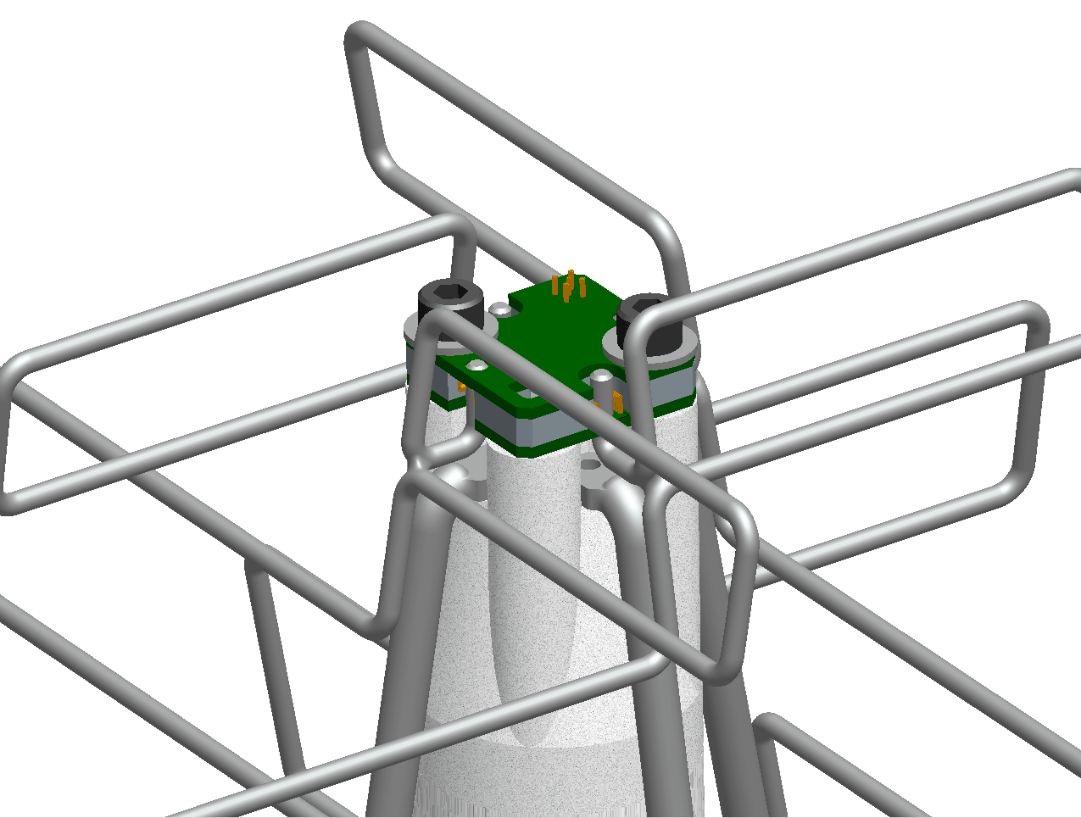
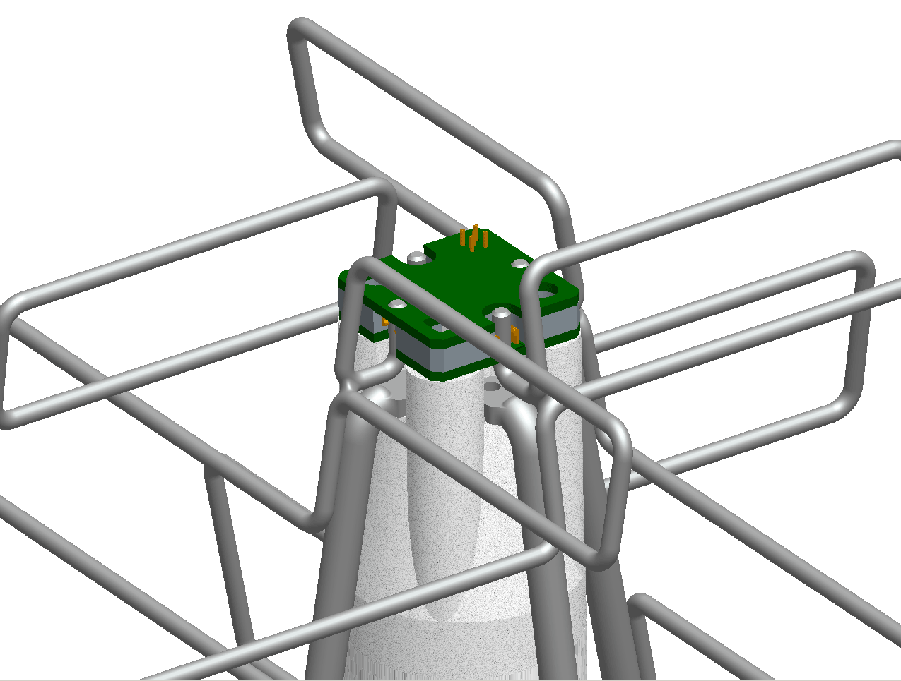
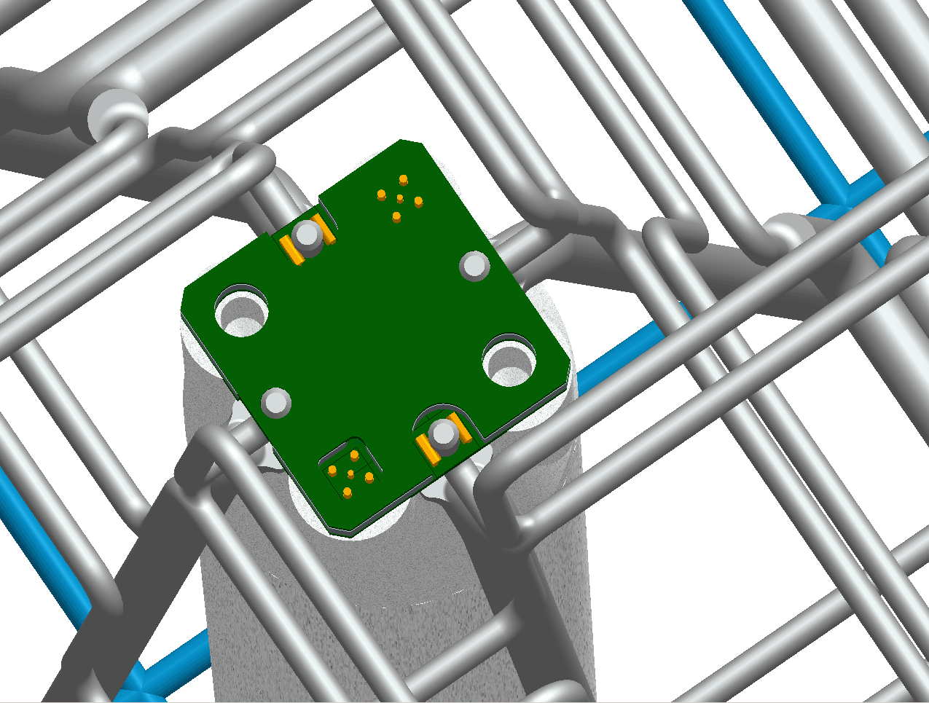
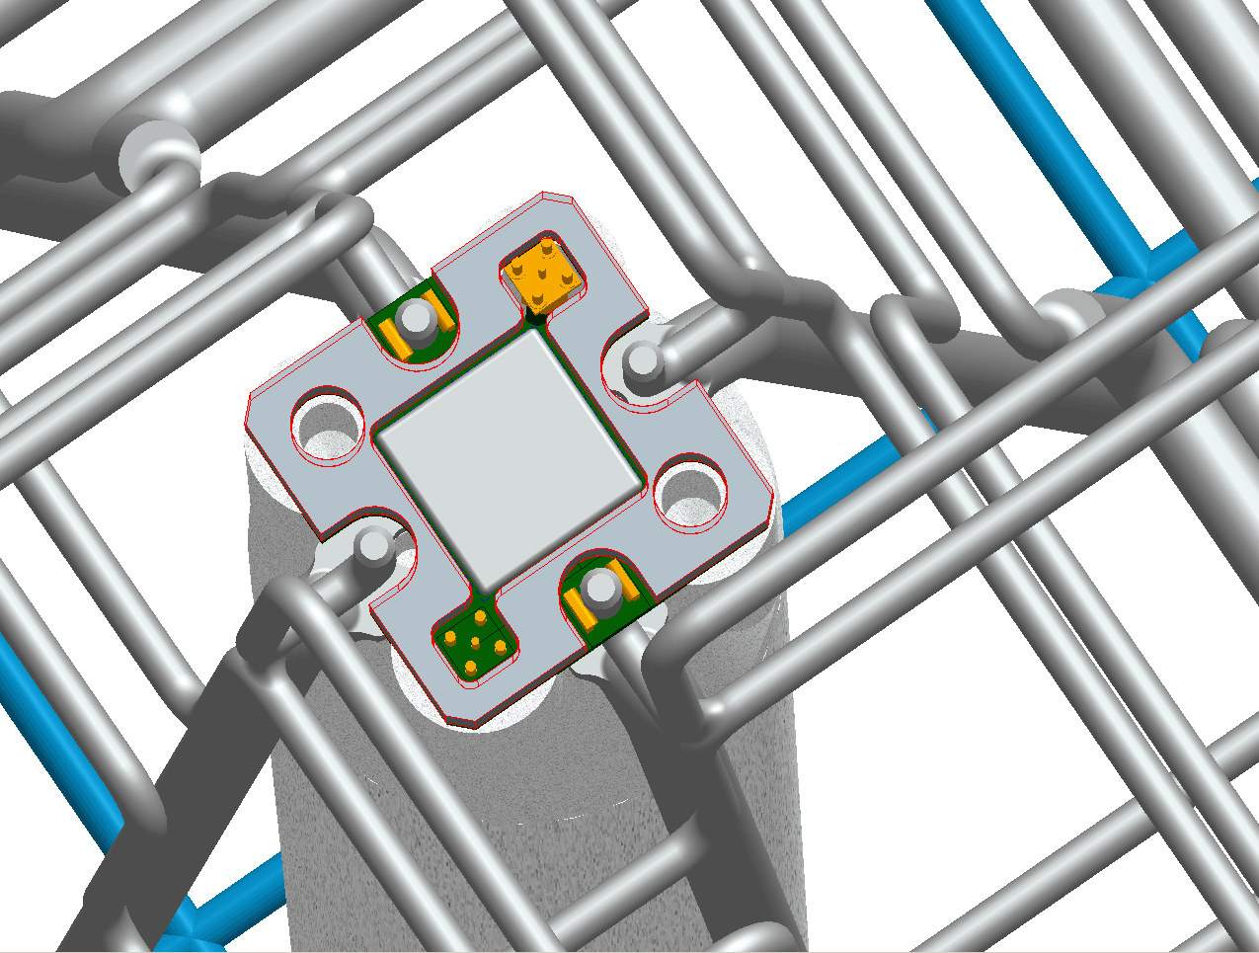
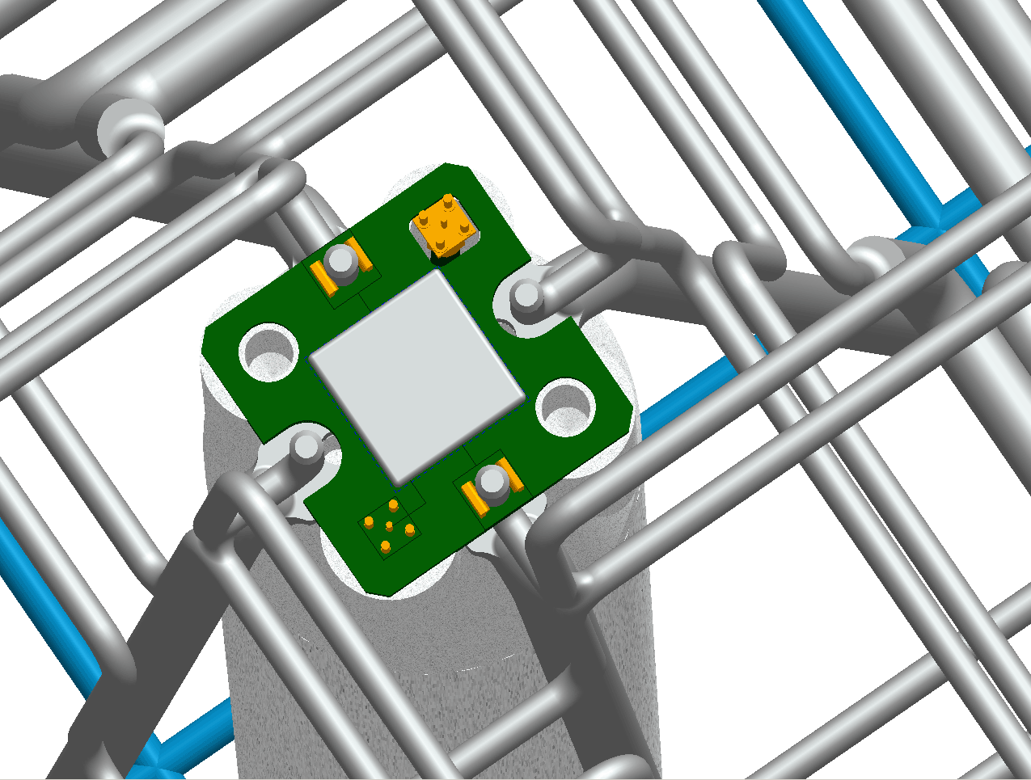
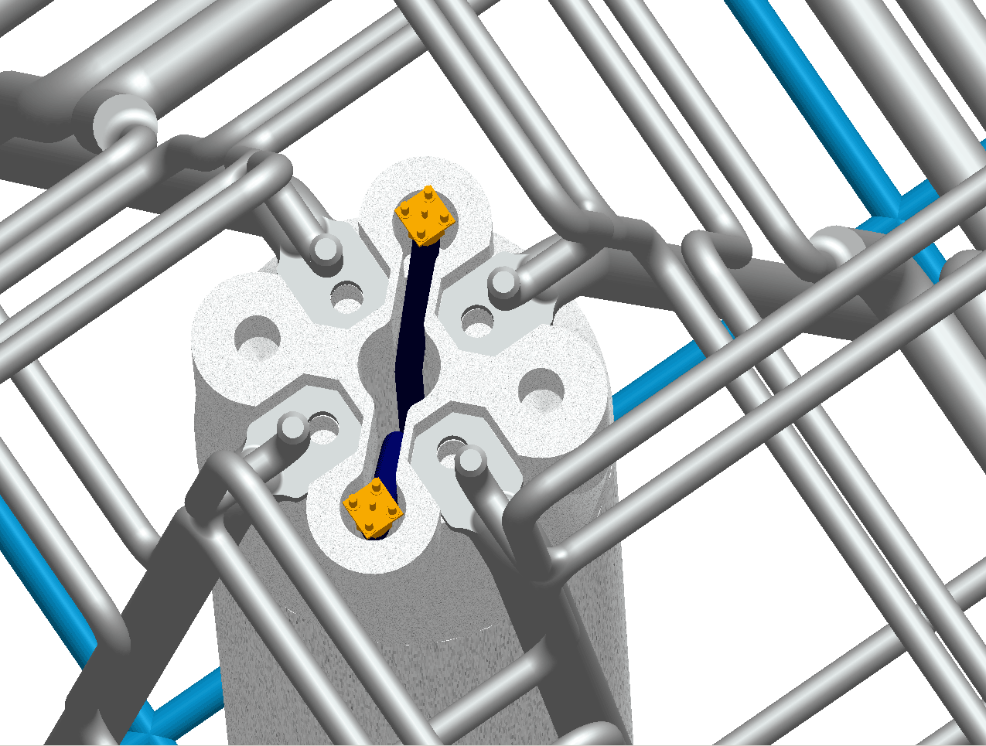
Current status of SKALA
Notes:
The LHC of RA
2016

Slide 7
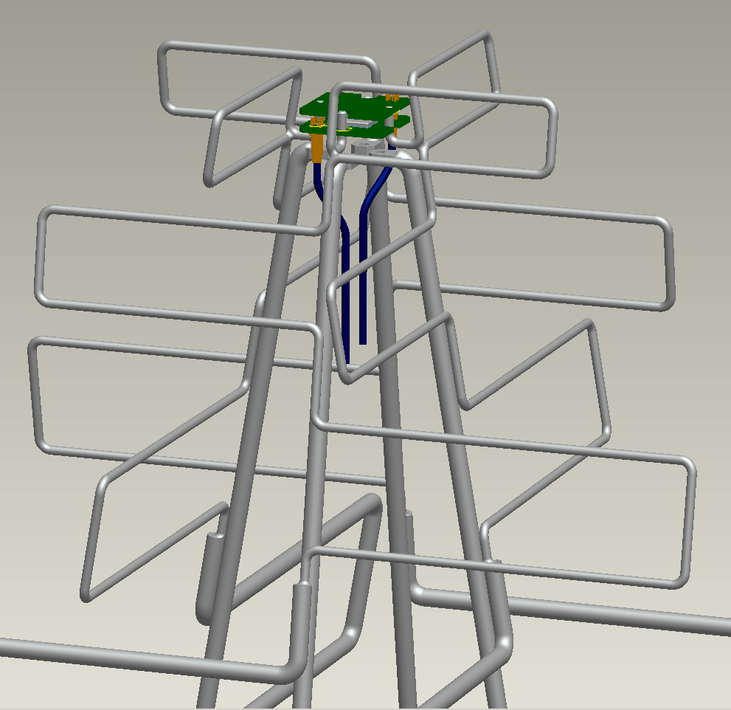
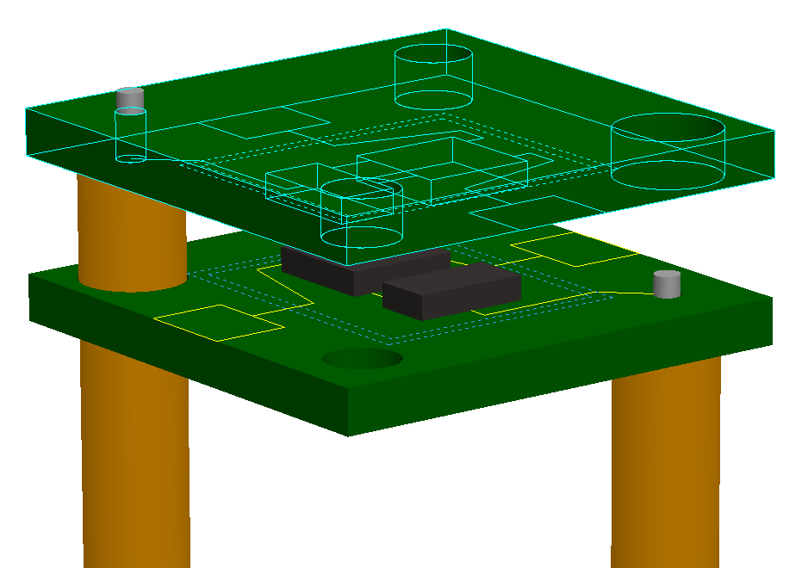
Mass production of SKALA and LNA

Slide 8
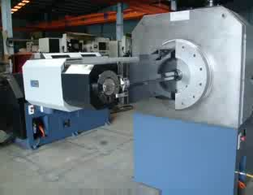
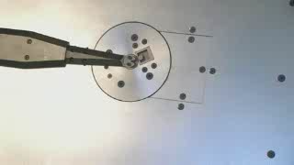
Mass production of SKALA and LNA
Some numbers:
  Cost of antennas for AAVS1 is around 150€/element.
  Cost of antenna for AAVS2 is targeted at 75€/element (this is for the 2 polarisations and includes the electronics).
  Weight of each arm would be 1.56 kg if made of steel wire.

Slide 9
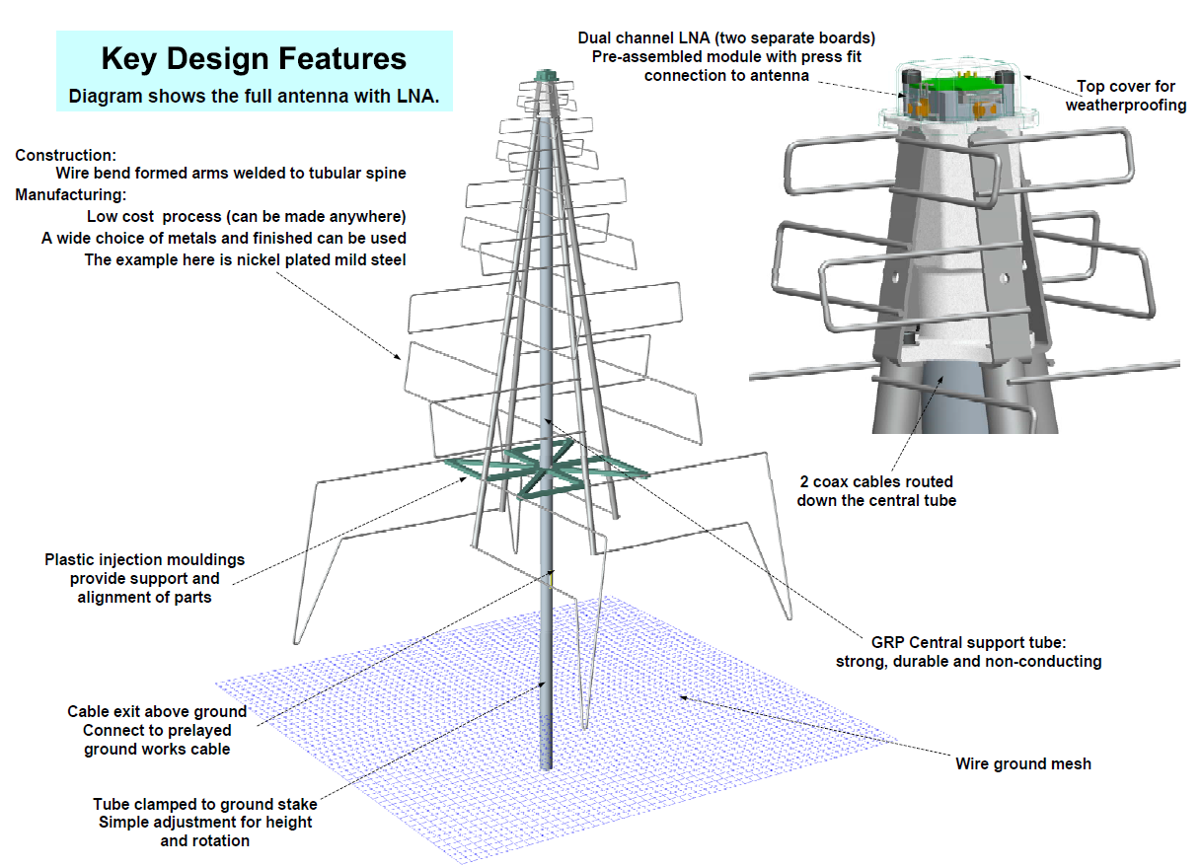
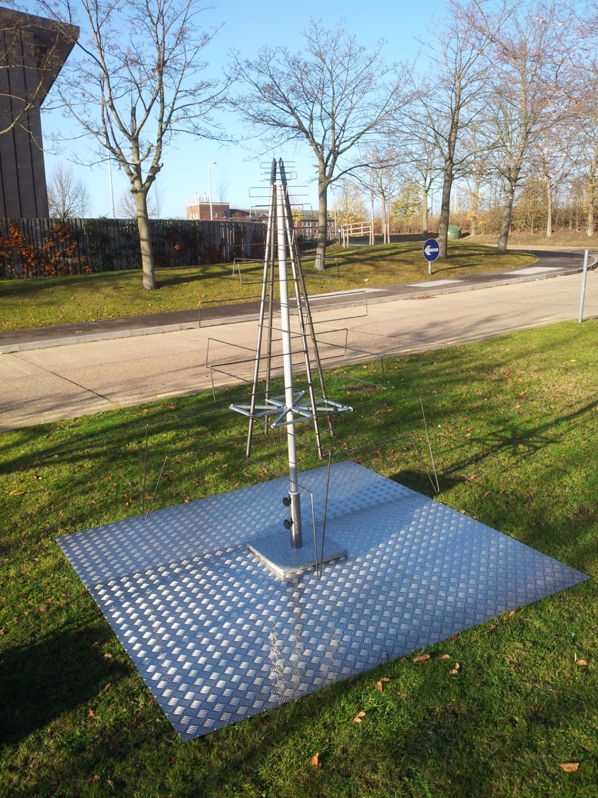
First prototype

Slide 10
Performance

Slide 11
Low Noise Amplifier for SKALA
Frequency range 70 to 450MHz
Gain > 20dB
Gain flatness, as flat as possible consistent with meeting other spec. parameters
Noise temperature < 30K at 450MHz
P1dB, high enough to allow astronomical observations to be made at Lords Bridge
Power consumption < 100mW
Unconditionally stable at both input and output ports
Differential source (antenna), single-ended load
High Level of Common Mode Signal Rejection

Slide 12
Concept

Slide 13
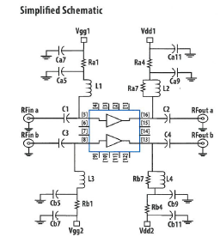
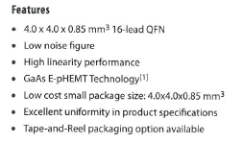
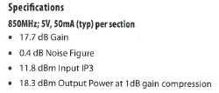
Dual Matched Low Noise RF FETs Required

Slide 14
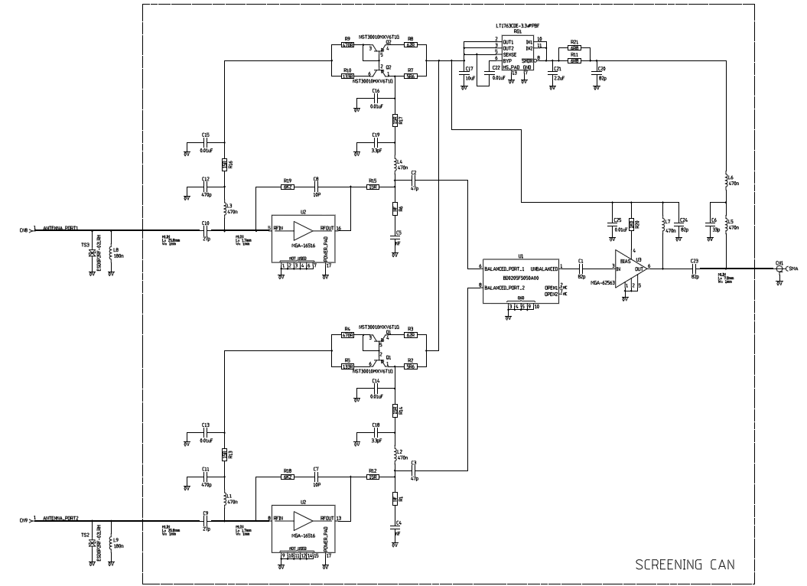
Schematic
AVAGO MGA-16516

Slide 15
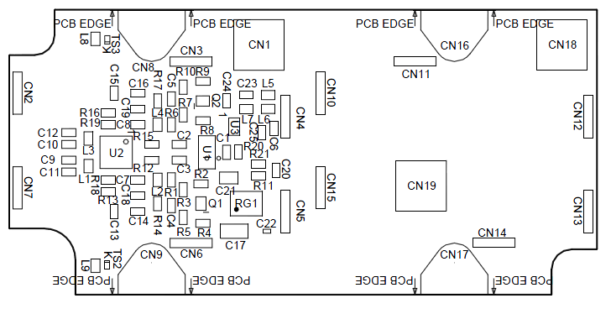
Board layout

Slide 16
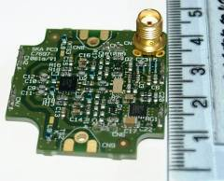
Picture

Slide 17
LNA & antenna performance

Slide 18
LNA+antenna simulated performance (includes a 20dB gain second stage on chip)

Slide 19
LNA+antenna simulated performance (includes a 20dB gain second stage on chip)

Slide 20

Simulated A/T for SKA1
(with log-periodic antenna)
- A/T shown is A/T of 1 antenna x N (number of antennas in a 180 m station with elements spaced 1.5 m apart) x 50 stations.
η (radiation efficiency) = 90%
D (directivity)
Tsky (sky noise temperature) following Tsky = 1.691*(freq[GHz].^-2.751) + 4.875 K
Tamb (ambient temperature) = 295 K
Trec (receiver noise temperature) -> Assuming ideal amplifier with:
  Zopt (optimum noise impedance) = 100 Ω
  Rn (noise resistor) = 10 Ω
  Fmin (minimum noise figure) = 0.3 dB -> 21 K

Slide 21
* Peak is at 2452 m^2/K

Slide 22
* Peak is at 2452 m^2/K

Slide 23
* Peak is at 3468 m^2/K

Slide 25
Effect of Soil/GND – (Soil B – 5% humidity)
Even a bigger pitch may be possible!

Slide 26
X-pol

Slide 27
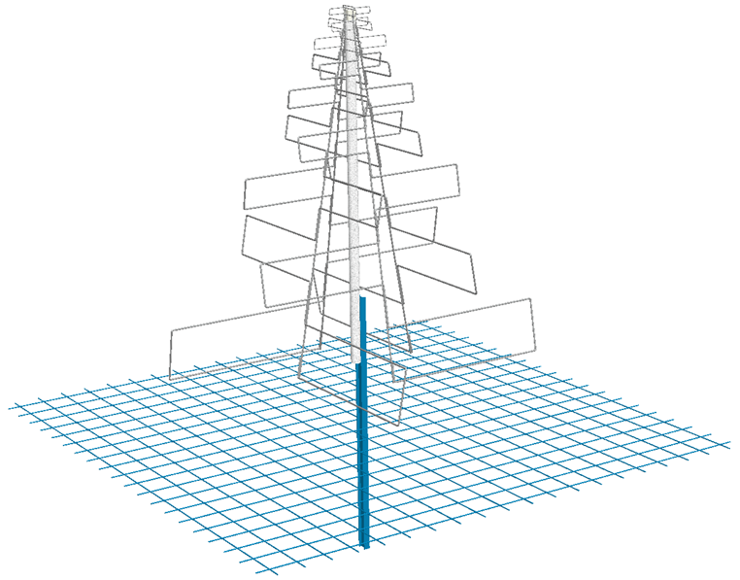
SKALA tests and AAVS0
16 dual-polarised SKALA elements.
Aim:
  Test realistic SKA AA-low front-end technology in an array environment:
    Effect of cables.
    Effect of ground mesh/soil.
    Effect of mutual coupling on noise and pattern.
  Challenges:
    Measure the pattern in an array environment. Options:
      Use of known field source: NF, FF.
      Use data from interferometry experiment.
  Cost:
    Estimated total cost is 5-10 K€ depending on
    tools and equipment needed for the tests.
ADC: 1GS/s
50
-
100m all
optical
e/o
Data
e/o
Control
Analogue
e/o
Sync.

Slide 28
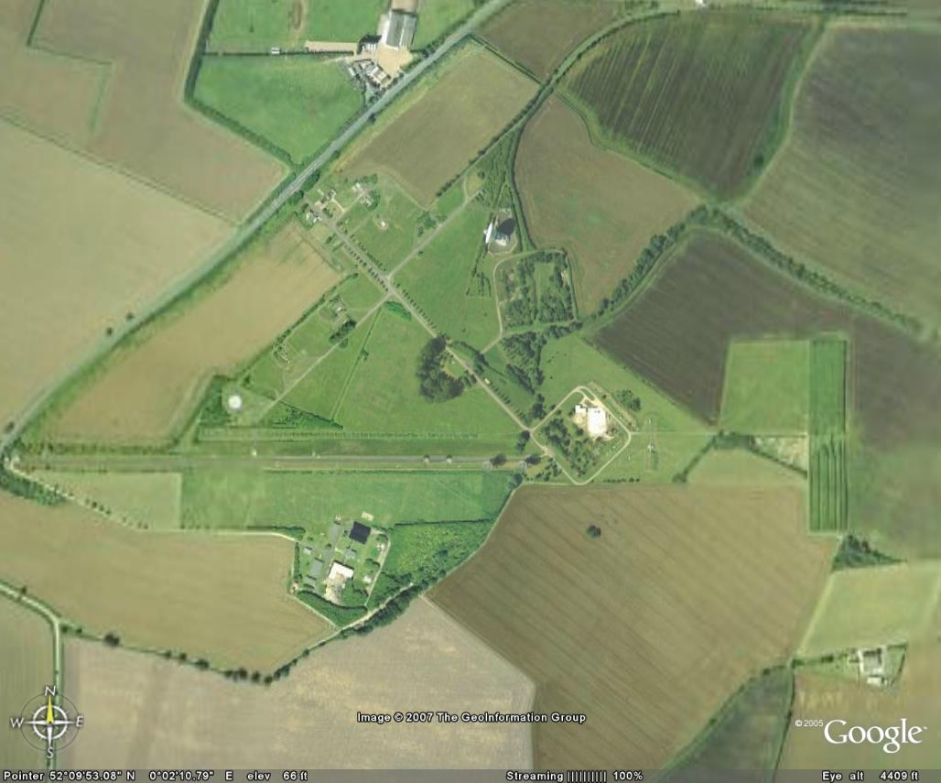
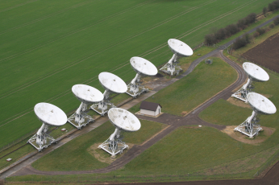
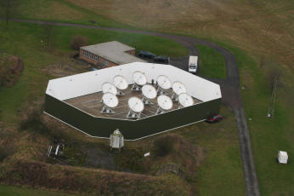

Lord’s Bridge Observatory
SKALA-AAVS0

Slide 29
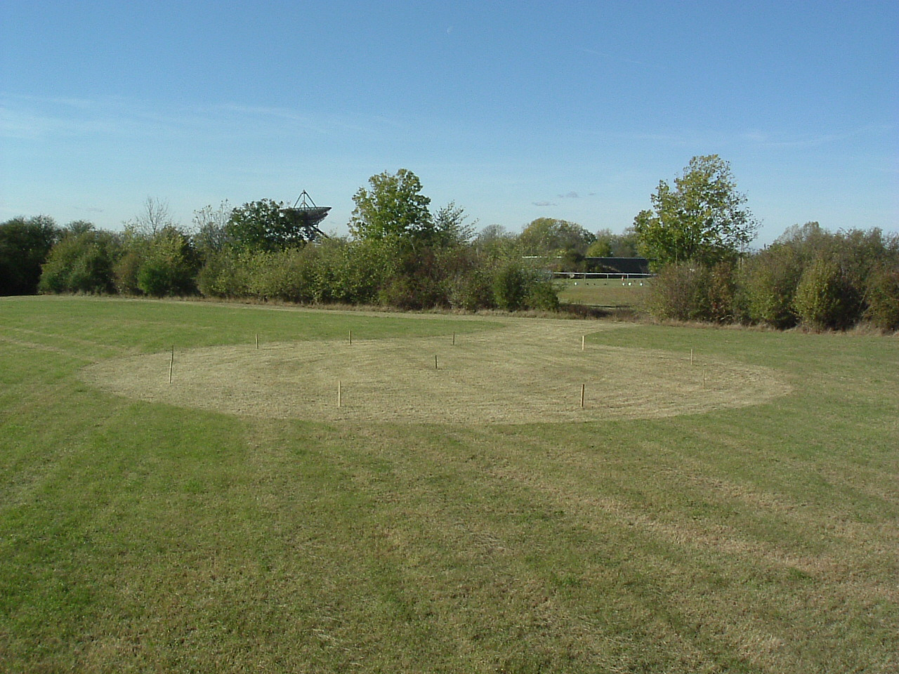

Slide 30
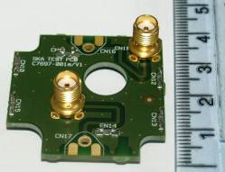
Upcoming tests:
December 2011:
  Impedance test with “dummy” board.
January 2011:
  Single element pattern measurement in outdoor test range, Perth?
  Single element pattern measurement in outdoor test range, UK.
  Noise matching with integrated LNA in reverberation chamber, UK.
  Impedance tests on AAVS0.
February-March 2011: (with Roach back-end)
  Noise tests on AAVS0: pointing the array to hot and cold patches of the sky.
  Pattern tests on AAVS0: (compare with analytical/EM models - UCL)
    Interferometry experiment: full correlation/correlation with high gain antenna
    Known source: Near field source (no back-end needed), minicopter?
  More tests... Any suggestion? Plug into other back-ends?

Slide 31
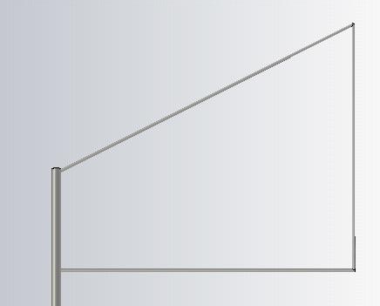
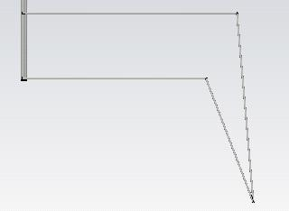
Important numbers
Noise:
  <30 K @ 450 MHz.
Sky coverage – A/T:
  Meets DRM specifications down to +/- 45º at all frequencies.
Frequency band:
  Potential to go down to 50 MHz (lower arm).
Foot-print: 1x1 m possible (lower arm).
Cost:
  Targeted to 75 € including LNA and ground mesh.

Slide 32
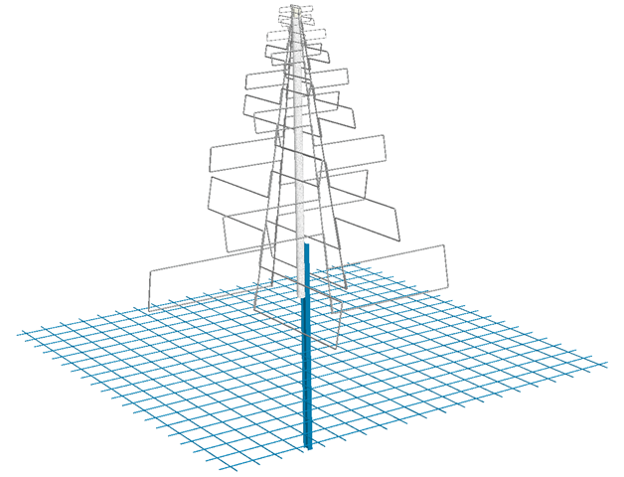
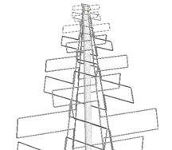
Single-Dual band
Low-band: high gain element, OK.
High-band: low gain element? Not so easy... Getting down to 30 K with a low gain antenna in a 3:1 band is not that easy. You will probably need a high gain element anyway and rather large.

Slide 33
Summary and conclusions
Antenna+LNA pair meets DRM requirements.
In early 2012 noise and pattern tests for AAVS0.
Mass production prototypes are in their way (75€/element).

Slide 34
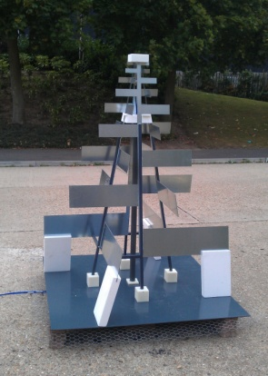
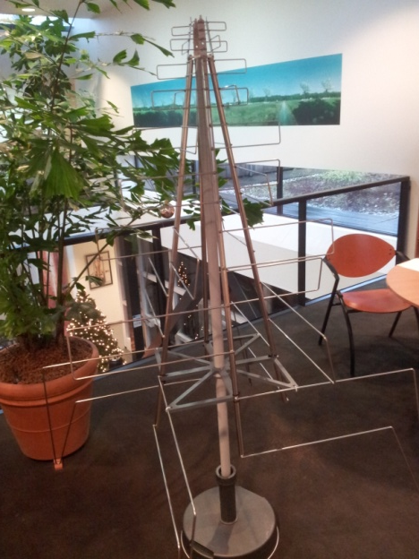
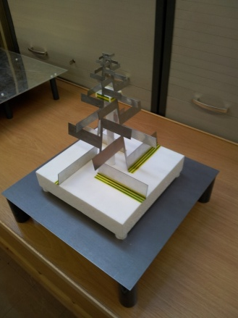
Thank you! Any questions?
SKALA1
(Cambridge)
SKALA2
(ICRAR)
SKALA3
(Cambridge)
SKALA4
(ASTRON)
SKALA0
miniSKALA
(Cambridge)

