Slide 2
Photonics and
AA station design
Peter Maat – ASTRON

Slide 3
RFoF Technology for the SKA
Analog Optical Link Technology in the SKA
AA-low Antenna Element Connection
AA-mid Tile Connection
Wideband SPF Connection
PAF Antenna Element Connection
Why Photonic Technology?
Broadband / High Frequency
Immunity for RFI
Galvanic Isolation
Lightning Resistant
Light Weight
Small Space Envelope
General design of RFoF link

Slide 4
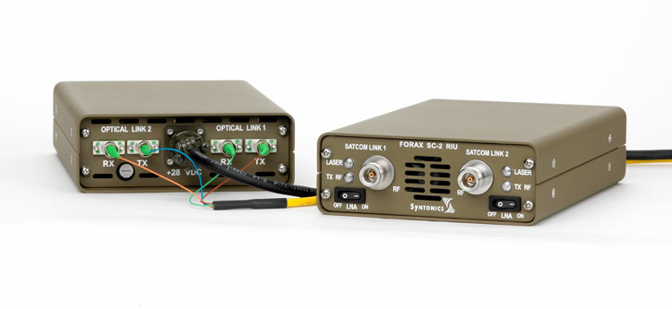
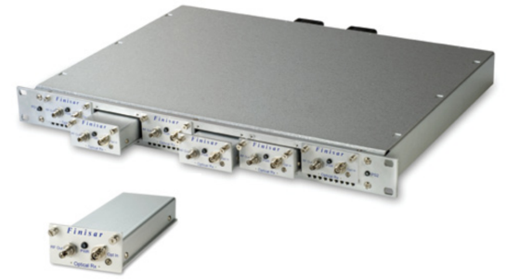
RFoF Technology for the SKA
Current Technology
Syntonics
Finisar
Expensive
Large size/volume
No easy integration
Use PCB based RFoF technology

Slide 5
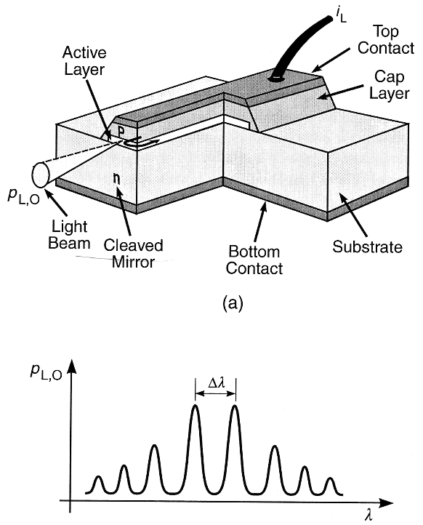
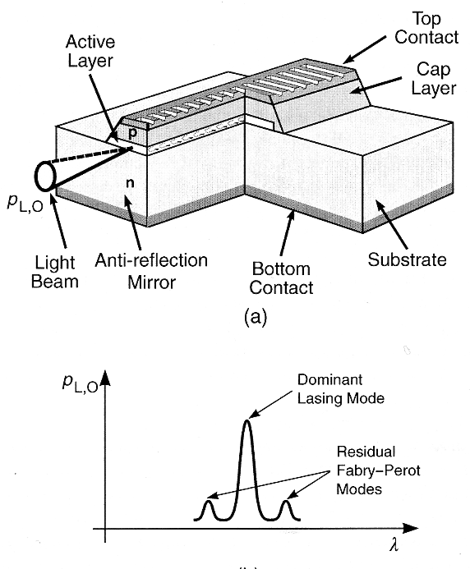
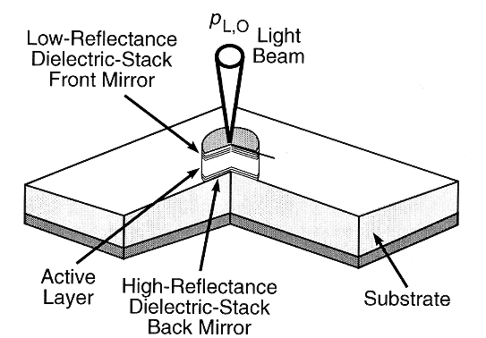
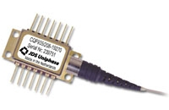
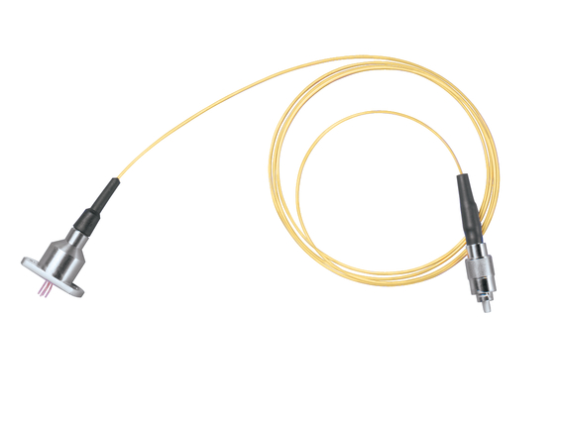
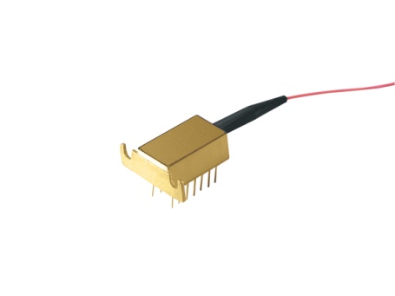
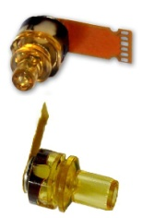
Components
Lasers
Fabry-Perot DFB / DBR VCSEL
Issues
Availability in all λ windows
Modulation bandwidth
Output power
Temperature control

Slide 6
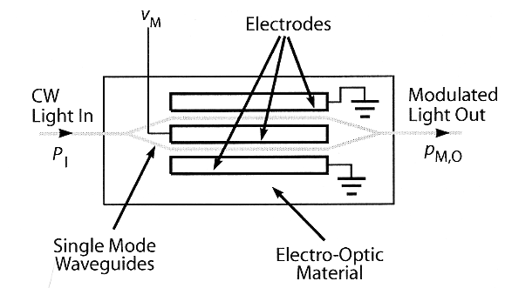
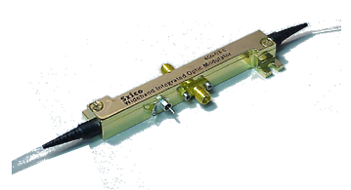
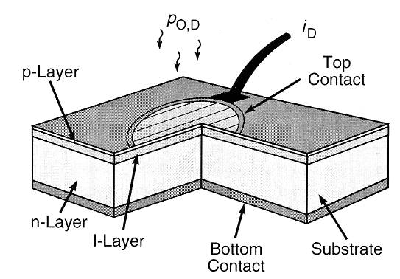
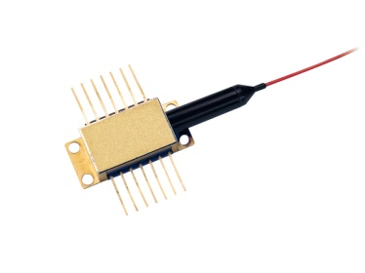
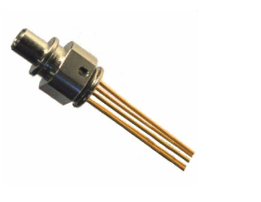
Components
Modulators
Mach-Zehnder interferometer modulator
Electro-absorption modulator
Detectors
PIN
APD
Issues
Availability at all λ’s
Modulation bandwidth
Input power

Slide 7
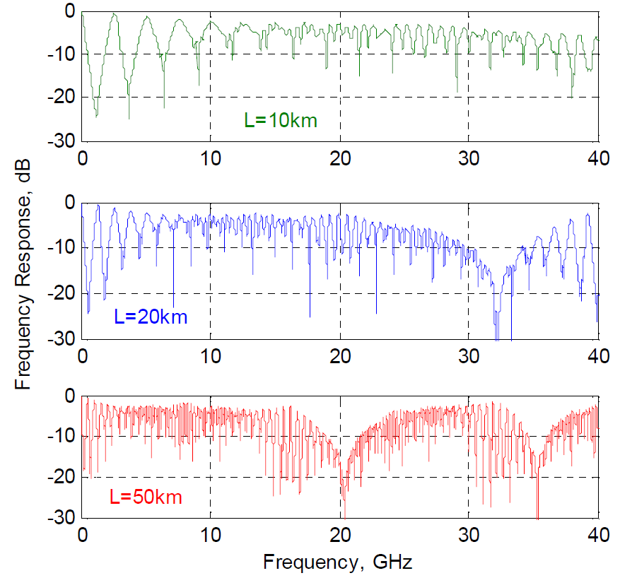
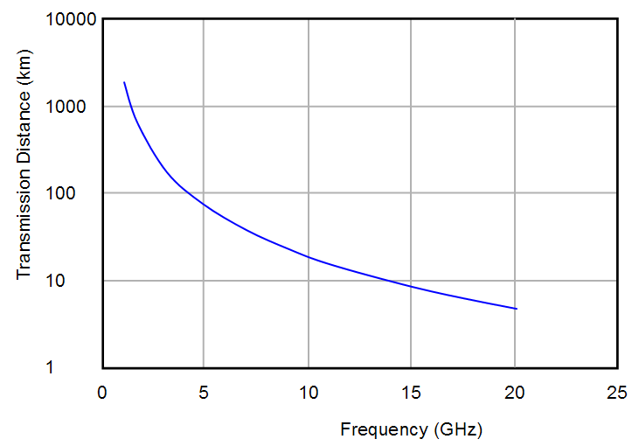
RFoF Technology for the SKA
Issues:
External Modulation vs. Direct Modulation
EM: more expensive
EM: better link gain
Equal SFDR and transmission distance
Single mode vs. multimode
Low cost
Dispersion Issues
Transmission distance limitations
Available optical power
Chromatic dispersion
Carrier suppression effect
FP laser: distance: 2 km @ 1 GHz
Modal dispersion
Fiber related distortions

Slide 8
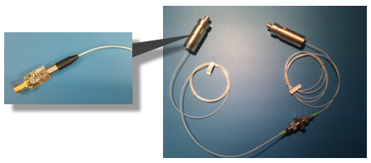
RFoF Technology for the SKA
Photonic Coax

Slide 9
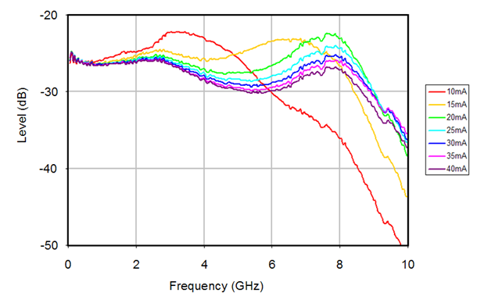
RFoF Technology for the SKA
Direct modulated DFB
Detector: responsivity ~ 0.9 A/W
Laser: slope efficiency ~ 0.05 – 0.3 W/A
Link gain ~ -25 dB
Cost Level: ~ 100 €

Slide 10
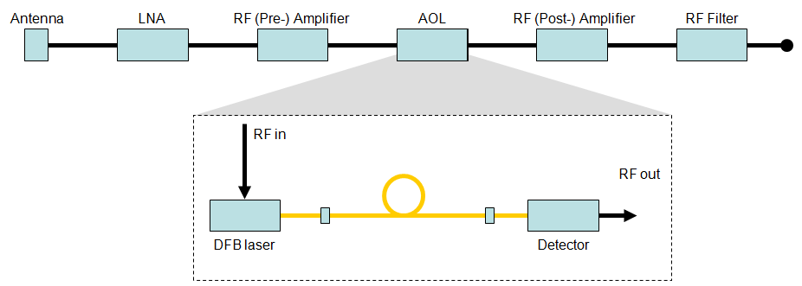
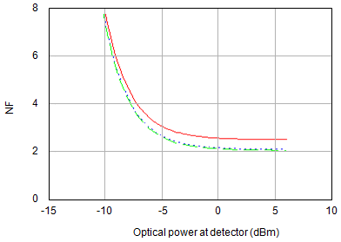
RFoF Technology for the SKA
RF systems with direct modulation AOL
Pmax_{RFin} = -50 dBm
Pmax_{RFout} = 0 dBm
150 dB/Hz
160 dB/Hz
170 dB/Hz
NF < 6 dB requirement is satisfied for:
P_{op} > -8 dBm
RIN = -150 dB/Hz
Bandwidth of 1.2 GHz

Slide 11
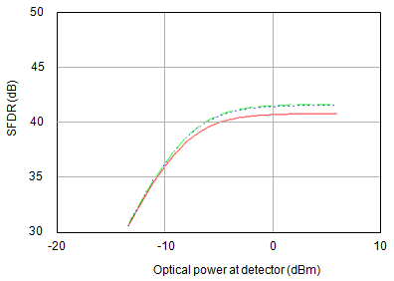
RFoF Technology for the SKA
RF systems with direct modulation AOL
Pmax_{RFin} = -50 dBm
Pmax_{RFout} = 0 dBm
150 dB/Hz
160 dB/Hz
For 200 MHz – 1.4 GHz: SFDR = 41.5 dB
For 70 MHz – 240 MHz: SFDR = 50 dB (1)
For Δν = 3 GHz: SFDR = 37.5 dB
Dynamic range is limited by antenna and LNA noise
170 dB/Hz

Slide 12
Cost and Power
Now: ~100 Euro
DM AOL system cost: 255 Euro / Power: 0.62 W

Slide 13
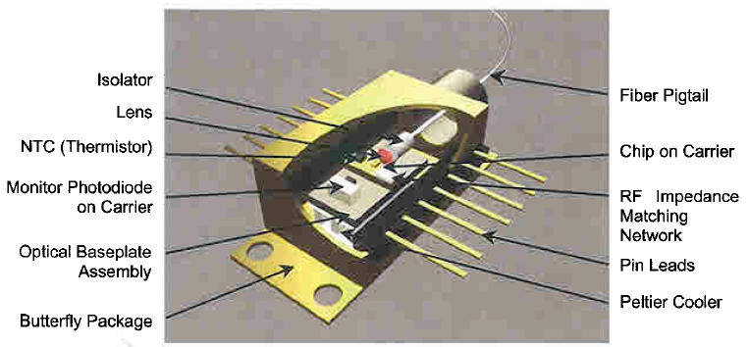
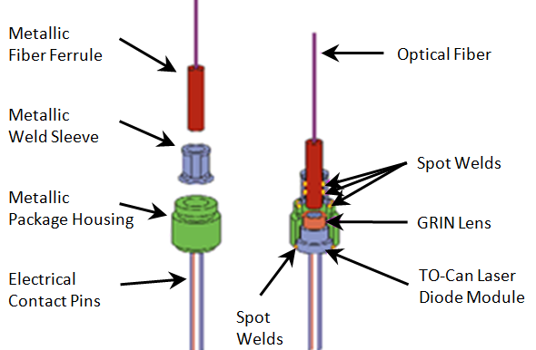
Optical Tx/Rx Technology: next step
High cost level caused by expensive packaging
Technology development for cost reduction
Multiple components in a module: component integration
Lower cost packaging technology
Follow the market trends to obtain low cost technology
Connect with industry to have the technology available in time
Market trend: parallel Tx/Rx technology for e.g. 100GbE
Market trend: low cost optical interconnect technology for data centers

Slide 14
Optical Tx/Rx Technology: next step
Example 1: IBM
Example 2: TE Connectivity

Slide 15
Future work
Inventory low cost DFB, FP, VCSEL technology
Investigation of Tx and Rx phase and amplitude stability in climate chamber (/field test)
Development of PCB based low power / low cost TX/RX technology

Slide 17
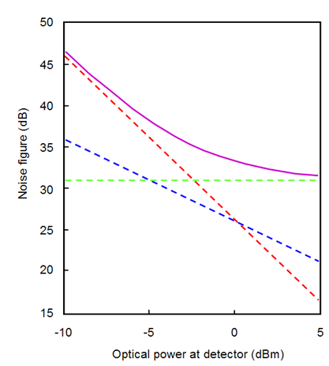
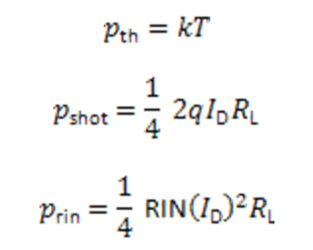
RFoF Technology for the SKA
Direct Modulation: Tx/Rx Noise
Noise sources:
Thermal noise
Shot noise
RIN

Slide 18
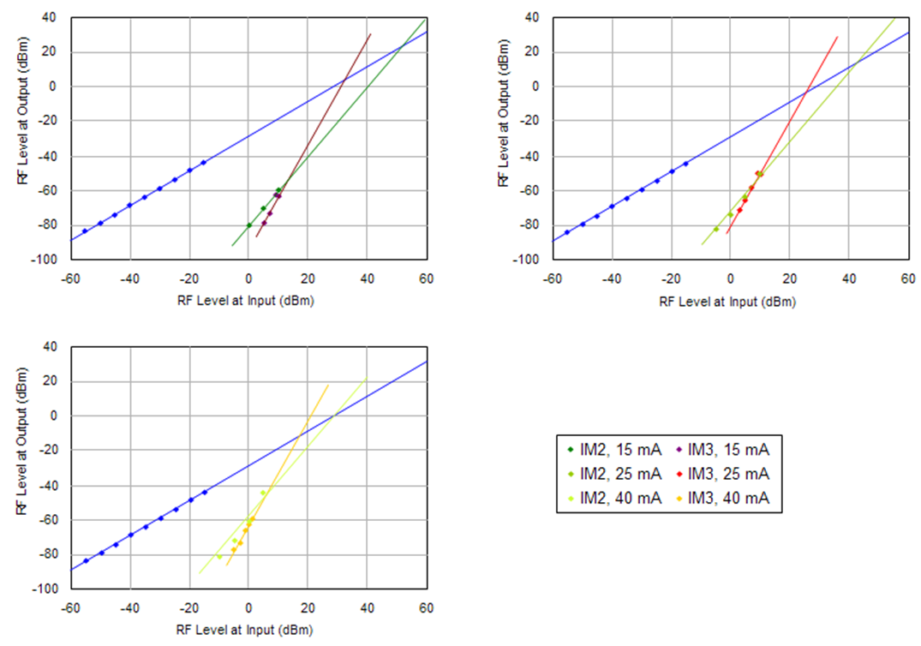
RFoF Technology for the SKA
Direct Modulation: Tx/Rx Distortion
NF = ~32 dB
IIP2 = 52 dBm
IIP3 = 33 dBm
OIP3 = 6 dBm
OIP2 = 25 dBm
IMF2 = 47 dB (1 GHz)
IMF3 = 49 dB (1 GHz)

