Slide 1


AAVS receiver
Federico Perini
AAVP 2011 12-16 December, 2011 - ASTRON, Dwingeloo

Slide 2
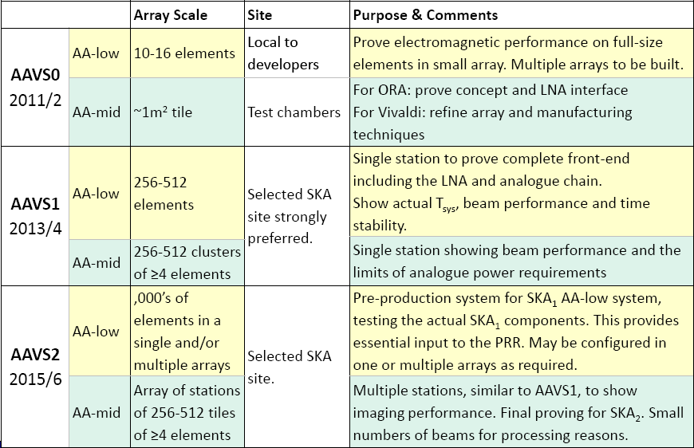

AAVS0
Embedded element
Mutual coupling

Slide 3
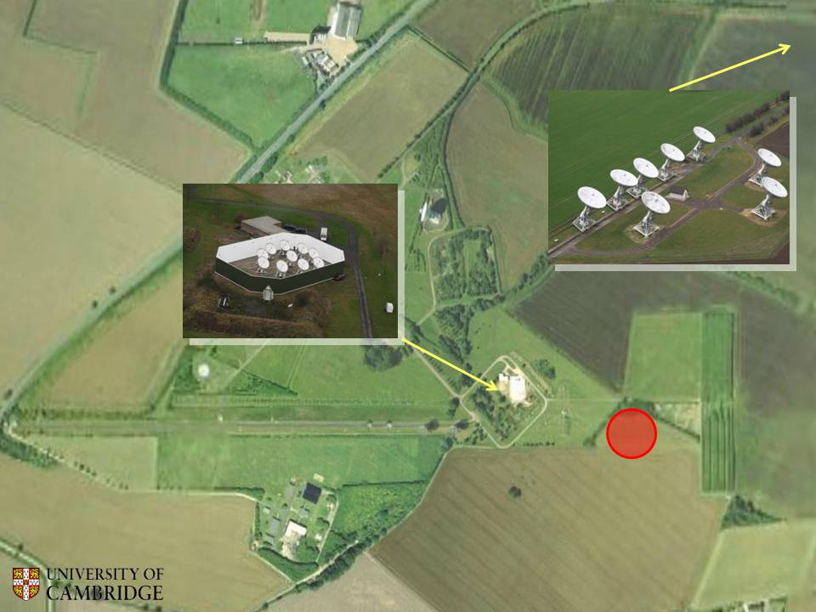
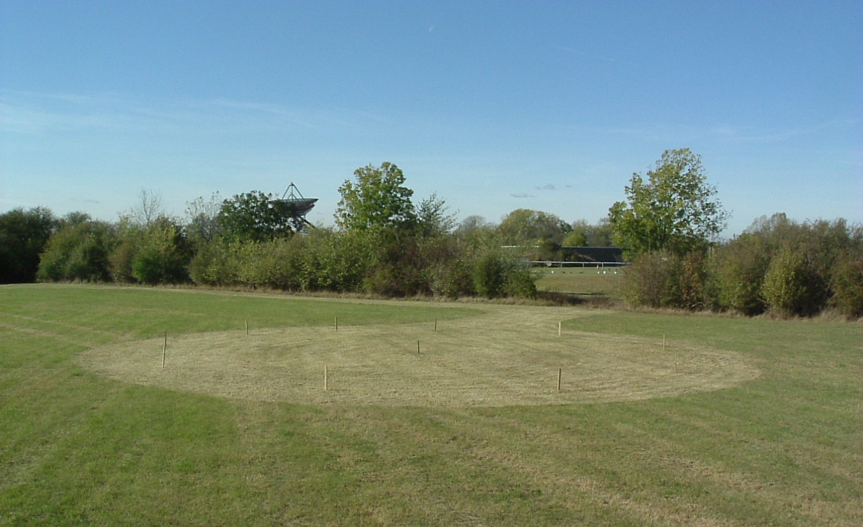
AAVS0 test sites
Lord’s Bridge, Cambridge

Slide 4
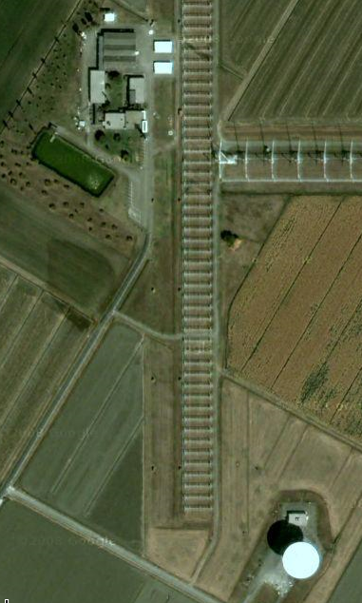
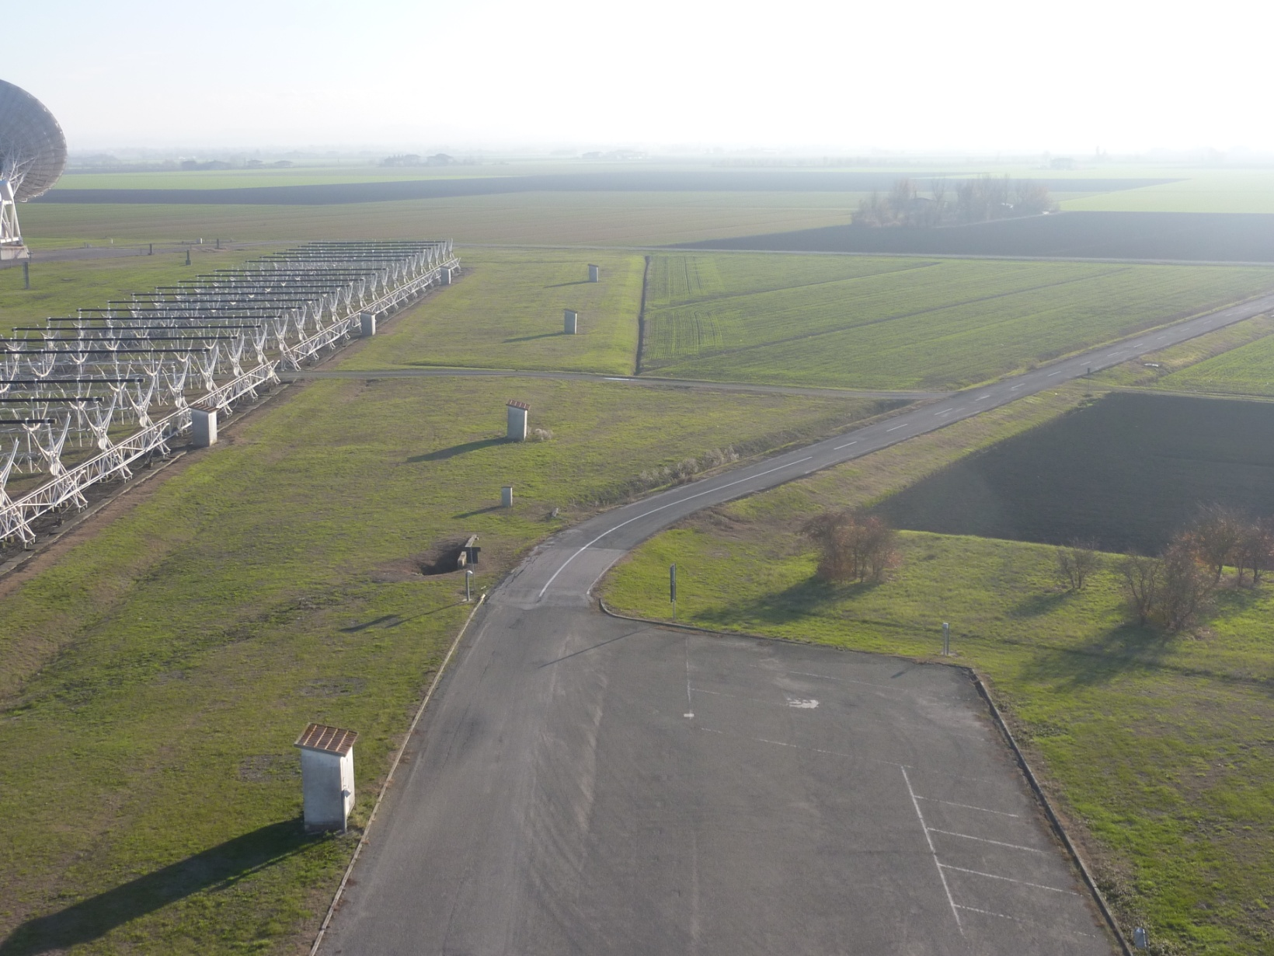
AAVS0 test sites
Medicina

Slide 5
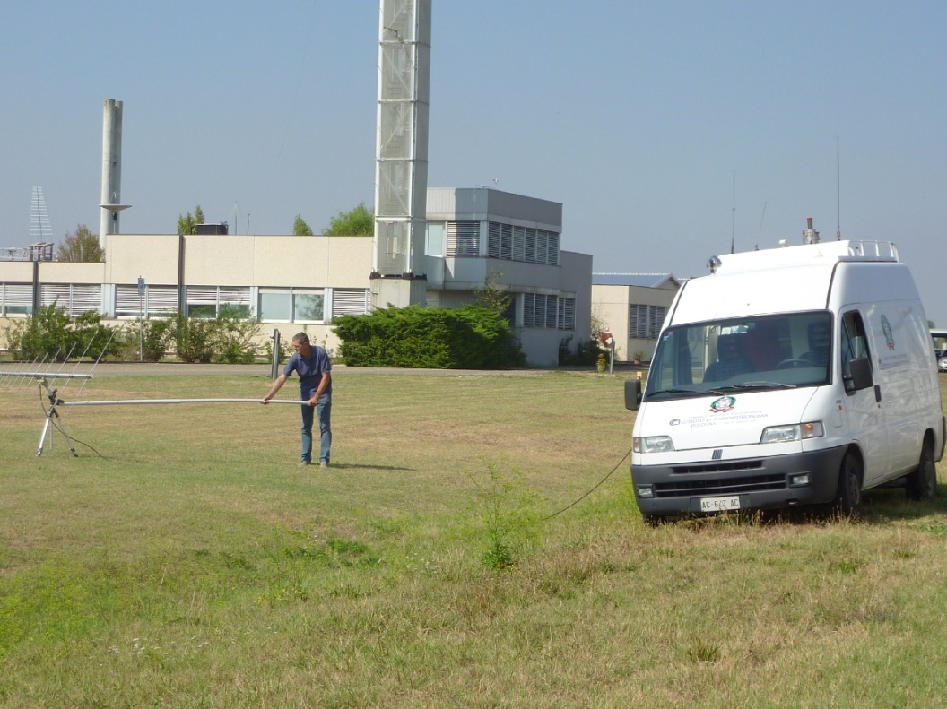
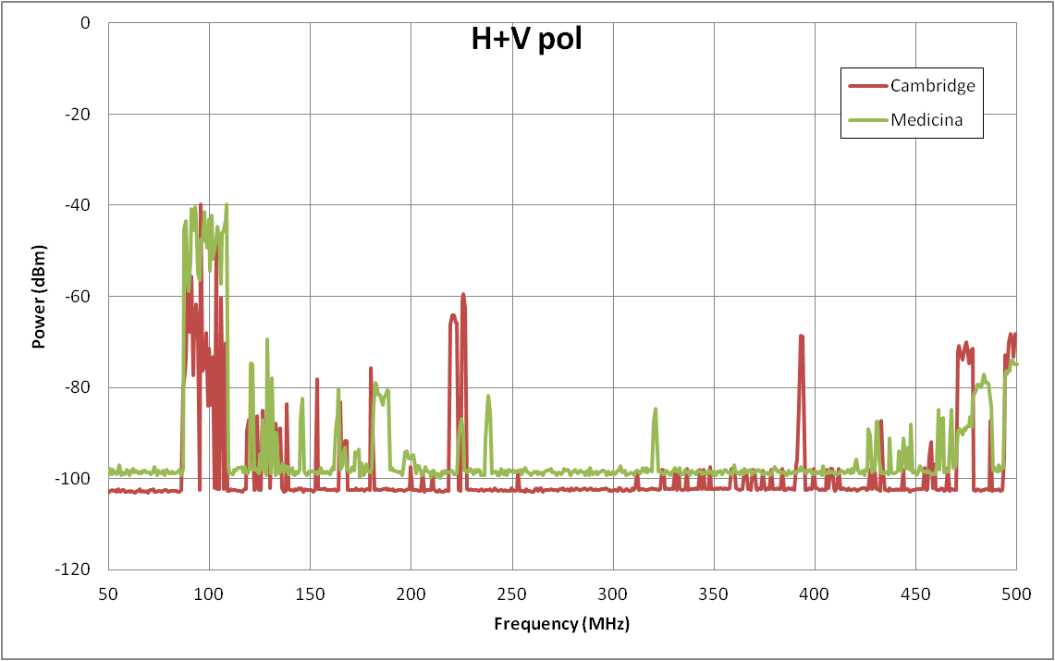
AAVS0 RFI
RBW=10KHz
VBW=10KHz
SPAN=50-500MHz
Data corrected for antenna gain and coax loss

Slide 6
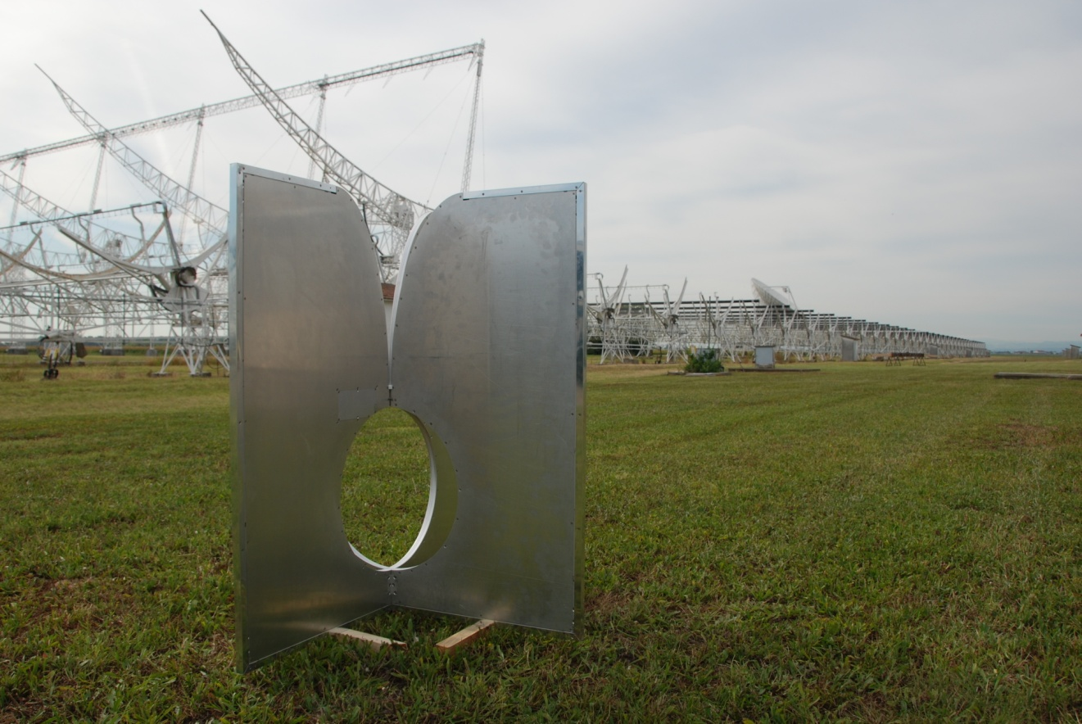
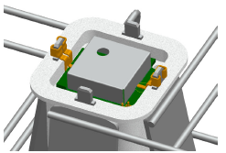
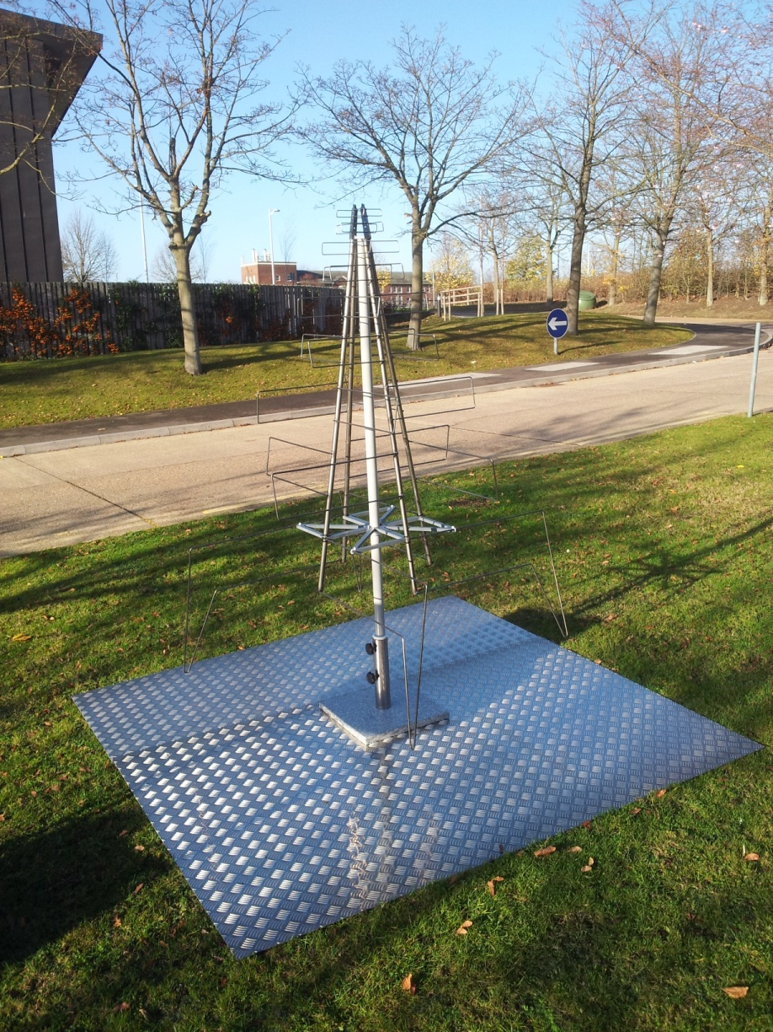
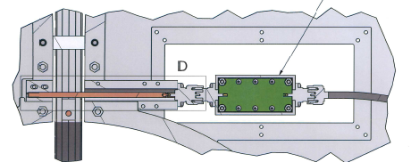
Elements under test

Slide 7
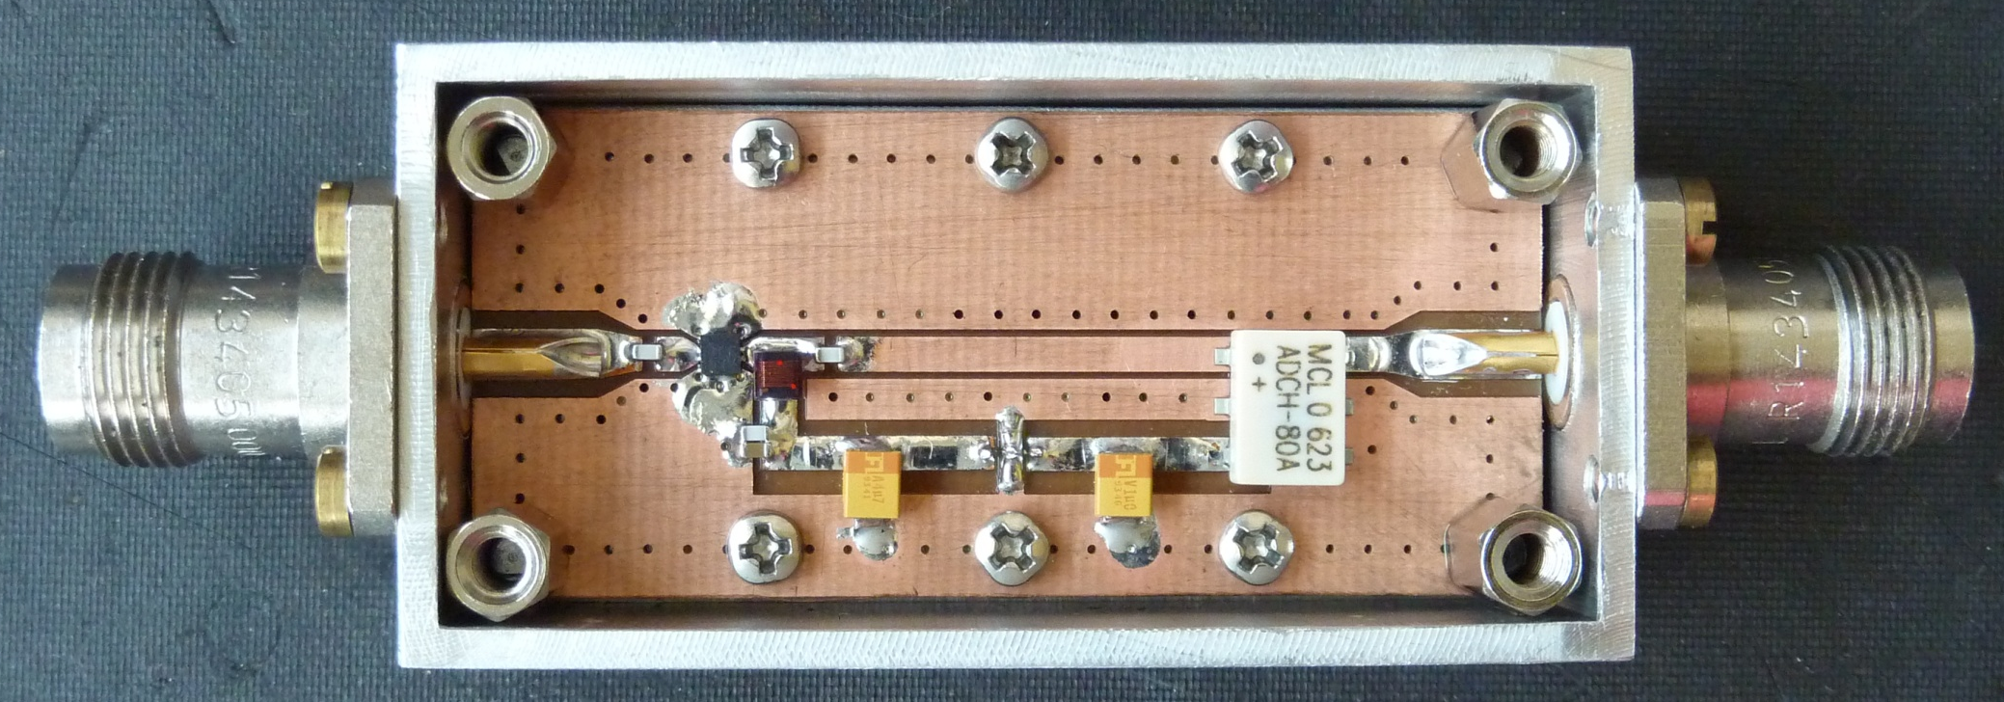
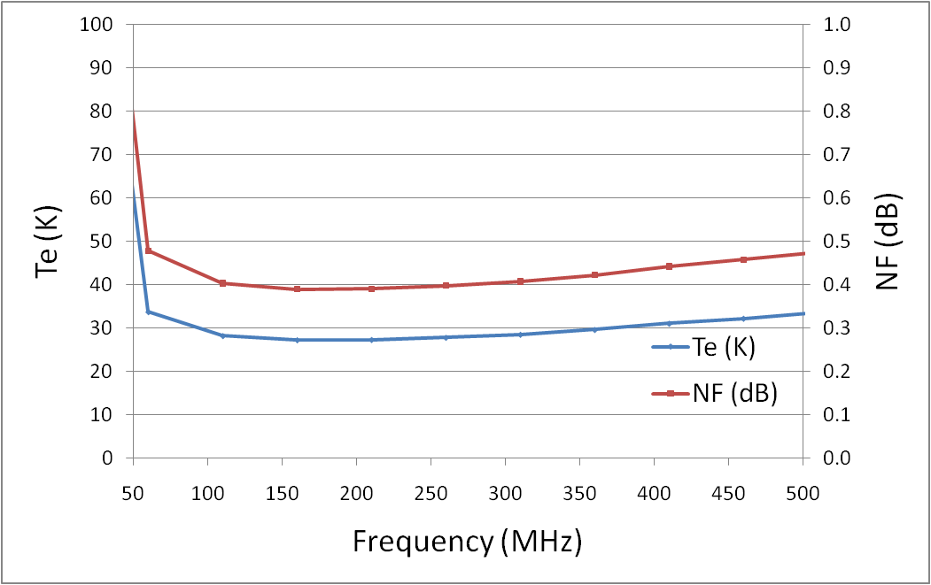
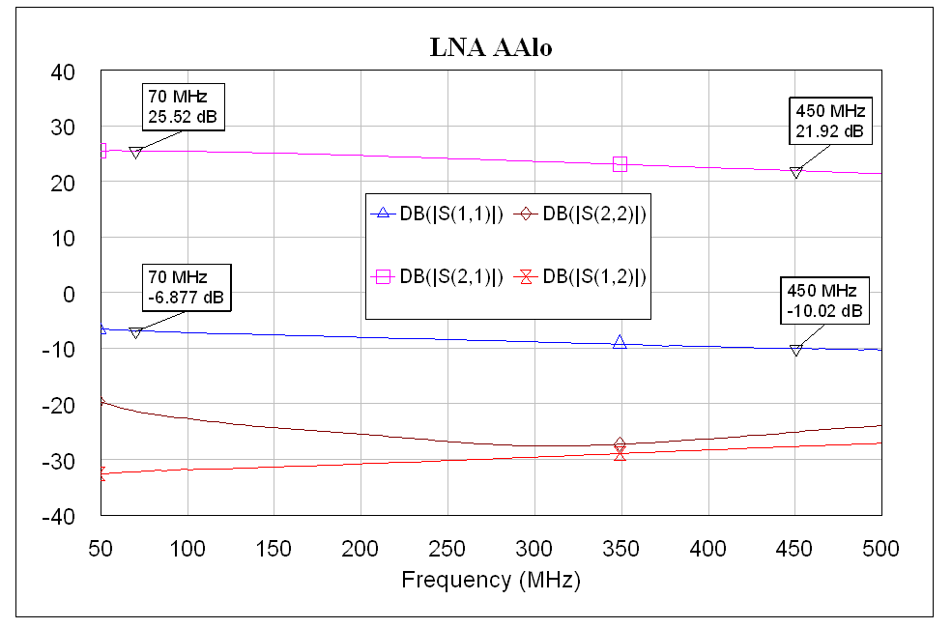
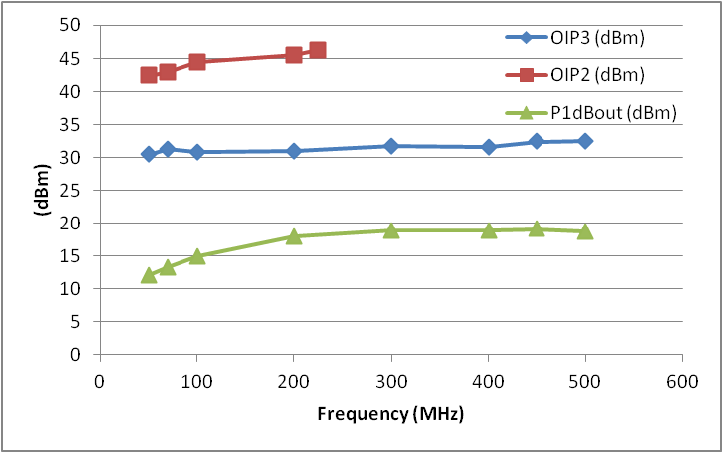
LNA for Vivaldi
TNC connectors, 50Ohm I&O
Vmin=3V, I=60mA (180mW)
Bias through output coax cable or feed through

Slide 8
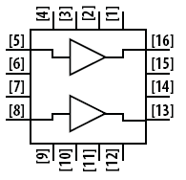
LNA for Logperiodic
Based on AVAGO MGA-16516
Low Noise, High Linearity Match Pair Low Noise Amplifier
Frequency range 70 to 450MHz
Gain > 20dB (40dB)
Gain flatness, as flat as possible consistent with meeting other spec. parameters
Noise temperature < 30K at 450MHz
P1dB, high enough to allow astronomical observations to be made at Lords Bridge
Power consumption < 100mW (Vmin=4.5V, I=131mA)
Unconditionally stable at both input and output ports
Differential source (antenna), single-ended (50Ohm) load
High Level of Common Mode Signal Rejection
Biasing through the coax cable

Slide 9
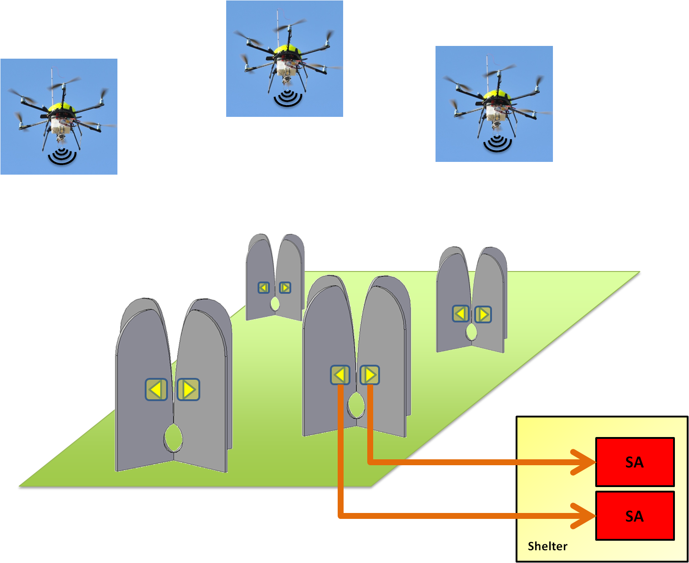
AAVS0: embedded pattern

Slide 10

AAVS0: embedded pattern

Slide 11
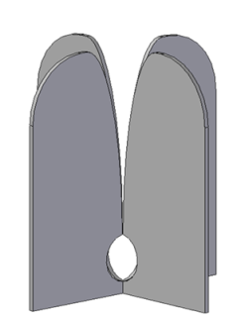

AAVS0: mutual coupling
VNA
Shelter

Slide 12
AAVS0: mutual coupling
RX
TX
VNA
TX
RX
Shelter

Slide 13
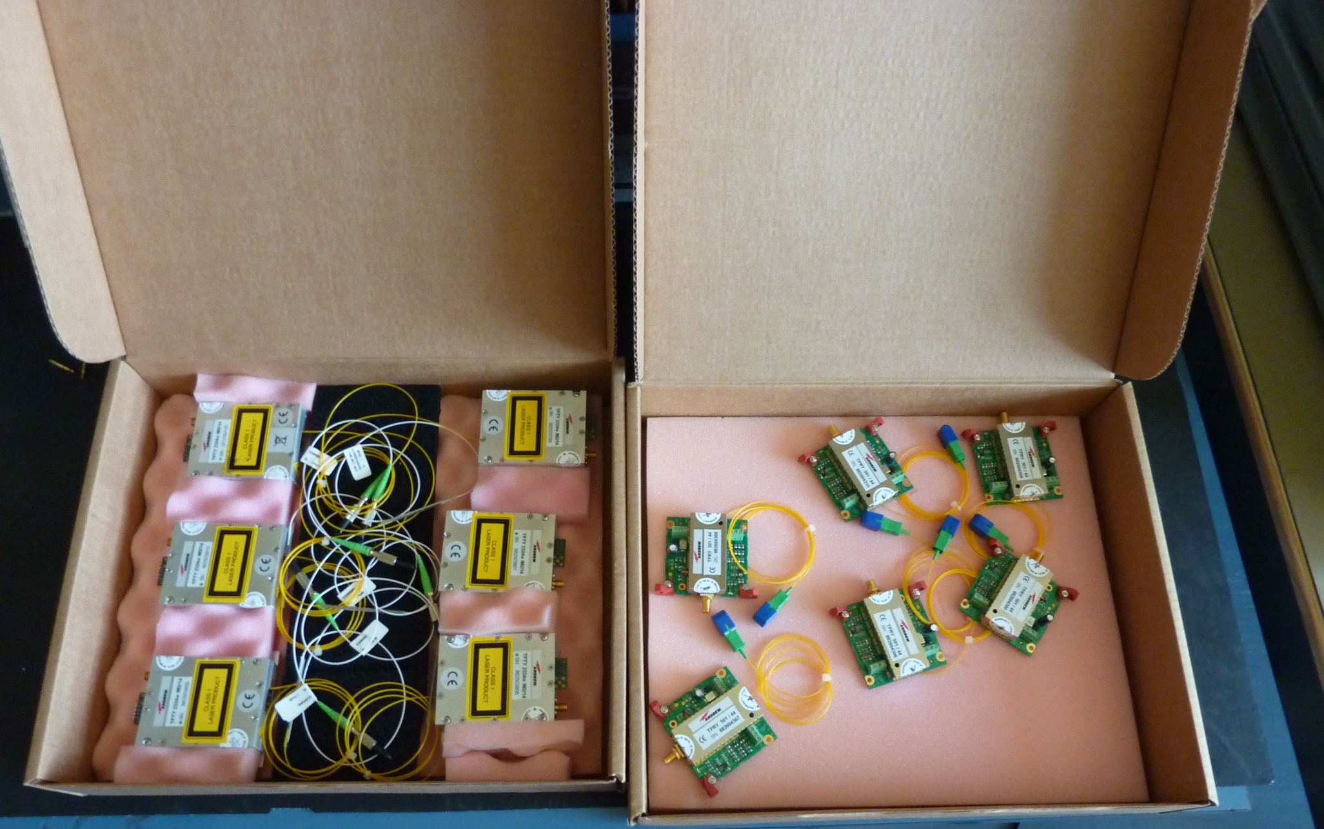
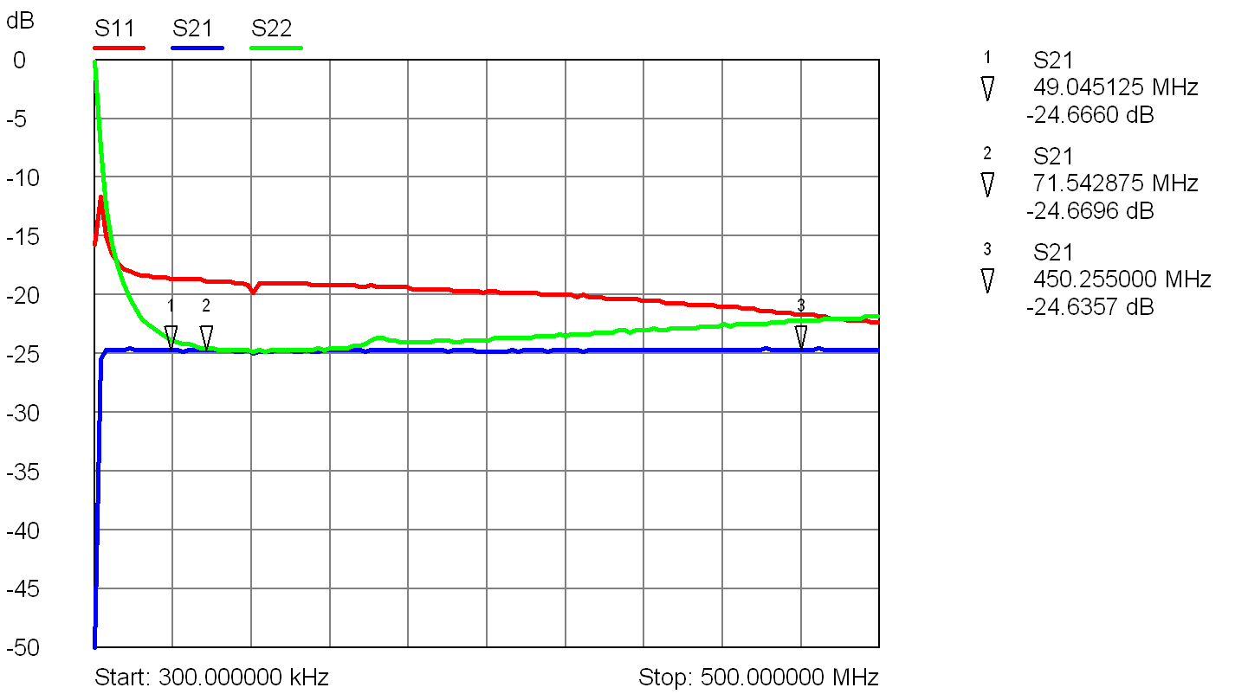
Link for AAVS0 tests
Gain (dB) | -25
IRL (dB) | >15
ORL (dB) | >20
IIP3 (dBm) | +33
NF (dB) | 36
SFDR (dB/Hz^{2/3}) | 114

Slide 14
AAVS0, 1 ,#?
Embedded element
Mutual coupling
Beamforming
Bandpass
Tsys
….
AAVS0+ ?

Slide 15
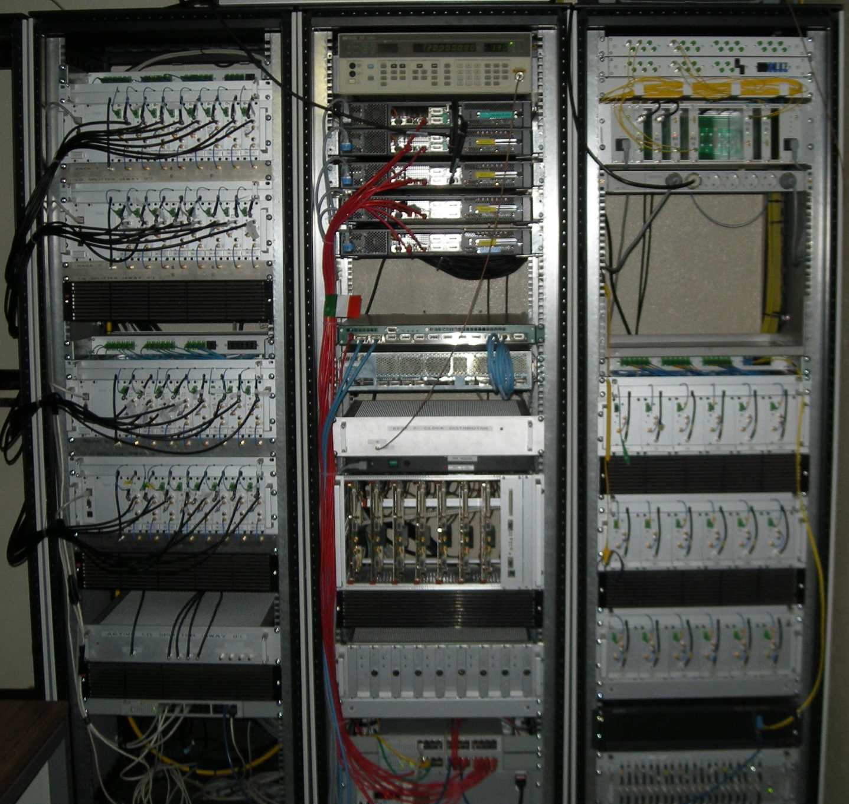
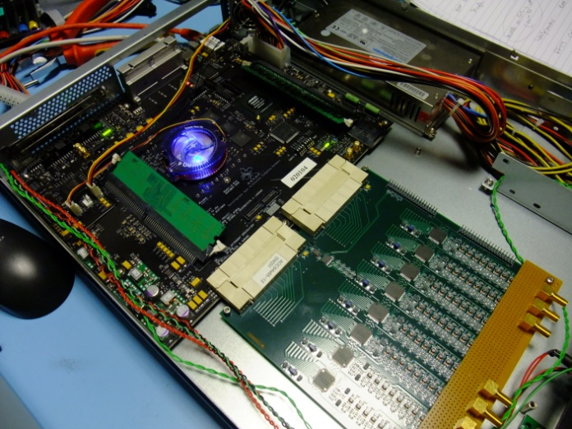
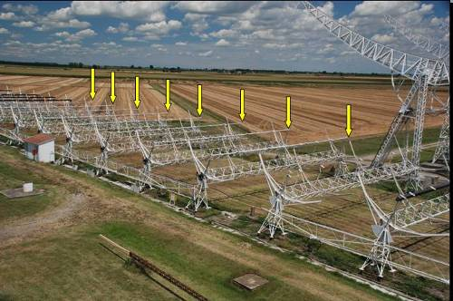
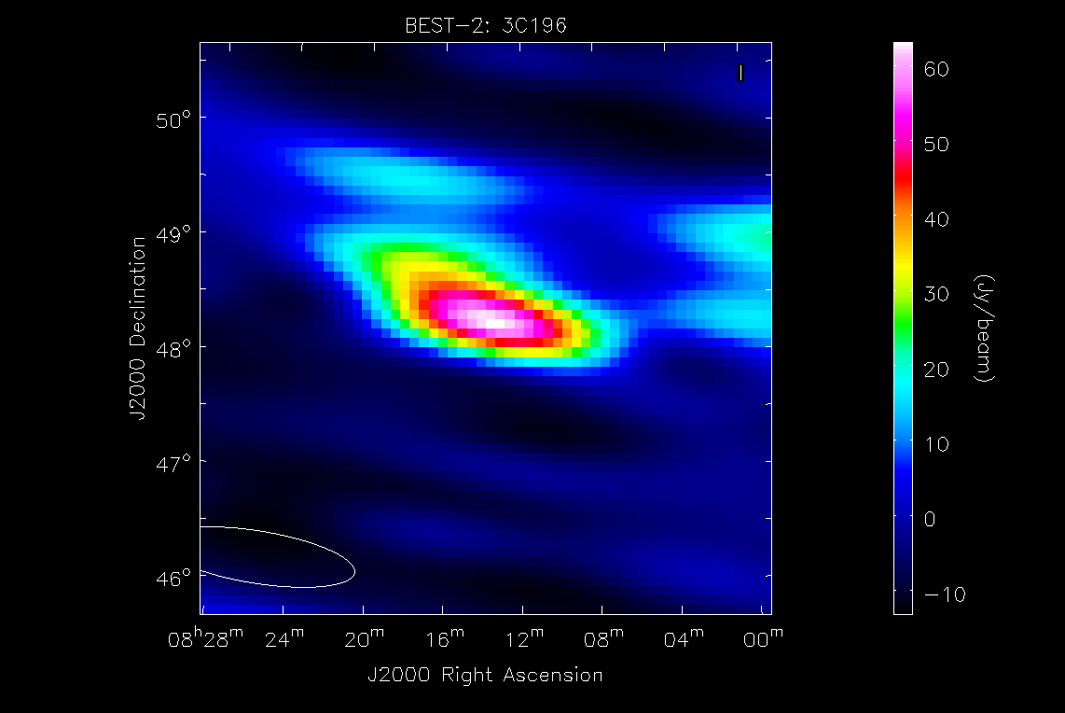

SKADS/prepSKA BEST RX
3C196 radiomap obtained with the Medicina BEST-2 SKADS demonstrator array and the CASPER data processing

Slide 16
AAVS0+ receiver: Narrow Band
1
NB
ADC
65MS/s
12bit
ROACH
NB
2
NB
NB
NB
3
NB
I/Q balancing
1024ch spectrometer
Digital Beamformer
Digital Correlator
NB
16
NB

Slide 17
NB RX specifications
Frequency Range | 70 - 450MHz
Output Bandwidth | 2xIQ 0-16MHz
Minimum Gain KTB@50MHz=-88.5dBm KTB@70MHz=-92dBm KTB@450MHz=-108dBm | 53dB (considering the LNA) @2bit for noise @50MHz=33.5dB @70MHz=37dB @450MHz=53dB
Noise Figure | <5dB
Input return loss | <-15dB
Output return loss | <-15dB
SFDR | >60dB (10bits) TBD
Minimum output signal | -49dBm @3bit for noise -55dBm @2bit for noise
Ripple | ±1dB
Disequalization | <3dB (70-450MHz)

Slide 18
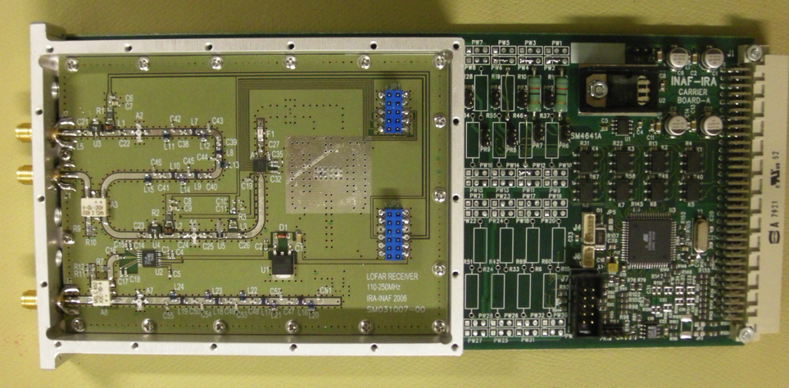
NB receiver: block diagram
BOX under/close the antenna
Coax from LNA
BIAS T
COUPL
FM
STOP
A
Filter bank
A
TX
NG
0-180°
Power
to LNA
NG
Control & Power Supplies
LO
ADC
65MS/s
12bit
+
ROACH
A
Filter
RX
A
FILT
DIG ATT
0 90°
A
Filter
Control & Power Supplies

Slide 19
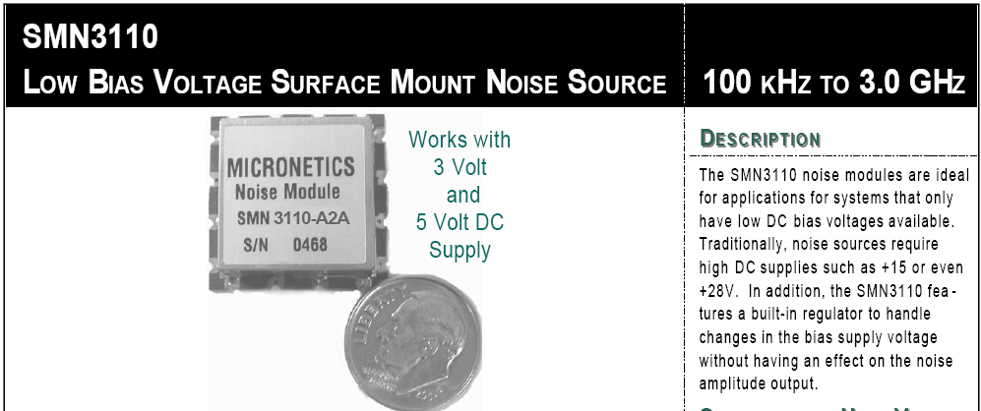
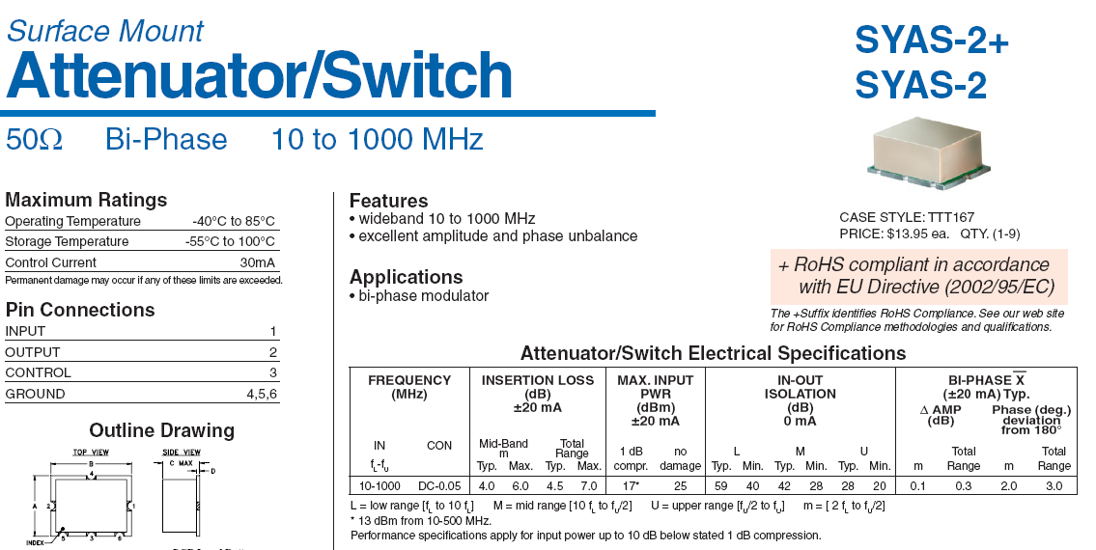
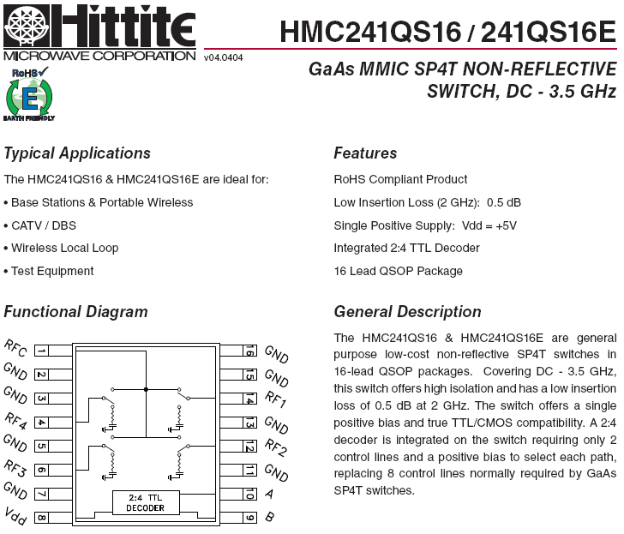
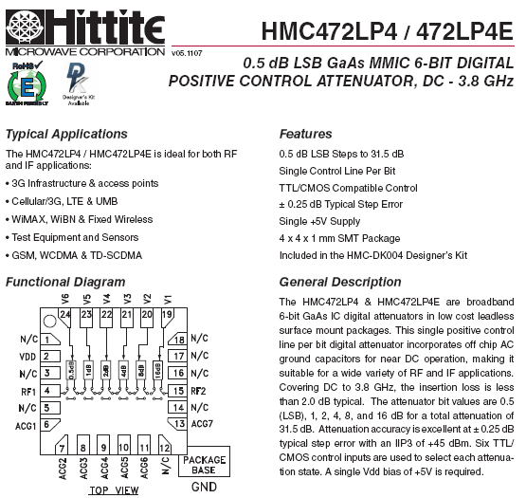
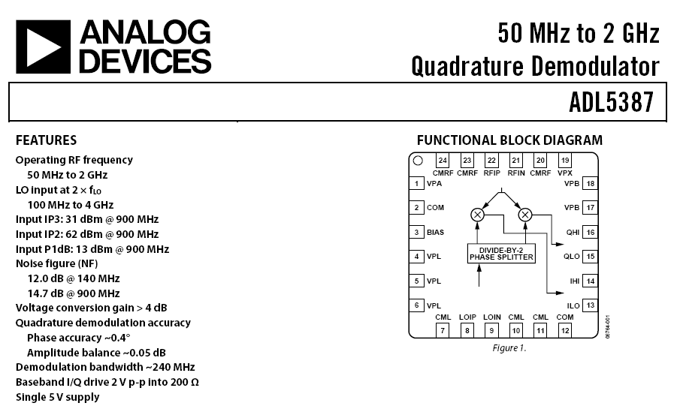
NB receiver components

Slide 20
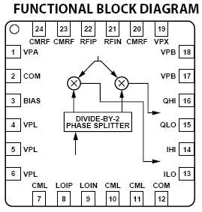
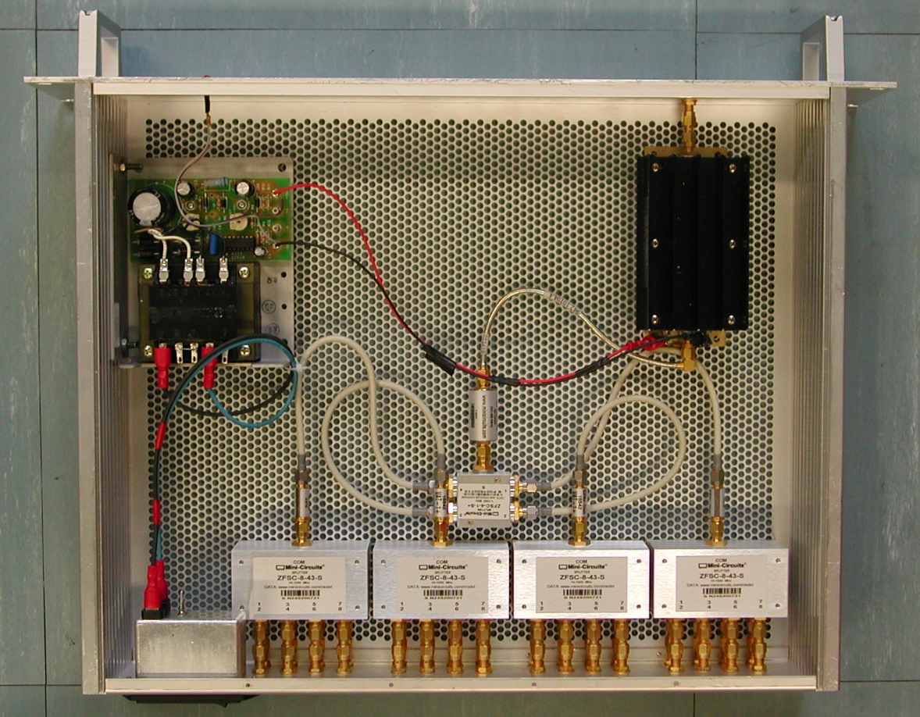
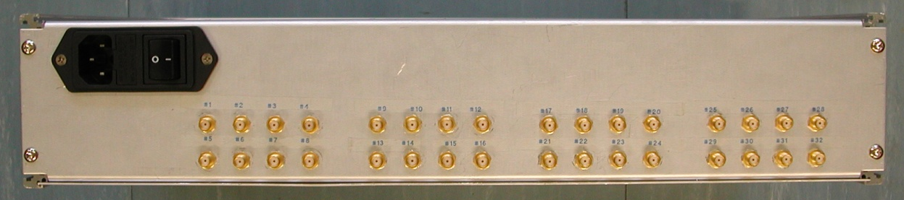
NB receiver: LO distributor
AD5387
IQ mixer
LO level: Typ=0dBm
(-6dBm to 6dBm)
LO frequency at the input to the device have to be twice that of the desired LO frequency at the mixer core.
RF from 70 to 450MHz
→
LO from 140 to 900MHz

Slide 21
WB RX
WB
1GS/s
8bit
ROACH
WB: test bandpass and stability characteristics of the RF-chain.
A 1024ch spectrometer is being developed which will split the 500MHz into 500kHz channels.
WB
1GS/s
8bit
WB
1GS/s
8bit
WB
1GS/s
8bit

Slide 22
WB receiver: block diagram
Coax from LNA
BOX under/close the antenna
BIAS T
COUPL
FM
STOP
A
Filter Bank
A
TX
Power
to LNA
NG
0-180°
NG
Control & Power Supplies
ADC
1GS/s
8bit
+
ROACH
RX
A
FILT
DIG ATT
Pre-White
A
Control & Power Supplies

Slide 23
Conclusions
AAVS0: RoF links (already available) are sufficient
AAVS0+: narrow and wide band receivers are under development
  OL distributor, mechanical housing and RX control by reusing BEST stuff
  Back End & Firmware already available too
AAVS1: evolution of the WB AAVS0+

Slide 24
Thanks!

