Slide 1
A New Antenna Calibration algorithm for AA single station snapshot correlation S.Salvini, F.Dulwich, B.Mort, K.Zarb-Adami stef.salvini@oerc.ox.ac.uk

Slide 2
Content
Fundamentals
Results 1: Chilbolton LOFAR
Results 2: Simulated sky tests (experiments)

Slide 3
Content
Fundamentals
Results 1: Chilbolton LOFAR
Results 2: Simulated sky tests (experiments)

Slide 4
Algorithm motivation
Antenna calibration for gains and phases
Antenna cross-correlation matrix available
Scalable to
LOFAR station (~100 antennas)
LOFAR core (~300 antennas)
SKA Phase 1 AA (~1,000 antennas)
Model sky availability

Slide 5
Algorithm Requirement
If N is the number of antennas ...
Speed and scalability with N
O(N²) floating-point operations throughout
Automatic
“Tuning” parameters available – defaults usually sufficient
L₂ (least-squares) minimisation
Distance between model sky and calibrated observation
Accuracy and Robustness
In particular wrt incomplete visibilities
Missing baselines
Partial cross-correlation
Limited dependency on the model sky complexity
The main body of the algorithm does not depend on the model sky

Slide 6
Some Linear Algebra
Invariants
What is preserved under a transformation
The algorithm is based on that
The SVD
Unique decomposition
U, V are unitary matrices, Σ is a diagonal matrix
U ∙ U^{H} = U^{H} ∙ U = I; V ∙ V^{H} = V^{H} ∙ V = I;
σ_{i} = Σ_{i,i} ≥ 0 is the i-th largest singular value
Singular values are invariant under right or left application of any unitary matrix
σ (A) = σ (W ∙ A ∙ Y) for any A, W, (W, Y unitary)
Also ║ A ║₂ = ║ W ∙ A ∙ Y ║₂
A = U^{H} ∙ Σ ∙ V

Slide 7
Image and Visibility
Visibilities V ➔ image I by 2-D Fourier Transform or similar
Fourier transforms are unitary
F⁻¹ = F^{H}
Hence
V = F^{H} ∙ I∙ F^{H}
the singular values are preserved: σ (I) = σ (F ∙ V ∙ F) = σ (V)
Iterating over the singular space of V is “equivalent” to iterating over the singular space of I (F is known)
I is real hence V is Hermitian: V = V^{H}
For Hermitian matrices, eigenvalues are real and equal to the singular values σ_{i} apart the sign (±).
I = F ∙ V∙ F

Slide 8
The Algorithm
Initialisation (V are the observed visibilities)
For each pass
Repeat until convergence
Set the missing elements of V
Get the largest eigenvalues and eigenvectors of V (the number of eigenvalues is adjusted dynamically)
Compute the new correction to V using the largest eigenvalues
Check for convergence
Purge the negative eigenvalues if required
Carry out a first preliminary calibration
Compute the complex gains
If only one eigenvalue is required ➔ immediate complex gains are obtained
If more than one eigenvalue is required (rank-k problem k > 1)
New algorithm, much faster than Levenberg-Marquardt or line search

Slide 9
Algorithm components
Largest eigenvalues computation – both O(N²)
Lanczos with complete reorthogonalisation
Power (subspace) iteration with Raileigh-Ritz estimates
L2 minimisation
Levenberg-Marquardt far too slow
New algorithm is O(N²)
Iterative one-sided solution
Attempts to “jump” between convergence curves
Very fast convergence
It appears to work also for “brute force” approach, i.e. Minimise distance between observed and model visibilities (although with larger errors)

Slide 10
Some further considerations
From the measurement equation
Where
Complex gain Γ is diagonal
Hence
Error of phases only, unitary transformation: easy problem
Error of gains: difficult problem – it “scrambles” the eigenvalues

Slide 11
Content
Fundamentals
Results 1: Chilbolton LOFAR
Results 2: Simulated sky tests (experiments)

Slide 12
Chilbolton LBA LOFAR Station
Chilbolton LBA LOFAR station data
Thanks to Griffin Foster!
Channel 300: 58.4 MHz
Other channels also available
Sequence of snapshots
Observations spaced by ~520 seconds
Model sky of increasing complexity
2 sources
500 sources
5,000 sources

Slide 13
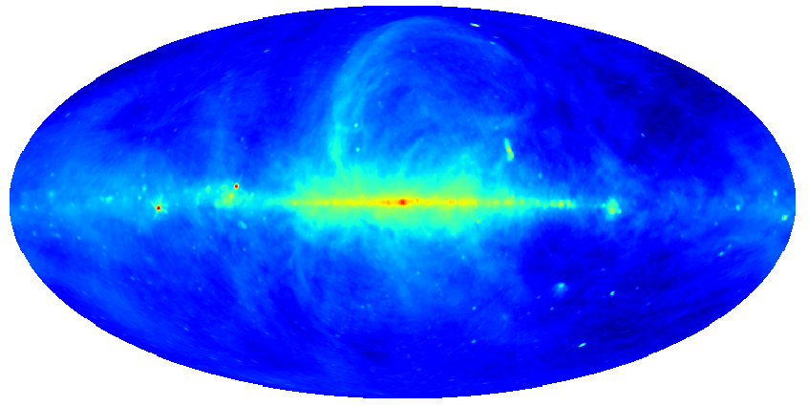
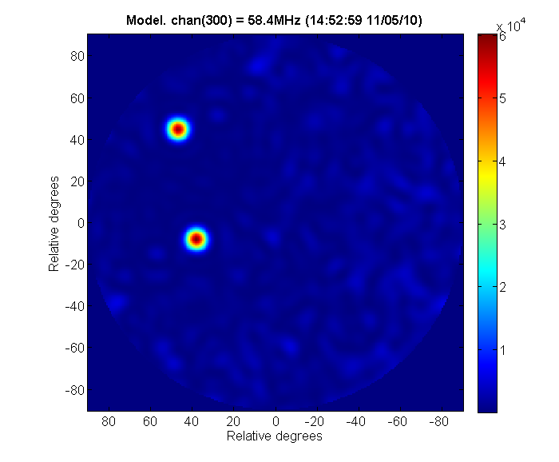
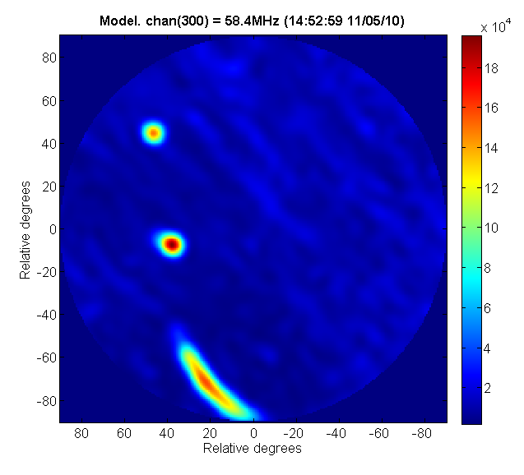
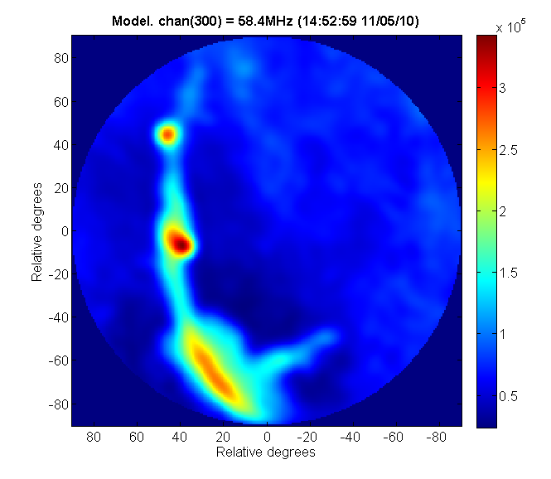
Model Sky
2 sources
500 sources
5000 sources

Slide 14
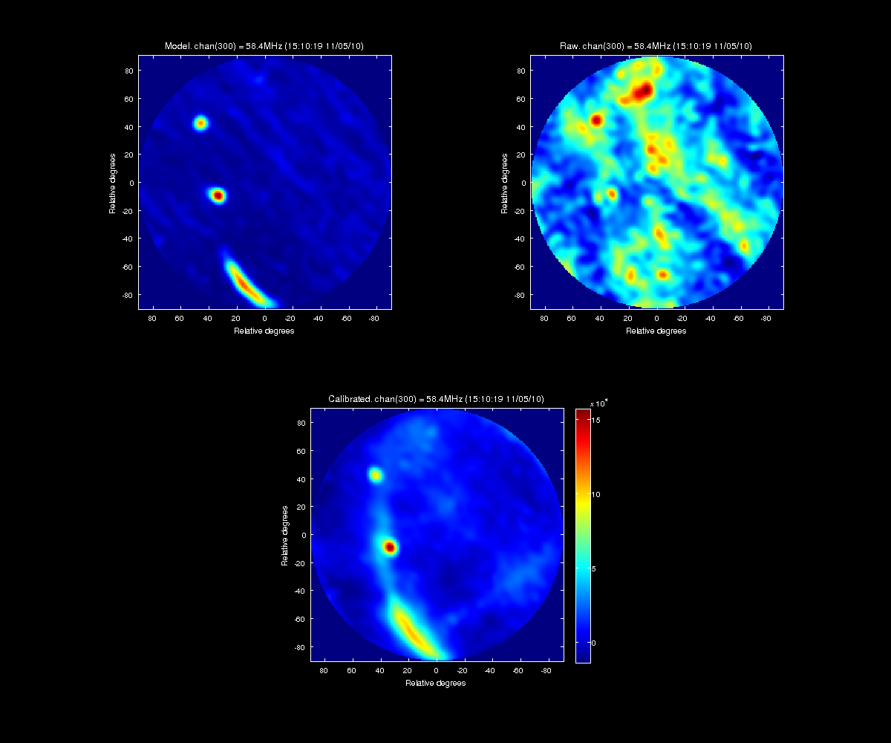
58.4 MHz – 500 sources model sky

Slide 15
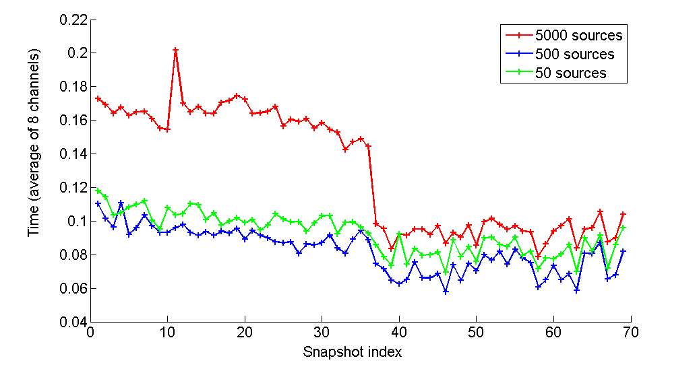
Timing and performance

Slide 16
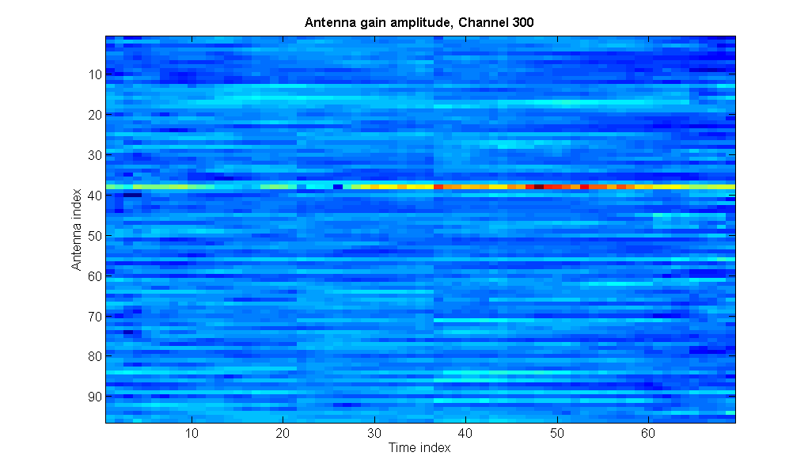
Antenna Gains

Slide 17
Content
Fundamentals
Results 1: Chilbolton LOFAR
Results 2: Simulated sky tests (experiments)

Slide 18
Simulated Sky
Antennas
STD of gains errors ~ 50%
STD of phase errors: ~ 2 π rad
Noise:
equivalent to 150 K
Diagonal elements of noise:
Off-diagonal elements of noise: G is Gaussian random variate, with M the number of integration points
Number of integration points M = 1,000,000
Corresponding to sampling rate 1 GHz, channelised into 1,000 channels, integrated for 1 second

Slide 19
Some performance figures
Simulated sky
MATLAB code
My own laptop (Intel Core 2 i7, 2.5 GHz, Windows)
No. Antennas | Equivalent to | Time (seconds)
96 | LOFAR station | 0.06
351 | > LOFAR core | 0.12
1,000 | SKA Phase 1 ? | 0.88

Slide 20
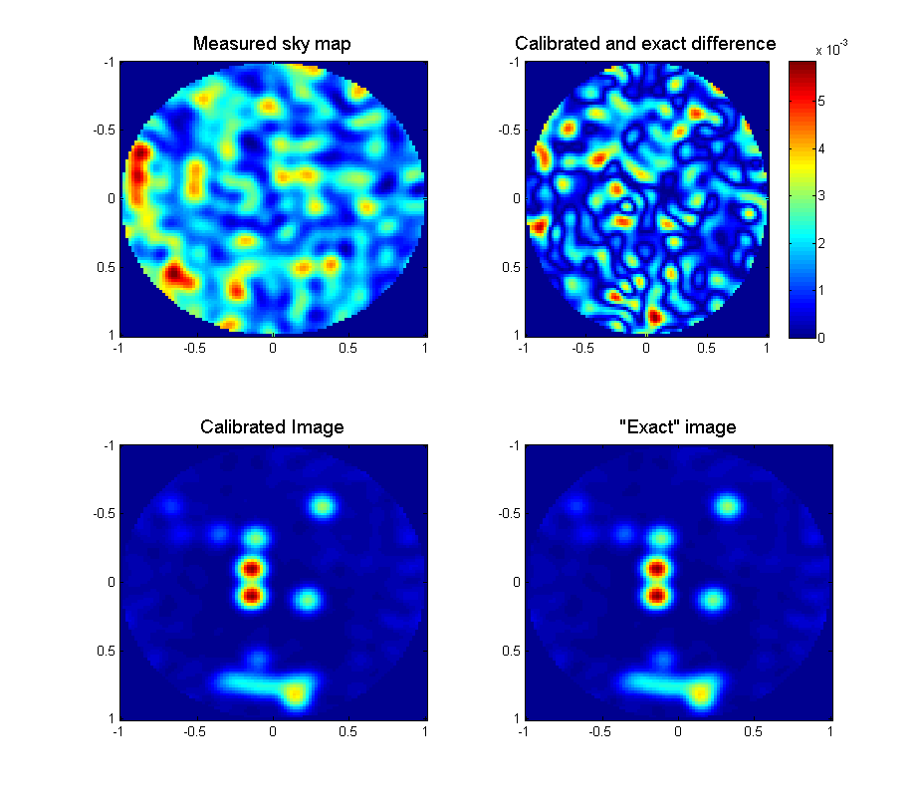
96 Antennas Simulation

Slide 21
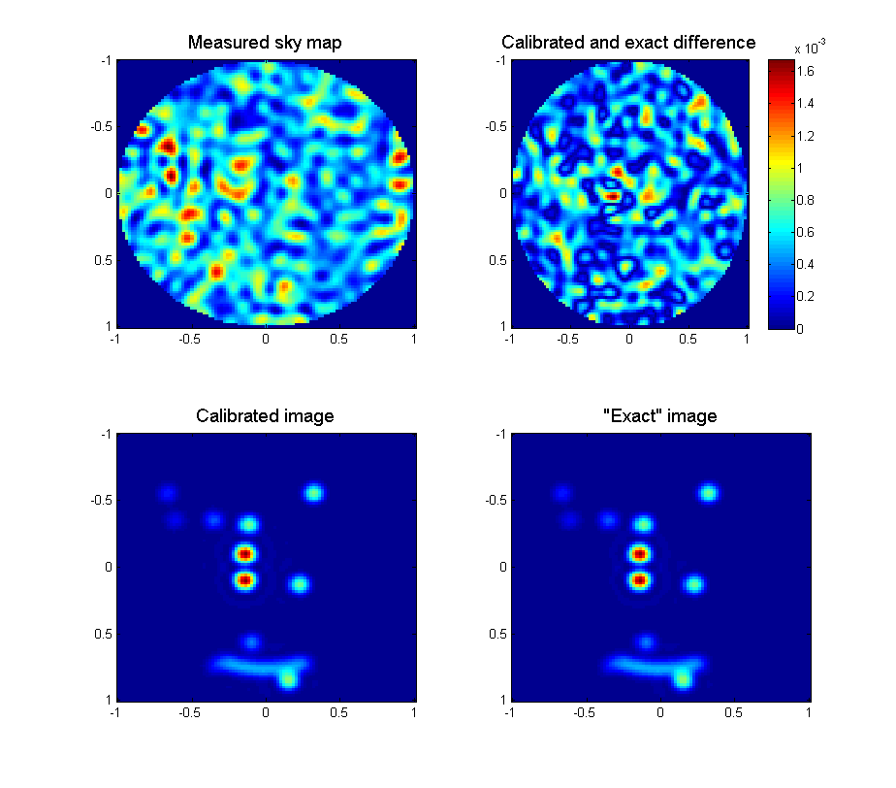
351 Antennas Simulation

Slide 22
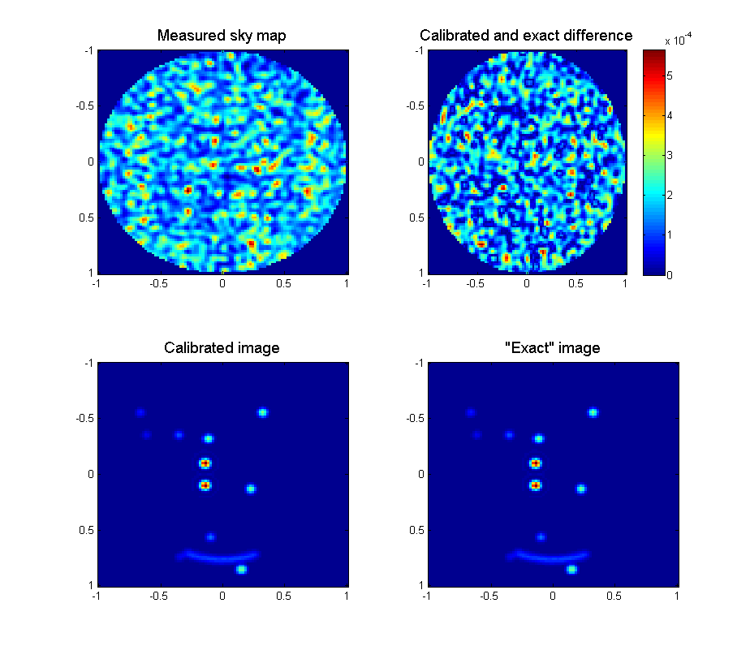
1,000 Antennas Simulation

Slide 23
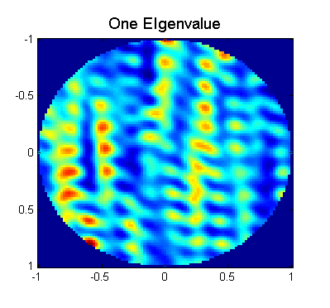
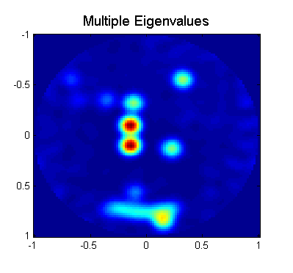
One or more eigenvalues?
Near degeneracy between eigenvalues causes havoc!
No longer individual eigenvalues
The whole near degenerate subspace
Rank 1 can optimise trivially
For rank k, k > 1 no simple solution
Full L₂ minimisation
Simple algorithm works well
0.5 seconds using LM
~ 0.02 secs using the new alg
Chilbolton LOFAR LBA
2 to 4 eigenvalues
Code chooses automatically

Slide 24
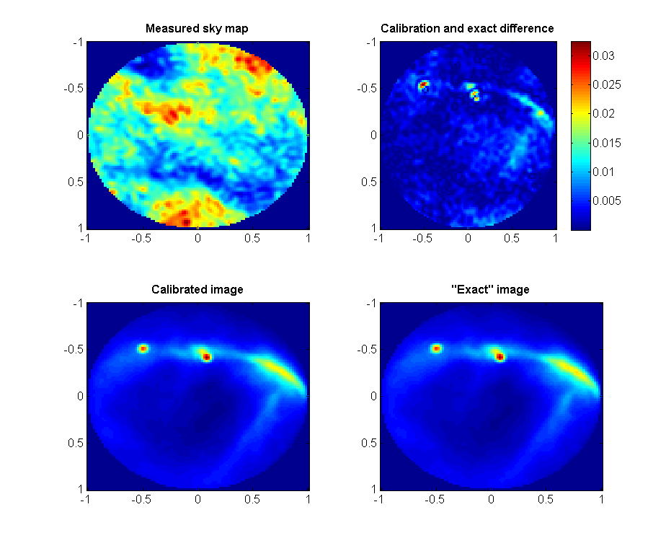
Realistic simulated sky – 351 antennas
Simulated sky
> 24,000 sources
Same corruptions as before
Same noise as before
20 calibration sources
2 eigenvalues used

Slide 25
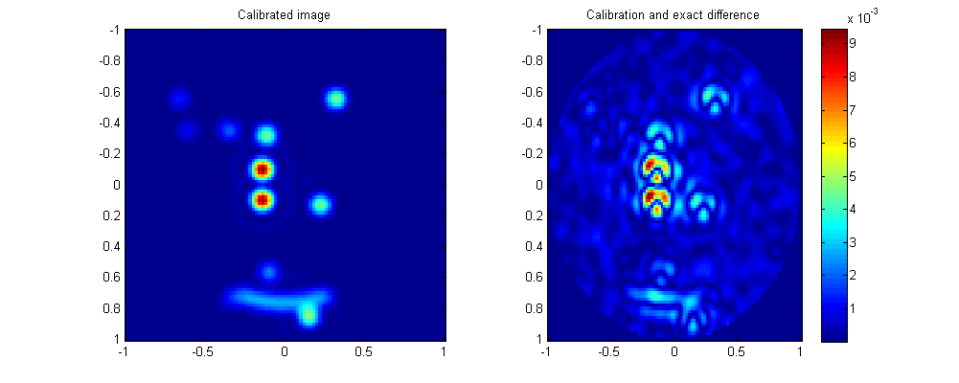
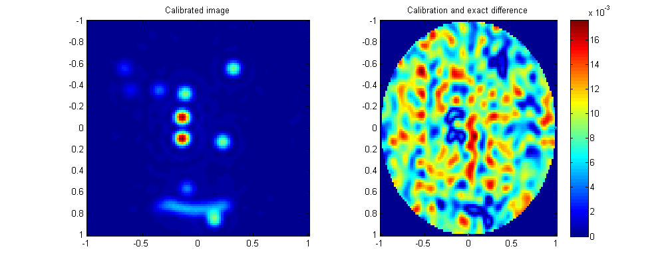
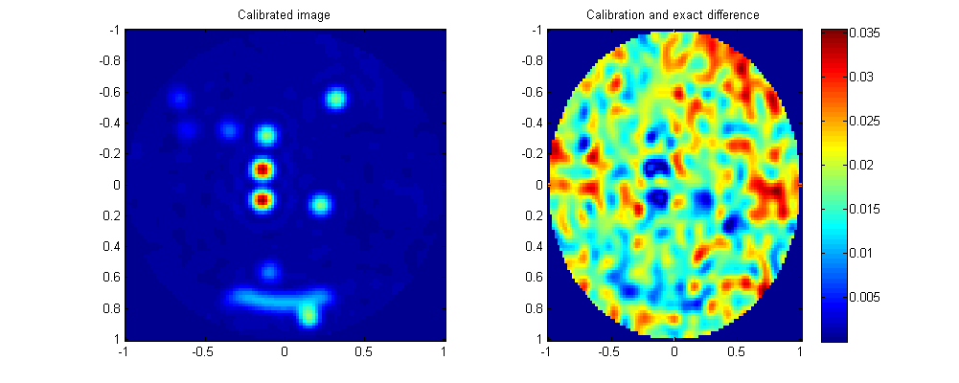
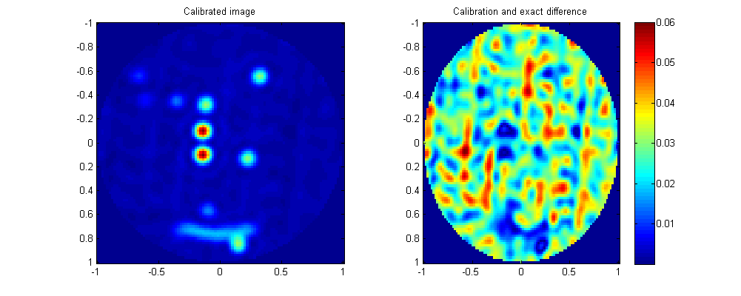
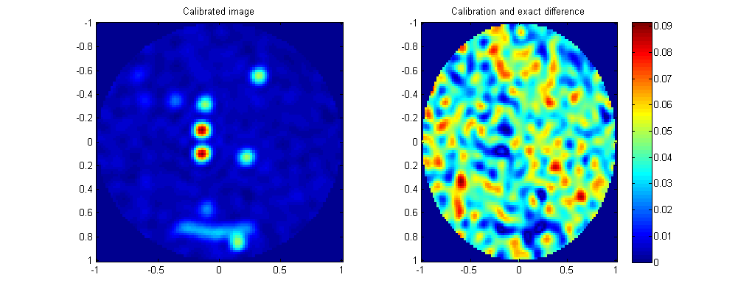
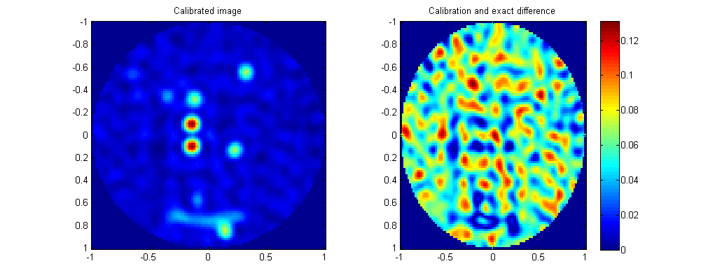
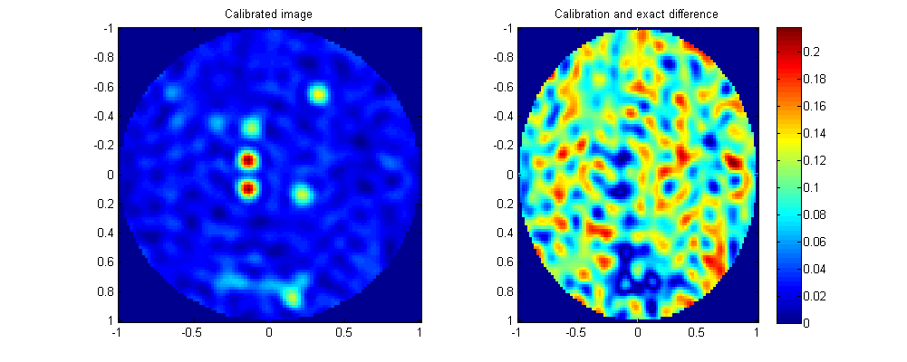
Missing Baselines (351 antennas case)
What if baselines (i.e. Antenna pairs) are removed from V?
Partial cross-correlation (too many antennas)
Missing data
Removal of short baselines
Computation using “brute force” approach (less accurate)
Missing baselines
25%
0 %
50 %
90 %
98 %
95 %
75 %

Slide 26
Conclusions
Fast
Number of operation is O(N²)
Prototype code in MATLAB
Expected some gains in performance when ported to a compiled language (C, C++, Fortran)
Even if it fails, worth using it first: computationally cheap
Starting point for much more complex optimisations
Robust
Extra work always needed, but promising
Any suggestions?

Slide 27
Thank you for your attention!
Any questions?
Comments and suggestions would be very helpful

