Slide 1

Update on the SKA
R. T. Schilizzi
AA Workshop@ASTRON
13 December 2011

Slide 2


SKA₂ Key Science Drivers
ORIGINS
Neutral hydrogen in the universe from the Epoch of Re-ionisation to now
  When did the first stars and galaxies form?
  How did galaxies evolve?
  Dark Energy, Dark Matter
Astro-biology
FUNDAMENTAL FORCES
Pulsars, General Relativity & gravitational waves
Origin & evolution of cosmic magnetism
TRANSIENTS (NEW PHENOMENA)
Science with the Square Kilometre Array
(2004, eds. C. Carilli & S. Rawlings, New Astron. Rev., 48)

Slide 3
SKA₁ Key Science Drivers
ORIGINS
Neutral hydrogen in the universe from the Epoch of Re-ionisation to now
  When did the first stars and galaxies form?
  How did galaxies evolve?
  Dark Energy, dark matter
FUNDAMENTAL FORCES
Pulsars, General Relativity & gravitational waves
Science with the Square Kilometre Array
(2004, eds. C. Carilli & S. Rawlings, New Astron. Rev., 48)

Slide 4
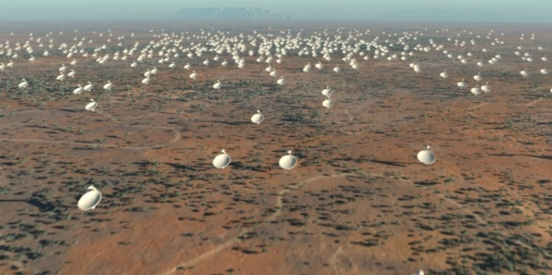
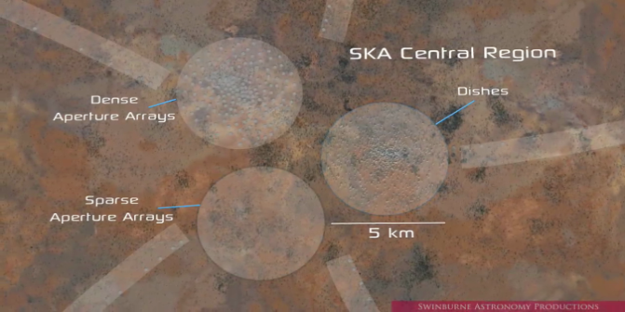

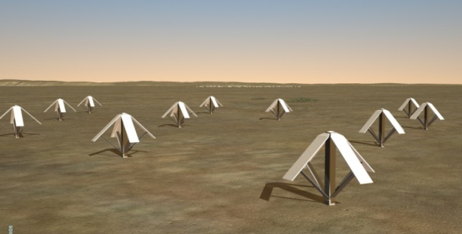
SKA₁ baseline design
Baseline technologies are mature and demonstrated in the SKA Precursors and Pathfinders
250 Dishes
Central Region
50 Sparse Aperture Arrays
Single pixel feed
Artist renditions from Swinburne Astronomy Productions

Slide 5
Advanced Instrumentation Program
    Development of innovative wide-field “radio camera” technologies at mid-frequencies
      mid-frequency aperture array (FoV ~ 200 deg²)
      phased array feeds (PAFs) on the dishes (FoV ~ 30 deg²)
    2. Ultra-wideband single pixel feeds
    The AIP is designed to build maturity and retire risk
    Has the potential for enhancing SKA₁ and being a major part of SKA₂
      Evaluation point in 2014
      Final decision in 2016

Slide 6
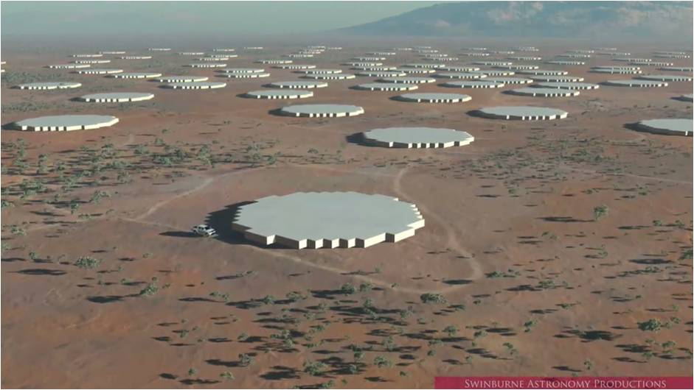
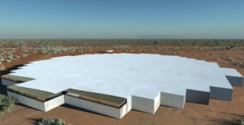

Options for SKA₂ including AIP technologies
250 Dense Aperture Arrays
2500 Dishes
3-Core Central Region
Wide Band Single Pixel Feeds
250 Sparse Aperture Arrays
Phased Array Feeds
Artist renditions from Swinburne Astronomy Productions

Slide 7

Standard System Engineering Approach
SKA System Engineering Management Plan

Slide 8
Conceptual Design Reviews in 2011-12
23-25 Feb System delta-CoDR on SKA₁
14-15 Apr Signal Processing
19-20 Apr Aperture Arrays
28-30 Jun Signal Transport & Networks
13-15 July Dish and Dish Arrays
          2-3 Feb PDR Dish Verification Antenna #1
9-11 Nov Monitor & Control
24-25 Nov delta-CoDR for AA-mid
6-8 Feb12 Software & Computing
System Requirements Review in 2012-Q4

Slide 9
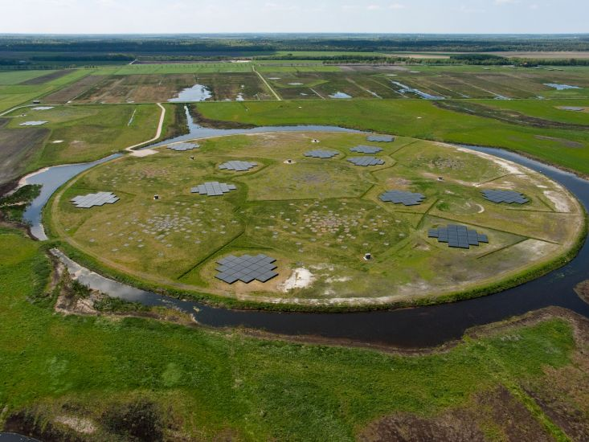
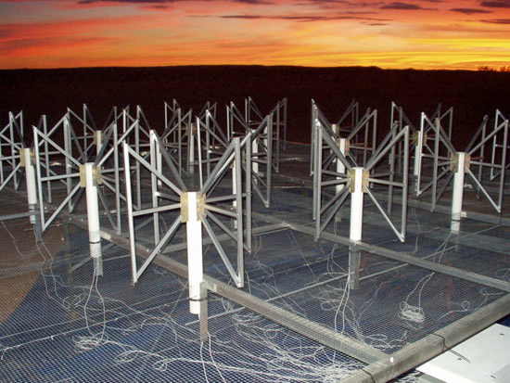
Baseline design component: Low frequency aperture arrays
LOFAR (Netherlands et al)
MWA (Australia, India, USA)

Slide 10
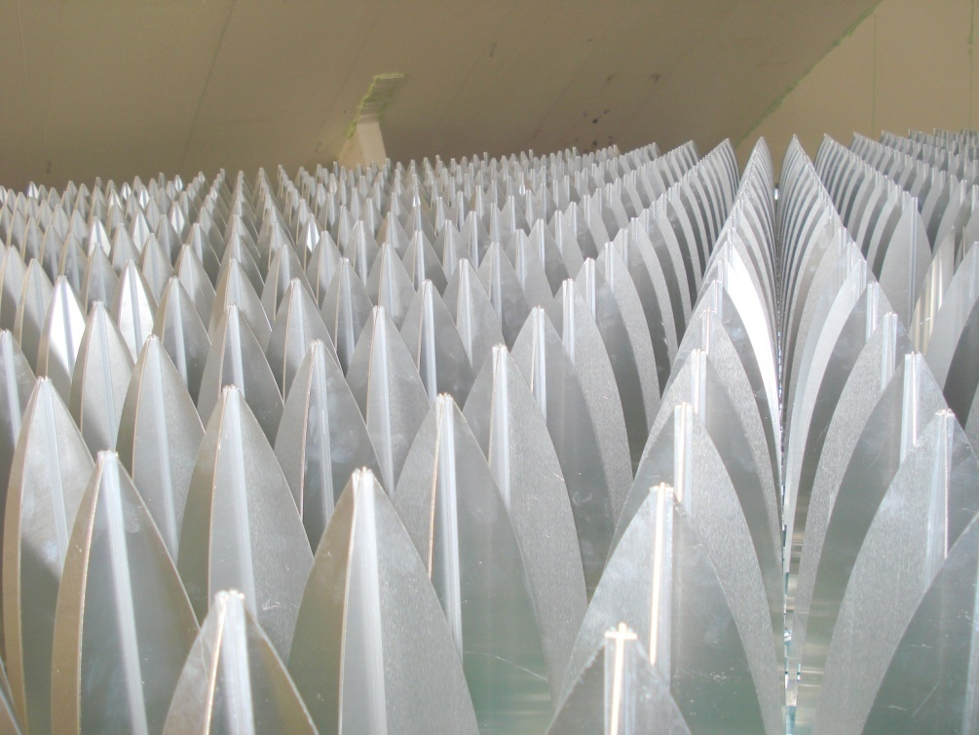
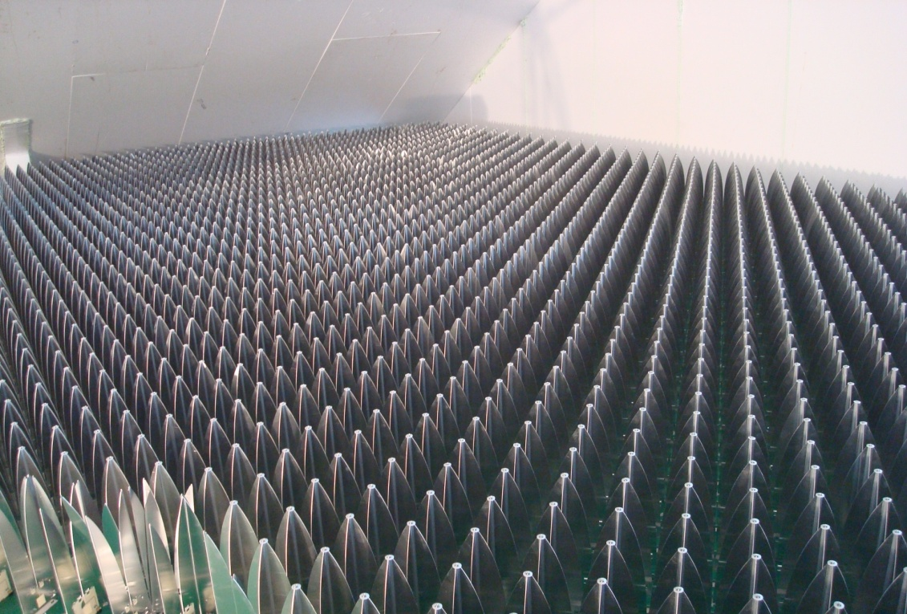
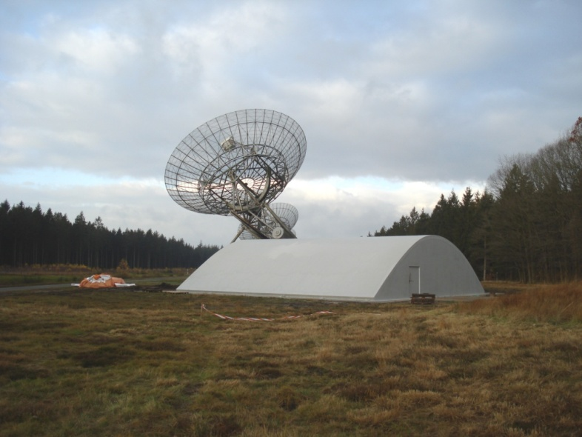
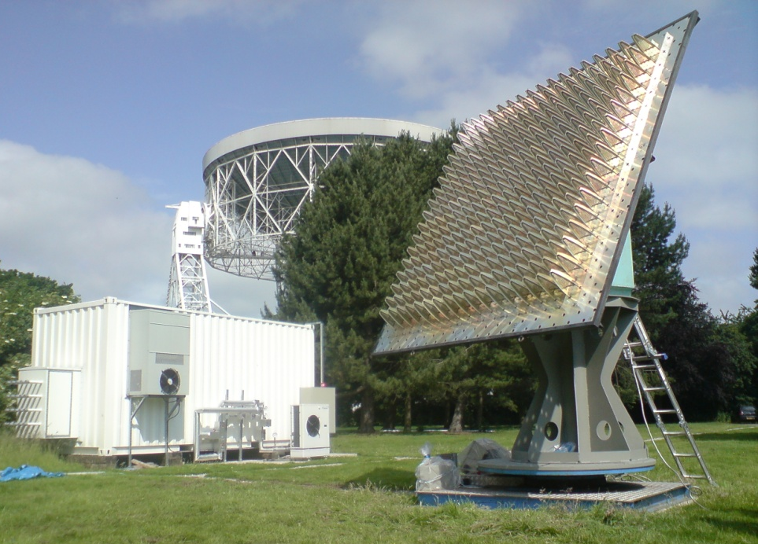
Advanced Instrumentation Program: mid-frequency aperture array
EMBRACE
2-PAD
Industry already involved in production.

Slide 11
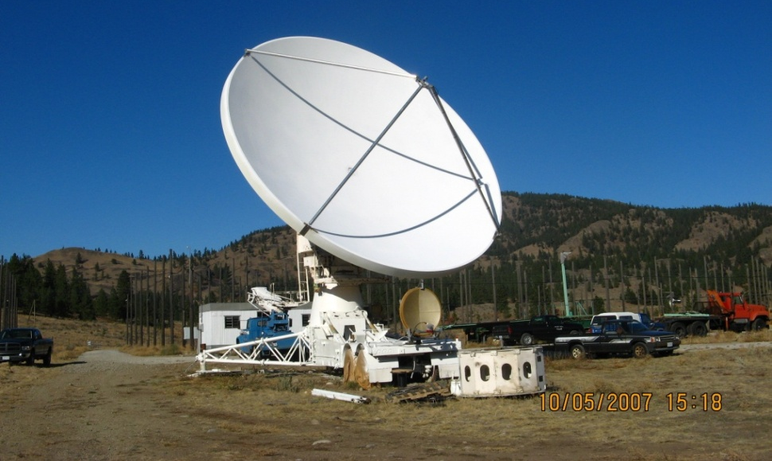
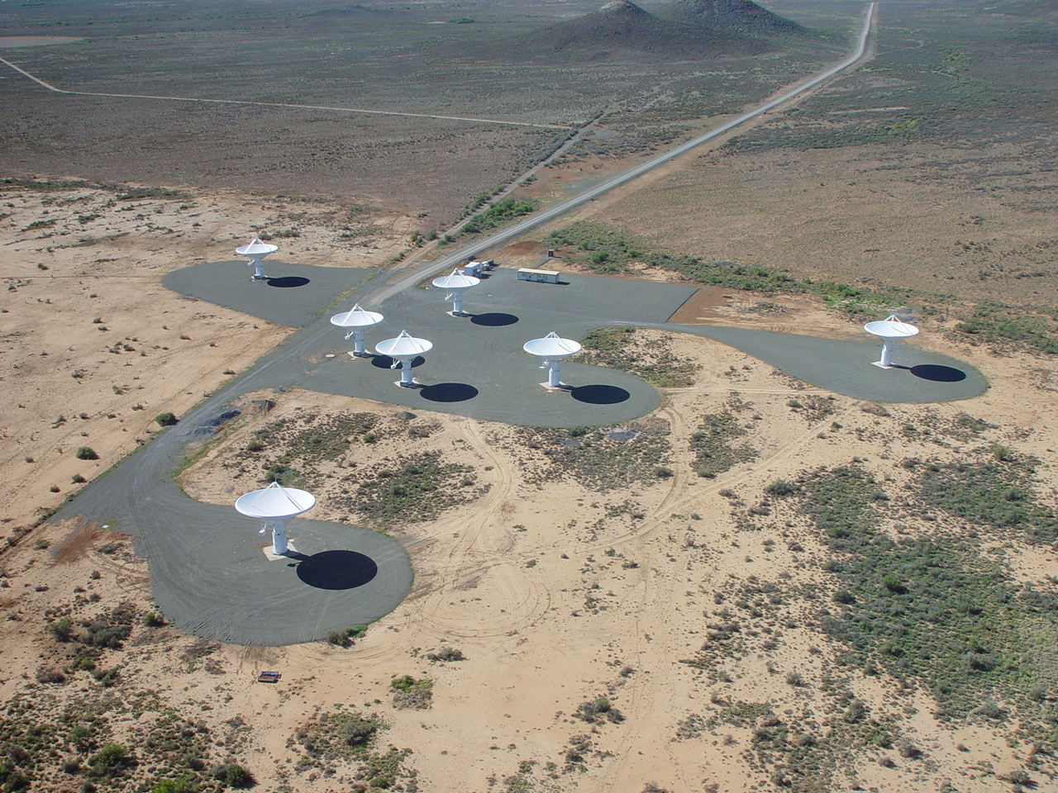
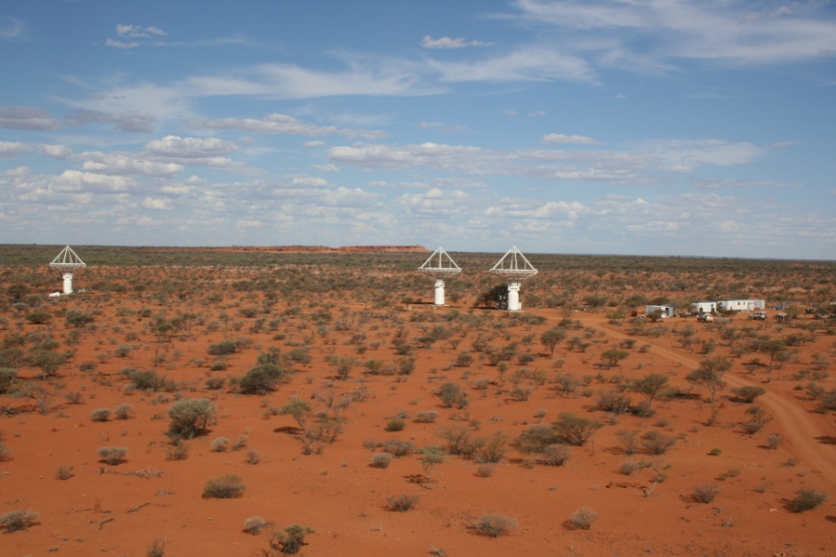
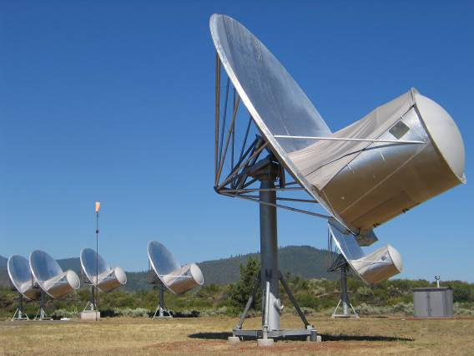
Baseline design component: Dishes + single pixel feeds
CART (Canada)
MeerKAT (South Africa)
80x12m composite dishes
SKA Dish Verification Antenna #1
Mechanical design by
Gordon Lacy & Matt Fleming
NRC-SPDO/SPO partnership
MeerKAT
10 m composite prototype
ASKAP (Australia)
36x12m panel dishes
ATA (USA)
42x6m hydroformed dishes

Slide 12
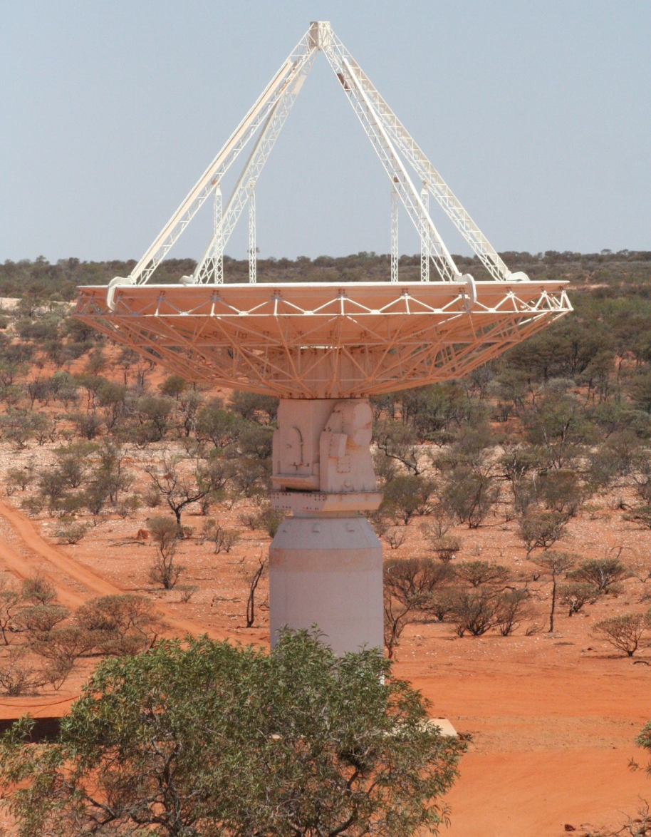

3-axis ASKAP Antenna Design

Slide 13
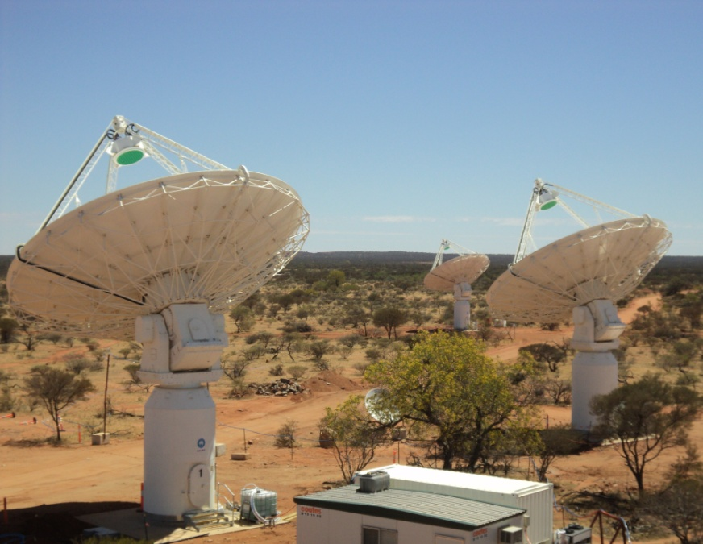
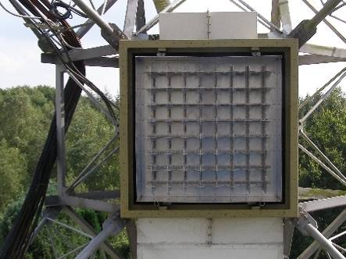
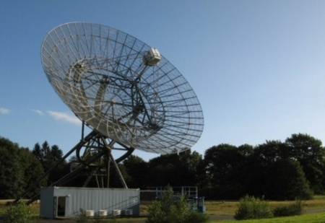
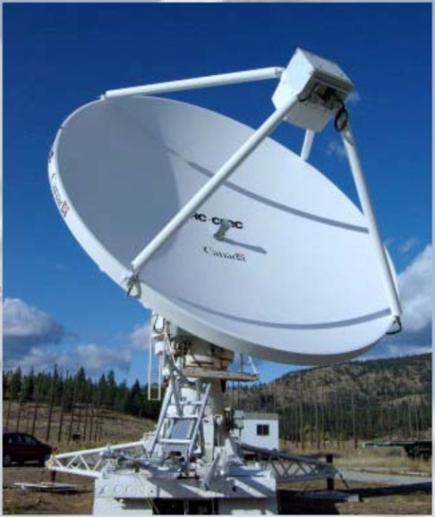
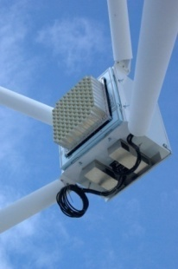
Advanced Instrumentation Program: dishes+multi-pixel feeds
ASKAP chequer board array
ASKAP
chequer board array
APERTIF (Astron, NL)
DRAO Canada

Slide 14
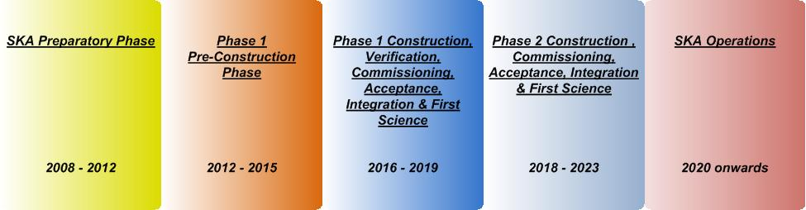
SKA Phases
Preparatory phase (current phase)
Pre-construction phase (production readiness)
SKA1 construction, verification, commissioning, acceptance, integration & first science
SKA2 construction, commissioning, acceptance, integration & first science
SKA Operations

Slide 15
Pre-construction phase (2012-15)
Goals
Progress the SKA design and prototyping to production readiness
Establish industry participation strategies, procurement processes, and protocols governing the selection of work package consortia
Identify funding commitments for SKA Phase 1 (SKA1) construction and operations
Prepare long term SKA organisational structure and arrangements for the construction, verification and operation of the SKA
Build relationships with relevant national and international astronomy organisations

Slide 16
Progress towards Pre-construction Phase
Interim Founding Board created 2 April 2011 to
  Establish a legal entity for the SKA Organisation
  Decide location of the SKA Project Office
  Allocate resources for the Project Execution Plan

Slide 17
Progress towards Pre-construction Phase
Interim Founding Board created 2 April 2011 to
  Establish a legal entity for the SKA Organisation
  DONE
  Decide location of the SKA Project Office
  DONE - Jodrell Bank Observatory
  Allocate resources for the Project Execution Plan
  PARTIALLY DONE - 91M€ proposed, 69M€ so far

Slide 18
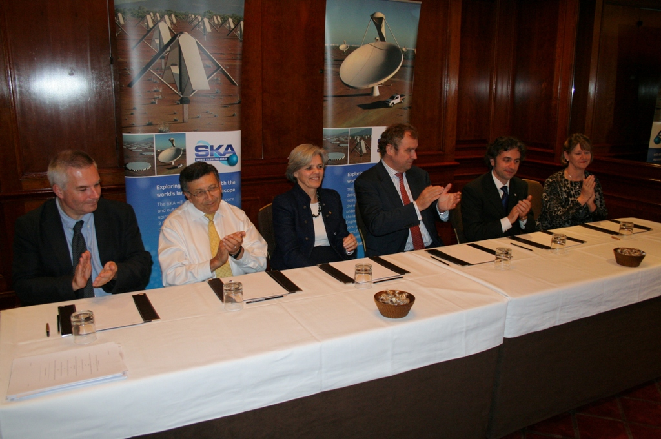
Pre-construction Phase Governance
  The legal entity for the SKA Organisation
  was created on 23 November in London
Signatories (r to l)
Australia
Italy
Netherlands
New Zealand
South Africa
UK
China (not able to be present)

Slide 19
SKA Organisation
Company Limited by Guarantee in the UK
  Membership Agreement including Articles of Association and Business Plan
Additional signatories expected early next year
  Canada
  Germany
Other interested countries
  France
  India
  Japan
  Korea
  Sweden

Slide 20
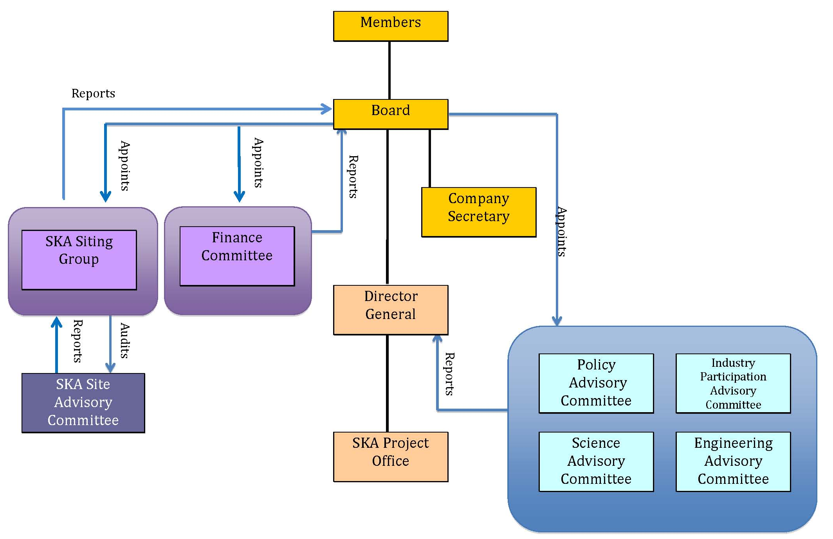
Organisation Chart

Slide 21
Pre-construction Phase:
Business Plan
Proposed funding: 91 M€
    28 M€ for SPO staff and operations (30%)
      Current pledges 17 M€
    63 M€ for Work Package Consortia (70%)
      Current pledges 52 M€
Two stage process
  Stage 1: ‘Completing the Preparatory Phase’
  Stage 2: ‘Delivering Construction Readiness’

Slide 22
Stage 1 at system level
SPO
Planning
Science Requirements
Technical Requirements
SRR

Slide 23
Stage 1 at element level
Pre-Stage 1
Stage 1
Requirements
Element Requirements;
WBS Development;
and Design studies
Planning
CoDR => SRR
_{(See next slide.}
Note SoW planning mtg wk 30Jan12)
Element SRR
Analysis of CoDRs
Verification Work

Slide 24
Assembling Element Level RFPs for Stage 1 Work
Assemble Work Package Consortia
Pre-Stage 1
Planning Element 1 CoDR-SRR Work
Define Top-level WBS
Bid
Planning Element 2 CoDR-SRR Work
SoWs
RFPs
Review
Planning Element N CoDR-SRR Work
Stage 1 Element MoAs
Develop Stage 1 Legal, Bid Policy, T&C Contract Templates
Nov/11
Apr/12
Jun/12

Slide 25
Work Package Consortia
Work Package Consortia will be funded by local sources and will operate under Consortium Agreements
SKA Organisation Board of Directors
Work Package Consortia will sign Multi-Lateral Agreements with the SKA Organisation to carry out the work
Director General
SKA Project Office (SPO)
Work package Consortium
Work package Consortium
Work package Consortium
Industry
Participating Orgs

Slide 26
Site selection

Slide 27
Site selection overview
Physical requirements
  1. Extremely radio quiet environment
  2. At least 3000 km in extent
  3. Low ionospheric turbulence
  4. Low tropospheric turbulence
Two candidates short-listed in 2006:
Australia + NZ Southern Africa
2010
2011
2012
2010
2011
2012
Site characterisation
decision
selection criteria
info acquisition & analysis
evaluat-ion
Site selection process

Slide 28
Site characterisation since the short-listing
EC-FP7 funded work on SKA from 2008 including site characterisation (led by the SPDO)
RFI monitoring at the proposed core sites, and 4 remote sites
Establishment of Radio Quiet Zones by the Candidate Sites
Tropospheric phase monitoring at the proposed core sites
Ionospheric modelling
Generation of configurations taking site constraints into account; analysis of EMI risk
Analysis of science performance of the configurations

Slide 29
Who are the current players?
Candidate sites
Board of Directors (BoD) of the SKA Organisation
  Responsible for selecting the SKA site
SKA Siting Group (SSG)
  appointed by the FB and SSEC
  has reported to FB and SSEC, Board of Directors from 13 Dec
  responsible for
    establishing the site selection factors
    overseeing the selection process
    validating the analysis, assessment, and evaluation process
    managing the SSAC

Slide 30
Who are the current players?
SKA Site Advisory Committee (SSAC)
  Appointed by the FB and SSEC, reports to the SSG
  Responsible for evaluating the information on the sites, and making a recommendation on the preferred site
SKA Program Development Office (SPDO)
  Reports to SSEC
  Managed the site characterisation proces
  Generates reports on some of the selection factors
  Provides advice and support for the SSG
  Provides technical support for the SSAC
  Provided briefings for Expert Panels and Consultants
SKA Project Office (SPO)
  will take over SPDO responsibilities on 1 January 2012
Expert Panels and Consultants
  Appointed by SPDO with approval of SSEC; report to SSG
  Responsible for assessing information on site selection factors and generating reports

Slide 31
2011 Selection Criteria
Categories
Science & technical
  1.1 Current and long-term RFI environment
  1.2 Ionospheric scintillation
  1.3 Tropospheric turbulence
  1.4 Array configuration and science performance
  1.5 Site physical characteristics
Other
  2.1 Customs and excise
  2.2 Security
  2.3 Legal
  2.4 Employment
  2.5 Working and Support Conditions
  2.6 Political, Socio-economic and Financial

Slide 32
Selection Criteria (2)
3. Implementation plans and costs
3.1 basic infrastructure components
3.2 power provision
3.2 data connectivity
based on a 3-core model of the SKA

Slide 33

www.skatelescope.org

Slide 34
Work Breakdown Structure
Level 1: SKA Total System (SPO)
Level 2: Telescope (WPCs)
Facilities (SPO)
Project management (SPO)
Science (SPO)
System design and system level system engineering (SPO)

Slide 35
WBS: Telescope
Level 3: Dish Array
AA-low
Signal & Data Transport
Central Signal Processing
Science Data Processing
Telescope Manager
Synchronisation & Timing
Power
Site & Infrastructure (SPO)
Advanced Instrumentation
(AA-mid, PAF, WBSPF)

Slide 36
SKA2
SKA2
SKA1
EVLA
LOFAR

Slide 37
SKA2
SKA1
LOFAR
EVLA

Slide 38
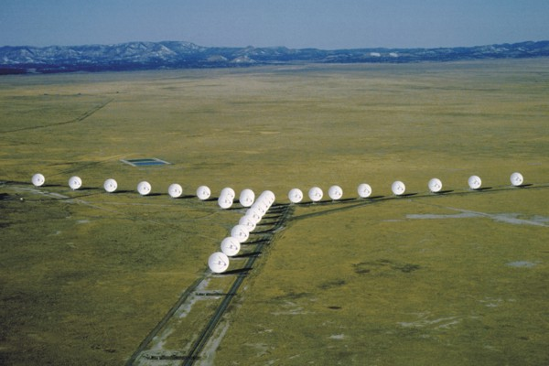
Top-level description
a large radio telescope for transformational science
up to 1 million m² collecting area distributed over a distance of 3000+ km
operating as an interferometer at frequencies from 70 MHz to 10 GHz (4m-3cm) with two or more detector technologies
connected to a signal processor and high performance computing system by an optical fibre network (sensor network)
providing
40 x sensitivity of the Expanded Very Large Array, and
up to 10000 x survey speed
Scientists and engineers in 67 institutes in
20 countries are participating
EVLA

Slide 39
Top-level description (2)
Construction will proceed in two phases: SKA₁, SKA₂
SKA₁ will be a subset (~10% area) of SKA₂
_{70 MHz – 3GHz}
_{100 km baselines}
Major science observations already possible with SKA₁ in 2020
Phased construction allows maximum use of advances in technology

Slide 40
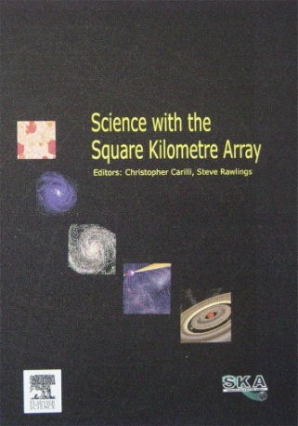
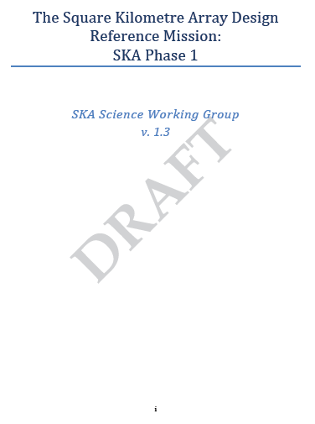
Science Case => Design Reference Mission => Science Requirements
Requirement #1
Requirement #2
Requirement #3
Requirement #4
Requirement #5
Requirement #6
Requirement #7
Requirement #8
Requirement #9
Requirement #10
Requirement #11
Requirement #12
Requirement #13
Requirement #14
Requirement #15
…
Requirement #N
Science Case
Lays out overarching goals, full suite of science
SKA1
Design Reference Mission.
Requirements Document
Incorporates input from science, but other inputs as well
Back-project result to original science case
40

