Slide 1




Sustainable Energies
AAVP2011
Manuel Silva Pérez
manuel.silva@ctaer.com

Slide 2
SKA and sustainable energy
Introduction
SKA activities in Spain
Renewable energy and the Spainsh industry
Characteristics of renewable energy sources
Renewable electricity technologies
Matching generation to demand
Sustainable power supply for SKA installations

Slide 3
CTAER - GENERAL OVERVIEW
The Advanced Technology Centre for Renewable Energies (CTAER)
The CTAER is a technology center whose primary objective is to contribute to the development of technologies for harnessing renewable energy. It was established as a Foundation aided by the Andalusian Government, Junta de Andalucía, through its specialized Agencies for Innovation and Energy – and later joined by the leaders in the energy sector, and the Spanish national Centre for Energy-Related, Environmental and Technological Research (CIEMAT).
CTAER projects are aimed mainly at improving performance and cost efficiency of technologies related to basic renewable resources such as solar, wind or biomass, which are especially abundant in Andalusia. Strategically, the area of ​​solar energy is located in the desert of Almeria, the wind energy sector, on the Atlantic coast of Andalusia, and the biomass area in the Upper Guadalquivir in Jaen.

Slide 4


















FOUNDATION’S STEERING COMMITTEE
Agencia de Innovación y Desarrollo de Andalucía | Agencia Andaluza de la Energía | Centro de Investigaciones Energéticas, Medioambientales y Tecnológicas
Universidad de Almería | Universidad de Jaén
Notes:
Comentar contactos nuevas incorporaciones

Slide 5

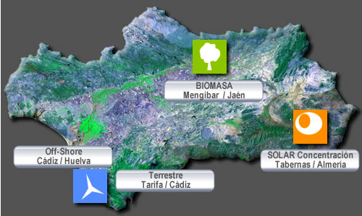
MAP OF CTAER RESEARCH AREAS

Slide 6
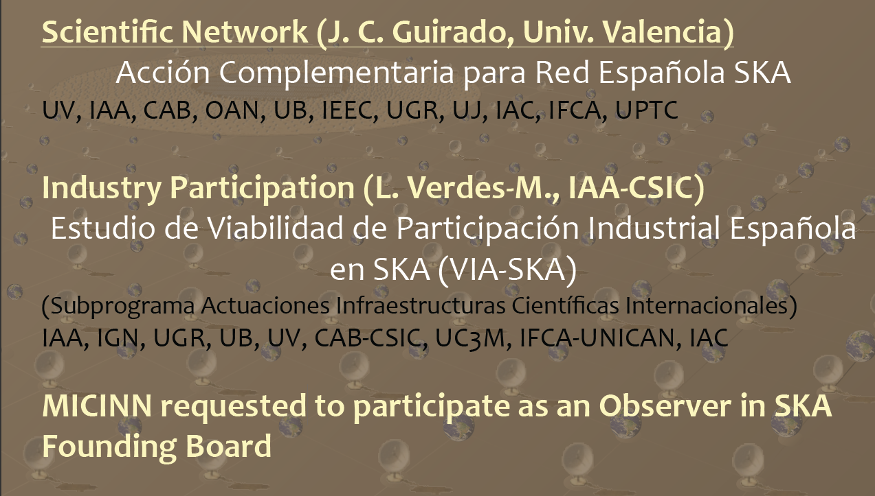
SKA Activities in Spain

Slide 7
The Spanish RE Industry and SKA
SKA installations will be powered from sustainable sources
Spanish RE industrial sector has been identified as a potential participant in the development of SKA
RE Spanish sector has demonstrated a great potential during the last decade, especially:
  Wind
  Solar
    CSP
    PV

Slide 8
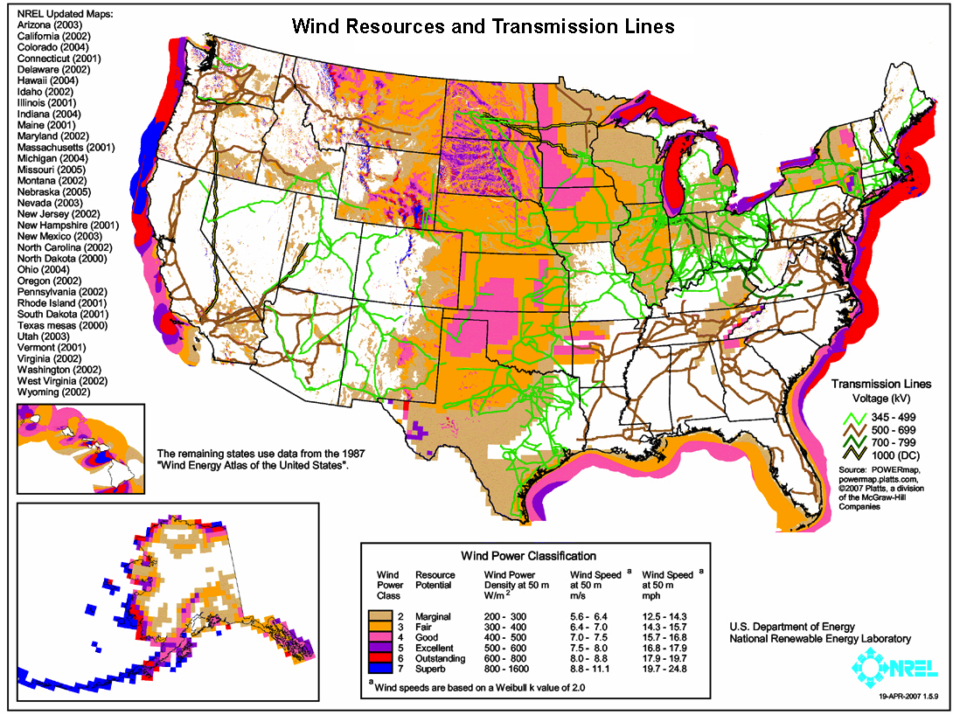
Characteristics of Renewable Energy Sources
Site-dependent
  Variable on time
  Intermittent
  Unpredictable
Low density

Slide 9
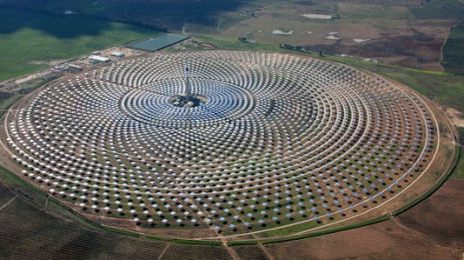
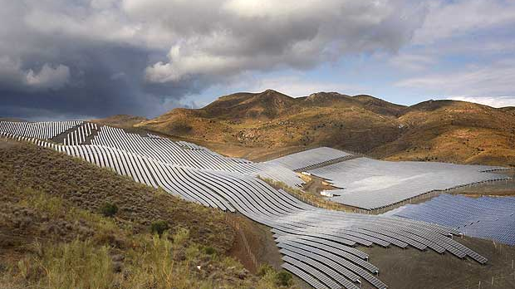
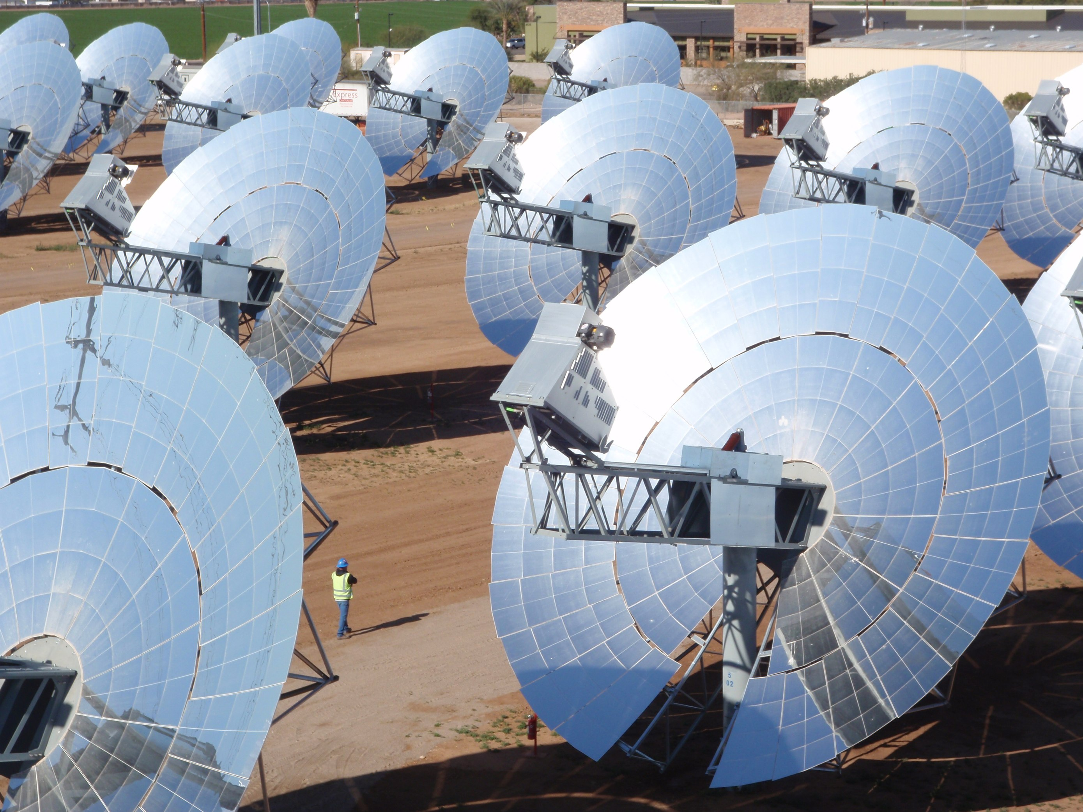
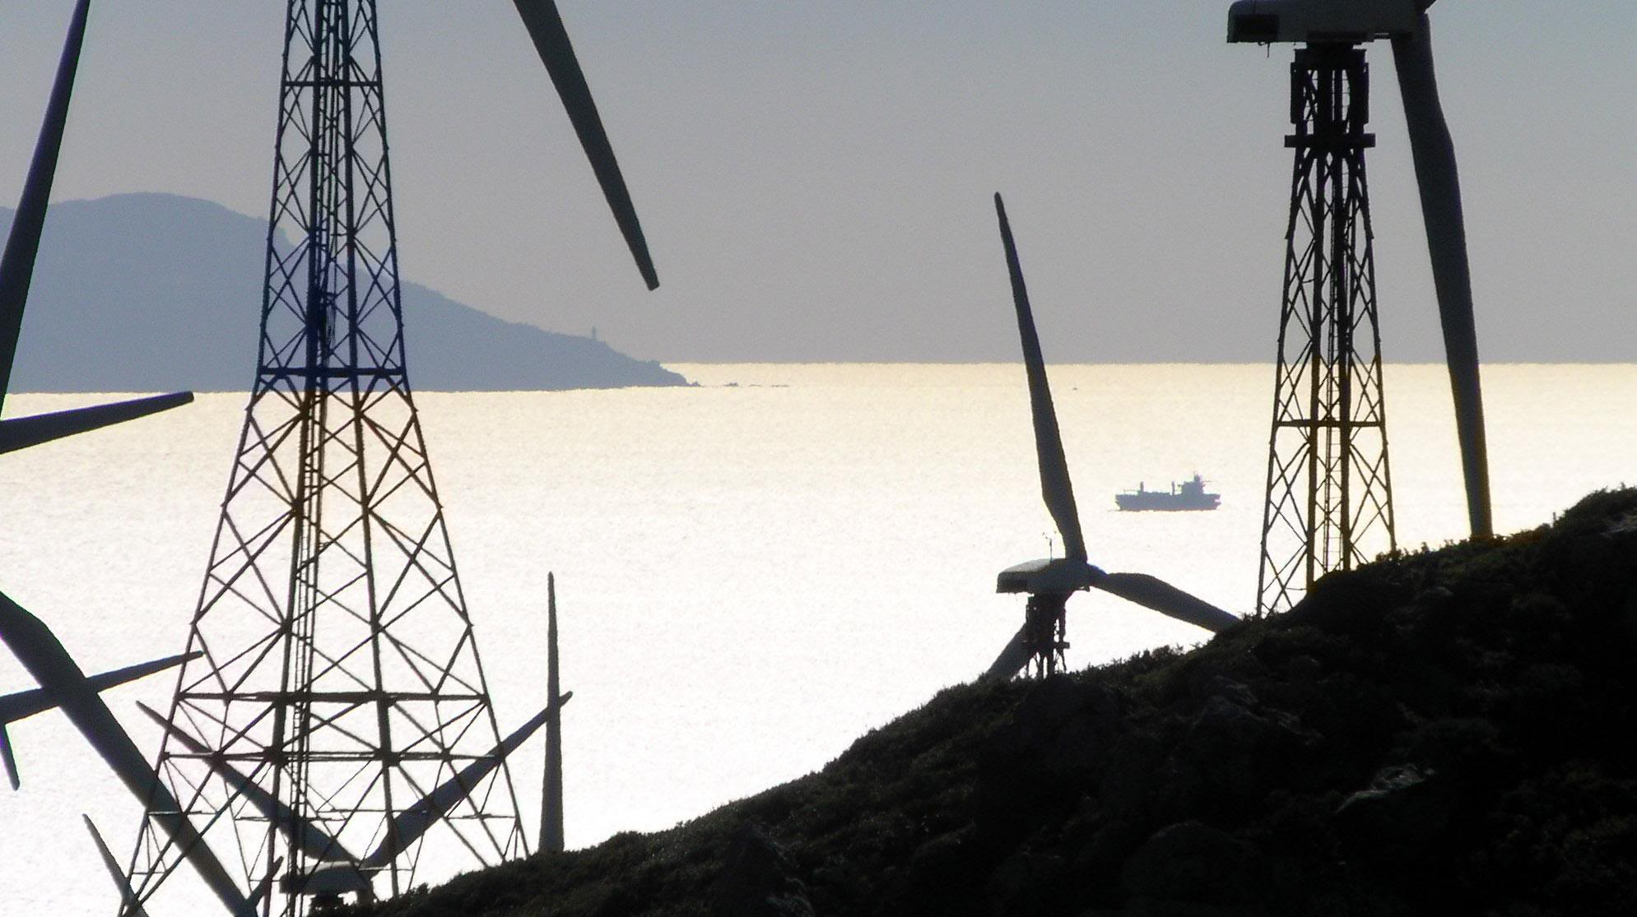
Renewable energy technologies
Wind
Solar
  PV
  STE
Geothermal
Marine
Biomass

Slide 10
Matching generation to demand
Energy storage
  Electrical storage
  Thermal storage
  Chemical storage (fuels)
Hybrid installations
  Solar / wind
  Solar / fuel

Slide 11
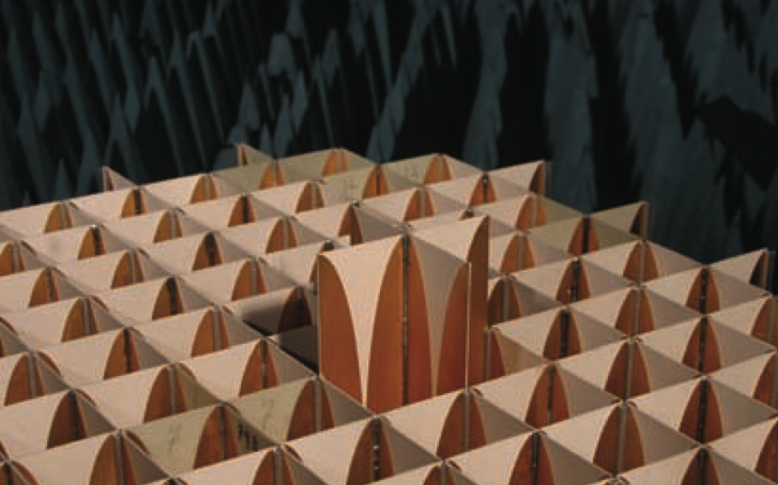
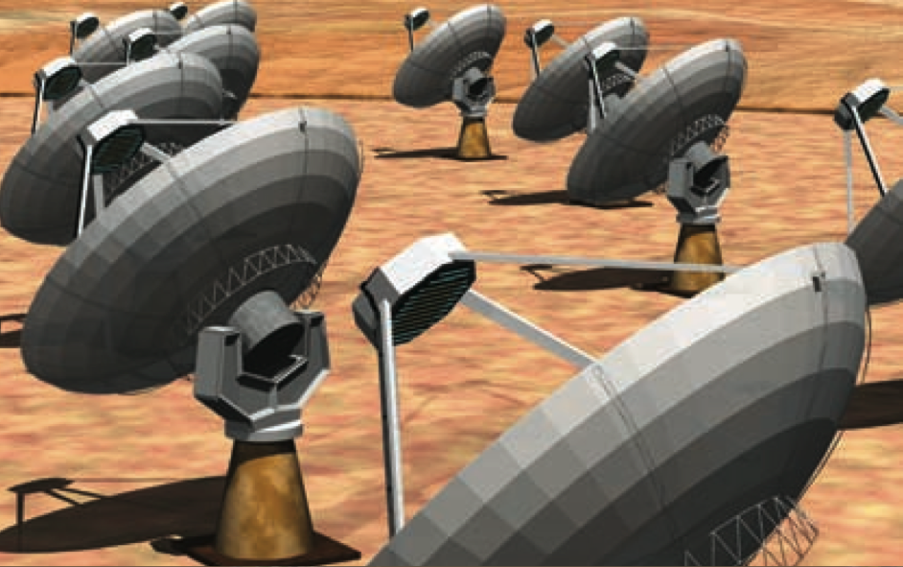
Sustainable power supply for SKA
The SKA facilities will require a power supply of about 100 – 150 MW?
Power and energy requirements will be distributed over a wide area
The power and energy requirements will differ between different antennae and installations
Power quality, EMS/RFI and reliability issues have to be addressed
Sustainable power supply can only be provided by means of proven and reliable Renewable Energy Technologies
Selection of the technologies and power generation system design will be strongly dependent on site resources

Slide 12
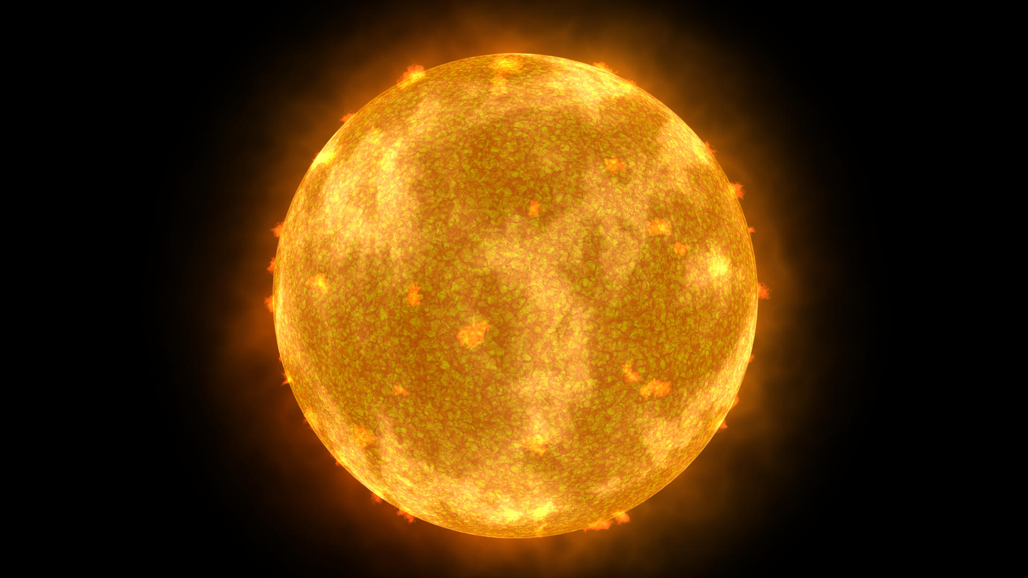
  Thanks for your attention!

