Slide 1
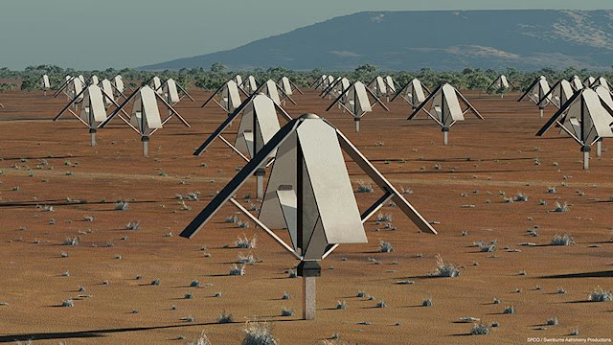
The Murchison Widefield Array
and SKA AA developments
MWA configuration
Prof. Steven Tingay (ICRAR, Curtin University), MWA Director
December 2011: Taking the AA Programme into SKA Pre-construction
ASTRON, December 12 - 16, 2011

Slide 2
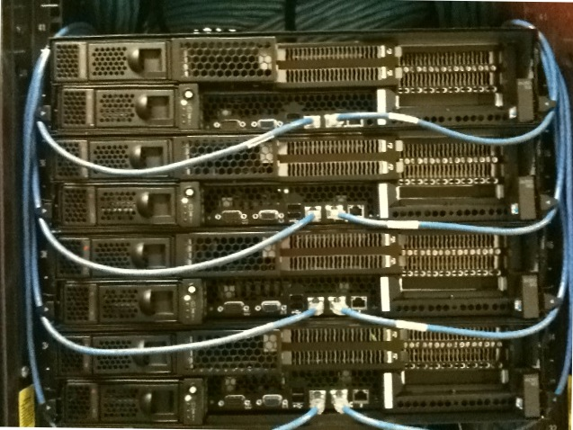
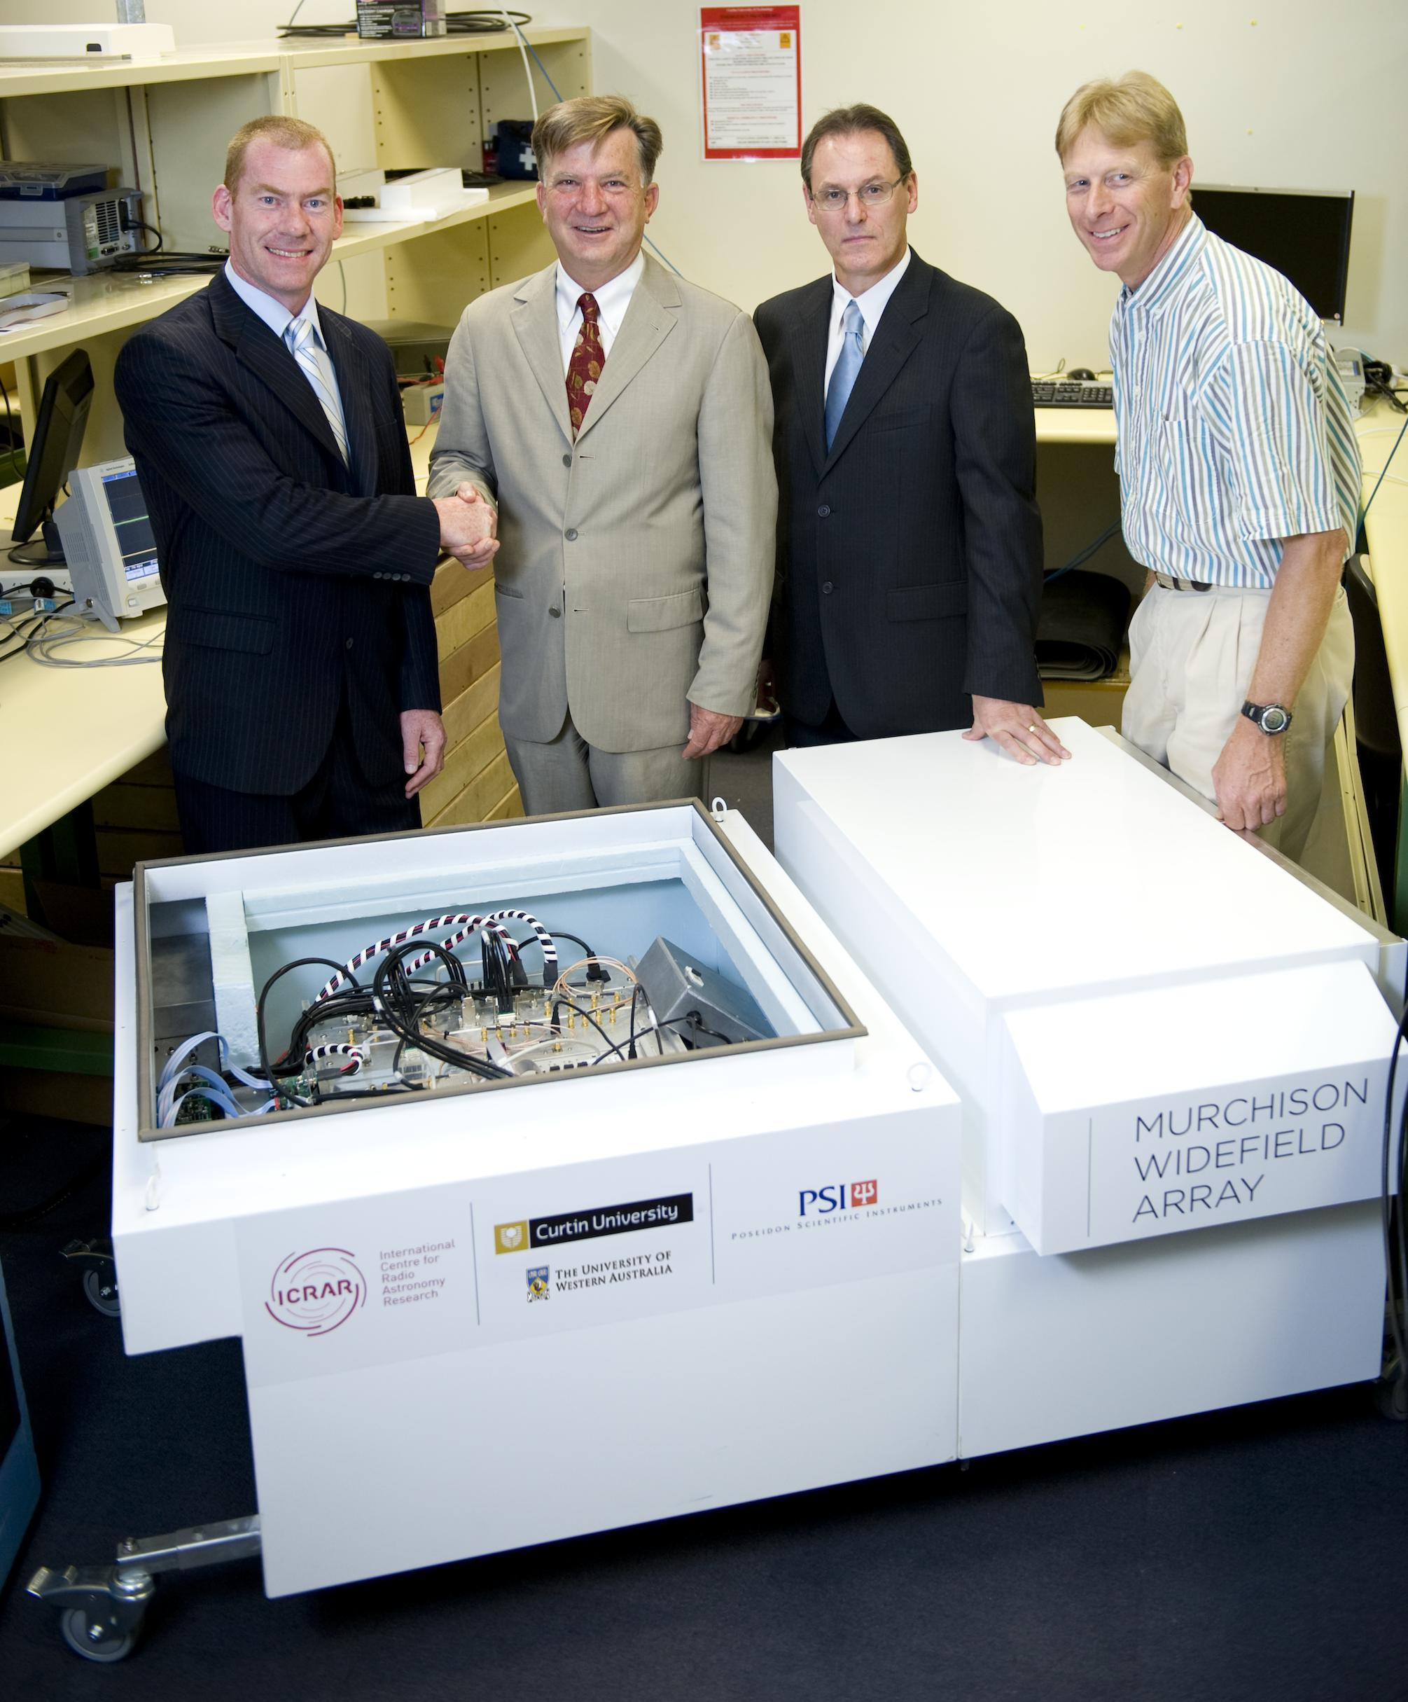
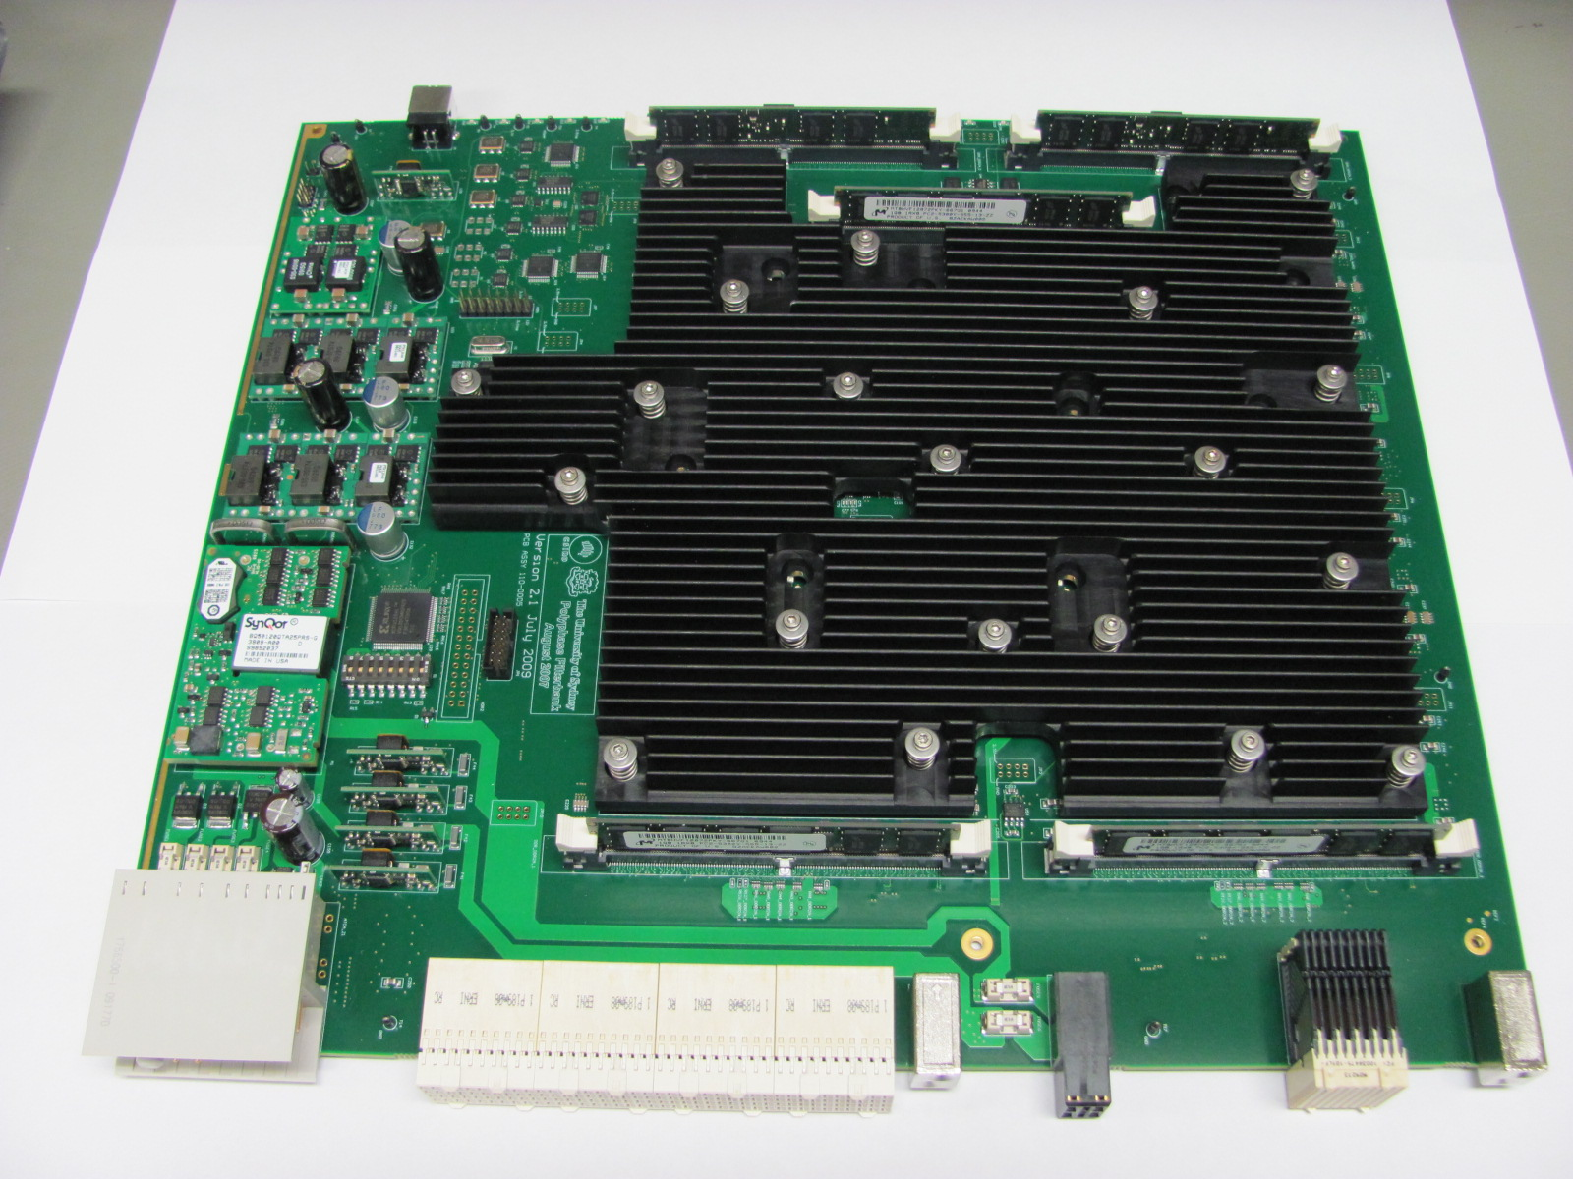
The Murchison Widefield Array
One of three SKA Precursor instruments: Pathfinder on an SKA candidate site. The only low frequency SKA Precursor.
80 – 300 MHz;
30 MHz of instantaneous bandwidth;
40 kHz channels, 0.5 second integrations;
3 km maximum baseline;
128 tiles.
“Tile”
Analog beamformer
Data archive/processing
Fine PFB
Receiver
Correlation
8 Tiles per receiver
Epoch of Reionisation; Solar Physics; Continuum surveys; Transients

Slide 3
Perth

Slide 4
300 m
300 m

Slide 5
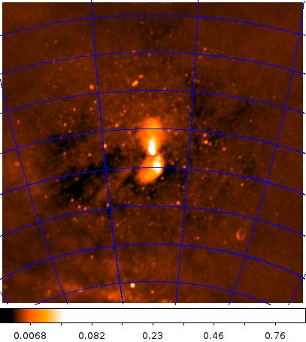
Ben McKinley
Divya Oberoi/
Lynn Matthews
Chris Williams

Slide 6
MWA enters the final construction phase
Build-out to 512 antennas not possible, due to NSF funding decision;
MWA de-scoped to 128 tiles;
Readiness reviews (engineering/science) completed in November 2011;
Fully funded project in Australia (remaining construction cost ~$8m)
Tiles
Receivers
100 m
3 km

Slide 7
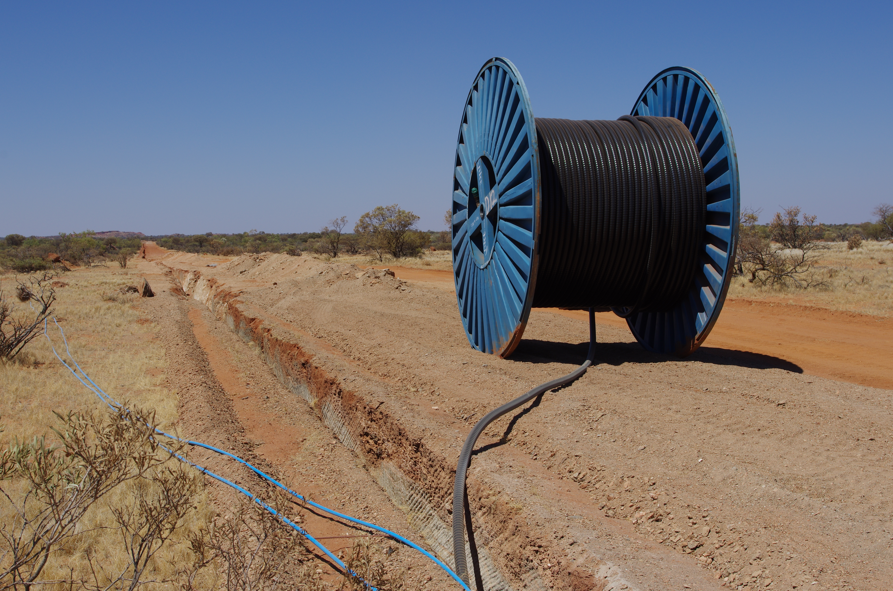
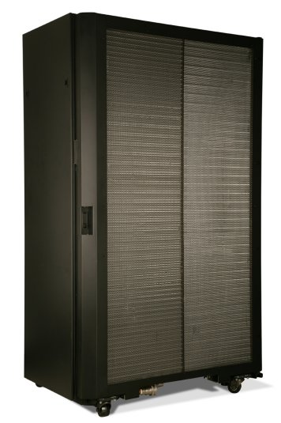
Construction and supply contracts executed.
Infrastructure (trenches, power and fibre reticulation): enough for 256 antennas;
128 Tiles and beamformers (supplied by Burns Industries, NH;
16 receivers (supplied by SME, Poseidon Scientific Instruments, Fremantle);
GPU-based correlator (supplied by IBM);

Slide 8
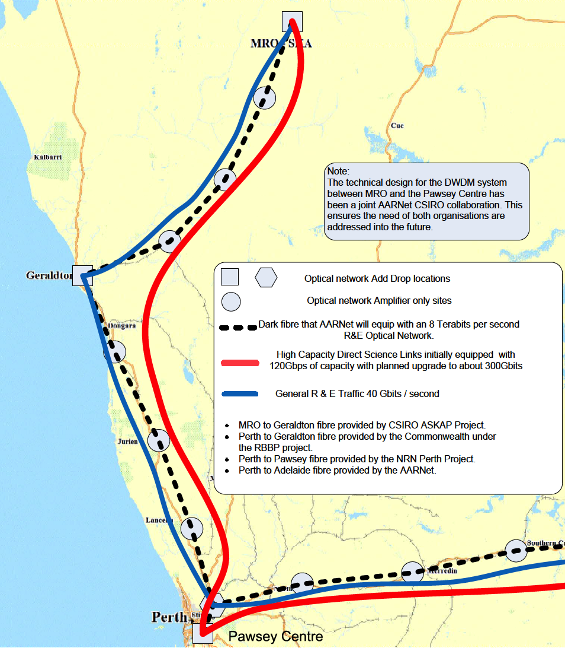
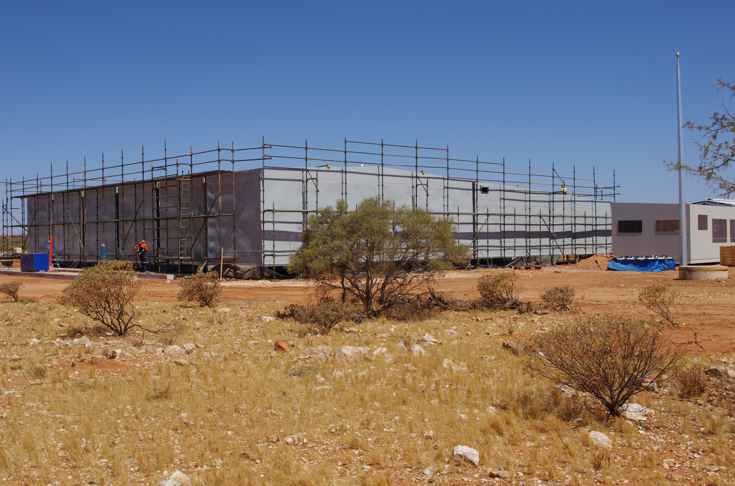
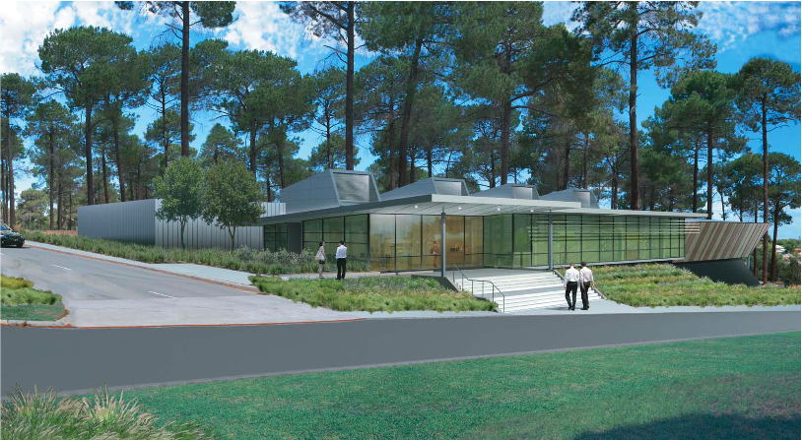
CSIRO infrastructure.
160 dB shielded building;
10 Gbps connection to Perth;
15 PB data storage @ $80m Pawsey supercomputing centre
10 Gbps for MWA

Slide 9
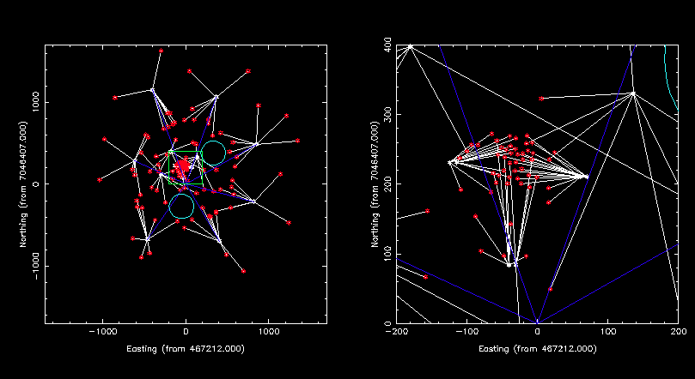
MWA and SKA AA development
300 m diameter areas close to power and fibre connections
MWA has infrastructure capacity built for 256 tiles, but will
only deploy 128 tiles in the first instance. Excess infrastructure.

Slide 10
A proposition to the AA team
Excess MWA infrastructure could host AA instrumentation during SKA pre-construction:
At least 2 x 300 m diameter areas for AA antennas;
9 x concrete pads to accommodate receivers/beamformers etc;
Power (240 V AC, 10 A outlets). Approximately 3 kV total excess over 9 pad locations;
~200 fibres excess over 9 pad locations, connected to 10 water cooled racks in central 160 dB shielded building;
10 Gbps connection from shielded building to Pawsey Centre in Perth. Approximately 2 – 3 Gbps excess on this link;
15 PB storage facility at Pawsey (plus massive compute – CPU/GPU).

Slide 11
Advantages for AA development:
Full signal path from field to archive;
Quick and inexpensive start for AA testing at radio quiet location;
Saves infrastructure development costs (approvals, agreements, contractors, management etc);
Infrastructure is already RFI qualified;
Cross-correlation of AA antennas with MWA antennas for testing?;
Help from MWA team: Dr Randall Wayth (MWA Commissioning Scientist)

Slide 12
Summary
MWA prototype phase complete: science results being published.
Final MWA construction phase commenced:
Construction complete by November 2012;
Commissioning underway by July 2011;
First calls for science proposals in first half 2013.
Excess MWA infrastructure (full signal path from field to archive) could help AA development program get off to a flying start in SKA pre-construction phase.

