Slide 1


AAVS0 Results,
Dual-Polarized Vivaldi Antenna
G. Virone, R. Tascone, A. Olivieri, O.A. Peverini, G. Addamo
F. Perini*, M. Schiaffino*, J. Monari*, G. Bianchi *, S. Montebugnoli*
*Istituto di Radio Astronomia
Istituto Nazionale di Astro Fisica

Slide 2
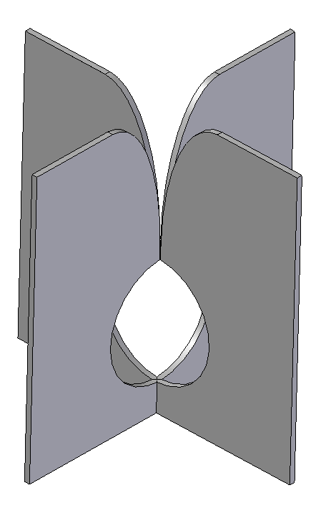
Dual-pol Vivaldi 50 Ohm ver1
Maximum size 1.1 m
Metal-only
50 Ohm unbal impedance
No additional ground plane
Very Low Cross-Pol

Slide 3
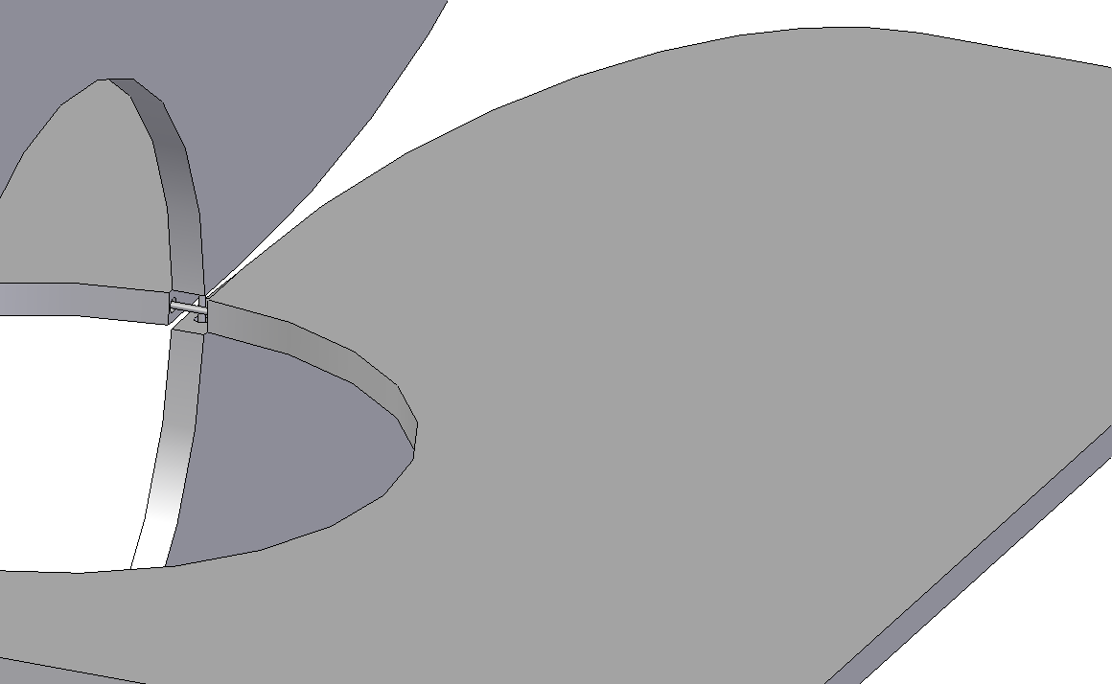
Feed Configuration and Labeling
Front Probe
Back Probe
Housing for Electronics

Slide 4
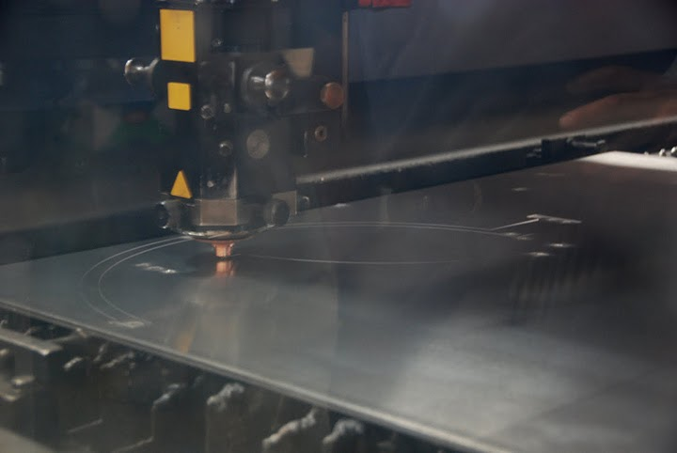

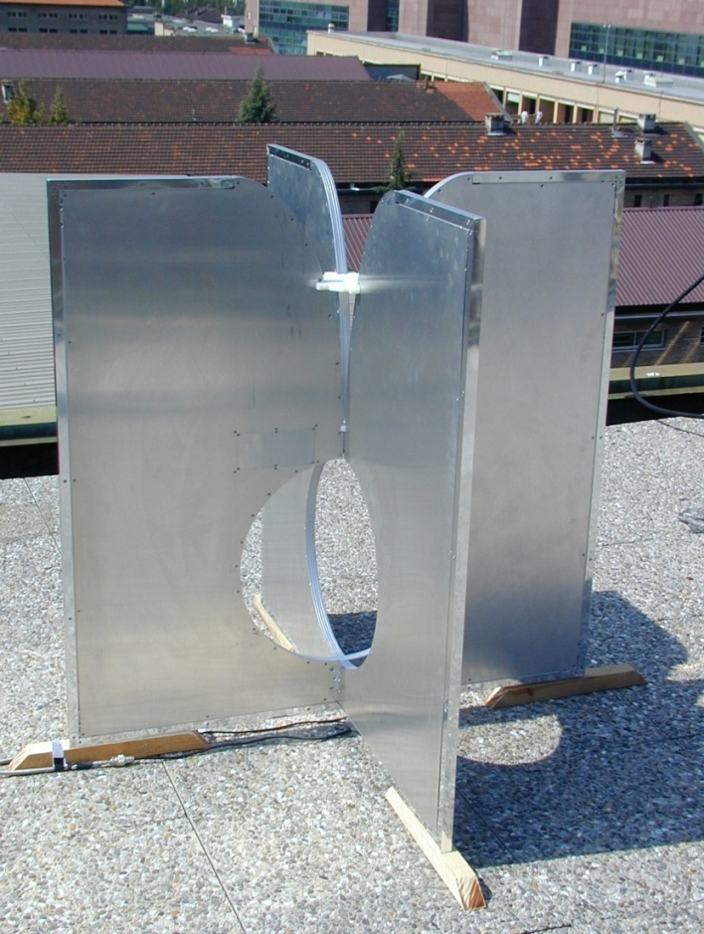
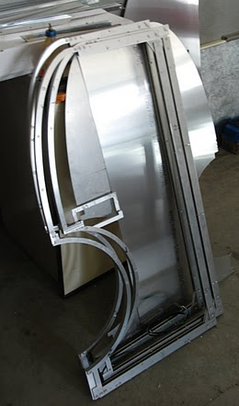
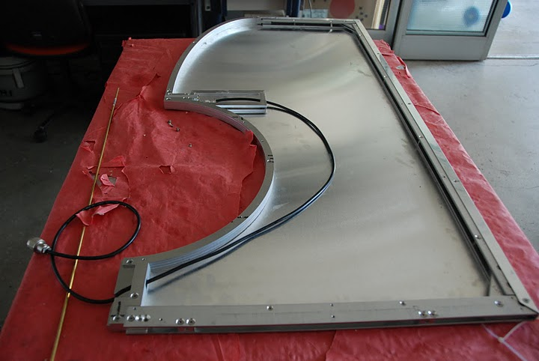
Manufacturing
-First Prototype
-Laser cutting machine
-Multi-layer alluminum prototype
Laser cutter

Slide 5
VNA Reflection Measurement

Slide 6

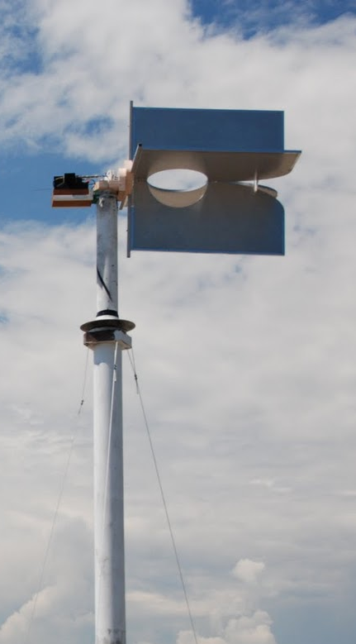
Radiation Pattern Measurements
Outdoor Elevated Antenna Test Range (Turin, July 2011)

Slide 7

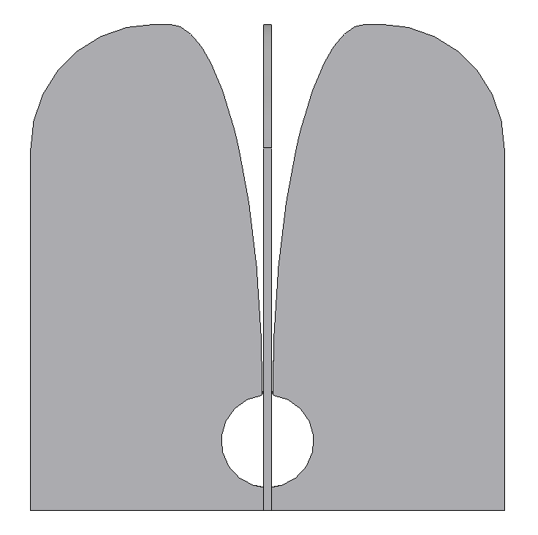
From Version 1 to Version 2
Good matching in the 70-450 MHz band
Acceptable matching in the 70-450 MHz band
Low directivity at 45° in E-plane
Higher directivity in the ±45° sky coverage
High back lobe
Lower back lobe

Slide 8
Vivaldi A_{eff}/T_{sys} for each polarization
Theta=0°
Theta=45°

Slide 9
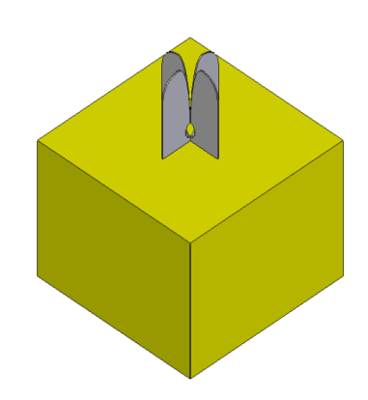
Effect of the Soil
ICRAR Soil DATA
Radiation Efficiency = 0.7
Rad. Eff. = 0.92

Slide 10
Computation of Tant_{Gnd}
Tant_{gnd} = T₀ (1-η_{R})
T₀ = 290 K

Slide 11
Gain vs Frequency

Slide 12
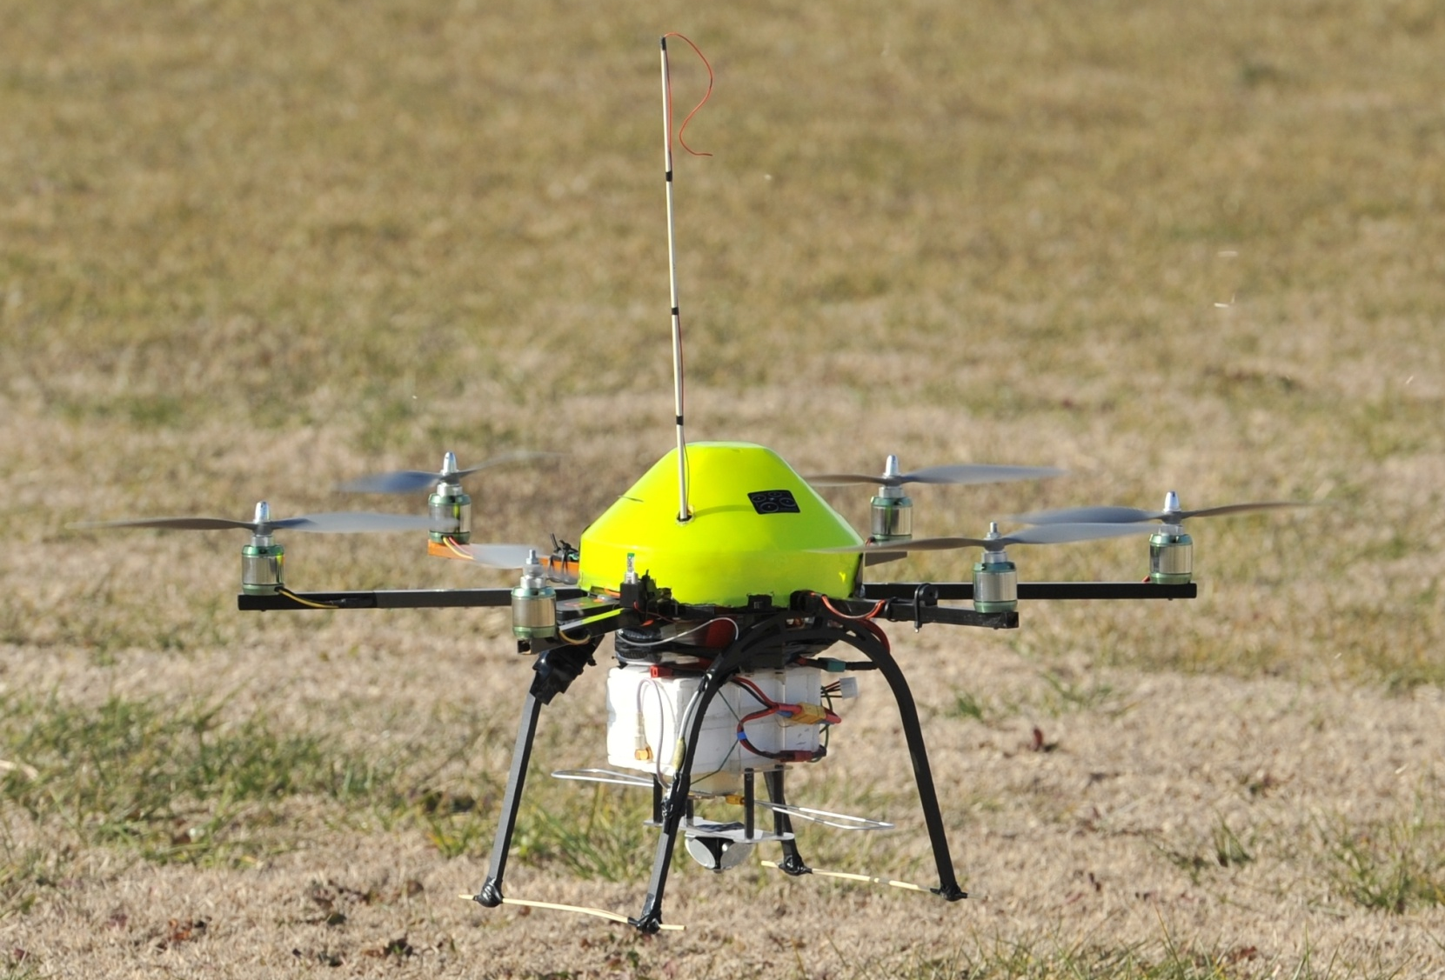
Hexacopter Far-Field Measurements (1)
Collaboration with DITAG, Politecnico di Torino
http://www.mikrokopter.de
Telemetry and GPS
RF TX and additional battery
Hexacopter Battery
Bow-tie antenna
Optical Scatterer

Slide 13
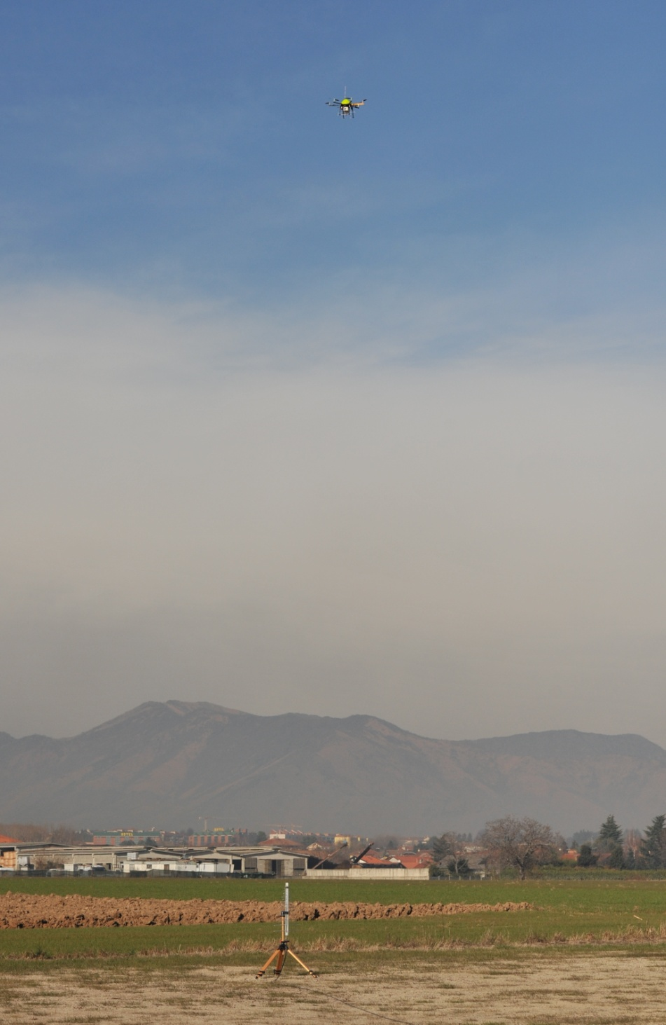
Hexacopter (2)
FF Pattern measurement in the operative condition (ground, small array)
Meas. range > 60 m
GPS Accuracy : 0.5 m-> 1 cm
Total Station Accuracy: 5 mm
GPS-sync spectrum analyzer

Slide 14


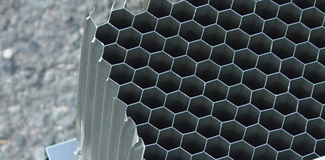
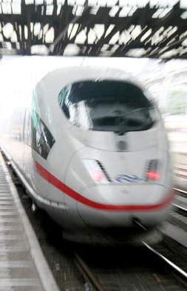
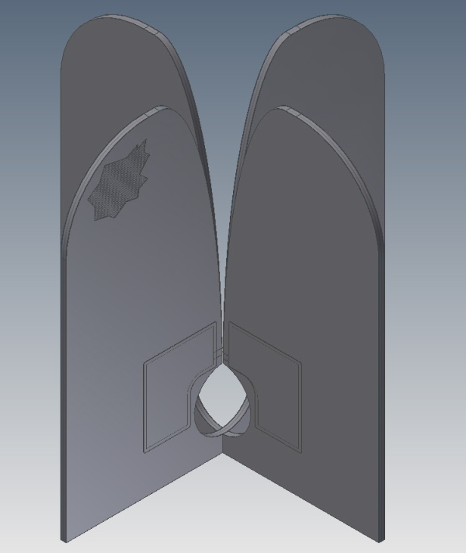
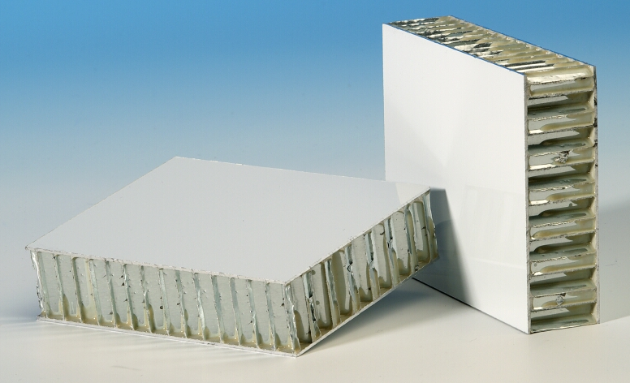
Low-cost Manufacturing
Mini-production of (48) Vivaldi, with 2cm honeycomb (used for High speed NL trains)
Target Cost
200€ x antenna

Slide 15
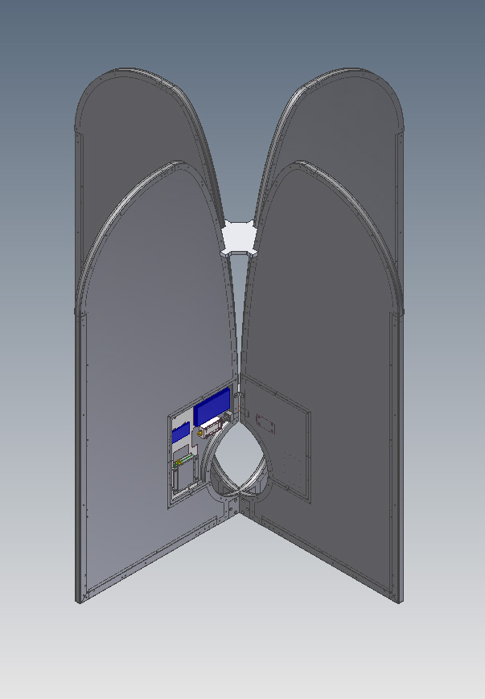
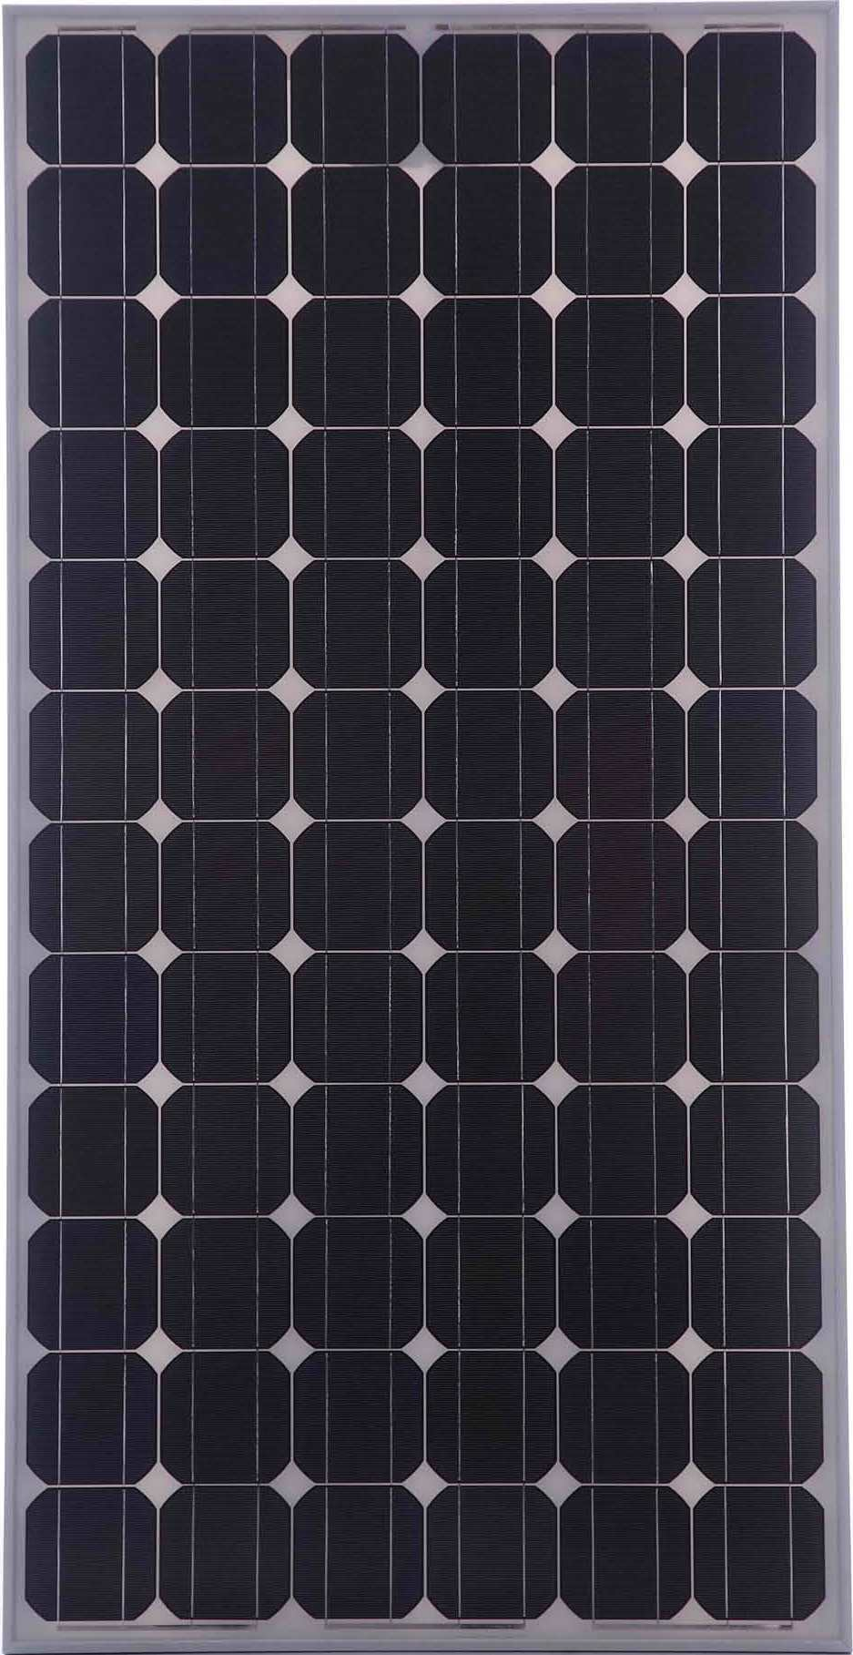
Optical Self-Powered Vivaldi
- Galvanic isolation between FE and DS
more stable amplitude&phase Vs temperature
RFI immunity (self-shielded)
no Gain disequalization
no Power Distribution → no DC power losses
easy-deployable (no buried FO)
We have 0.15 m² maximum
available area per arm.
BATTERY
Front End
That area could be sufficient,
but we need more investigation
and tests on the field.
Thin film (amorphous silicon )

Slide 16
Conclusion
Experimental results confirmed the computed data of the Dual-Pol Vivaldi v1.
An improved version (v2) has been designed (AAVS0) and manufactured (4 x 4 array)
Simulations of the soil ground effect confirm the performance (without additional mesh)
A new measurement setup is being developed
Industrialization process is in progress
Optical Self-powered element

Slide 18
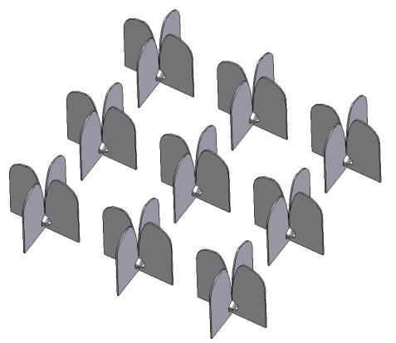
3 x 3 Regular Array Simulation
Element Spacing is 1.5 m

Slide 19
VNA Coupling Measurement

