Slide 1

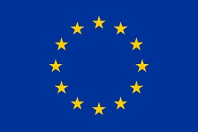
VLBI Techniques
Bob Campbell, JIVE
VLBI Arrays: a brief tour
Model / delay constituents
Getting the most out of VLBI phases
  Observing tactics / propagation mitigation
Wide-field mapping
Concepts for the VLBI Tutorial
ERIS #7, Dwingeloo . . . . . . . . . . . . . . . . . . . . . . . . . . . . . . . . . . . . . . . . . (18 oct 2017)
RadioNet has received funding from the European Commission’s Horizon 2020 Research and Innovation Programme under grant agreement No, 730562.

Slide 2
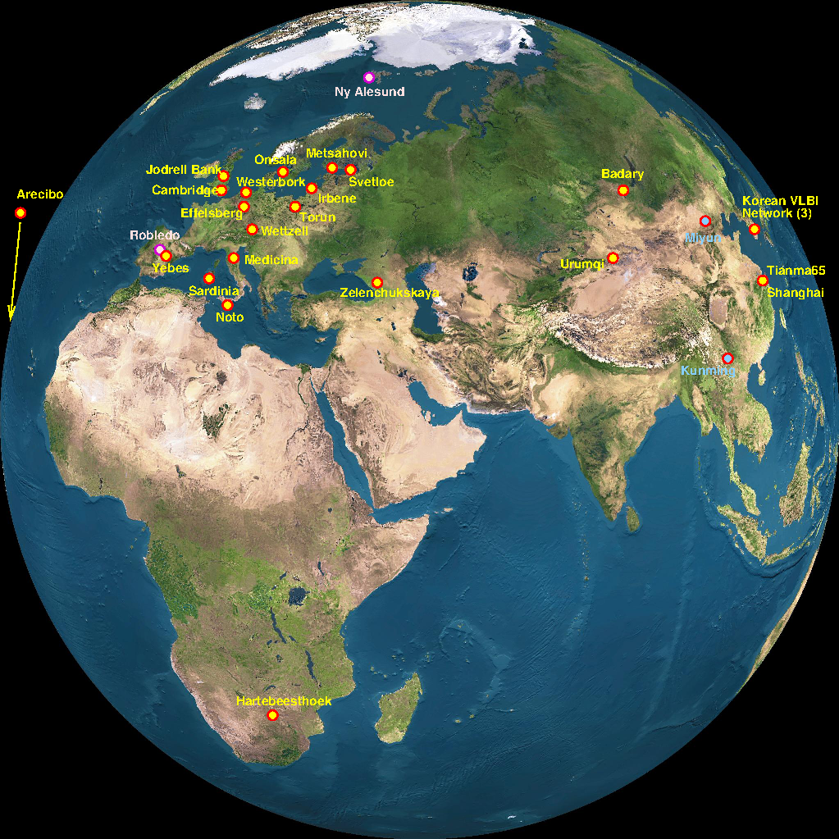
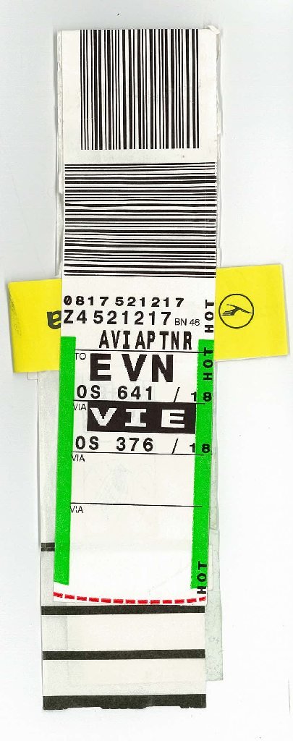
T
h
e
E
V
N

Slide 3
The EVN (European VLBI Network)
Composed of existing antennas
  generally larger (32m – 100m): more sensitive
  baselines up to 10k km (8k km from Ef to Shanghai, S.Africa)
  down to 17 km (with Jb-Da baseline from eMERLIN)
  heterogeneous, generally slower slewing
Frequency coverage [GHz]:
  workhorses: 1.4/1.6, 5, 6.0/6.7, 2.3/8.4, 22
  niches: 0.329, UHF (~0.6-1.1), 43
  frequency coverage/agility not universal across all stations
Real-time e-VLBI experiments
Observing sessions
  Three ~3-week sessions per year
  ~10 scheduled e-VLBI days per year
  Target of Opportunity observations

Slide 4
EVN Links
Main EVN web page: www.evlbi.org
  EVN Users’ Guide: Proposing, Scheduling, Analysis, Status Table
  EVN Archive
Proposals: due 1 Feb., 1 June, 1 Oct. (23:59:59 UTC)
  via NorthStar web-tool: proposal.jive.eu
User Support via JIVE (Joint Institute for VLBI ERIC)
  www.jive.eu
  RadioNet trans-national access
Links to proceedings of the biennial EVN Symposia:
  www.evlbi.org/meetings
  History of the EVN in Porcas, 2010, EVN Symposium #10

Slide 5
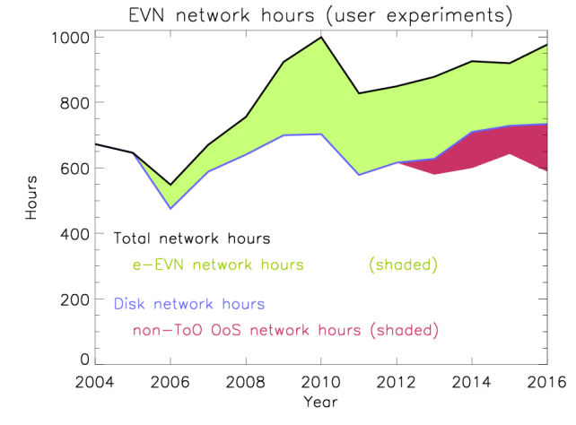
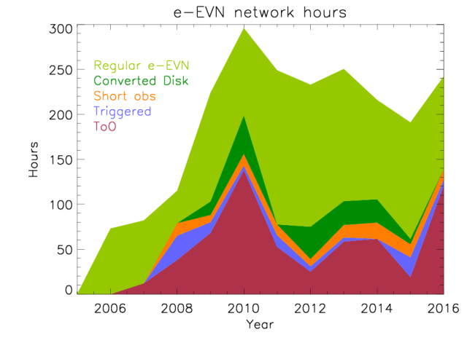
Real-time e-VLBI with the EVN
Data transmitted from stations to correlator over fiber
Correlation proceeds in real-time
  Improved possibilities for feedback to stations during obs.
  Much faster turn-around time from observations → FITS;
  permits EVN results to inform other observations
  Denser time-sampling (beyond the 3 sessions per year)
  EVN antenna availability at arbitrary epochs remains a limitation
Disk-recorded vs. e-VLBI: different vulnerabilities
  Recorded e- and/or e-shipping approaching best of both worlds

Slide 6
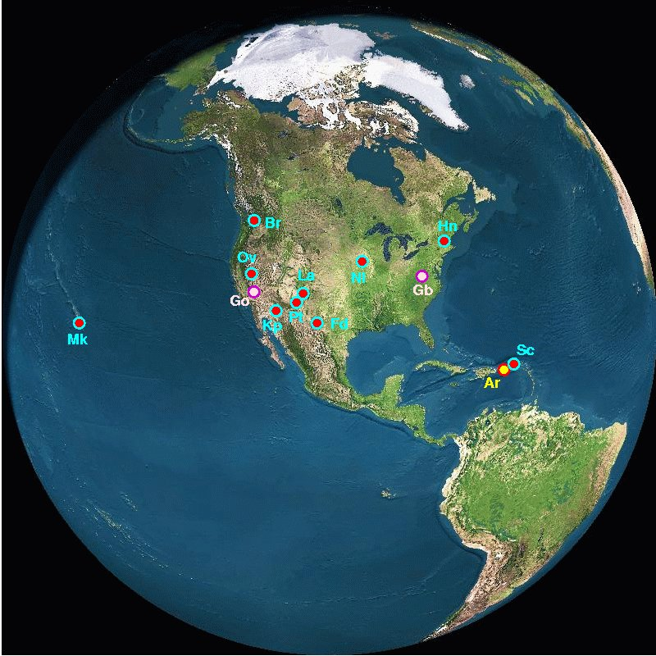
The VLBA (Very Long Baseline Array)
Homogeneous array (10x 25m)
  planned locations, dedicated array
  Bslns ~8600–250 km (~50 w/ JVLA)
  faster slewing
  HSA (+ Ef + Ar + GBT + JVLA)
Frequency agile
  down to 0.329, up to 86 GHz
Extremely large proposals
  Up towards 1000 hr per year
Globals: EVN + VLBA (+ GBT + JVLA)
  proposed at EVN proposal deadlines (1Feb, 1Jun, 1Oct)
  VLBA-only proposals: 1Feb, 1Aug
VLBA URL: science.lbo.us

Slide 7
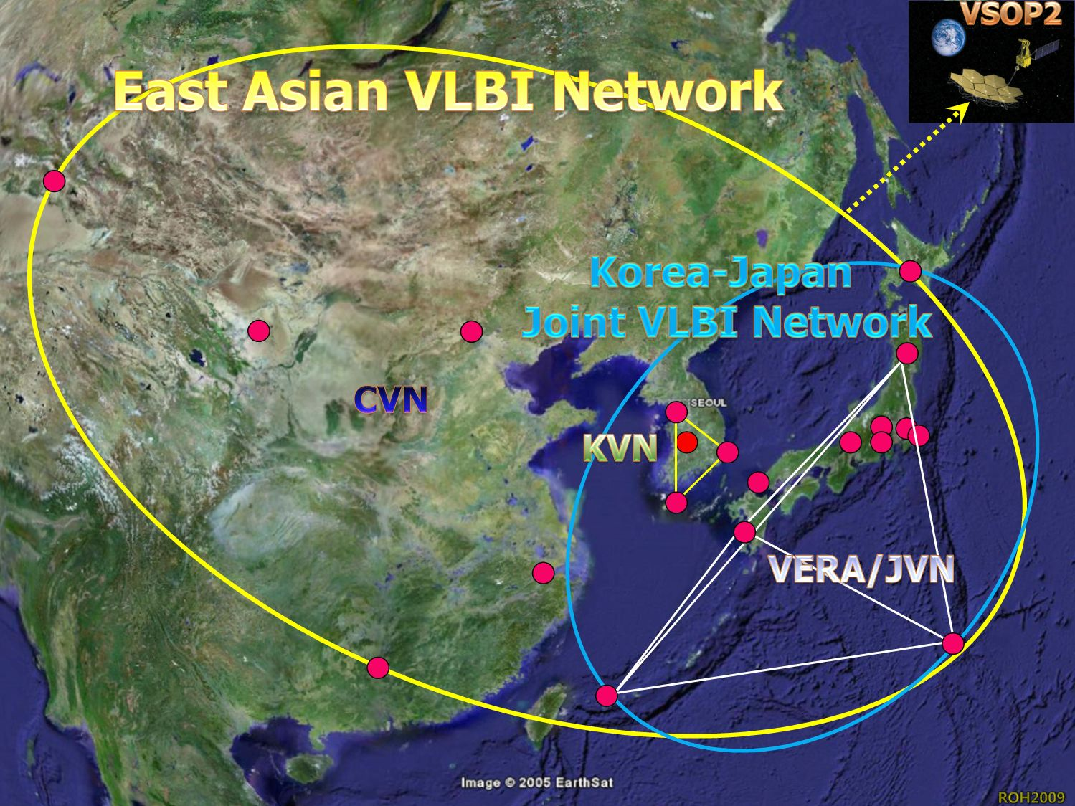
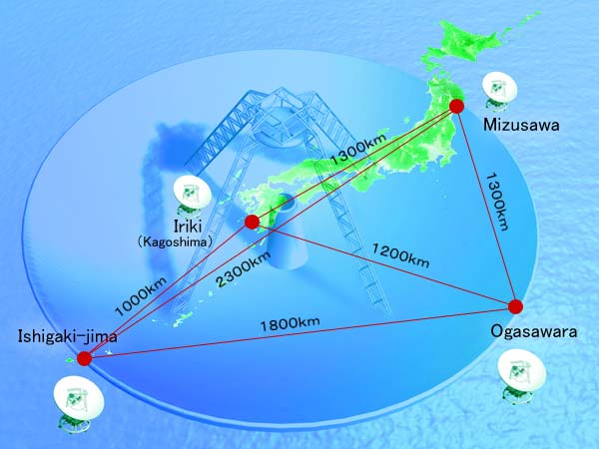
East Asian VLBI Networks
Chinese (CVN): 4 ants., primarily satellite tracking
Korean (KVN): 3 ants., simultaneous 22, 43, 86, 129 GHz
VERA: 4 dual-beam ants., maser astrometry 22-49 GHz
  KaVA == KVN + VERA (issues separate KaVA calls for proposals)
Japanese: various astronomical & geodetic stations

Slide 8
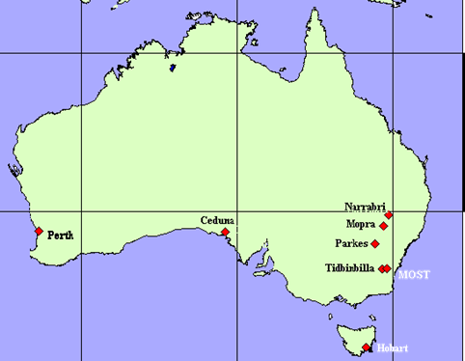
Other Astronomical VLBI Arrays
Long Baseline Array
  Only fully southern hemisphere array
Can now propose joint EVN+LBA obs
  growing number of east-Asian EVN stations provide lots of N-S baselines
  LBA—western EVN ~12k km (< 1 hr)
Global mm VLBI Network (GMVA)
  Effelsberg, Onsala, Metsahövi, Pico Veleta, NOEMA, KVN, most VLBAs, Green Bank (LMT, ALMA)
86 GHz
~2 weeks of observing per year
Coordinated from MPIfR Bonn

Slide 9
IVS (International VLBI Service)
VLBI as space geodesy
  cf: GPS, SLR/LLR, Doris
Frequency: 2.3 & 8-9
some at 8-9 & 27-34
Geodetic VLBI tactics:
  many short scans
  fast slews
  uniform distribution of stations over globe
VGOS: wide-band geodetic system (4x 2GHz over 2-14 GHz)
IVS web page: ivscc.gsfc.nasa.gov
  Mirror: ivscc.bkg.bund.de
History of geodetic VLBI (pre-IVS):
  Ryan & Ma 1998, Phys. Chem. Earth, 23, 1041

Slide 10
Some rule-of-thumb VLBI scales
Representative angular scales: 0.1 — 100 mas
Physical scales of interest:
  Angular-diameter distance D_{A}(z)
  Proper-motion distance D_{M}(z) → μ to β_{app} conversion
  D_{A} turns over with z (max z~1.6), D_{M} doesn’t
Brief table, using Planck 2015 cosmology parameters (from J.P. Rachen colloquium, Dwingeloo 11jun2015)
z | 1 mas subtends (D_{A}) | β_{app} for 0.1 mas/yr (D_{M})
0.1 | 1.8 pc | 0.66 c
0.5 | 6.4 pc | 3.1 c
1 | 8.3 pc | 5.4 c
1.6 | 8.4 pc | 7.4 c
3 | 8.0 pc | 10.3 c

Slide 11
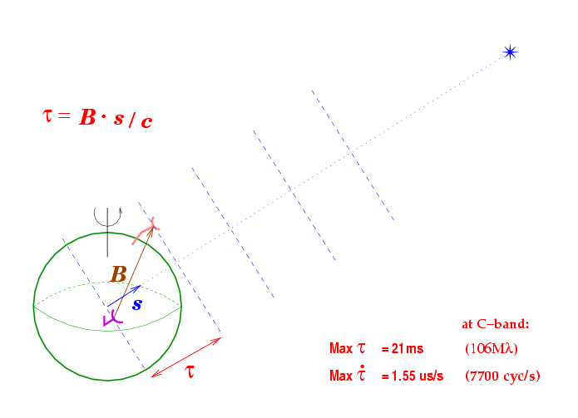
VLBI vs. shorter-BI
Sparser u-v coverage
More stringent requirements on correlator model to avoid de-correlating during coherent averaging
No truly point-like primary flux calibrators in sky
Independent clocks & equipment at the various stations

Slide 12
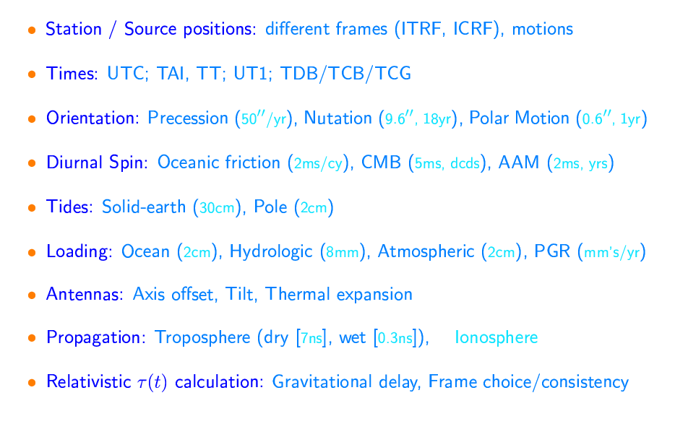
VLBI a priori Model Constituents

Slide 13
VLBI a priori Model: References
IERS Tech.Note #36, 2010: IERS Conventions 2010
  www.iers.org link via Publications // Technical Notes
Urban & Seidelmann (Eds.) 2013, Explanatory Supplement to the Astronomical Almanac (3rd Ed.)
IAU Division A (Fundamental Astronomy; was Div.I)
  www.iau.org/science/scientific_bodies/divisions/A/info
SOFA (software): www.iausofa.org
Global Geophysical Fluids center: geophy.uni.lu
Older (pre- IAU 2000 resolutions):
  Explanatory Supplement to the Astronomical Almanac 1992
  Seidelmann & Fukushima 1992, A&A, 265, 833 (time-scales)
  Sovers, Fanselow, Jacobs 1998, Rev Mod Phys, 70, 1393

Slide 14
VLBI Delay (Phase) Constituents
Conceptual components:
  τ_{obs} = τ_{geom} + τ_{str} + τ_{trop} + τ_{iono} + τ_{instr} + ε_{noise}
Instrumental Effects
Source Structure
Source/Station/Earth orientation
τ_{geom} = -[cosδ {b_{x} cos H(t) – b_{y} sin H(t)} + b_{z} sinδ] / c
where: H(t) = GAST – R.A.
and of course: φ = 2πωτ_{p}
Propagation
for φ_{obs}: ± N _{lobes}

Slide 15
Closure Phase
φ_{cls} = φ_{AB} + φ_{BC} + φ_{CA}
Independent of station-based Δφ
  propagation
  instrumental
But loses absolute position info
  degenerate to an arbitrary Δφ_{geom} added to a given station
B
A
C
However, φ_{str} is baseline-based: it does not cancel
  Closure phase can be used to constrain source structure
  Point source → closure phase = 0
  Global fringe-fitting / Elliptical-Gaussian modelling
Original ref: Rogers et al. 1974, ApJ, 193, 293

Slide 16
Difference Phase
Targ.
Ref.
Another differential φ measure
  pairs of sources from a given bsln
(Near) cancellations:
  propagation (time & angle between sources)
  instrumental (time between scans)
There remains differential:
  δφ_{str} (ideally, reference source is point-like)
  δφ_{geom} (contains the position offset between the reference and target)
Differential astrometry on sub-mas scales:
→ Phase Referencing ←

Slide 17
Phase-Referencing Tactics
Extragalactic reference source(s) (i.e., tied to ICRF2)
  Target referenced to an inertial frame
Close reference source(s)
  Tends towards needing to use fainter ref-sources
Shorter cycle times between/among the sources
  Shorter slews (close ref-sources, smaller antennas)
  Shorter scans (bright ref-sources, big antennas)
High SNR (longer scans, brighter ref-sources, bigger antennas)
Ref.src structure (best=none; if not, then not a function of ν or t)
In-beam reference source(s) – no need to “nod” antennas
  Best astrometry (e.g., Bailes et al. 1990, Nature, 319, 733)
  Requires a population of (candidate) ref-sources
  VERA multi-beam technique / Sites with twin telescopes

Slide 18
Where to Get Phs-Ref Sources
RFC Calibrator search tool (L. Petrov)
VLBA Calibrator search tool
  Links to both via www.evlbi.org
    under: VLBI links // VLBI Surveys, Sources, & Calibrators
  List of reference sources close to specified position
  FD (2 bands) on short & long |B|; Images, Amp(|u-v |)
Multiple reference sources per target
  Estimate gradients in “phase-correction field”
  AIPS memo #111 (task ATMCA)
Finding your own reference sources (e-EVN obs)
  Sensitive wide-field mapping around your target
  Go deeper than “parent” surveys (e.g., FIRST, NVSS)
Notes:
18

Slide 19
Celestial Reference Frame
Reference System vs. Reference Frame
  RS: concepts/procedures to determine coordinates from obs
  RF: coordinates of sources in catalog; triad of defining axes
Pre-1997: FK5
  “Dynamic” definition: moving ecliptic & equinox
  Rotational terms / accelerations in equations of motions
ICRS: kinematic → axes fixed wrt extra-galactic sources
  Independent of solar-system dynamics (incl. precession/nutation)
ICRF2: most recent realization of the ICRS
  IERS Tech.Note #35, 2009: 2nd Realization of ICRF by VLBI
  295 defining sources (axes constraint); 3414 sources overall
  Median σ_{pos}~ 100-175 μas (floor ~40 μas); axis stability ~10 μas
  More emphasis put on source stability & structure
Process to create ICRF3 underway

Slide 20
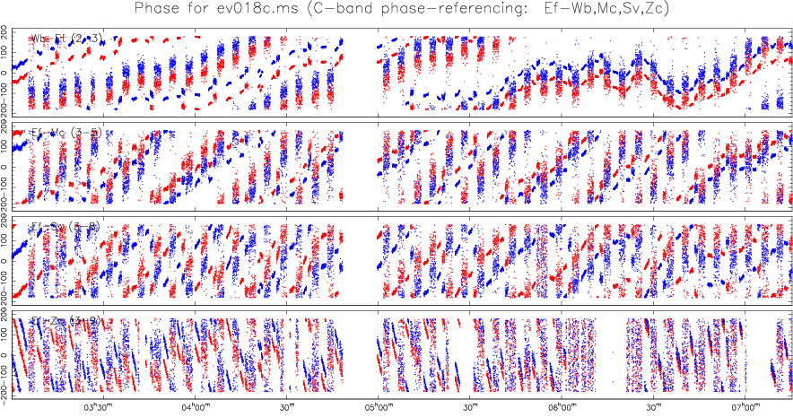
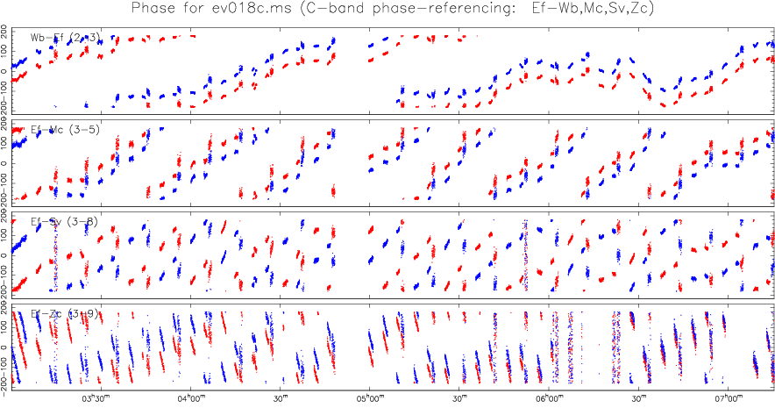
Faint-Source Mapping
Phase-referencing to establish Dly, Rt, Phs corrections at positions/scan-times of targets too faint to self-cal
Increasing coherent integration time to whole observation
  Beasley & Conway 1995, VLBI and the VLBA, Ch 17, p.327
  Alef 1989, VLBI Techniques & Applications, p.261

Slide 21
Differential Astrometry
Motion of target with respect to a reference source
  Extragalactic ref.src. → tied to inertial space (FK5 vs. ICRF)
  Shapiro et al. 1979, AJ, 84, 1459 (3C345 & NRAO 512: ’71-’74)
Masers in SFR as tracers of Galactic arms
  BeSSeL: bessel.vlbi-astrometry.org
Pulsar astrometry (birthplaces, frame ties, n_{e})
  PSRPI: safe.nrao.edu/vlba/psrpi
Stellar systems: magnetically active binaries, exo-planets
PPN γ parameter: Lambert et al. 2009, A&A, 499, 331
Frame dragging (GP-B): Lebach et al. 2012, ApJS, 201, 4
IAU Symp #248: From mas to μas Astrometry

Slide 22
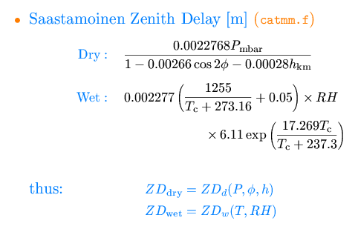
Phs-Ref Limitations: Troposphere
ΔZD
ΔZD x m.f.
ZD
ZD x mapping function
Station ΔZD → elevation-dependent Δφ
  Dry ZD ~ 7.5ns (~37.5 cycles of phase at C-band)
  Wet ZD ~ 0.3ns (0.1—1ns) but high spatial/temporal variability
Water-vapor radiometers to measure precipitable water along the antenna’s pointing direction

Slide 23
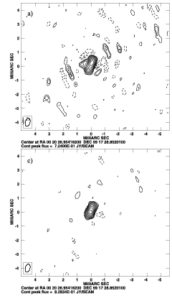
Troposphere Mitigation
Computing “own” tropo corrections from correlated data
Scheduling: insert “Geodetic” blocks in schedule
  sched: GEOSEG as scan-based parameter
  other control parameters
  egdelzn.key in examples
AIPS (AIPS memo #110)
  DELZN & CLCOR/opcode=atmo
Numerical weather models & ray-tracing
  ggosatm.hg.tuwien.ac.at/proj-ggosatm.html
  astrogeo.org/spd
raw
Brunthaler, Reid, & Falcke 2005, in Future Directions in High-Resolution Astronomy (VLBA 10th anniv.), p.455: “Atmosphere-corrected phase-referencing”
geo-blocks

Slide 24
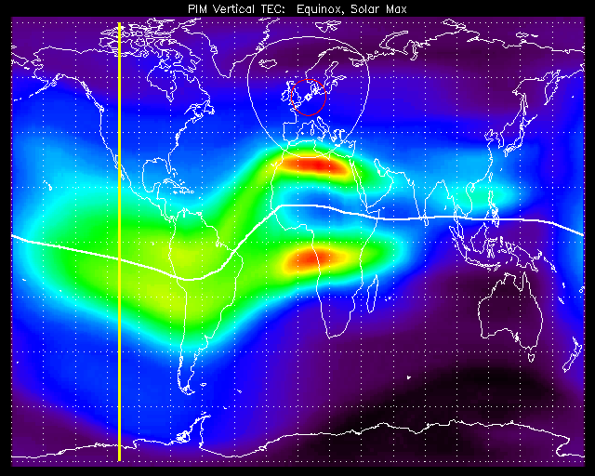
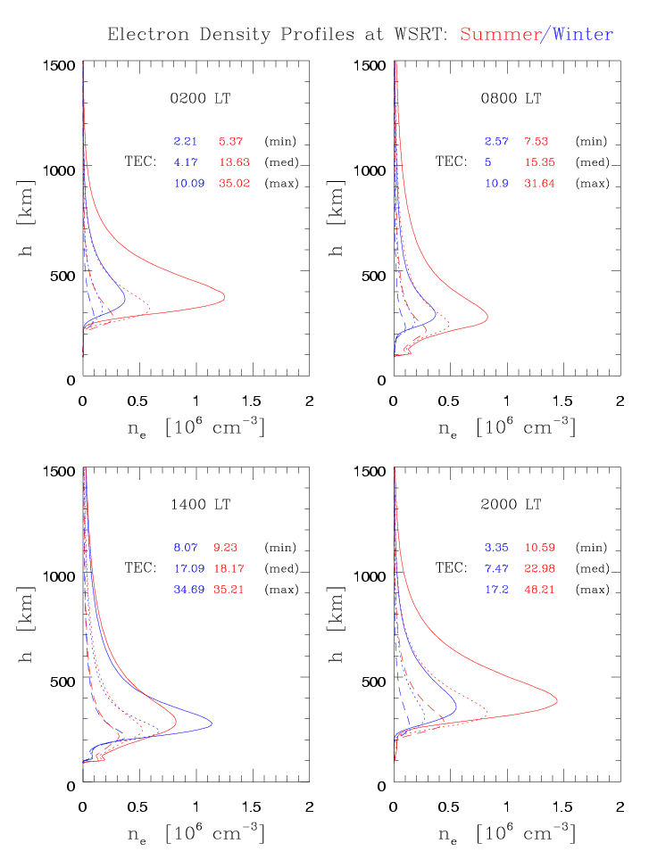
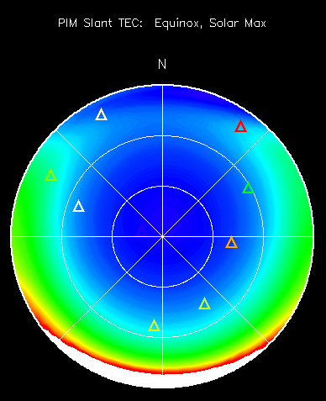
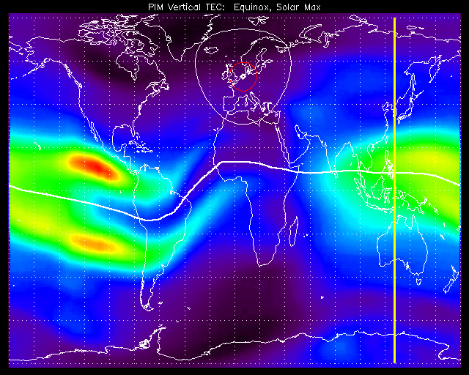
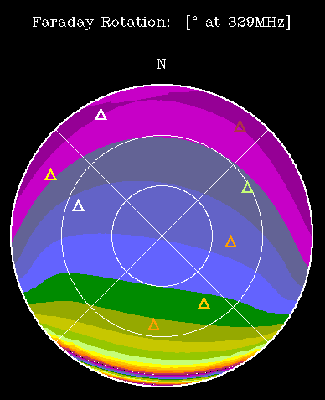
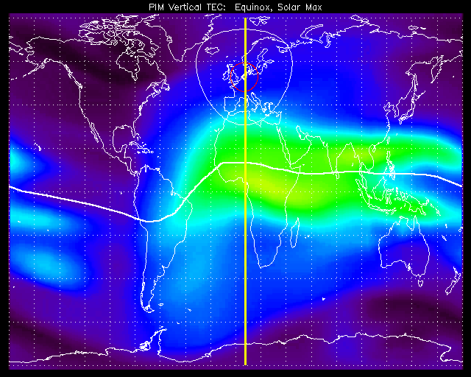
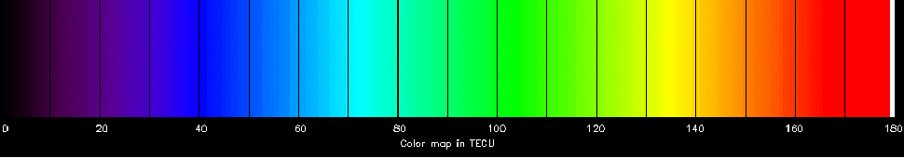
Phs-Ref Limitations: Ionosphere
1
9
3
0
0
3
3
0
1
1
3
0
USAF PIM model run for solar max
1 TECU = 1.34/ν_{[GHz]} cycles
TEC color-map scaling: 30 75 135 180

Slide 25
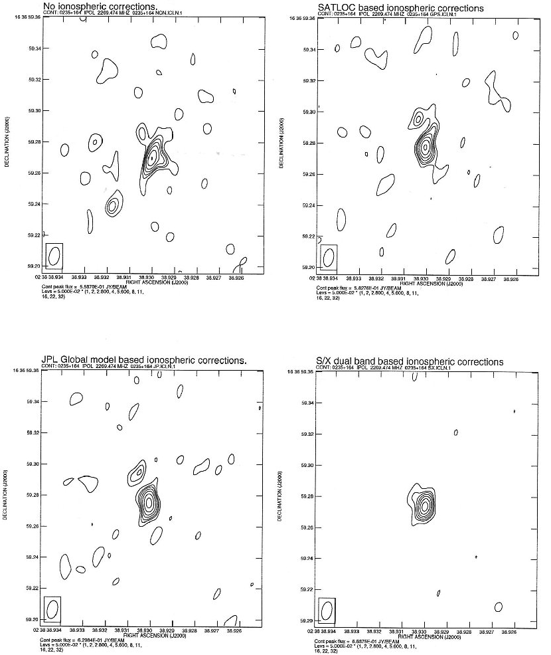
Ionosphere Mitigation
Dispersive delay → inverse quadratic dependence τ vs. ν
  Dual-frequency (e.g., 2.3, 8.4 GHz)
  widely-separated sub-bands (Brisken et al. 2002, ApJ, 571, 906)
IGS IONEX maps (gridded vTEC)
  .igscb.jpl.nasa.gov/components/prods.html
  5° long. x 2.5° lat., every 2 hr
  h = 450km || σ ~ 2-8 TECU
  Based on ≥150 GPS stations
  Various analysis centers’ solutions
AIPS: TECOR
  VLBI science memo #23
From raw GPS data:
  Ros et al. 2000, A&A, 356, 375
Incorporation of profile info?
  Ionosondes, GPS/LEO occultations
  igscb.jpl.nasa.gov

Slide 26
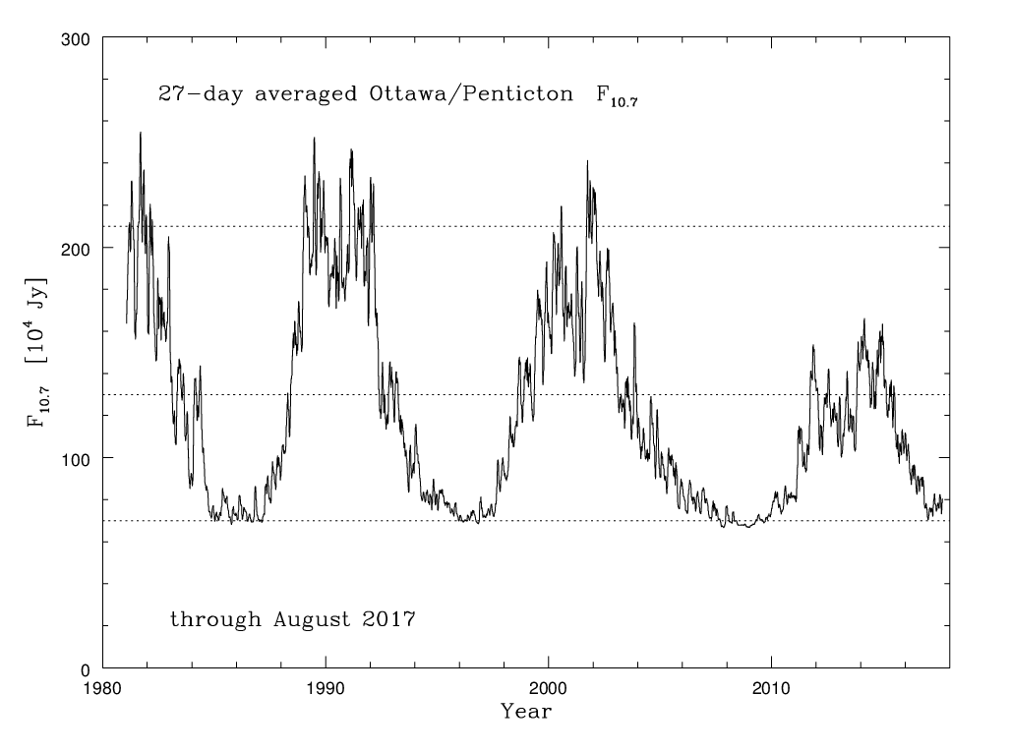
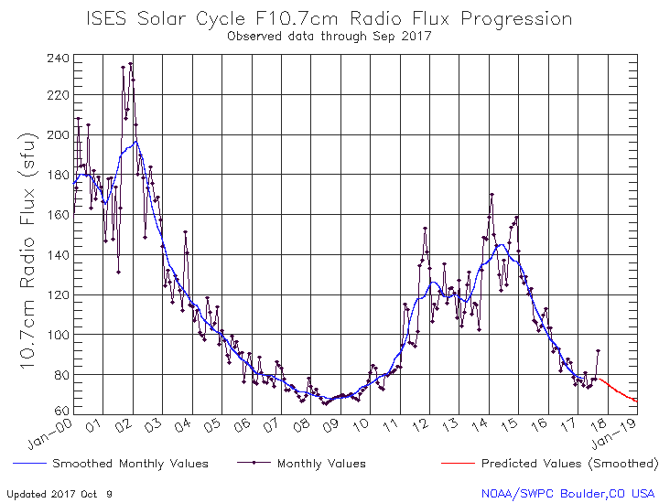
Ionosphere: Climatology
The past few solar cycles: solar 10.7cm flux density
Past peak more akin to a solar “medium” condition
Prediction for current solar cycle: nearing solar “minimum”

Slide 27
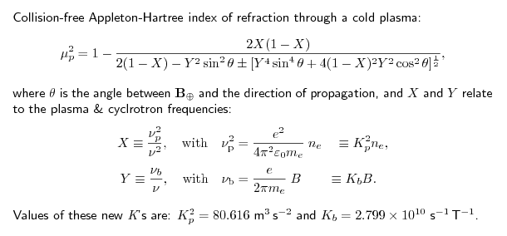
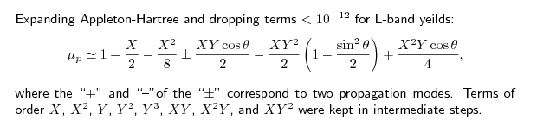

Ionosphere: Equations
N.B. μ_{p} < 1
τ_{p} = (∫μ_{p}dl ) /c
μ_{g} = d (νμ_{p}) /dν

Slide 28
Ionosphere: References
Davies, K.E. 1990, Ionospheric Radio
  from a more practical view-point; all frequency ranges
Hargreaves, J.K. 1995, Solar-Terrestrial Environment
  ~senior undergrad science in larger context
Kelly, M.C. 1989, Earth’s Ionosphere
  ~grad science, more detail in transport processes
Schunk, R. & Nagy, A. 2009, Ionospheres
  same as above, plus attention to other planets
Budden, K.G., 1988, Propagation of Radio Waves
  frightening math(s) for people way smarter than I…

Slide 29
Troposphere vs. Ionosphere
Cross-over frequency below which typical ionospheric delay exceeds typical tropospheric delay (at zenith)
  Troposphere: ~7.8 ns (at sea level, STP)
  Ionosphere: -1.34TEC _{[TECU]} / ν²_{[GHz]} ns
ν_{cross-over} ~ √TEC / 5.82 GHz
  can expect to encounter different tropospheric & ionospheric vertical → slant mapping functions
for some representative TECs:
TEC [TECU] | Cross-over ν [GHz]
10 | ~1.3
50 | ~2.9
100 | ~4.1

Slide 30
Wide-field Mapping: FoV limits
Residual delay, rate → slopes in phase vs. freq, time
  Delay = ∂φ/∂ω i.e., via Fourier transform shift theorem;
  Rate = ∂φ/∂t 1 wrap of φ across band = 1/BW [s] of delay)
Delay (& rate) = function of correlated position:
τ₀= -[cosδ₀{b_{x}cos(t_{sid}-α₀) – b_{y}sin(t_{sid}-α₀)} + b_{z}sinδ₀] / c
As one moves away from correlation center, can make a Taylor-expansion of delay (& rate):
  τ (α,δ) = τ (α₀,δ₀) + Δα ( ∂τ /∂α ) + Δδ ( ∂τ /∂δ )
→ leads to residual delays & rates across the field, increasing away from the phase center.
→ leads to de-correlations in coherent averaging over frequency (finite BW) and time (finite integrations).

Slide 31
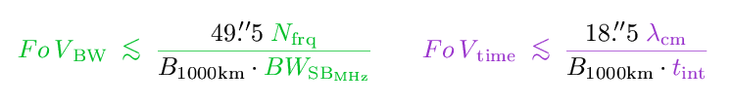
Wide-field Mapping: Scalings
To maintain ≤10% reduction in response to point-source:
  Wrobel 1995, in “VLBI & the VLBA” , Ch. 21.7.5
Scaling: BW-smearing: inversely with channel-width
time-smearing: inversely with t_{int}, obs. Frequency
Data size would scale as N_{frq} x N_{int} (e.g., ∝ area)
  Record for single experiment correlated at JIVE = 5.32 TB
  Expected record for an on-going multi-epoch exp. = 14.71 TB

Slide 32
WFM: Software Correlation
Software correlators can use almost unlimited N_{frq} & t_{int}
  PIs can get a much larger single FoV in a huge data-set
Multiple phase-centers: using the extremely wide FoV correlation “internally”, and steering a delay/rate beam to different positions on the sky to integrate on smaller sub-fields within the “internal” wide field:
  Look at a set of specific sources in the field (in-beam phs-refs)
  Chop the full field up into easier-to-eat chunks
As FoV grows, need looms for primary-beam corrections
  EVN has stations ranging from 20 to 100 m

Slide 33
Space VLBI: Orbiting Antennas
(Much) longer baselines, no atmosphere in the way
HALCA: Feb’97 — Nov’05
  Orbit: r = 12k—27k km; P = 6.3 hr; i = 31°
RadioAstron: launched 18 July 2011
  Orbit: r = 10-70k km — 310-390k km; P ~ 9.5d; i = 51.6°
  329 MHz, 1.6, 5, 22 GHz
  www.asc.rssi.ru/radioastron
Model/correlation issues:
  Satellite position/velocity; proper vs. coordinate time

Slide 34
Space VLBI: Solar System Targets
Model variations
  Near field / curved wavefront; may bypass some outer planets
  e.g., Duev et al. 2012, A&A, 541, 43
  Sekido & Fukushima 2006, J. Geodesy, 80, 137
Science applications
  Planetary probes (atmospheres, mass distribution, solar wind)
    Huygens (2005 descent onto Titan), Venus/Mars explorers, MEX fly-by of Phobos, BepiColombo (Mercury)
  Tests of GR (PPN γ, ∂G/∂t, deviations from inverse-square law)
    IAU Symp #261: Relavitivity in Fundamental Astronomy
  Frame ties (ecliptic within ICRS)

Slide 35
Future
Digital back-ends / wider IFs / faster sampling
  Higher total bit-rates (higher sensitivity)
  More flexible frequency configurations
  More linear phase response across base-band channels
Developments in software correlation
  More special-purpose correlation modes / features
More stations: better sensitivity, u-v coverage
  Additional African VLBI stations for N-S baselines
Continuing maturation of real-time e-VLBI
  Better responsiveness (e.g., automatic overrides)
  Better coordination into multi-λ campaigns

Slide 36
Concepts for the VLBI Tutorial
Review of VLBI- (EVN-) specific quirks
  |B| so long, no truly point-like primary calibrators
  Each station has independent maser time/ν control; different feeds, IF chains, & back-ends.
Processing steps
  Data inspection
  Amplitude calibration (relying on EVN pipeline…)
  Delay / rate / phase calibration (fringing)
  Bandpass calibration
  Imaging / self-cal
ParselTongue wiki:
  www.jive.eu/jivewiki/doku.php?id=parseltongue:parseltongue

Slide 37
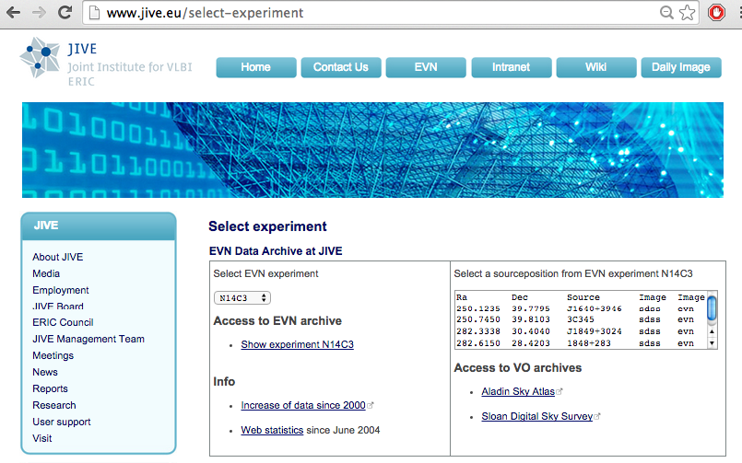
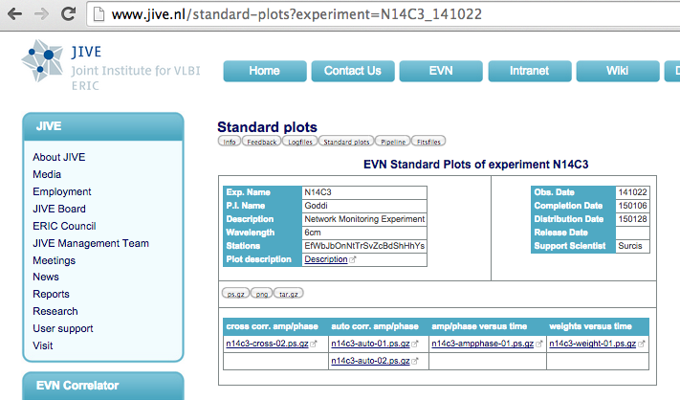
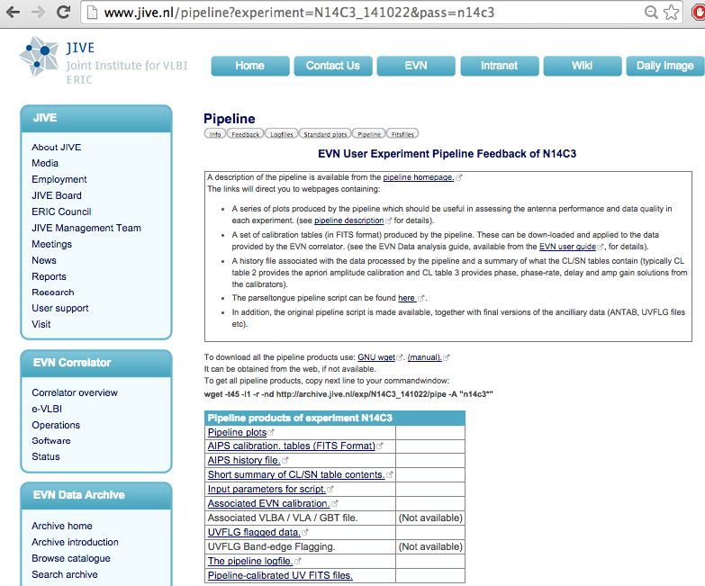
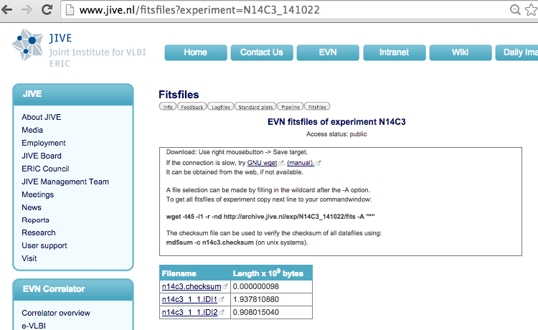
EVN Archive
Feedback Logfiles
Plots
FITS
Pipeline

Slide 38
Pipeline Outputs (downloads)
Plots up through (rough) images
Prepared ANTAB file (amplitude calibration input)
a priori Flagging file(s) (by time-range, by channel)
AIPS tables
  CL1 = “unity”, typically 15s sampling
  SN1 = TY ⊕ GC; CL2 = CL1 ⊗ SN1 (& parallactic angles)
  FG1 (sums over all input flagging files)
  SN2 = FG1 ⊕ CL2 ⊕ fring; CL3 = CL2 ⊗ SN2
  BP1 = computed after CL3 ⊕ FG1
Pipleline-calibrated UVFITS (per source)
Notes:
38

Slide 39
Data Familiarization
FITLD — to load data
LISTR — scan-based summary of observations
PRTAB, TBOUT, PRTAN
  Looking into contents of “tables”
POSSM, VPLOT, UVPLT
  Plots: vs. frequency, vs. time, u-v based
SNPLT
  Plot solution/calibration tables (various y-axes)
Notes:
39

Slide 40
Amplitude Calibration (I)
VLBI: no truly point-like primary calibrator
  Structure- and/or time-variability at smallest scales
Stations measure power levels on/off load
  Convertible to T_{sys} [K] via calibrated loads
Sensitivities, gain curves measured at station
SEFD = T_{sys}(t) / {DPFU * g(z)}
  √{SEFD₁*SEFD₂} as basis to convert from unitless correlation coefficients to flux densities [Jy]
EVN Pipeline provides JIVE-processed TY table
Notes:
40

Slide 41
Amplitude Calibration (II)
UVPLT: plot Amp(|uv|)
  Calibrators with simple structure: smooth drop-off
  e.g., A(ρ) ∝ J₁(πaρ) for a uniform disk, diameter=a
Poorly calibrated stations appear discrepant
Self-calibration iterations can help bring things into alignment
Notes:
41

Slide 42
Delay/Rate Calibration
Each antenna has its own “clock” (H-maser)
Each antenna has its own IF-chains, BBCs
  Differing delays (& rates?) per station/pol/subband
Delay → ∂φ/∂ω (phase-slope across band)
Rate → ∂φ/∂t (phase-slope vs.time)
Point-source = flat φ(ω,t)
  Regular variations: clocks, source-structure, etc.
  Irregular variations: propagation, instrumental noise
  φ_{str} doesn’t necessarily close (not station-based)
Notes:
42

Slide 43
Fringe-fitting
Over short intervals (SOLINT), estimate delay and rate at each station (wrt reference sta.)
  above = “global fringe-fit” (cf. “baseline fringe-fit”)
“Goldilocks” problem for setting SOLINT:
  too short: low SNR
  too long: > atmospheric coherence time [ = f(ω) ]
After fringing, phases should be flat in the individual subbands, and subbands aligned
BPASS: solve for station bandpass (amp/phase)
  removes phase-curvature across individual subbands
Notes:
43

Slide 44
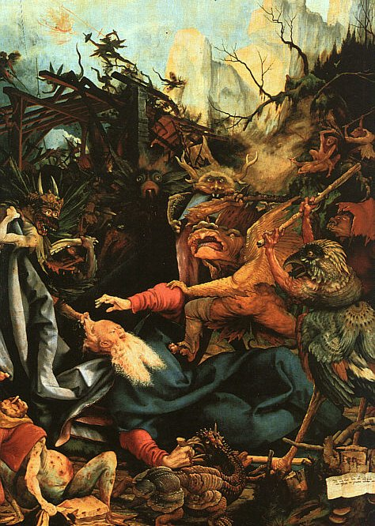
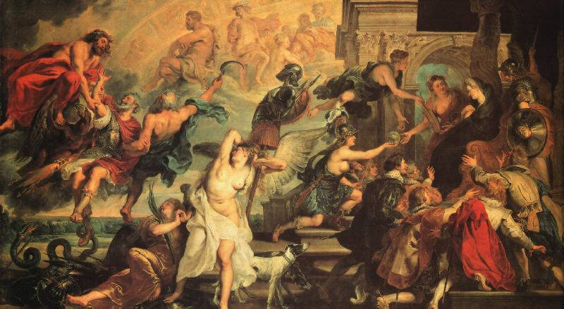
More detailed Monte Carlo simulations reveal an altogether different post-ERIS paradigm:
VLBI (EVN) obs:
What you may have thought before ERIS: artifacts from the dim mists of a Jungian collective unconcious?

